Slide 1
Alice480: Programming Contest Web Application
Carl Caviness, Tanya Do, Ryan Luedke, and Paul Mould

Slide 2
Team Members & Roles
Carl Caviness
Database, PHP, HTML, Documentation
Tanya Do
Manager, HTML, Documentation
Ryan Luedke
PHP, HTML
Paul Mould
Documentation

Slide 3
The Alice Programming Contest
Semi-annual programming contest
Hosted by Mercer’s Computer Science Department
Introduce young students to computer science
Middle and high school students
Use Alice
Programming language and environment

Slide 4
Problem
Clients
Dr. Allen and Dr. White
Problem
Create a web application that facilitates hosting a programming contest
Web application needs to be:
Scalable
Easy to use
Increase contest control
Decrease web maintenance
Handle outsourcing of graders

Slide 5
Technologies
LAMP stack
Linux, Apache, MySQL, PHP
Dynamic Database Schema
MySQL Workbench
phpMyAdmin
Bootstrap from Twitter
Front-end framework
Optimizes for various-sized screens

Slide 6
Features
Scalable
Customizable permissions
Individual accounts for users
Teachers will be able to create their own contest
Different views for users of different permissions
Auto-delete old users

Slide 7
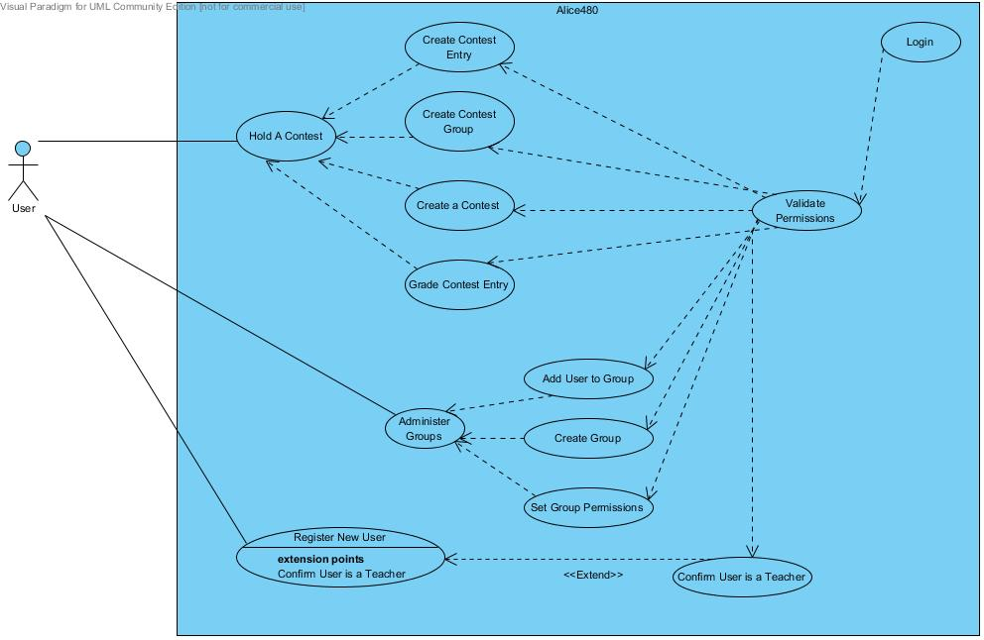
Use Case Diagram

Slide 8
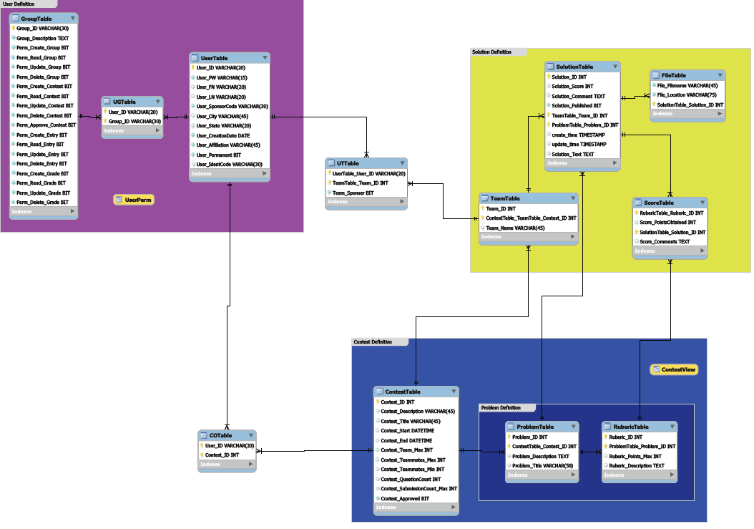
Database Schema (Overview)

Slide 9
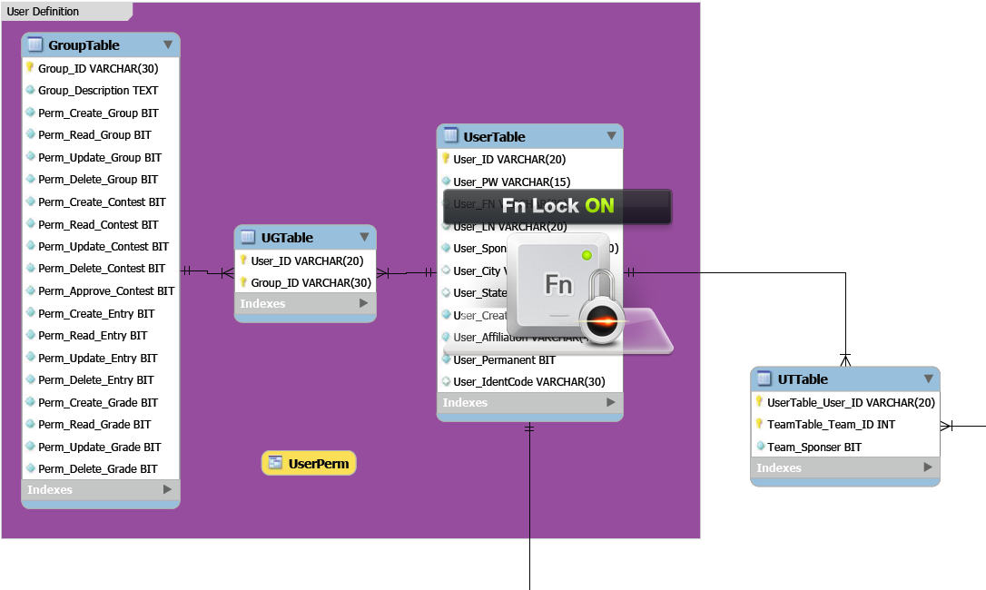
Database Schema (User Definition)

Slide 10
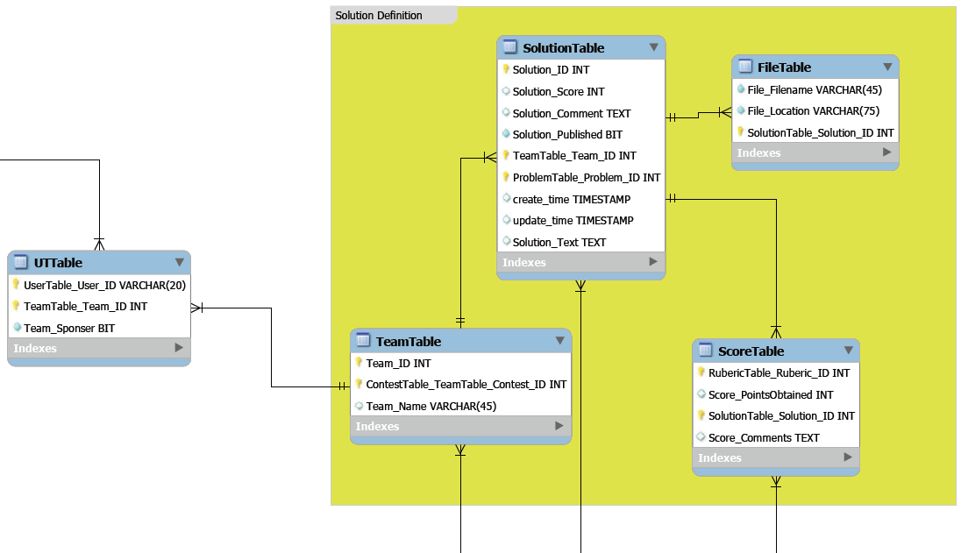
Database Schema (Solution Definition)

Slide 11
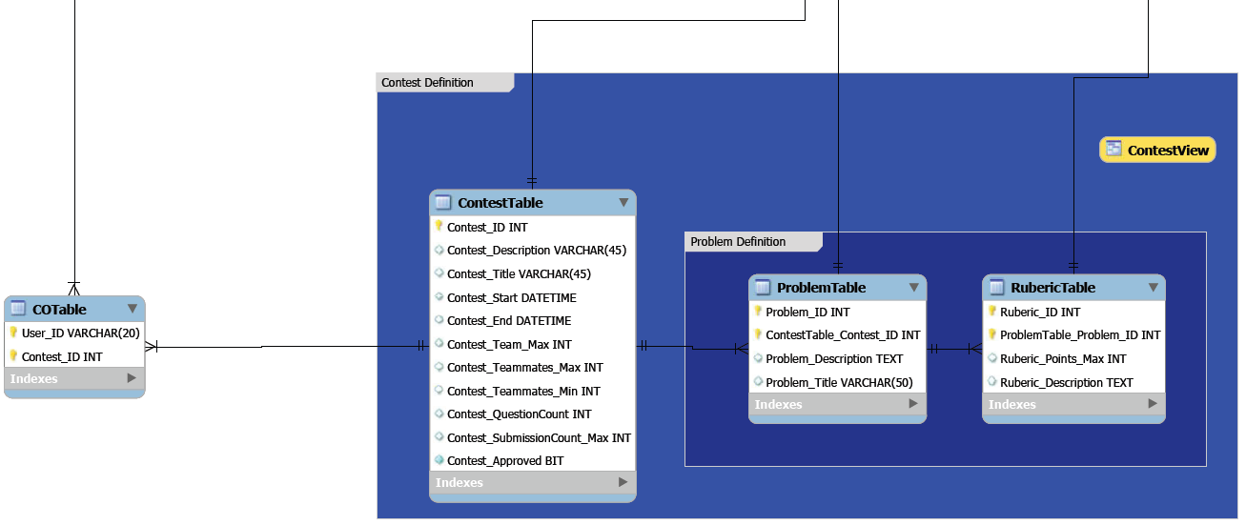
Database Schema (Contest Definition)

Slide 12
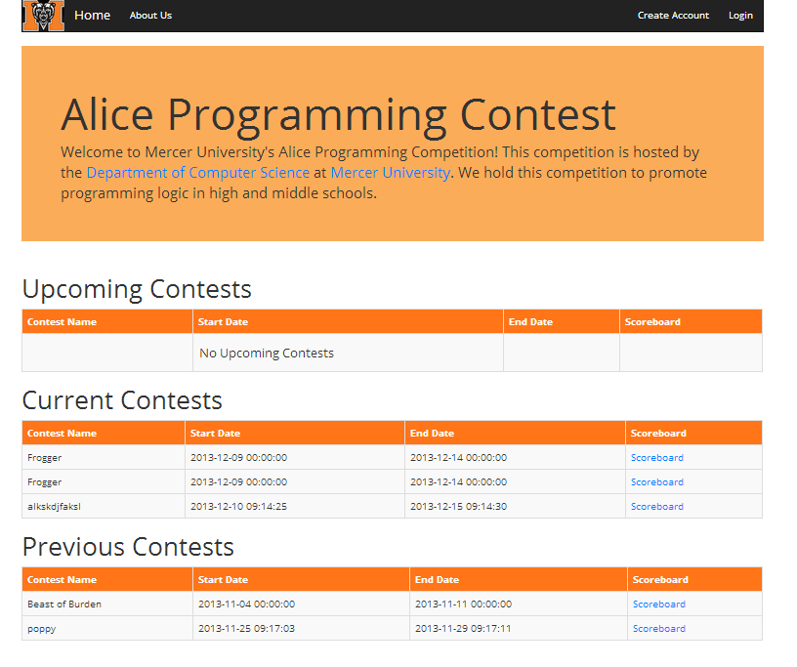

Slide 13
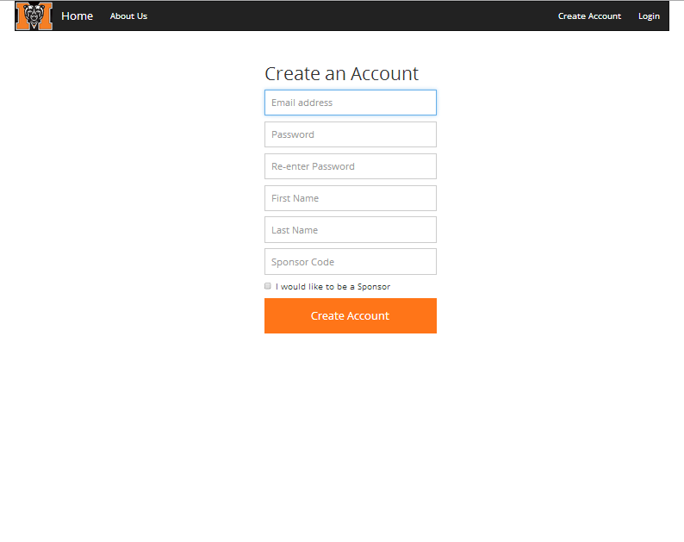

Slide 14
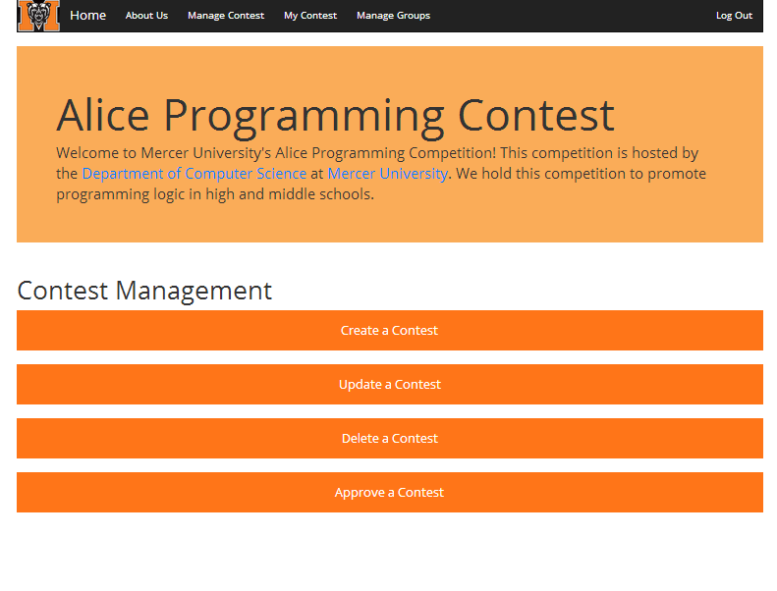

Slide 15
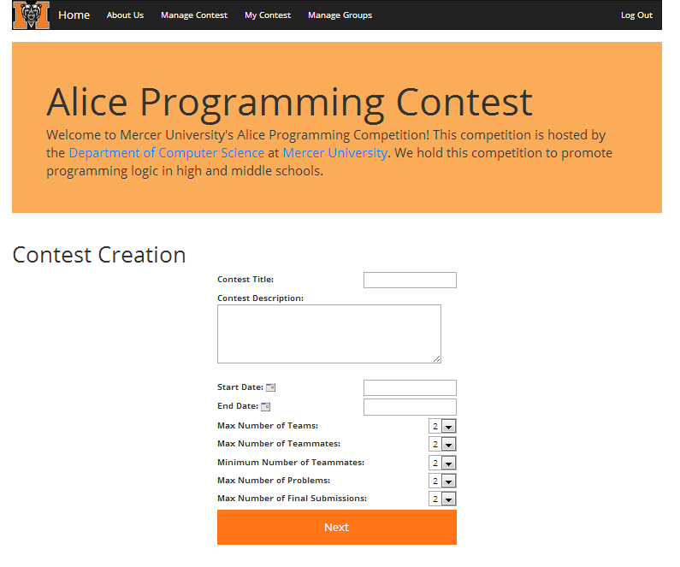

Slide 16
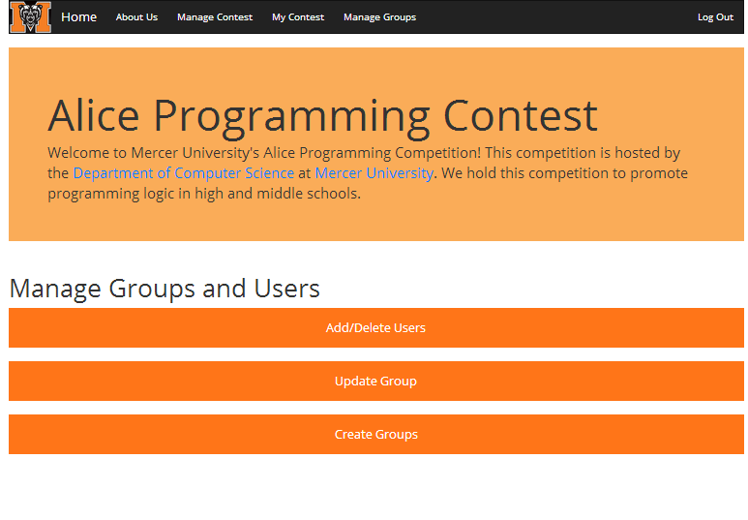

Slide 17
