Slide 1
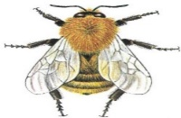
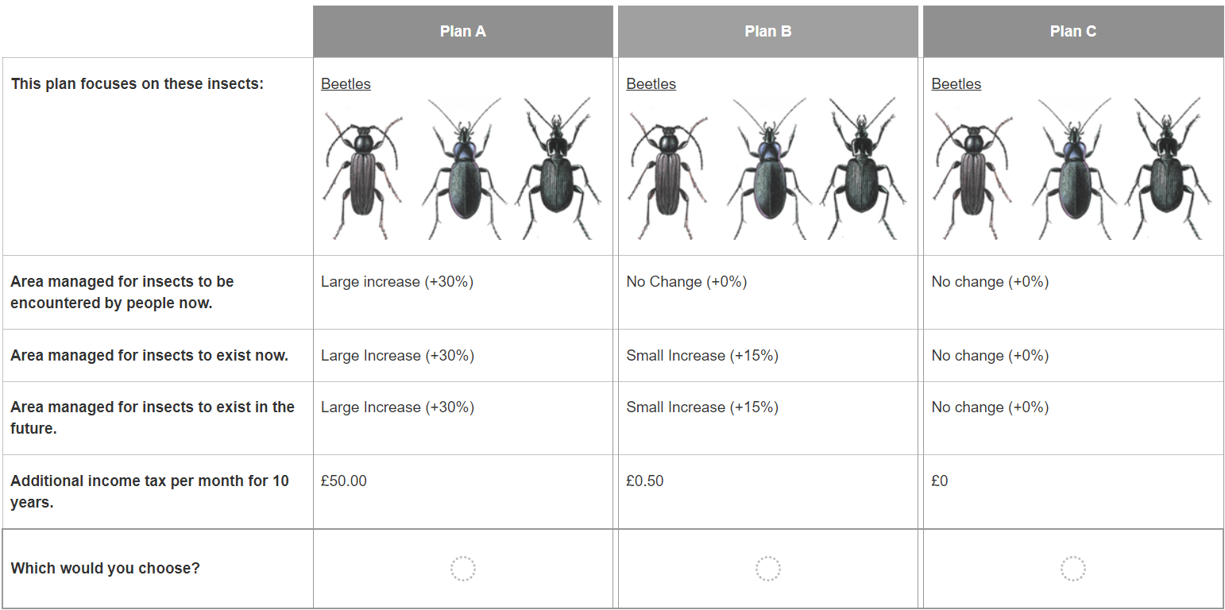
Each card will be about one of three types of insect that we are interested in. The card will show and tell you what these insects can look like.
Plan C is business as usual – there will still be declines in insect populations and you will pay nothing further.
In each case, the plan will be different according to these factors.
Only plans A and B will feature an increase in income taxes. The amount will change in each card.

Slide 2
You can only choose one plan at a time.
Plan C is a valid choice, as you may feel that you cannot afford to pay for any of the changes, or you would prefer not to.

Slide 3
You can only choose one plan at a time.
Plan C is a valid choice, as you may feel that you cannot afford to pay for any of the changes, or you would prefer not to.

Slide 4
Land near you could be immediately managed through actions like creating wildflower meadows and hedgerows, making the area more suitable for insects.
As a result, you would be more likely to personally encounter (see, hear, interact with) the pictured insect species in your day-to-day life.
These measures will last only as long as the plan is funded (i.e., up to 2034) as they require active maintenance and upkeep.

Slide 5
Each card will be about one of three types of insects: bees, ground beetles, or wasps.
The card will tell you what these insects can look like.
We are asking about different types of insects to understand views on these insects.

Slide 6
 | Plan A | Plan B | Plan C
This plan focuses on these insects
Area managed so that you are more likely to encounter insects now | Small increase (+15%) | Large increase (+30%) | No change (+0%)
Area managed for insects to exist now | Small increase (+15%) | Large increase (+30%) | No change (+0%)
Area managed for insects to exist in the future | Small increase (+15%) | Large increase (+30%) | No change (+0%)
Additional income tax per month for ten years. | £5 | £10 | £0
Which plan do you prefer? (Select one)

Slide 7
 | Plan A | Plan B | Plan C
This plan focuses on these insects
Area managed so that you are more likely to encounter insects now | Small increase (+15%) | Large increase (+30%) | No change (+0%)
Area managed for insects to exist now | Small increase (+15%) | Large increase (+30%) | No change (+0%)
Area managed for insects to exist in the future | Small increase (+15%) | Large increase (+30%) | No change (+0%)
Additional income tax per month for ten years. | £5 | £10 | £0
Which plan do you prefer? (Select one)
You can only choose one plan at a time.
Plan C is a valid choice, as you may feel that you cannot afford to pay for any of the changes, or you would prefer not to.

Slide 8
 | Plan A | Plan B | Plan C
This plan focuses on these insects
Area managed so that you are more likely to encounter insects now | Small increase (+15%) | Large increase (+30%) | No change (+0%)
Area managed for insects to exist now | Small increase (+15%) | Large increase (+30%) | No change (+0%)
Area managed for insects to exist in the future | Small increase (+15%) | Large increase (+30%) | No change (+0%)
Additional income tax per month for ten years. | £5 | £10 | £0
Which plan do you prefer? (Select one)
Each card will be about one of three types of insects: bees, ground beetles, or wasps.
The card will tell you what these insects can look like.
We are asking about different types of insects to understand views on these insects.

Slide 9
 | Plan A | Plan B | Plan C
This plan focuses on these insects
Area managed so that you are more likely to encounter insects now | Small increase (+15%) | Large increase (+30%) | No change (+0%)
Area managed for insects to exist now | Small increase (+15%) | Large increase (+30%) | No change (+0%)
Area managed for insects to exist in the future | Small increase (+15%) | Large increase (+30%) | No change (+0%)
Additional income tax per month for ten years. | £5 | £10 | £0
Which plan do you prefer? (Select one)
Land near you could be immediately managed through actions like creating wildflower meadows and hedgerows, making the area more suitable for insects.
As a result, you would be more likely to personally encounter (see, hear, interact with) the pictured insect species in your day-to-day life.
These measures will last only as long as the plan is funded (i.e., up to 2034) as they require active maintenance and upkeep.

Slide 10
 | Plan A | Plan B | Plan C
This plan focuses on these insects
Area managed so that you are more likely to encounter insects now | Small increase (+15%) | Large increase (+30%) | No change (+0%)
Area managed for insects to exist now | Small increase (+15%) | Large increase (+30%) | No change (+0%)
Area managed for insects to exist in the future | Small increase (+15%) | Large increase (+30%) | No change (+0%)
Additional income tax per month for ten years. | £5 | £10 | £0
Which plan do you prefer? (Select one)
Grassland and woodland that is not publicly accessible could have immediate management actions to make the area a more suitable habitat for the pictured insect species.
These measures will last only as long as the plan is funded (i.e., up to 2034) as they require active maintenance and upkeep.
Even though you would not personally encounter these insects in your day-to-day life, you would know that these insects have a suitable area for them.

Slide 11
 | Plan A | Plan B | Plan C
This plan focuses on these insects
Area managed so that you are more likely to encounter insects now | Small increase (+15%) | Large increase (+30%) | No change (+0%)
Area managed for insects to exist now | Small increase (+15%) | Large increase (+30%) | No change (+0%)
Area managed for insects to exist in the future | Small increase (+15%) | Large increase (+30%) | No change (+0%)
Additional income tax per month for ten years. | £5 | £10 | £0
Which plan do you prefer? (Select one)
Grassland and woodland that is not publicly accessible could be more permanently through planting and supporting varied grasslands and woodlands, to reliably support greater insect populations in the long-term
Although this would take much longer to be established (by 2050), it would be self-sustaining even after the plan is concluded.
Even though you would not personally encounter these insects in your day-to-day life, you would know that these insects would be preserved for the future.

Slide 12
 | Plan A | Plan B | Plan C
This plan focuses on these insects
Area managed so that you are more likely to encounter insects now | Small increase (+15%) | Large increase (+30%) | No change (+0%)
Area managed for insects to exist now | Small increase (+15%) | Large increase (+30%) | No change (+0%)
Area managed for insects to exist in the future | Small increase (+15%) | Large increase (+30%) | No change (+0%)
Additional income tax per month for ten years. | £5 | £10 | £0
Which plan do you prefer? (Select one)
Additional income tax you would pay per month to support this plan.
This increase would be for ten years (up to 2034) and would exclusively support whichever plan you chose.
The current basic income tax rate is 20% and this increase would be an amount on top of that.

Slide 13
 | Plan A | Plan B | Plan C
This plan focuses on these insects
Area managed so that you are more likely to encounter insects now | Small increase (+15%) | Large increase (+30%) | No change (+0%)
Area managed for insects to exist now | Small increase (+15%) | Large increase (+30%) | No change (+0%)
Area managed for insects to exist in the future | Small increase (+15%) | Large increase (+30%) | No change (+0%)
Additional income tax per month for ten years. | £5 | £10 | £0
Which plan do you prefer? (Select one)
Please think carefully about the different choices in relation to your household's income.
There is no right or wrong answer.

Slide 14
Insect: Bees
 | Plan A | Plan B | Plan C
Area managed so that you are more likely to encounter insects now | Small increase (+15%) | Large increase (+30%) | No change (+0%)
Area managed for insects to exist now | Small increase (+15%) | Large increase (+30%) | No change (+0%)
Area managed for insects to exist in the future | Small increase (+15%) | Large increase (+30%) | No change (+0%)
Additional income tax per month for ten years. | £5 | £10 | £0
Which plan do you prefer? (Select one)
Grassland and woodland that is not publicly accessible could be more permanently through planting and supporting varied grasslands and woodlands, to reliably support greater insect populations in the long-term
Although this would take much longer to be established (by 2050), it would be self-sustaining even after the plan is concluded.
Even though you would not personally encounter these insects in your day-to-day life, you would know that these insects would be preserved for the future.

Slide 15
Insect: Bees
 | Plan A | Plan B | Plan C
Area managed so that you are more likely to encounter insects now | Small increase (+15%) | Large increase (+30%) | No change (+0%)
Area managed for insects to exist now | Small increase (+15%) | Large increase (+30%) | No change (+0%)
Area managed for insects to exist in the future | Small increase (+15%) | Large increase (+30%) | No change (+0%)
Additional income tax per month for ten years. | £5 | £10 | £0
Which plan do you prefer? (Select one)
Additional income tax you would pay per month to support this plan.
This increase would be for ten years (up to 2034) and would exclusively support whichever plan you chose.
The current basic income tax rate is 20% and this increase would be an amount on top of that.

Slide 16
Insect: Bees
 | Plan A | Plan B | Plan C
Area managed so that you are more likely to encounter insects now. | Small increase (+15%) | Large increase (+30%) | No change (+0%)
Area managed for insects to exist now. | Small increase (+15%) | Large increase (+30%) | No change (+0%)
Area managed for insects to exist in the future. | Small increase (+15%) | Large increase (+30%) | No change (+0%)
Additional income tax per month for ten years. | £5 | £10 | £0
Which plan do you prefer? (Select one)
Please think carefully about the different choices in relation to your household's income.
There is no right or wrong answer.

