Slide 1

FitNesse / DbFit Demo
Database Test Automation for MOI
Mark Matten

Slide 2
What is FitNesse?
A Wiki interface to FIT
  Framework for Integrated Testing
  You enter the input data, the function-to-test to test, and the expected results in Wiki format.
  The system runs the function-to-test against the inputs, and reports if the function-to-test produced the expected results.
  Set Up and Tear Down of inputs and outputs ensure tests are repeatable.
The function-to-test could be Java, .Net, DB Stored Procedures, ETL, …
Tests are organised as individual pages or larger suites.

Slide 3
What is DbFit?
A set of FIT ‘fixtures’ for database testing.
Designed to test stored procedures/functions.
MOI use is primarily for ETL and view testing.
Used for Unit Testing: -
  Have we built the code right?
Used for Functional Testing: -
  Have we build the right code?

Slide 4
Main FitNesse and DbFit Fixtures and Features
Insert – Set Up of input data.
Query – Retrieve actual results and compare to expected results.
Clean – Tear Down of input and actual output data.
CommandLine – run any OS command. E.g. ODI, SSIS.
Store Query – store query results and reuse them in other fixtures.
Parameters – define and set parameters and reuse them in other fixtures.
Symbols – capture query cells and automatically use them as parameters.

Slide 5
Typical Developer Installation
JRE 1.5.
Local FitNesse+DbFit.
Local ODI.
Remote personal ODI master repository.
Remote personal ODI work repository.
Test pages and suites maintained in TFS.

Slide 6
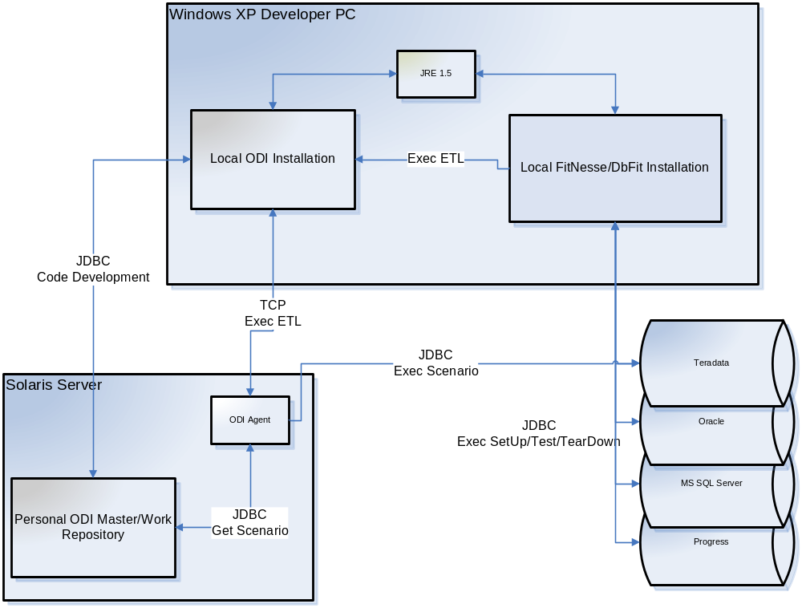
Typical Developer Installation

Slide 7
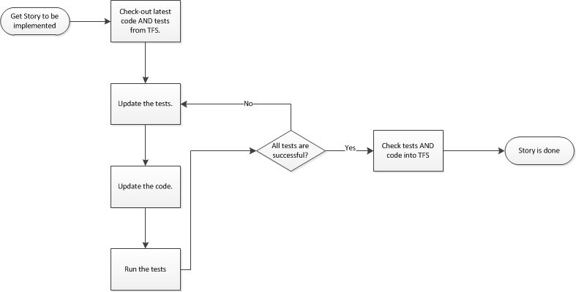
Typical Developer Micro-workflow

Slide 8
Resource and Further Reading
http://fitnesse.info/dbfit
DbFit Acceptance Tests: -
  http://<your FitNesse+DbFit server:port>/AcceptanceTests
FitNesse+DbFit front page: -
  http://<your FitNesse+DbFit server>

Slide 9
Questions?

Slide 10
For now…
Thank You

