Slide 1

TFS Training
Process Improvement Team

Slide 2
Agenda
TFS Training I - Overview
  Release Strategy
  TFS branches/Content
  My local workspace
TFS Training II
  Get latest version & Check-out
  Associate with a Work-Item/Story & Check-in
  Run my own DbFit/ODI
TFS Training III
  Resolve Conflicts
  Import Incremental to local ODI

Slide 3

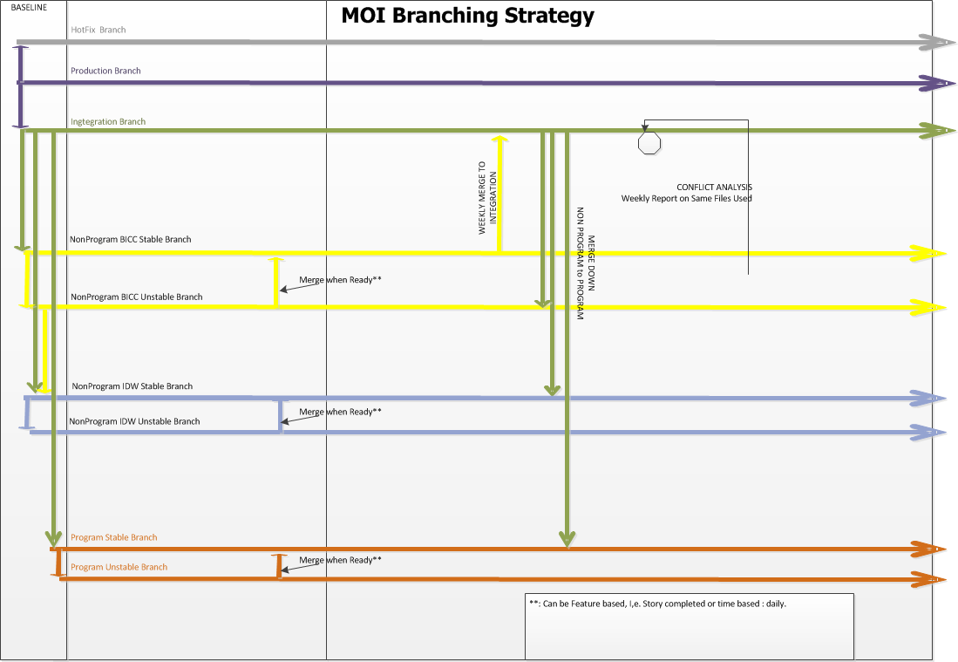
Release Strategy

Slide 4
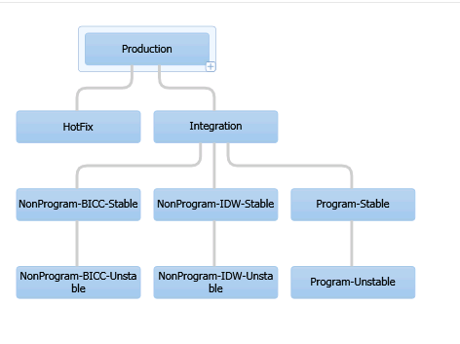
TFS branches/Content

Slide 5
Content of branches
    Development
      ODI
      Cognos + Reports
      Erwin
      User views
      FitnesseRoot
    Configuration
      Scripts
      Tools
        Odi
        Fitness
        Java

Slide 6
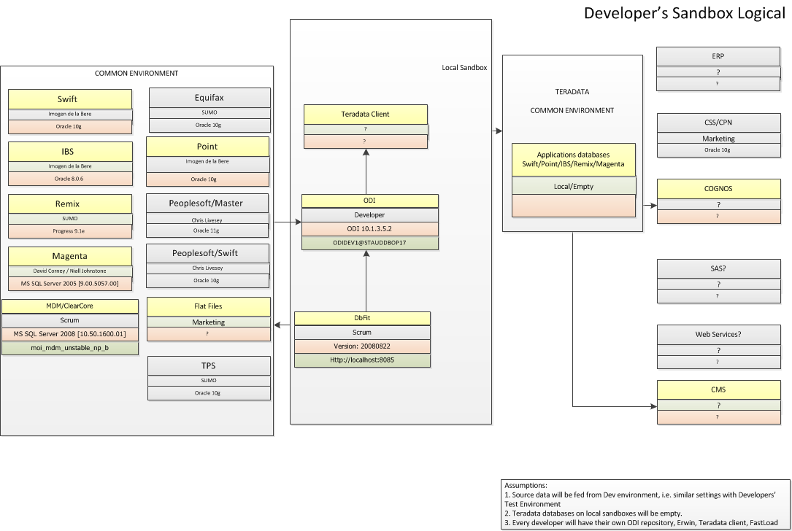
Local Workspace

Slide 7
Workspaces
per person
  One branch
  One ODI
  One DbFit
  Local Folder:
  C:\MOI\Development

Slide 8
Get workspaces: \\vmstamoibld01\Setup\SetupMyLocalWorkspace.bat
Modify to match your local ODI
  C:\Moi\Configuration\Tools\odi\bin\odiparams.bat
  C:\Moi\Configuration\Tools\odi\bin\snps_login_security.xml
  C:\Moi\Configuration\Tools\odi\bin\snps_login_work.xml
Run
  C:\Moi\Configuration\Scripts\GetIncremental.ps1
  Does check latest changeset number
    C:\Moi\Configuration\Scripts\Logs\Update\Changesets.txt
  Writes output to: C:\Moi\Configuration\Scripts\Logs\Script

Slide 9
Thank You

