Slide 1
Module 2
Data types

Slide 2
Data types
Every value has a type, and the built-in type function returns the type of the result of any expression.
Examples:
type(abs) – inbuilt method or function
type(1) - int
a = 2 : type(a) – int
Type(3.245) -- float

Slide 3
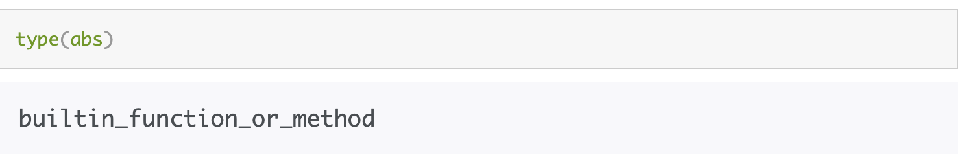
Built in function or method
Example of inbuilt function is abs.
We can check its type using:
(Demo) notebook 2.1
Notes:
Section 3

Slide 4
Numbers

Slide 5
Ints and Floats
Python has two real number types
int: an integer of any size
float: a number with an optional fractional part
An int never has a decimal point; a float always does
A float might be printed using scientific notation
Three limitations of float values:
They have limited size (but the limit is huge)
They have limited precision of 15-16 decimal places
After arithmetic, the final few decimal places can be wrong
(Demo) notebook 2.1

Slide 6
Strings

Slide 7
Text and Strings
A string value is a snippet of text of any length
'a’
'word’
"there can be 2 sentences. Here's the second!"
Strings that contain numbers can be converted to numbers
int('12’)
float('1.2')
Any value can be converted to a string
str(5)
(Demo) notebook 2.1
Notes:
Section 2

Slide 8
Examples of String methods
upper() – turns string into upper case
E.g; “loud”.upper() -- LOUD
lower() – turns string into lower case
E.g; “loud”.lower() -- loud
capitalize() – capitalizes the first letter of the string
E.g; “loud”.capitalize() – Loud
replace() – replaces a substring of the string with another string
E.g; “loud”.replace(”lo”, “clo”) -- cloud
(Demo)
Notes:
Demo link: https://umass-data-science.github.io/190fwebsite/textbook/04/2/1/string-methods/

Slide 9
Discussion Question
Assume you have run the following statements
x = 3
y = '4'
z = '5.6'
What's the source of the error in each example?
x + y
x + int(y + z)
str(x) + int(y)
str(x, y) + z

Slide 10
Reminders

Slide 11
Reminders
Stop you server on Datahub when not using it
HW2 is out, material covered today will be useful in completing the assignment
Lab 2 tomorrow at 9:05am. Attendance needed for grade
OH today after class, 10am – 11am, LGRC, A205
HW1 completed, grades should be out soon

Slide 12
Comparisons

Slide 13
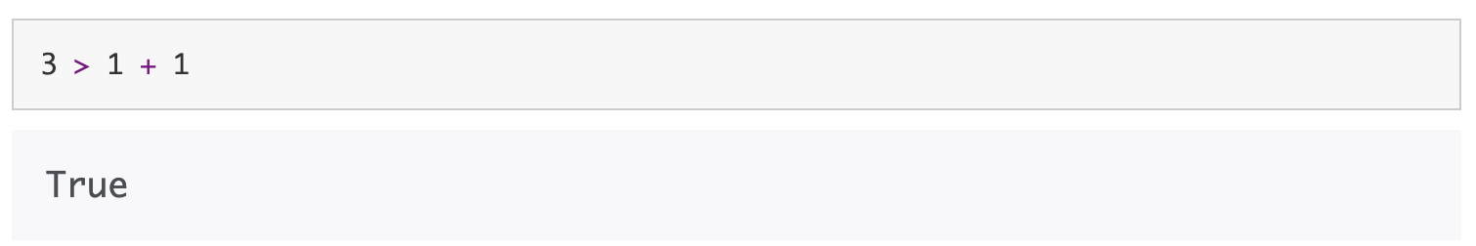
Booleans
Boolean values most often arise from comparison operators.
Ex. 1 – comparing numbers
Notes:
No demo for this slide so add some code yourself

Slide 14
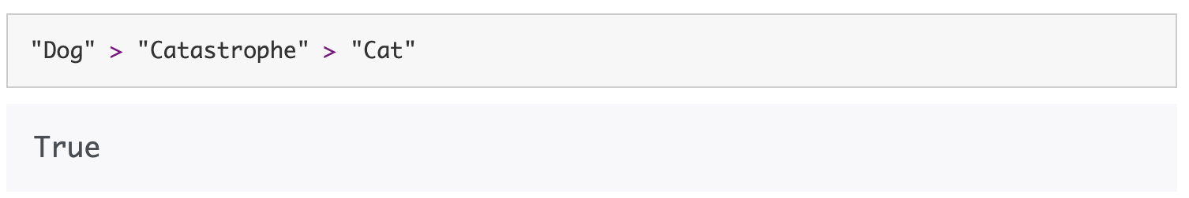
Comparing strings
When comparing strings, we consider their order alphabetically.
A shorter string is less than a longer string that begins with the shorter string.
Example:
Notes:
No demo for this slide so add some code yourself

Slide 15
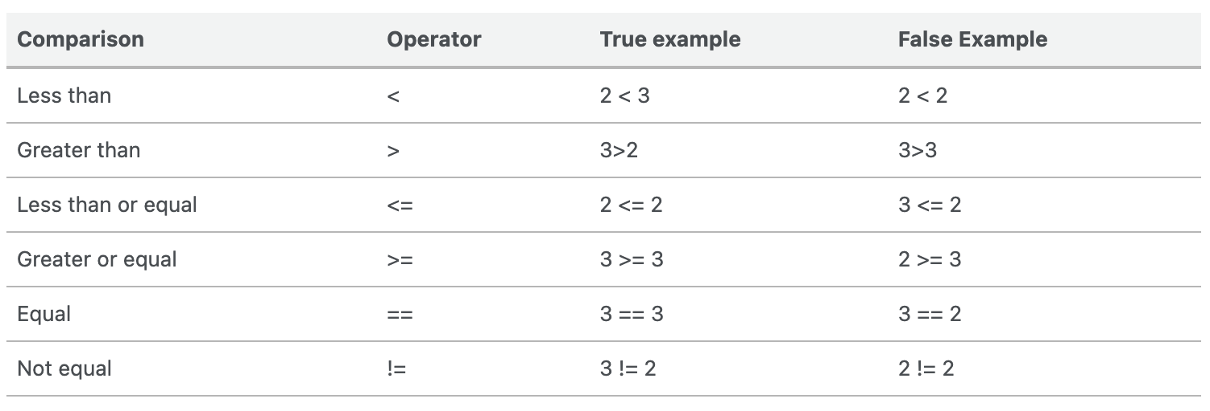
Most common python comparison operators
Python includes a variety of operators that compare values.
Notes:
No demo for this slide so add some code yourself

Slide 16
sequences

Slide 17
1. Arrays
An array contains a sequence of values
All elements of an array should have the same type
Arithmetic is applied to each element individually
When two arrays are added, they must have the same size; corresponding elements are added in the result
A column of a table is an array
(Demo) – notebook 2.1

Slide 18
2. Ranges
A range is an array of consecutive numbers
np.arange(end): An array of increasing integers from 0 up to end
np.arange(start, end): An array of increasing integers from start up to end
np.arange(start, end, step): A range with step between consecutive values
The range always includes start but excludes end
(Demo) – notebook 2.1

Slide 19
Lists

Slide 20
Lists are Generic Sequences
A list is a sequence of values (just like an array), but the values can all have different types
[2+3, 'four', Table().with_column('K', [3, 4])]
If you create a table column from a list, it will be converted to an array automatically
(Demo) – notebook 2.1
Notes:
Be sure to emphasize the list function

Slide 21
Tables

Slide 22
Table Structure
We organize our data in tables
A Table is a sequence of labeled columns
Data within a column should be of the same "type"
Label
Name | Code | Area (m2)
California | CA | 163696
Nevada | NV | 110567
Row
Column
(Demo) – notebook 2.2

Slide 23
Ways to create a table
Table() - an empty table
Table.read_table(filename) - reads a table from a spreadsheet
and...
(Demo) – notebook 2.2

Slide 24
Arrays → Tables
Table().with_column(label, data) - creates a table with a single column; data is an array
Table().with_columns(label1, data1, ...) - creates a table, with an array of data for each column
(Demo) – notebook 2.2
Notes:
Section named Extending a Table with a New Column.
Emphasize that the arrays were obtained from reading a column’s values in Accessing a Column as an Array

Slide 25
The where method
t.where(label, condition) - constructs a new table with just the rows that match the condition
(Demo) – notebook 2.2

Slide 26
Take Rows, Select Columns
The take method returns a table with only some rows
Rows are numbered, starting at 0
Taking a single number returns a one-row table
Taking a list of numbers returns a table as well
The select method returns a table with only some columns
(Demo) – notebook 2.2

Slide 27
Table Operations
t.select(label) - constructs a new table with just the specified columns
t.sort(label) - constructs a new table, with rows sorted by the specified column
(Demo) – notebook 2.2

Slide 28
Table Methods
Creating and extending tables:
Table().with_columns and Table.read_table
Finding the size: num_rows and num_columns
Referring to columns: labels, relabeling, and indices
labels and relabeled; column indices start at 0
Accessing data in a column
column takes a label or index and returns an array
Using array methods to work with data in columns
item, sum, min, max, and so on
Creating new tables containing some of the original columns:
select, drop

Slide 29
Examples
The table students has columns Name, ID, and Score.
Write one line of code that evaluates to:
A table consisting of only the column labeled Name
students.select('Name')
b) The largest score
students.column('Score').max()
max(students.column('Score'))

Slide 30
Manipulating Rows
t.sort(column) sorts the rows in increasing order
t.take(row_numbers) keeps the numbered rows
Each row has an index, starting at 0
t.where(column, are.condition) keeps all rows for which a column's value satisfies a condition
t.where(column, value) keeps all rows for which a column's value equals some particular value
t.with_row makes a new table that has another row

Slide 31
Census Data

Slide 32
The Decennial Census
Every ten years, the Census Bureau counts how many people there are in the U.S.
In between censuses, the Bureau estimates how many people there are each year.
Article 1, Section 2 of the Constitution:
“Representatives and direct Taxes shall be apportioned among the several States … according to their respective Numbers …”

Slide 33
Analyzing Census Data
Leads to the discovery of interesting features and trends in the population
(Demo)

Slide 34
Census Table Description
Values have column-dependent interpretations
The SEX column: 1 is Male, 2 is Female
The POPESTIMATE2010 column: 7/1/2010 estimate
In this table, some rows are sums of other rows
The SEX column: 0 is Total (of Male + Female)
The AGE column: 999 is Total of all ages
Numeric codes are often used for storage efficiency
Values in a column have the same type, but are not necessarily comparable (AGE 12 vs AGE 999)
http://www2.census.gov/programs-surveys/popest/datasets/2010-2015/national/asrh/nc-est2015-agesex-res.pdf

Slide 35
Discussion Questions
The table nba has columns NAME, POSITION, and SALARY.
Create an array containing the names of all point guards (PG) who make more than $15M/year
nba.where(1, 'PG').where(3, are.above(15)).column(0)
b) After evaluating these two expressions in order, what's the result of the second one?
nba.with_row(['Samosa', 'Mascot', 100])
nba.where('NAME', are.containing('Samo'))
Notes:
Demo for this is named NBA_in_class_exercise

Slide 36
Questions

