Slide 1
Module 5
Randomness

Slide 2
Why RANDOMNESS?
Data scientists should be able to understand randomness.
For example, they should be able to assign individuals to treatment and control groups at random, and then try to say whether any observed differences in the outcomes of the two groups are simply due to the random assignment or genuinely due to the treatment.
Notes:
John Snow and the Broad Street Pump – Cholera

Slide 3
Comparison and Booleans

Slide 4
Randomness and Booleans
A fundamental question about random events is whether or not they occur. For example:
Did an individual get assigned to the treatment group, or not?
Once the event has occurred, you can answer "yes" or "no" to these questions.
In programming, it is conventional to do this by labeling statements as True or False.
In Python, Boolean values, named for the logician George Boole, represent truth and take only two possible values: True and False.

Slide 5
Comparison Operators
The result of a comparison expression is a bool value
x = 2 y = 3
x > 1 x > y
x == y x != 2
Assignment statements
y >= 3
Comparison expressions
2 < x < 5
Notes:
Whether problems involve randomness or not, Boolean values most often arise from comparison operators.

Slide 6
Aggregating Comparisons
Summing an array or list of bool values will count the True values only.
1 | + | 0 | + | 1 | == | 2
True | + | False | + | True | == | 2
sum([1 , 0 , 1 ]) == 2
sum([True, False, True]) == 2
(Demo – notebook 5.1,
Aggregating comparisons)

Slide 7
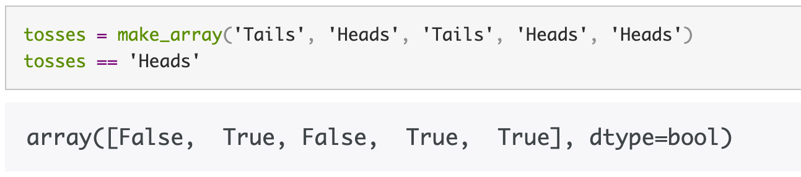
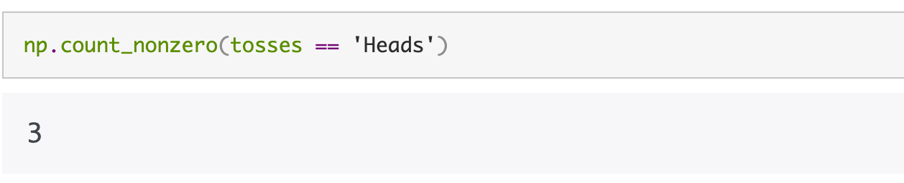
NP.count_nonzero()
The numpy method count_nonzero evaluates to the number of non-zero (that is, True) elements of the array.

Slide 8
Conditional Statements

Slide 9
Randomness and Conditional Statements
In many situations, actions and results depend on a specific set of conditions being satisfied.
For example, individuals in randomized controlled trials receive the treatment if they have been assigned to the treatment group.
A conditional statement is a multi-line statement that allows Python to choose among different alternatives based on the truth value of an expression.

Slide 10
Conditional Statements
A conditional statement always begins with an if header, which is a single line followed by an indented body.
The purpose of if is to define functions that choose different behavior based on their arguments
The body is only executed if the expression directly following if (called the if expression) evaluates to a true value.
If the if expression evaluates to a false value, then the body of the if is skipped.

Slide 11
Control Statements
These statements control the sequence of computations that are performed in a program
The keywords if and for begin control statements
The purpose of if is to define functions that choose different behavior based on their arguments
The purpose of for is to perform a computation for every element in a list or array

Slide 12
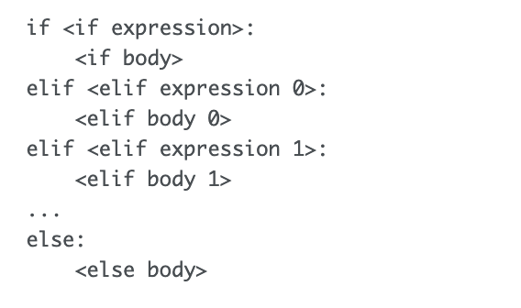
General form of conditional statements
A conditional statement can have multiple clauses with multiple bodies, and only one of those bodies can ever be executed.
(Demo – notebook 5.1,
Conditional statements)
Notes:
There is always exactly one if clause, but there can be any number of elif clauses.
Python will evaluate the if and elif expressions in the headers in order until one is found that is a true value, then execute the corresponding body.
The else clause is optional.
When an else header is provided, its else body is executed only if none of the header expressions of the previous clauses are true.
The else clause must always come at the end (or not at all).

Slide 13
Random Selection

Slide 14
Random Selection in python
np.random.choice
Selects uniformly at random
with replacement
from an array,
a specified number of times
np.random.choice(some_array, sample_size)
Demo – notebook 5.1, Random selection
Notes:
During the demo, decide how to go through the random selection stuff first, before going through append. Then after append, resume last bits of the random selection section

Slide 15
Iteration

Slide 16
Randomness and Iteration
In programming – especially when dealing with randomness – we often want to repeat a process multiple times.
For example, we might want to assign each person in a study to the treatment group or to control, based on tossing a coin.
We could run np.random.choice(make_array('Heads', 'Tails’))
However, we would need to copy and paste and run it for each of the participants in the study, even if they are 1000!
Better strategy? Iteration

Slide 17
Iteration
A more automated solution is to use a for statement to loop over the contents of a sequence. This is called iteration.
A for statement:
begins with the word for,
followed by a name we want to give each item in the sequence,
followed by the word in,
and ending with an expression that evaluates to a sequence.
The indented body of the for statement is executed once for each item in that sequence.

Slide 18
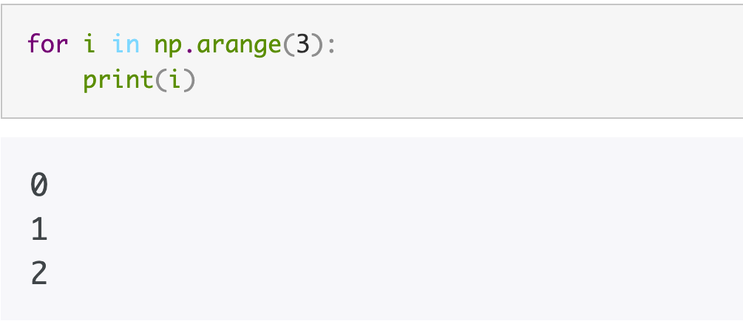
For Statements
for is a keyword that begins a control statement
The purpose of for is to perform a computation for every element in a list or array
Example:
(Demo – notebook 5.1, For statements)
Notes:
Notice that the name i is arbitrary, just like any name we assign with =.

Slide 19
Appending Arrays

Slide 20
Storing the results of a iteration
The for statement in the previous slide simply prints the output.
This output is NOT in a form that we can use for computation.
A typical use of a for statement is to create an array of results, by augmenting it each time.
The append method in numpy helps us do this.

Slide 21
Appending to an Array
np.append(array_1, value)
new array with value appended to array_1
value has to be of the same type as elements of
array_1
np.append(array_1, array_2)
new array with array_2 appended to array_1
array_2 elements must have the same type as
array_1 elements
(Demo – notebook 5.1,
Appending arrays)
Notes:
To connect this slide contextually to the previous one, tell the students how this material is helping us get into the randomness stuff. Connect it to previous material too.
Demo is Notebook 5.1, section 3, appending arrays

Slide 22
Simulation

Slide 23
Definition and steps
Simulation is the process of using a computer to mimic a physical experiment.
Step 1: What to Simulate
For example, you might decide that you want to simulate the outcomes of tosses of a coin.
Step 2: Simulating One Value
In our example, figure out how to simulate the outcome of one toss of a coin.
Step 3: Number of Repetitions
Decide how many times you want to simulate the quantity, then repeat Step 2 that many times. E.g., 1000
Step 4: Coding the Simulation
Put it all together in code.
Notes:
After the first bullet point: In this class, those experiments will almost invariably involve chance.
Step 1: What to Simulate¶
Specify the quantity you want to simulate.
For example, you might decide that you want to simulate the outcomes of tosses of a coin.
Step 2: Simulating One Value¶
Figure out how to simulate one value of the quantity you specified in Step 1.
In our example, you have to figure out how to simulate the outcome of one toss of a coin.
If your quantity is more complicated, you might need several lines of code to come up with one simulated value.
Step 3: Number of Repetitions¶
Decide how many times you want to simulate the quantity. You will have to repeat Step 2 that many times. In one of our earlier examples we had decided to simulate the outcomes of 1000 tosses of a coin, and so we needed 1000 repetitions of generating the outcome of a single toss.
Step 4: Coding the Simulation¶
Put it all together in code.
Create an empty array in which to collect all the simulated values. We will call this the collection array.
Create a "repetitions sequence," that is, a sequence whose length is the number of repetitions you specified in Step 3. For n repetitions we will almost always use the sequence np.arange(n).
Create a for loop. For each element of the repetitions sequence:
Simulate one value based on the code you developed in Step 2.
Augment the collection array with this simulated value.

Slide 24
Simulation step 4
Step 4: Coding the Simulation
Create an empty array in which to collect all the simulated values. We will call this the collection array.
Create a "repetitions sequence,” - a sequence whose length is the number of repetitions you specified in Step 3.
For n repetitions we will often use the sequence np.arange(n).
Create a for loop. For each element of the repetitions sequence:
Simulate one value based on the code you developed in Step 2.
Augment the collection array with this simulated value.

Slide 25
ex 1: Bigger number = $1
Let's play a game: we each roll a die.
If my number is bigger: you pay me a dollar.
If they're the same: we do nothing.
If your number is bigger: I pay you a dollar.
Steps:
What to simulate: two dice rolls.
Simulate one value: compute how much money we win/lose based on the result of the roll
Number of repetitions: Do steps 1 and 2 10,000 times.
Put it all in code
(Demo – notebook 5.1, Simulation)
Notes:
Demo is notebook 5.1 section 6.1, simulation ex. 1
Ask them how much they expect the players to get

Slide 26
ex 2: Number of Heads in 100 Tosses
In this example we will simulate the number of heads in 100 tosses of a coin.
Steps:
What to stimulate: outcomes of tosses of a coin.
Simulate one value: make one set of 100 tosses and count the number of heads
Number of repetitions: Do steps 1 and 2 10,000 times.
Put it all in code
(Demo – notebook 5.1, Simulation)
Notes:
Demo is notebook 5.1 section 6.1, simulation ex. 2

Slide 27
Chance and probability

Slide 28
The Monty Hall Problem

Slide 29
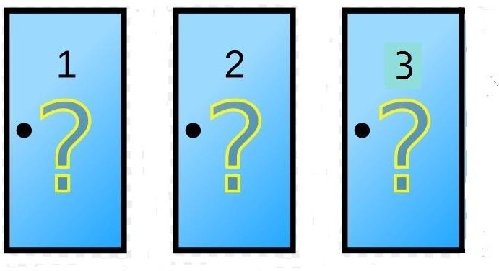
Monty Hall Problem
https://probabilityandstats.files.wordpress.com/2017/05/monty-hall-pic-1.jpg
Notes:
Use the description in the book to discuss the Monty hall problem -- https://umass-data-science.github.io/190fwebsite/textbook/09/4/monty-hall-problem/
The setting is derived from a television game show called "Let's Make a Deal". Monty Hall hosted this show in the 1960's, and it has since led to a number of spin-offs.
An exciting part of the show was that while the contestants had the chance to win great prizes, they might instead end up with "zonks" that were less desirable. This is the basis for what is now known as the Monty Hall problem.
The setting is a game show in which the contestant is faced with three closed doors. Behind one of the doors is a fancy car, and behind each of the other two there is a goat.
The contestant doesn't know where the car is, and has to attempt to find it under the following rules.
The contestant makes an initial choice, but that door isn't opened.
At least one of the other two doors must have a goat behind it. Monty opens one of these doors to reveal a goat, displayed in all its glory in Wikipedia
There are two doors left, one of which was the contestant's original choice. One of the doors has the car behind it, and the other one has a goat. The contestant now gets to choose which of the two doors to open.
What choice would y

Slide 30
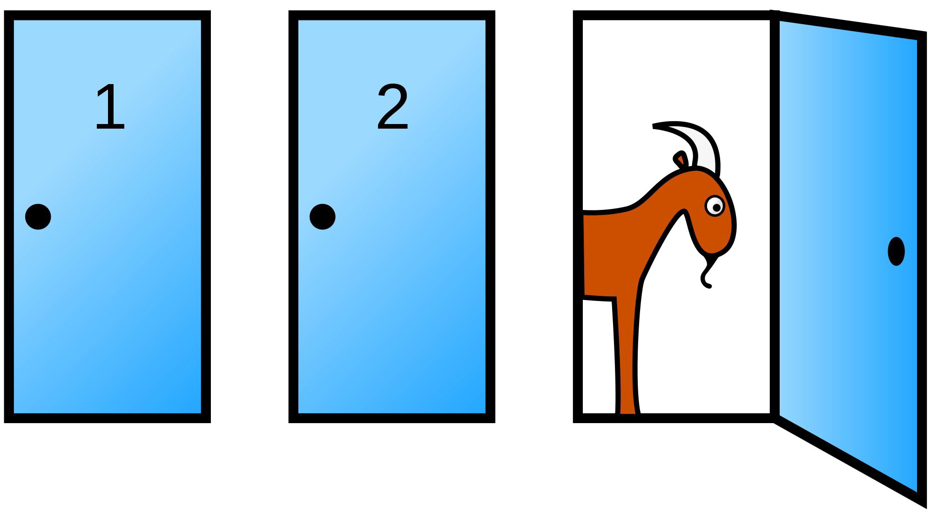
The Final Choice
(Demo – notebook 5.1,
Monty Hall problem)
https://en.wikipedia.org/wiki/Monty_Hall_problem
Still can’t wrap your head around it? Here’s another intuitive way to think about it

Slide 31
Probability

Slide 32
Definitions and notations
Most probabilities will be relative frequencies
By convention, probabilities are numbers between 0 and 1, or, equivalently, 0% and 100%.
Standard notation: P(event) denotes the probability that "event" happens
Notes:
Math is the main tool for finding probabilities exactly, though computers are useful for this purpose too. Simulation can provide excellent approximations, with high probability.

Slide 33
Basics
Lowest value: 0
Chance of event that is impossible
Highest value: 1 (or 100%)
Chance of event that is certain
Complement: P(an event doesn’t happen)
= 1−P(the event happens)
If an event has chance 70%, then the chance that it doesn’t happen is
100% - 70% = 30%, or, 1 - 0.7 = 0.3
Notes:
Impossible events have probability 0. Events that are certain have probability 1.
Chance and probability are (and will be) used interchangeably

Slide 34
Equally Likely Outcomes
Assuming all outcomes are equally likely, the chance of an event A is:
number of outcomes that make A happen
P(A) =
total number of outcomes
Notes:
An example here: P(getting 1 spot on a dice roll) = #(face with 1 spote)/#(number of all faces) = #(1)/#(1, 2, 3, 4, 5, 6) = 1/6
For example, the chance that the die shows an even number is number of even faces/number of all faces = #{2,4,6}/#{1,2,3,4,5,6} = 3/6
Use examples in the book for this section going forward. Examples are here: https://umass-data-science.github.io/190fwebsite/textbook/09/5/finding-probabilities/

Slide 35
A Question
I have three cards: ace of hearts, king of diamonds, and queen of spades.
I shuffle them and draw two cards at random without replacement.
What is the chance that I get the Queen followed by the King?
Notes:
Use example from the book to answer this question – specifically under the sub-section named: ”when two events must both happen”. Link: https://umass-data-science.github.io/190fwebsite/textbook/09/5/finding-probabilities/
This question is a precursor to the next slide, the multiplicative rule

Slide 36
Multiplication Rule
Chance that two events A and B both happen
= P(A happens) x P(B happens given that A has happened)
The answer is less than or equal to each of the two chances being multiplied
The more conditions you have to satisfy, the less likely you are to satisfy them all

Slide 37
Another Question
I have three cards: ace of hearts, king of diamonds, and queen of spades.
I shuffle them and draw two cards at random without replacement.
What is the chance that one of the cards I draw is a King and the other is Queen?
AK AQ KA KQ QA QK
Notes:
Use examples from the book here. The link is https://umass-data-science.github.io/190fwebsite/textbook/09/5/finding-probabilities/
The specific subsection for this slide is named “when an event can happen in two different ways”
This question is a precursor to the next slide on addition rule

Slide 38
Addition Rule
If event A can happen in exactly one of two ways, then
P(A) = P(first way) + P(second way)
The answer is greater than or equal to the chance of each individual way

Slide 39
Complement: E.G., At Least One Head
In 3 tosses:
Any outcome except TTT
P(T) = ½
P(TTT) = (1/2) x (1/2) x (1/2) = (1/2)**3 = 1/8
P(at least one head) = 1 - P(TTT) = 1 - (1/8) = 87.5%
In 10 tosses:
1 - (1/2)**10 ≅ 99.9%
Notes:
Use examples from the book here. Link: https://umass-data-science.github.io/190fwebsite/textbook/09/5/finding-probabilities/
The specific subsection for this slide is named: “At least one success”
Motivate the at least one success (we compute the compliment because it is clearer. At least one head is 1 – P(all tails))
Point students to the computation of compliment examples in the book, esp. computation of the chance that the face with six spots comes up at least once in rolls of a die. Chapter 9 last section

Slide 40
Discussion Question
A population has 100 people, including Rick and Morty. We sample two people at random without replacement.
P(both Rick and Morty are in the sample)
= P(first Rick, then Morty) + P(first Morty, then Rick)
= (1/100) * (1/99) + (1/100) * (1/99) = 0.0002
P(neither Rick nor Morty is in the sample)
= (98/100) * (97/99) = 0.9602

Slide 41
Sampling

Slide 42
Random Samples
Deterministic sample:
Sampling scheme doesn’t involve chance
Random sample:
Before the sample is drawn, you have to know the selection probability of every group of people in the population
NOTE: Not all individuals / groups have to have equal chance of being selected
Notes:
Deterministic sample: Occurs when you simply specify which elements of a set you want to choose, without any chances involved, e.g., using take() or where()
Point students to the example in the book on random samples – the one with A selected with probability 1, and B and C selected with probability 1/2

Slide 43
Probability samples
A Random sample is a probability sample, because we know the probability of every individual in the sample
Recap of terminology:
Individual: study subjects, typically, what a row of data will contain
New terminology
A population is the set of all elements from whom a sample will be drawn.
A probability sample is one for which it is possible to calculate, before the sample is drawn, the chance with which any subset of elements will enter the sample.
In a probability sample, all elements don’t need to have the same chance of being chosen.
Notes:
Population contains all individuals

Slide 44
Systematic sample An Example of Probabilistic sample
Suppose we wanted to sample elements from a sequence
One method of sampling is to start by choosing a random position early in the list, and then evenly space positions after that.
The sample consists of the elements in those positions.
Such a sample is called a systematic sample.
(Demo – notebook 5.2,
Random sampling)
Notes:
During the demo here, first few cells are showing how to obtain a deterministic sample, then the last is showing how to obtain a systematic sample

Slide 45
Sampling with or without replacement
Random sampling with replacement, same individual/element can be sampled multiple times.
This is the default behavior of np.random.choice when it samples from an array.
Random sampling without replacement, AKA, "simple random sample", same individual/element cannot be sampled multiple times
because it (individual/element) is replaced into the population after it has been sampled.

Slide 46
Sample of Convenience
Example: sample consists of whoever walks by
Just because you think you’re sampling “randomly”, doesn’t mean you have a random sample.
If you can’t figure out ahead of time
what’s the population
what’s the chance of selection, for each group in the population
then you don’t have a random sample

Slide 47
Distributions

Slide 48
Probability Distribution
Random quantity with various possible values
“Probability distribution”:
All the possible values of the quantity
The probability of each of those values
If you can do the math, you can work out the probability distribution without ever simulating it
But... simulation is often easier!
(Demo – notebook 5.2,
Distributions)
Notes:
For instance, the probability distribution of faces of a die
We know that the probability that every face of the die appears is 1/6
We’ll visualize that in a histogram soon.
Do demo here (for the probability distribution)
The histogram helps us visualize the fact that every face appears with probability 1/6.
We say that the histogram shows the distribution of probabilities over all the possible faces.
Since all the bars represent the same percent chance, the distribution is called uniform on the integers 1 through 6.
Variables whose successive values are separated by the same fixed amount, such as the values on rolls of a die (successive values separated by 1), fall into a class of variables that are called discrete.
The histogram above is called a discrete histogram. Its bins are specified by the array die_bins and ensure that each bar is centered over the corresponding integer value.

Slide 49
Empirical Distribution
“Empirical”: based on observations
Observations can be from repetitions of an experiment
“Empirical Distribution”
All observed values
The proportion of times each value appears
(Demo – notebook 5.2,
Distributions)
Notes:
In data science, the word "empirical" means "observed". Empirical distributions are distributions of observed data, such as data in random samples.
The distribution from the previous slide consists of the theoretical probability of each face.
It is not based on data.
It can be studied and understood without any dice being rolled.
Empirical distributions, on the other hand, are distributions of observed data.
They can be visualized by empirical histograms.

Slide 50
Large Random Samples

Slide 51
Law of Averages / Law of Large Numbers
If a chance experiment is repeated many times, independently and under the same conditions, then the proportion of times that an event occurs gets closer to the theoretical probability of the event
As you increase the number of rolls of a die, the proportion of times you see the face with five spots gets closer to 1/6
Notes:
Here "independently and under identical conditions" means that every repetition is performed in the same way regardless of the results of all the other repetitions.

Slide 52
Empirical Distribution of a Sample
If the sample size is large, then the empirical distribution of a uniform random sample resembles the distribution of the population, with high probability
(Demo – notebook 5.2,
Large Random Samples)
Notes:
The law of averages also holds when the random sample is drawn from individuals in a large population.
That is, it not only applies to empirical distribution vs probability distributions, it extends to large empirical samples
Notice that ”large” is subjective and will depend on a case by case basis. For instance, with the die toss and united a sample of 1000 individuals was already closely resembling the probability (population) distribution
For a large random sample, the empirical histogram of the sample resembles the histogram of the population, with high probability.
This justifies the use of large random samples in statistical inference. The idea is that since a large random sample is likely to resemble the population from which it is drawn, quantities computed from the values in the sample are likely to be close to the corresponding quantities in the population.

Slide 53
A Statistic

Slide 54
Inference
Statistical Inference:
Making conclusions based on data in random samples
fixed
Example:
Use the data to guess the value of an unknown number
depends on the random sample Create an estimate of the unknown quantity

Slide 55
Terminology
Parameter
A number associated with the population
Statistic
A number calculated from the sample
A statistic can be used as an estimate of a parameter
Notes:
Frequently, we are interested in numerical quantities associated with a population.
In a population of voters, what percent will vote for Candidate A?
In a population of Facebook users, what is the largest number of Facebook friends that the users have?
In a population of United flights, what is the median departure delay?
Numerical quantities associated with a population are called parameters.
For the population of flights in united, we know the value of the parameter "median delay”
In many situations, we will be interested in figuring out the value of an unknown parameter.
For this, we will rely on data from a large random sample from the population.
A statistic (note the singular!) is any number computed using the data in a sample.
The sample median, therefore, is a statistic.

Slide 56
Probability Distribution of a Statistic
Values of a statistic vary because random samples vary
“Sampling distribution” or “probability distribution” of the statistic:
All possible values of the statistic,
and all the corresponding probabilities
Can be hard to calculate
Either have to do the math
Or have to generate all possible samples and calculate the statistic based on each sample
(Demo – notebook 5.2,
Simulating statistics)
Notes:
Demo is Notebook 5.2 section 4, simulating Statistics.
See comments on probability distribution of a statistic

Slide 57
Empirical Distribution of a Statistic
Empirical distribution of the statistic:
Based on simulated values of the statistic
Consists of all the observed values of the statistic,
and the proportion of times each value appeared
Good approximation to the probability distribution of the statistic
if the number of repetitions in the simulation is large
(Demo – notebook 5.2,
Simulating statistics )
Notes:
Demo is Notebook 5.2 section 4, simulating Statistics. See comments on empirical distribution of a statistic
Also demo, section 5, empirical distributions overlayed
Because a sample is most likely different each time we obtain it, the statistics obtained could also be different
For this reason, we need to obtain multiple values of the statistic to get a sense of the range it occupies. To do this, we have to simulate the statitic

Slide 58
Questions?

