Slide 1
Module 6
Testing Hypotheses & Comparing Two Samples

Slide 2
Assessing Models

Slide 3
Models
A model is a set of assumptions about the data
In data science, many models involve assumptions about processes that involve randomness
“Chance models”
Key question: does the model fit the data?

Slide 4
Approach to Assessment i.e., how can we tell if a model is good?
If we can simulate data according to the assumptions of the model, we can learn what the model predicts.
We can then compare the predictions to the data that were observed.
If the data and the model’s predictions are not consistent, that is evidence against the model.

Slide 5
Ex. 1: Jury Selection

Slide 6
Swain vs. Alabama, 1965
Talladega County, Alabama
Robert Swain, black man convicted of crime
Appeal: one factor was all-white jury
Only men 21 years or older were allowed to serve
26% of this population were black
Swain’s jury panel consisted of 100 men
8 men on the panel were black

Slide 7
Supreme Court Ruling [in English]
About disparities between the percentages in the eligible population and the jury panel, the Supreme Court wrote:
“... the overall percentage disparity has been small and reflects no studied attempt to include or exclude a specified number of Negroes”
The Supreme Court denied Robert Swain’s appeal

Slide 8
Supreme Court Ruling [in Data]
Paraphrase: 8/100 is less than 26%, but not different enough to show Black men were systematically excluded
Question: is 8/100 a realistic outcome if the jury panel selection process were truly unbiased?
i.e., if the jury panel was selected at random

Slide 9
Simulating jury selection 1
First, we pick a statistic – one that can help us decide between the model and alternative views about the data.
What’s the model? That the jury panel was picked at random (and it’s just by chance that the number of black men was 8% rather than closer to 26%)
What’s the alternative? It’s what the Swain’s appeal team used as their main point: the panel was not drawn at random because it contained too few black men.
A natural statistic then is: number of black men in a simulated sample of 100 men representing the panel
Notes:
The statistic has to be able to help us decide between the model and alternative views about the data.
Ask them what the statistic would tell us.
If value is large – favours Swain’s hypothesis
Small values of the statistic will favor the alternative viewpoint.

Slide 10
Simulating jury selection 2
Next, we simulate sampling of the statistic
We can use sample_proportions() to simulate one value of the statistic.
The sample size is 100, the size of the panel.
The distribution from which we will sample is the distribution in the population of eligible jurors.
Since 26% of them were Black, we will sample from the distribution specified by the proportions [0.26, 0.74].
Notes:
We can use sample_proportions to simulate one value of the statistic. The sample size is 100, the size of the panel. The distribution from which we will sample is the distribution in the population of eligible jurors. Since 26% of them were Black, we will sample from the distribution specified by the proportions [0.26, 0.74].

Slide 11
Sampling from a Distribution
Sample at random from a categorical distribution
sample_proportions(sample_size, pop_distribution)
Samples at random from the population
Returns an array containing the distribution of the categories in the sample
(Demo – Notebook 6.1, Swain vs. Alabama)
Notes:
The categories in the output array of sample_proportions are in the same order as in the input array.
So the proportion of Black panelists in the random sample is item(0) of the output array.
For the demo: Run the cell below a few times to see how the sample proportion of Black jurors varies in a randomly selected panel. Do you see any values as low as 0.08?
For the demo: Because there are 100 men in the sample, the number of men in each category is 100 times the proportion. So we can just as easily simulate counts instead of proportions, and access the count of black men only.
Run the cell a few times to see how the output varies.

Slide 12
Simulating jury selection 3
To get a sense of the variability we generate a large number of simulated values of the statistic (e.g., 10,000).
Next, we interpret the results.
First, we visualize the simulated values using a histogram
Then, we compare the prediction (our simulation results) with the data
Let’s plot the data value on the histogram
(Demo – Notebook 6.1, Swain vs. Alabama)
Notes:
The histogram tells us what the model of random selection predicts about our statistic, the count of black men in the sample.
To generate each simulated count, we drew at 100 times at random from a population in which 26% were black. So, as you would expect, most of the simulated counts are around 26. They are not exactly 26 – there is some variation. The counts range between about 10 and 45.
Findings: Though the simulated counts are quite varied, very few of them came out to be eight or less. The value eight is far out in the left hand tail of the histogram. It's the red dot on the horizontal axis of the histogram.
Thus the simulation shows that if we select a panel of 100 jurors at random from the eligible population, we are very unlikely to get counts of black men as low as the eight that were in Swain's jury panel. This is evidence that the model of random selection of the jurors in the panel is not consistent with the data from the panel.

Slide 13
Conclusion from the simulation
The simulation shows that if we select a panel of 100 jurors at random from the eligible population, we are very unlikely to get counts of black men as low as the eight that were in Swain's jury panel.
This is evidence that the model of random selection of the jurors in the panel is not consistent with the data from the panel.
When the data and a model are inconsistent, the model is hard to justify.
Why? the data is real, while the model is just a set of assumptions.
Notes:
Thus the simulation shows that if we select a panel of 100 jurors at random from the eligible population, we are very unlikely to get counts of black men as low as the eight that were in Swain's jury panel. This is evidence that the model of random selection of the jurors in the panel is not consistent with the data from the panel.
When the data and a model are inconsistent, the model is hard to justify. After all, the data are real. The model is just a set of assumptions. When assumptions are at odds with reality, we have to question those assumptions.
When assumptions are at odds with reality, we have to question those assumptions.

Slide 14
Assessment of the model - results
While it is possible that a panel like Robert Swain's could have been generated by chance, our simulation demonstrates that it is very unlikely.
Thus, our assessment is that the model of random draws is not supported by the evidence.
i.e., Swain's jury panel does not look like the result of random sampling from the population of eligible jurors.

Slide 15
Ex. 2: A Genetic Model

Slide 16
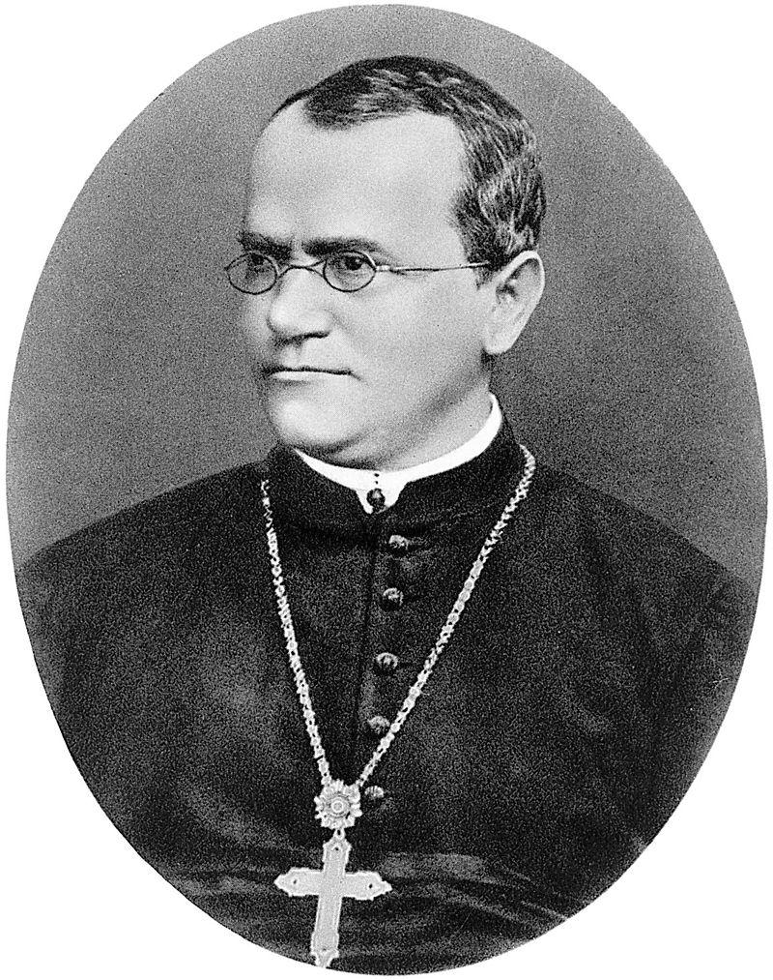
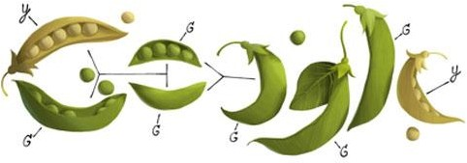
Gregor Mendel, 1822-1884
Notes:
Gregor Mendel (1822-1884) was an Austrian monk who is widely recognized as the founder of the modern field of genetics. Mendel performed careful and large-scale experiments on plants to come up with fundamental laws of genetics.
Many of his experiments were on varieties of pea plants. He formulated sets of assumptions about each variety; these were his models. He then tested the validity of his models by growing the plants and gathering data.

Slide 17
A Model
Pea plants of a particular kind
Each one has either purple flowers or white flowers
Mendel’s model:
Each plant is purple-flowering with chance 75%,
regardless of the colors of the other plants
Question:
Is the model good, or not?
Notes:
Mendel grew many pea plants.
One particular kind had either purple or white flowers

Slide 18
Choosing a Statistic
Take a sample, see what percent are purple-flowering
If that percent is much larger or much smaller than 75, that is evidence against the model
Distance from 75 is the key
Statistic:
| sample percent of purple-flowering plants - 75 |
If the statistic is large, that is evidence against the model
Notes:
To go about assessing Mendel's model, we can simulate plants under the assumptions of the model and see what it predicts. Then we will be able to compare the predictions with the data that Mendel recorded.
Our goal is to see whether or not Mendel's model is good. We need to simulate a statistic that will help us make this decision.
If the model is good, the percent of purple-flowering plants in the sample should be close to 75%. If the model is not good, the percent purple-flowering will be away from 75%. It may be higher, or lower; the direction doesn't matter.
The key for us is the distance between 75% and the percent of purple-flowering plants in the sample. Big distances are evidence that the model isn't good.

Slide 19
Simulating purple flowering plants
We have decided on a statistic
Next, we simulate one outcome (i.e., one value of the statistic)
Sample 929 (total number of plants of this type that Mendel grew) times at random from the distribution specified by the model and find the sample proportion in the purple-flowering category.
Multiply the proportion by 100 to get a percent.
Subtract 75 and take the absolute value of the difference.
Finally, run the simulation a large number of times and visualize the results in a histogram
(Demo – notebook 6.1,
Mendel and Pea Flowers)
Notes:
First, we have to figure out how many times to sample. To do this, remember that we are going to compare our simulation with Mendel's plants. So we should simulate the same number of plants that he had.

Slide 20
Assessment of the model - Results
To provide a final assessment we need to compare the prediction with the data
The visualization of the prediction showed that the values of our statistic as small, which is desirable
We have to plot the observed value of our statistic.
Of the 929 plants Mendel grew, 705 were purple flowering
Therefore, the observed value of the statistic = abs (100 * (705 / 929) - 75) = 0.888
We add that to our histogram (demo – notebook 6.1, Mendel and Pea Flowers)
The observed value of the statistic is in the heart of the distribution predicted by Mendel's model.
Therefore, our model is supported by Mendel’s data (i.e., evidence)
Notes:
The observed statistic is like a typical distance predicted by the model. By this measure, the data are consistent with the histogram that we generated under the assumptions of Mendel's model. This is evidence in favor of the model.

Slide 21
Two Viewpoints when assessing a model

Slide 22
Model and Alternative
Jury selection:
Model: The people on the jury panels were selected at random from the eligible population
Alternative viewpoint: No, they weren’t
Genetics:
Model: Each plant has a 75% chance of having purple flowers
Alternative viewpoint: No, it doesn’t

Slide 23
Steps in Assessing a Model
Choose a statistic to measure discrepancy between model and data
Simulate the statistic under the model’s assumptions
Compare the data to the model’s predictions:
Draw a histogram of simulated values of the statistic
Compute the observed statistic from the real sample
If the observed statistic is far from the histogram, that is evidence against the model

Slide 24
Discussion Questions
In each of (a) and (b), choose a statistic that will help you decide between the two viewpoints.
Data: the results of 400 tosses of a coin
(a)
“This coin is fair.”
“No, it’s not.”
(b)
“This coin is fair.”
“No, it’s biased towards heads.”

Slide 25
“Fair”
For both (a) and (b),
The number of heads in the 400 tosses is a good starting point, but might need adjustment
A number of heads around 200 suggests “fair”

Slide 26
Answers
Very large or very small values of the number of heads suggest “not fair.”
The distance between number of heads and 200 is the key
Statistic: | number of heads − 200 |
Large values of the statistic suggest “not fair”
Large values of the number of heads suggest “biased towards heads”
Statistic: number of heads

Slide 27
Assessing models with multiple categories

Slide 28

Jury Selection in Alameda County
Notes:
We have developed a way of assessing models about chance processes that generate data in two categories. The method extends to models involving data in multiple categories. The process of assessment is the same as before, the only difference being that we have to come up with a new statistic to simulate.

Slide 29
Jury Panels
Eligible jurors in a County
List of eligible residents
Jury panel
Jury
Section 197 of California's Code of Civil Procedure says, "All persons selected for jury service shall be selected at random, from a source or sources inclusive of a representative cross section of the population of the area served by the court."
Notes:
A jury panel is a group of people chosen to be prospective jurors; the final trial jury is selected from among them.
Jury panels can consist of a few dozen people or several thousand, depending on the trial.
By law, a jury panel is supposed to be representative of the community in which the trial is taking place.
Section 197 of California's Code of Civil Procedure says, "All persons selected for jury service shall be selected at random, from a source or sources inclusive of a representative cross section of the population of the area served by the court.”
The final jury is selected from the panel by deliberate inclusion or exclusion.
The law allows potential jurors to be excused for medical reasons;
lawyers on both sides may strike a certain number of potential jurors from the list in what are called "peremptory challenges";
the trial judge might make a selection based on questionnaires filled out by the panel; and so on.
But the initial panel is supposed to resemble a random sample of the population of eligible jurors.

Slide 30
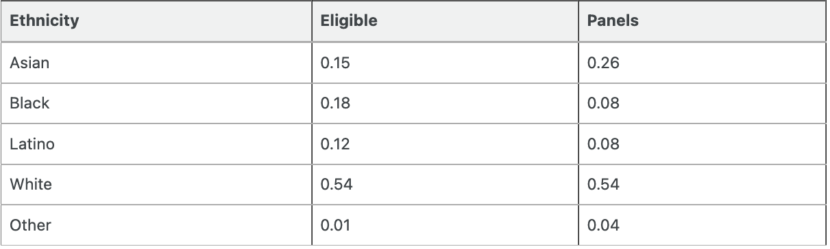
ALAmeda county jury panels
The ACLU of Northern California in 2010 presented a report on jury selection in Alameda county, CA.
The focus of the study was ethnic composition of the panels (based on data collected in 2009 and 2010)
The data is available in the table called jury, but it shows the following to be the ethnic composition of the jury panel
Notes:
The American Civil Liberties Union (ACLU) of Northern California presented a report on jury selection in Alameda County, California.
The focus of the study by the ACLU of Northern California was the ethnic composition of jury panels in Alameda County.
The ACLU compiled data on the ethnic composition of the jury panels in 11 felony trials in Alameda County in the years 2009 and 2010.
In those panels, the total number of people who reported for jury service was 1,453.
The ACLU gathered demographic data on all of these prosepective jurors, and compared those data with the composition of all eligible jurors in the county.
The data are tabulated below in a table called jury.
We will explore the comnposition of the panels and do some visualizations

Slide 31
Comparison with panels drawn at Random
What if we select a random sample of 1,453 people from the population of eligible jurors?
Will the distribution of their ethnicities look like the distribution of the panels above?
Demo(Notebook 6.1, Alameda County Jury Panels)
Technical note.
Random samples of prospective jurors would be selected without replacement.
However, when the size of a sample is small relative to the size of the population, sampling without replacement resembles sampling with replacement; the proportions in the population don't change much between draws.
Notes:
Address note before demo
This is part of the note
The population of eligible jurors in Alameda County is over a million, and compared to that, a sample size of about 1500 is quite small. We will therefore sample with replacement.

Slide 32
A New Statistic
Notes:
To assess whether the sampled proportion values are particular to one random sample or more general, we can simulate multiple panels under the model of random selection and see what the simulations predict.
But we won't be able to look at thousands of bar charts like the one above.
We need a statistic that will help us assess whether or not the model of random selection is supported by the data.

Slide 33
Distance Between Distributions
People on the panels are of multiple ethnicities
Distribution of ethnicities is categorical
To see whether the the distribution of ethnicities of the panels is close to that of the eligible jurors, we have to measure the distance between two categorical distributions
Notes:
We know how to measure how different two numbers are – if the numbers are xx and yy, the distance between them is |x−y||x−y|.
Now we have to quantify the distance between two distributions.
For example, we have to measure the distance between the eligible and panel distributions.

Slide 34
Total Variation Distance
Every distance has a computational recipe
Total Variation Distance (TVD):
For each category, compute the difference in proportions between two distributions
Take the absolute value of each difference
Sum, and then divide the sum by 2
(Demo – notebook 6.1, Distance Between Distributions)
Notes:
Refer to the book on why we can’t just compute the difference between proportions of the distribution for each category.
They would sum to 0 (https://umass-data-science.github.io/190fwebsite/textbook/11/2/multiple-categories/).
We therefore need to compute the absolute difference, i.e, distance. Summing that though, gives us twice the total positive value of the differences between proportions in each category for the 2 distributions.
Therefore we need to divide by 2.
To not have to keep track of which differences are positive, we use absolute distances

Slide 35
Simulating ethnic composition in the jury
Once we’ve obtained a statistic, here, the distance between 2 distributions
For the observed statistic that would be distance between eligible and observed panel
For the simulated statistic that would be distance between eligible and simulated panel
We can simulate a single statistic
Generate an ethnic distribution (proportions) of the jury from a sample size of 1453
Then compute the TVD between that distribution and eligible distribution
Then, iterate several times (to understand the variability of the simulated statistic)
Append the obtained values in an array
Then visualize the results (on a histogram)
And, compare the predictions (empirical TVD of the simulated statistic) against the data (actual TVD from the data).
(Demo – notebook 6.1, Total Variation Distance)

Slide 36
Summary of the Method
To assess whether a sample was drawn randomly from a known categorical distribution:
Use TVD as the statistic because it measures the distance between categorical distributions
Sample at random from the population and compute the TVD from the random sample; repeat numerous times
Compare:
Empirical distribution of simulated TVDs
Actual TVD from the sample in the study

Slide 37
Testing Hypotheses

Slide 38
Testing Hypotheses
A test chooses between two views of how data were generated
The views are called hypotheses
The test picks the hypothesis that is better supported by the observed data
Notes:
All statistical tests attempt to choose between two views of the world.
Specifically, the choice is between two views about how the data were generated.
These two views are called hypotheses.

Slide 39
Null and Alternative
The method only works if we can simulate data under one of the hypotheses.
Null hypothesis
A well defined chance model about how the data were generated
We can simulate data under the assumptions of this model – “under the null hypothesis”
Alternative hypothesis
A different view about the origin of the data
Notes:
The null hypothesis. This is a clearly defined model about chances. It says that the data were generated at random under clearly specified assumptions about the randomness. The word "null" reinforces the idea that if the data look different from what the null hypothesis predicts, the difference is due to nothing but chance.
From a practical perspective, the null hypothesis is a hypothesis under which you can simulate data.
In the example about Mendel's model for the colors of pea plants, the null hypothesis is that the assumptions of his model are good: each plant has a 75% chance of having purple flowers, independent of all other plants.
Under this hypothesis, we were able to simulate random samples, by using sample_proportions(929, [0.75, 0.25]). We used a sample size of 929 because that's the number of plants Mendel grew.
The alternative hypothesis. This says that some reason other than chance made the data differ from the predictions of the model in the null hypothesis.
In the example about Mendel's plants, the alternative hypothesis is simply that his model isn't good.

Slide 40
Test Statistic
The statistic that we choose to simulate, to decide between the two hypotheses
Questions before choosing the statistic:
What values of the statistic will make us lean towards the null hypothesis?
What values will make us lean towards the alternative?
Preferably, the answer should be just “high”. Try to avoid “both high and low”.
Notes:
In order to decide between the two hypothesis, we must choose a statistic that we can use to make the decision.
This is called the test statistic.

Slide 41
Prediction Under the Null Hypothesis
Simulate the test statistic under the null hypothesis; draw the histogram of the simulated values
This displays the empirical distribution of the statistic under the null hypothesis
It is a prediction about the statistic, made by the null hypothesis
It shows all the likely values of the statistic
Also how likely they are (if the null hypothesis is true)
The probabilities are approximate, because we can’t generate all the possible random samples

Slide 42
Conclusion of the Test
Resolve choice between null and alternative hypotheses
Compare the observed test statistic and its empirical distribution under the null hypothesis
If the observed value is not consistent with the distribution, then the test favors the alternative (“data is more consistent with the alternative”)
Whether a value is consistent with a distribution:
A visualization may be sufficient
If not, there are conventions about “consistency”

Slide 43
Decisions and Uncertainty

Slide 44
Incomplete Information
We are trying to choose between two views of the world, based on data in a sample.
It is not always clear whether the data are consistent with one view or the other.
Random samples can turn out quite extreme. It is unlikely, but possible.

Slide 45
Another Example

Slide 46
The Problem
Large(-ish) Statistics class divided into 12 discussion sections
Graduate Student Instructors (GSIs) lead the sections
After the midterm, students in Section 3 notice that the average score in their section is lower than in others

Slide 47
The GSI’s Defense
GSI’s position (Null Hypothesis):
If we had picked my section at random from the whole class, we could have got an average like this one.
Alternative:
No, the average score is too low. Randomness is not the only reason for the low scores.
(Demo – Notebook 6.2)

Slide 48
Statistical Significance

Slide 49
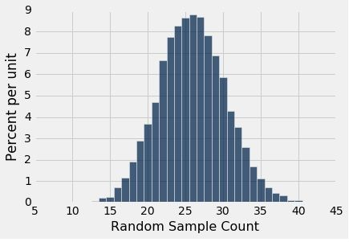
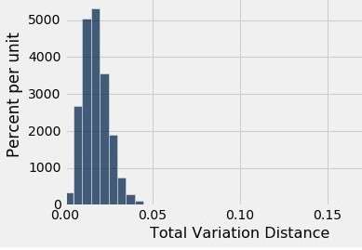
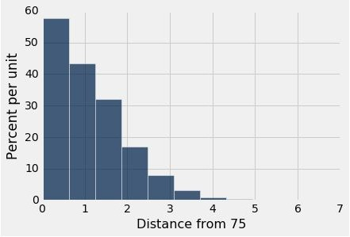
Tail Areas
Alabama Jury
Alameda Jury
Pea Plants
Observed Number (8)
Observed TVD (0.14)
Observed Distance (0.88)

Slide 50
Conventions About Inconsistency
“Inconsistent with the null”:
The test statistic is in the tail of the empirical distribution under the null hypothesis
“In the tail,” first convention:
The area in the tail is less than 5%
The result is “statistically significant”
“In the tail,” second convention:
The area in the tail is less than 1%
The result is “highly statistically significant”
(Demo - Notebook 6.2, Statistical Significance)

Slide 51
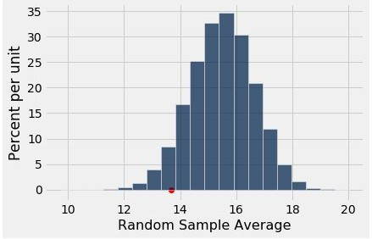
The P-Value as an Area
Empirical distribution of the test statistic under the null hypothesis
The red dot is the observed statistic.

Slide 52
Definition of the P-value
Formal name: observed significance level
The P-value is the chance,
under the null hypothesis,
that the test statistic
is equal to the value that was observed in the data
or is even further in the direction of the alternative.

Slide 53
A/B Testing

Slide 54
How We’ve Tested Thus Far

Slide 55
Hypothesis Testing Review
One Category (ex: percent of flowers that are purple)
Test Statistic (1): empirical_percentage
Test Statistic (1): abs(empirical_percentage - null_percentage)
How to Simulate: sample_proportions(n, null_dist)
Multiple Categories (ex: ethnicity distribution of jury panel)
Test Statistic: tvd(empirical_dist, null_dist)
How to Simulate: sample_proportions(n, null_dist)
Numerical Data (ex: scores in a lab section)
Test Statistic: empirical_mean
How to Simulate: population_data.sample(n, with_replacement=False)

Slide 56
Comparing Two Samples
Compare values of sampled individuals in Group A with values of sampled individuals in Group B.
Question: Do the two sets of values come from the same underlying distribution?
Answering this question by performing a statistical test is called A/B testing.
Notes:
Do the two sets of values come from the same underlying distribution? i.e., are the two distributions identical or different?
If different, are the differences just by chance?

Slide 57
The Groups and the Question
Random sample of mothers of newborns. Compare:
(A) Birth weights of babies of mothers who smoked during pregnancy
(B) Birth weights of babies of mothers who didn’t smoke
(Demo – Notebook 6.3, Comparing Two Samples)

Slide 58
The Groups and the Question
Random sample of mothers of newborns. Compare:
(A) Birth weights of babies of mothers who smoked during pregnancy
(B) Birth weights of babies of mothers who didn’t smoke
Question: Could the difference be due to chance alone?

Slide 59
Hypotheses
Null:
In the population, the distributions of the birth weights of the babies in the two groups are the same. (They are different in the sample just due to chance)
Alternative:
In the population, the babies of the mothers who smoked weigh less, on average, than the babies of the non-smokers.

Slide 60
Test Statistic
Group A: non-smokers
Group B: smokers
Statistic: Difference between average weights
i.e., Group B average - Group A average
Negative values of this statistic favor the alternative
(Demo – Notebook 6.3, Test statistic)

Slide 61
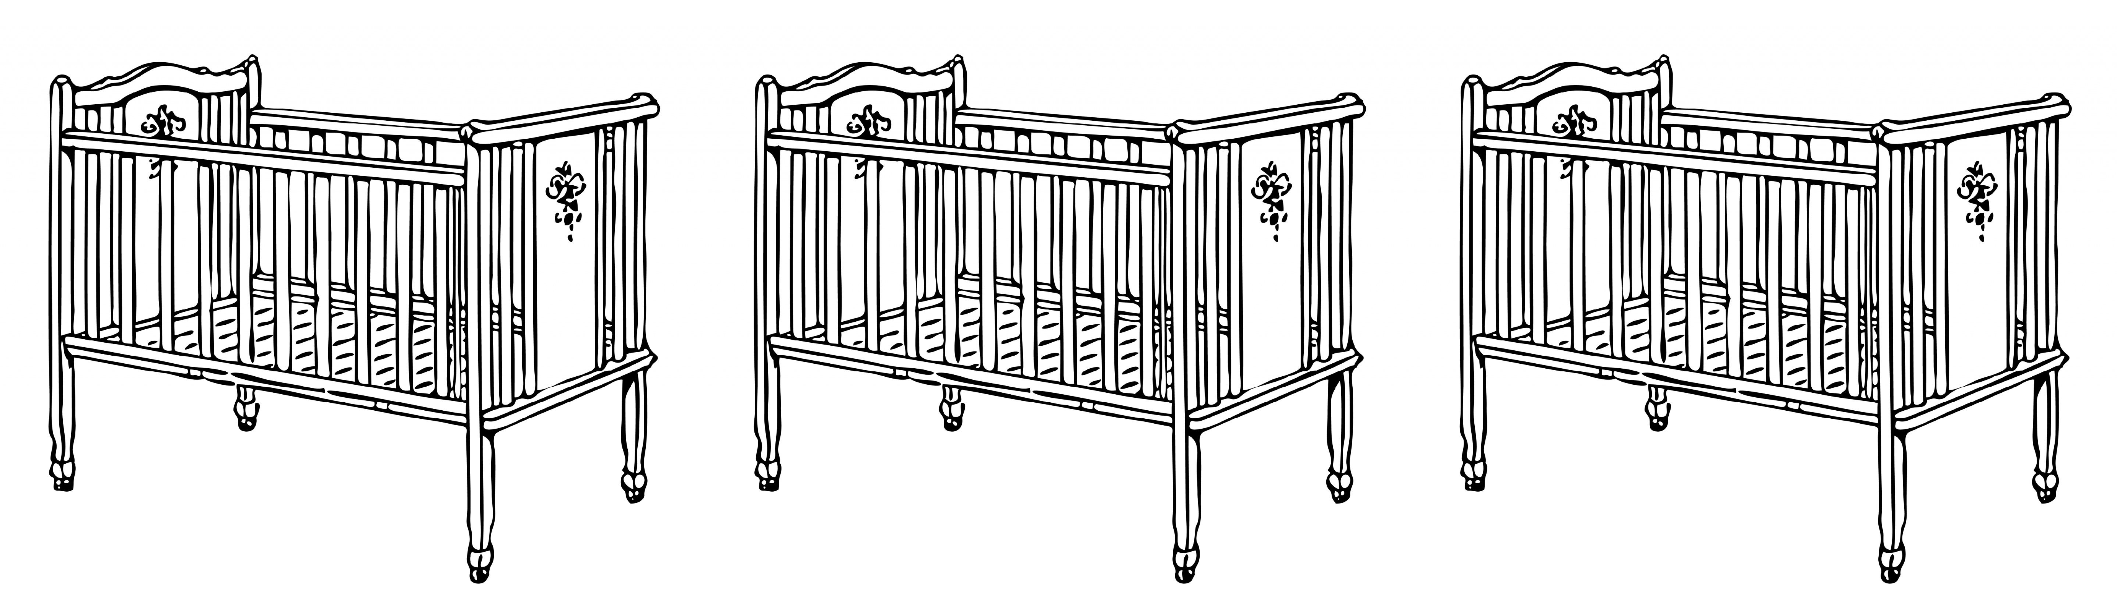
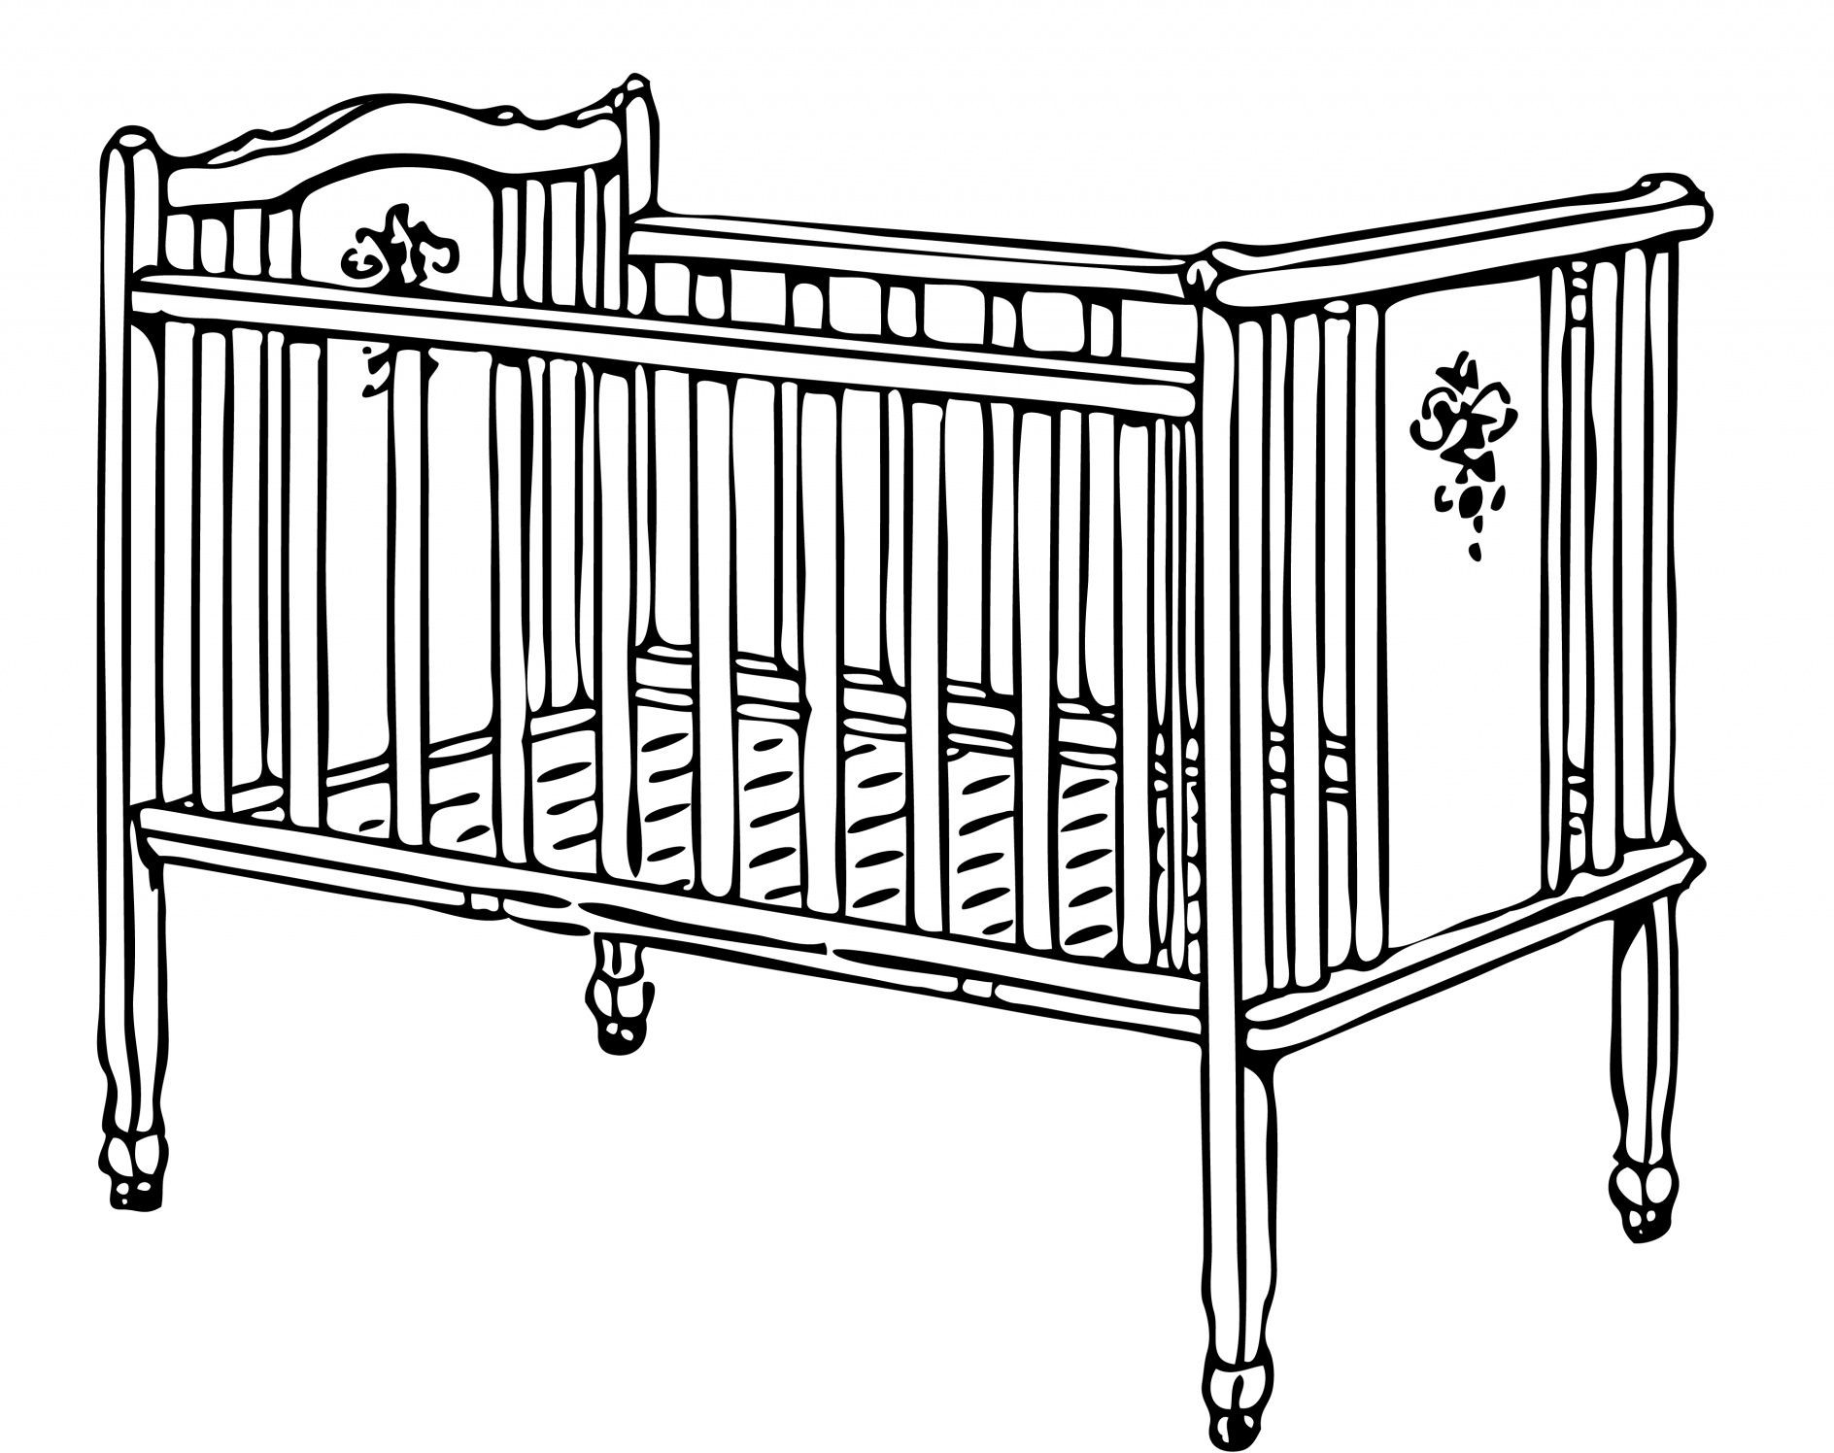
The Data
...
Non-smoker
120 oz
Smoker
108 oz
Non-smoker 117 oz
Non-smoker
113 oz
Smoker
128 oz
...
Notes:
How do we predict what the outcome could be? How do we simulate the statistic under a hypothesis (e.g., null hypothesis)
Predicting the Statistic Under the Null Hypothesis¶
To see how the statistic should vary under the null hypothesis, we have to figure out how to simulate the statistic under that hypothesis.
A clever method based on random permutations does just that.

Slide 62
Shuffling Labels Under the Null
...
Smoker
120 oz
Non-smoker
113 oz
Non-smoker
128 oz
Smoker
108 oz
...
Smoker
117 oz
Notes:
If there were no difference between the two distributions in the underlying population, then whether a birth weight has the label True or False with respect to maternal smoking should make no difference to the average.
The idea, then, is to shuffle all the birth weights randomly among the mothers.
This is called random permutation.

Slide 63
Shuffling Rows

Slide 64
Random Permutation
tbl.sample(n)
Table of n rows picked randomly with replacement
tbl.sample()
Table with same number of rows as original tbl, picked randomly with replacement
tbl.sample(n, with_replacement = False)
Table of n rows picked randomly without replacement
tbl.sample(with_replacement = False)
All rows of tbl, in random order
(Demo – Notebook 6.3, Random Permutation (Shuffling)

Slide 65
Simulating Under the Null
If the null is true, all rearrangements of labels are equally likely
Plan:
Shuffle all group labels
Assign each shuffled label to a birth weight
Find the difference between the averages of the two shuffled groups
Repeat (i.e, iterate to get a sense of variability of the simulated value of the test statistic)
(Demo, Notebook 6.3,
Simulation under null hypothesis and permutation test)
Notes:
So, we know that we need to do random permutation, and we know how to do it (using the sample() method)
Now, let’s put together these things so that we can simulate our test statistic under the null hypothesis

Slide 66
How We’ve Tested Thus Far

Slide 67
Hypothesis Testing Review
1 Sample: One Category (e.g. percent of flowers that are purple)
Test Statistic: empirical_percent, abs(empirical_percent - null_percent)
How to Simulate: sample_proportions(n, null_dist)
1 Sample: Multiple Categories (e.g. ethnicity distribution of jury panel)
Test Statistic: tvd(empirical_dist, null_dist)
How to Simulate: sample_proportions(n, null_dist)
1 Sample: Numerical Data (e.g. scores in a lab section)
Test Statistic: empirical_mean, abs(empirical_mean - null_mean)
How to Simulate: population_data.sample(n, with_replacement=False)
2 Samples: Numerical Data (e.g. birth weights of smokers vs. non-smokers)
Test Statistic: group_a_mean - group_b_mean,
group_b_mean - group_a_mean, abs(group_a_mean - group_b_mean)
How to Simulate: empirical_data.sample(with_replacement=False)
Notes:
Point the students to another example of A/B testing in the book – chapter 12.2 Deflategate

Slide 68
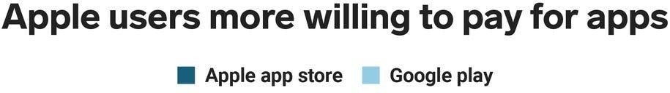
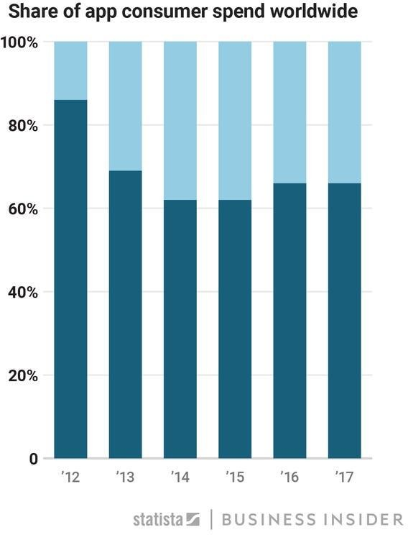
Importance of Random Assignment

Slide 69
Importance of Random Assignment
iOS users spend 2x as much as Android users on 3rd party apps
Is higher spending caused by users owning
iPhone?
Can’t Tell:
Users aren’t randomly assigned a phone
Other factors contribute to their phone purchasing decisions (e.g. income, geography)
Notes:
There is an association between mobile phone OS and the amount of money spent on apps
However, is that association causal?

Slide 70
Causality

Slide 71
Randomized Controlled Experiment
Sample A: control group
Sample B: treatment group
If the treatment and control groups are selected at random, then you can make causal conclusions.
Any difference in outcomes between the two groups could be due to:
chance
the treatment
(Demo – Notebook 6.4,
Randomized Control Experiment)

Slide 72
Before the randomization
In the population there is one imaginary ticket for each of the 31 participants in the experiment.
Each participant’s ticket looks like this:
Potential Outcome
Potential Outcome
Outcome if assigned to treatment group
Outcome if assigned to control group

Slide 73
The Data
16 randomly picked tickets show:
Outcome if assigned to control group
The remaining 15 tickets show:
Outcome if assigned to treatment group

Slide 74
The Hypotheses
Null:
In the population, the distribution of all potential control scores is the same as the distribution of all potential treatment scores.
tl;dr the treatment has no effect
Alternative:
In the population, more of the potential treatment scores are 1 (pain improves) than the potential control scores.
(Demo – Notebook 6.4, Hypotheses All Potential Scores and Testing the hypotheses)

Slide 75

Random Assignment & Shuffling
Data Generation
Sample Data
Hypothesis Testing
Difference of Means Permutation Test
Conclusions
Observational Sample
Association
Our Two-Sample
Numerical Data
Shuffle Labels to Simulate from Null
Randomized Control Experiment
Causation

Slide 76
An Error Probability

Slide 77


Can the Conclusion be Wrong?
Yes.
 | Null is true | Alternative is true
Test favors the null | ✅ | ❌
Test favors the alternative | ❌ | ✅

Slide 78
An Error Probability
The cutoff for the P-value is an error probability.
If:
your cutoff is 5%
and the null hypothesis happens to be true
then there is about a 5% chance that your test will reject the null hypothesis.

Slide 79
P-value cutoff vs P-value
P-value cutoff
Does not depend on observed data or simulation
Decide on it before seeing the results
Conventional values at 5% and 1%
Probability of hypothesis testing making an error
P-value
Depends on the observed data and simulation
Probability under the null hypothesis that the test statistic is the observed value or further towards the alternative

Slide 80
Testing Hypotheses - Conclusion

Slide 81
How to do a hypothesis test
Before computing anything: figure out the viewpoint the question wants to test, and formulate:
Null hypothesis: Completely specified chance model under which you can simulate data
Alternative hypothesis: Viewpoint from the question
Test statistic: to help you choose one viewpoint
Compute the value of the test statistic in your data
Simulate the test statistic under the null many times
Compare the results

Slide 82
P-Values and Error Probabilities

Slide 83
Example: Benford’s Law
(Demo)

Slide 84
Questions?

