Slide 1
Module 7
Estimation
Notes:
In this chapter, we will develop a way to estimate an unknown parameter.
- Remember that a parameter is a numerical value associated with a population.
To figure out the value of a parameter, we need data.
- If we have the relevant data for the entire population, we can simply calculate the parameter.
But if the population is very large – for example, if it consists of all the households in the United States – then it might be too expensive and time-consuming to gather data from the entire population.
- In such situations, data scientists rely on sampling at random from the population.

Slide 2

Percentiles
Notes:
Why percentiles?
- Our goal in this lesson is to learn how to estimate an unknown parameter in the population
A common statistic people estimate is the median. Median is the 50% percentile.
To give us a better understanding of median and/any other percentages of the data we’d want to get, we need to learn more about how to compute percentiles

Slide 3
Defining percentiles
A percentile is the value at a particular rank.
Let p be a number between 0 and 100. The pth percentile of a collection is the smallest value in the collection that is at least as large as p% of all the values.
Practically, suppose there are n elements in the collection. To find the pth percentile:
Sort the collection in increasing order.
Find p% of n: (p/100)×n(p/100)×n. Call that k.
If k is an integer, take the kth element of the sorted collection.
If k is not an integer, round it up to the next integer, and take that element of the sorted collection.
Notes:
So, what is a percentile?
Numerical data can be sorted in increasing or decreasing order.
- Thus the values of a numerical data set have a rank order. A percentile is the value at a particular rank.
For example, if your score on a test is on the 95th percentile, a common interpretation is that only 5% of the scores were higher than yours.
By the definition above, any percentile between 0 and 100 can be computed for any collection of values, and it is always an element of the collection.

Slide 4
Computing Percentiles
The Xth percentile is the first value on the sorted list that is at least as large as X% of the elements.
Example: s = [1, 7, 3, 9, 5]
Percentile Data set
s_sorted = [1, 3, 5, 7, 9]
percentile(80, s) is 7 The 80th percentile is ordered element 4: (80/100) * 5
For a percentile that does not exactly correspond to an element, take the next greater element instead
Notes:
- The median is the 50th percentile; it is commonly assumed that 50% the values in a data set are above the median.
The percentile function¶
The percentile function takes two arguments: a rank between 0 and 100, and a array. It returns the corresponding percentile of the array.

Slide 5
The percentile Function
The pth percentile is the smallest value in a set that is
at least as large as p% of the elements in the set
Function in the datascience module:
percentile(p, values)
p is between 0 and 100
Returns the pth percentile of the array
(Demo – notebook 7.1, Percentiles)

Slide 6
Discussion Question
Which are True, when s = [1, 7, 3, 9, 5]?
percentile(10, s) |  | == | 0
percentile(39, s) |  | == | percentile(40, s)
percentile(40, s) |  | == | percentile(41, s)
percentile(50, s) |  | == | 5
(Demo – notebook 7.1, Percentiles in class)
Notes:
False
True
False
True

Slide 7
Estimation

Slide 8
Inference: Estimation
How do we calculate the value of an unknown parameter?
If you have a census (that is, the whole population):
Just calculate the parameter and you’re done
If you don’t have a census:
Take a random sample from the population
Use a statistic as an estimate of the parameter
(Demo – Notebook 7.1, Estimating Median - Sample Median)

Slide 9
Variability of the Estimate
One sample ➜ One estimate
But the random sample could have come out differently
And so the estimate could have been different
Big question:
How different would it be if we did it again?
(Demo – Notebook 7.1, Variability of the Estimate)

Slide 10
Quantifying Uncertainty
The estimate is usually not exactly right:
Estimate = Parameter + Error
How accurate is the estimate, usually?
How big is a typical error?
When we have a census, we can do this by simulation
(Demo – Notebook 7.1, Quantifying Uncertainty)
Notes:
With simulation, we were generating a new random sample each time. i.e., we mimick being able to go back to the field and collect another sample.
Because we assume during a simulation that we have data for the whole population

Slide 11
Where to Get Another Sample?
We want to understand errors of our estimate
Given the population, we could simulate
...but we only have the sample!
To get many values of the estimate, we needed many random samples
Can’t go back and sample again from the population:
No time, no money
Stuck?
Notes:
With simulation, we were generating a new random sample each time. i.e., we mimick being able to go back to the field and collect another sample.
Because we assume during a simulation that we have data for the whole population

Slide 12
The Bootstrap

Slide 13
The Bootstrap
A technique for simulating repeated random sampling
All that we have is the original sample
… which is large and random
Therefore, it probably resembles the population
So, we sample at random from the original sample!
AKA, resampling
Notes:
Since it is not feasible to generate new samples from the population, the bootstrap generates new random samples by a method called resampling: the new samples are drawn at random from the original sample.
Why would resampling work? – Ask them as a question
- Law of averages/ law of large numbers – if a random sample is large, it’s distribution will resemble that of the population with a high likelihood

Slide 14
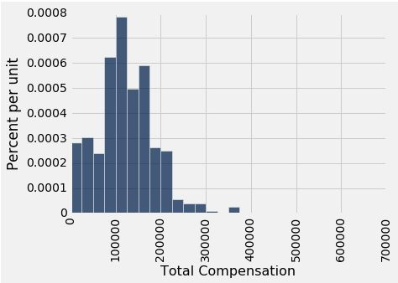
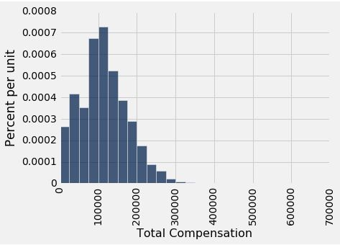
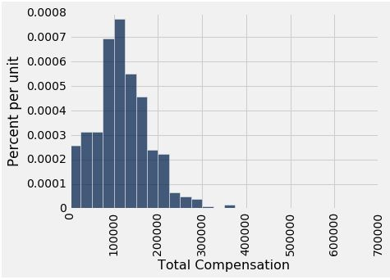
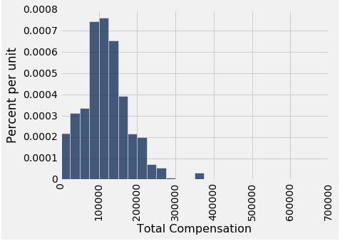
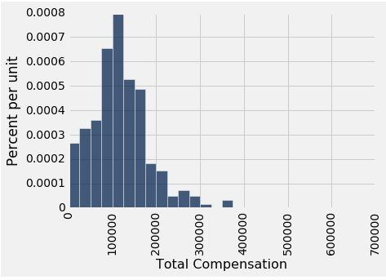

Why the Bootstrap Works
resamples
population
sample
All of these look pretty similar, most likely.
Notes:
- Law of averages/ law of large numbers – if a random sample is large, it’s distribution will resemble that of the population with a high likelihood

Slide 15
Why We Need the Bootstrap
resamples
population
sample
What we wish we could get
What we really get

Slide 16
Real World vs. Bootstrap World
Real world: Bootstrap world:
True probability distribution ● (population)
→ Random sample 1
→ Estimate 1
→ Random sample 2
→ Estimate 2
Empirical distribution of original sample (“population”)
→ Bootstrap sample 1
→ Estimate 1
→ Bootstrap sample 2
→ Estimate 2
…
→ Random sample 10000
→ Estimate 10000
...
→ Bootstrap sample 1000
→ Estimate 1000
Hope: these two scenarios are analogous

Slide 17
Real vs. Bootstrap World
Real world (what we want): Bootstrap world:
True probability distribution ● (population)
→ Random sample 1
→ Estimate 1
Empirical distribution of original sample (“population”)
→ Bootstrap sample 1
→ Estimate 1
→ Bootstrap sample 2
→ Estimate 2
 | → Random sample 2
Can’t get th | ese :( | → Estimate 2
 | … → Random sample 10000 → Estimate 10000
...
→ Bootstrap sample 1000
→ Estimate 1000
Hope: these two scenarios are analogous

Slide 18
The Bootstrap Principle
The bootstrap principle:
Bootstrap-world sampling ≈ Real-world sampling
Not always true!
… but reasonable if sample is large enough
We hope that:
Variability of bootstrap estimate
Distribution of bootstrap errors
...are similar to what they are in the real world

Slide 19
Key to Resampling
From the original sample,
draw at random
with replacement
as many values as the original sample contained
The size of the new sample has to be the same as the original one, so that the two estimates are comparable
(Demo – notebook 7.1, Bootstrap)
Notes:
Here are the steps of the bootstrap method for generating another random sample that resembles the population:
Treat the original sample as if it were the population.
Draw from the sample, at random with replacement, the same number of times as the original sample size.

Slide 20
Confidence Intervals
Notes:
New question to answer is: Do the Estimates Capture the Parameter?¶
How often does the empirical histogram of the resampled medians sit firmly over the red dot, and not just brush the dot with its tails? To answer this, we must define "sit firmly". Let's take that to mean "the middle 95% of the resampled medians contains the red dot".

Slide 21
Do the Estimates Capture the Parameter?
Q: How often does the empirical histogram of the resampled medians contain our parameter?
For instance, how often does the middle 95% of the resampled medians contain our parameter?

Slide 22
95% Confidence Interval
Interval of estimates of a parameter
Based on random sampling
95% is called the confidence level
Could be any percent between 0 and 100
Higher level means wider intervals
The confidence is in the process that gives the interval:
It generates a “good” interval about 95% of the time.
(Demo – notebook 7.1, Confidence Intervals)

Slide 23
Each line here is a confidence interval from a fresh sample from the population
Notes:
Suppose you are estimating the population median by the following process:
Draw a large random sample from the population.
Bootstrap your random sample and get an estimate from the new random sample.
Repeat the above step thousands of times, and get thousands of estimates.
Pick off the "middle 95%" interval of all the estimates.
That gives you one interval of estimates.
Now if you repeat the entire process 100 times, ending up with 100 intervals, then about 95 of those 100 intervals will contain the population parameter.
In other words, this process of estimation captures the parameter about 95% of the time.

Slide 24
95% CI: Usage vs Interpretation
How to create it
Middle 95% of the bootstrapped estimates
How to interpret it
95% of samples will give a 95% CI that contains the true parameter

Slide 25
Use Methods Appropriately

Slide 26
Can You Use a CI Like This?
By our calculation, an approximate 95% confidence interval for the average age of the mothers in the population is (26.9, 27.6) years.
True or False:
About 95% of the mothers in the population were between 26.9 years and 27.6 years old.
Answer: False. We’re estimating that their average age is in this interval.

Slide 27
Is This What a CI Means?
An approximate 95% confidence interval for the average age of the mothers in the population is (26.9, 27.6) years.
True or False:
There is a 0.95 probability that the average age of mothers in the population is in the range 26.9 to 27.6 years.
Answer: False. The average age of the mothers in the population is unknown but it’s a constant. It’s not random. No chances involved.

Slide 28
When Not to Use The Bootstrap
If you’re trying to estimate very high or very low percentiles, or min and max
If you’re trying to estimate any parameter that’s greatly affected by rare elements of the population
If the probability distribution of your statistic is not roughly bell shaped (the shape of the empirical distribution will be a clue)
If the original sample is very small

Slide 29
Confidence Intervals For Testing
Notes:
Estimating a parameter by confidence intervals does have an important use besides just telling us roughly how big the parameter is.

Slide 30
Using a CI for Testing
Null hypothesis: Population average = x
Alternative hypothesis: Population average ≠ x
Cutoff for P-value: p%
Method:
Construct a (100-p)% confidence interval for the population average
If x is not in the interval, reject the null
If x is in the interval, can’t reject the null
Notes:
Going back to the example of estimating the average age of mothers in the babies dataset.
Our approximate 95% confidence interval for the average age in the population goes from 26.9 years to 27.6 years.
Suppose someone wants to test the following hypotheses:
- Null hypothesis. The average age in the population is 30 years.
- Alternative hypothesis. The average age in the population is not 30 years.
Then, if you were using the 5% cutoff for the P-value, you would reject the null hypothesis.
- This is because 30 is not in the 95% confidence interval for the population average.
- At the 5% level of significance, 30 is not a plausible value for the population average.
This use of confidence intervals is the result of a duality between confidence intervals and tests:
- if you are testing whether or not the population mean is a particular value x, and you use the 5% cutoff for the P-value, then you will reject the null hypothesis if x is not in your 95% confidence interval for the mean.
This can be established by statistical theory.
In practice, it just boils down to checking whether or not the value specified in the null hypothesis lies in the confidence interval.
- If you were using the 1% cutoff for the P-value, you would have to check if the value specified in the null hypothesis lies in a 99% confidence interval for the population mean.

Slide 31
Questions?

