Slide 1
Module 9
Prediction

Slide 2
Prediction

Slide 3
Guessing the Future
Based on incomplete information
One way of making predictions:
To predict an outcome for an individual,
find others who are like that individual
and whose outcomes you know.
Use those outcomes as the basis of your prediction.
(Demo – Notebook 9.1, Prediction)
Notes:
As we saw in Section 7.1, Galton studied how physical characteristics are passed down from one generation to the next.
The primary reason for collecting the data was to be able to predict the adult height of a child born to parents similar to those in the dataset.
Our approach was to base the prediction on all the points that correspond to a midparent height of around the midparent height of the new person
To do this, we wrote a function called predict_child which takes a midparent height as its argument and returns the average height of all the children who had midparent heights within half an inch of the argument.
The prediction at a given midparent height lies roughly at the center of the vertical strip of points at the given height. This method of prediction is called regression

Slide 4
Association

Slide 5
Two Numerical Variables
Trend
Positive association
Negative association
Pattern
Any discernible “shape” in the scatter?
Linear
Non-linear
Visualize, then quantify
(Demo – Notebook 9.1, Association)
Notes:
Association is a very general relationship: one variable provides information about another.
Correlation is more specific: two variables are correlated when they display an increasing or decreasing trend. Correlation AKA linear association?
See example here: https://www.nature.com/articles/nmeth.3587#:~:text=Association%20is%20a%20very%20general,an%20increasing%20or%20decreasing%20trend.
The table hybrid contains data on hybrid passenger cars sold in the United States from 1997 to 2013.

Slide 6
Correlation Coefficient

Slide 7
The Correlation Coefficient
r
Measures linear association
Based on standard units
-1 ≤ r ≤ 1
r = 1: scatter is perfect straight line sloping up
r = -1: scatter is perfect straight line sloping down
r = 0: No linear association; uncorrelated
(Demo – Notebook 9.1, Correlation)
Notes:
We will now define a measure that uses standard units to quantify the kinds of association that we have seen.
The correlation coefficient measures the strength of the linear relationship between two variables.
Graphically, it measures how clustered the scatter diagram is around a straight line.
The term correlation coefficient isn't easy to say, so it is usually shortened to correlation and denoted by r.

Slide 8
Definition of
r
Correlation Coefficient (r) =
average of | product of | x in standard units | and | y in standard units
Measures how clustered the scatter is around a straight line
Demo()
Notes:
The formula for r is not apparent from our observations so far.
It has a mathematical basis that is outside the scope of this class.
However, as you will see, the calculation is straightforward and helps us understand several of the properties of r.

Slide 9
Properties of
r
r is a pure number. It has no units.
This is because r is based on standard units.
r is unaffected by changing the units on either axis.
This too is because r is based on standard units.
r is unaffected by switching the axes. (Demo – Notebook 9.1, Switching Axes )
Algebraically, this is because the product of standard units does not depend on which variable is called x and which y.
Geometrically, switching axes reflects the scatter plot about the line y=x, but does not change the amount of clustering nor the sign of the association.
Notes:
The calculation of r showed us that:

Slide 10
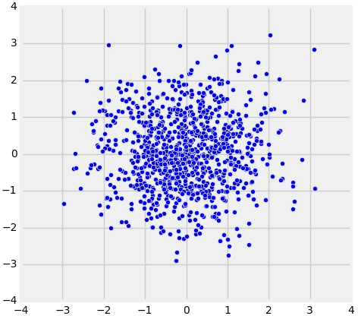
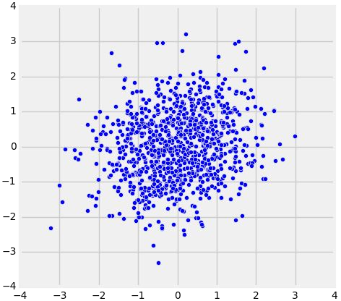
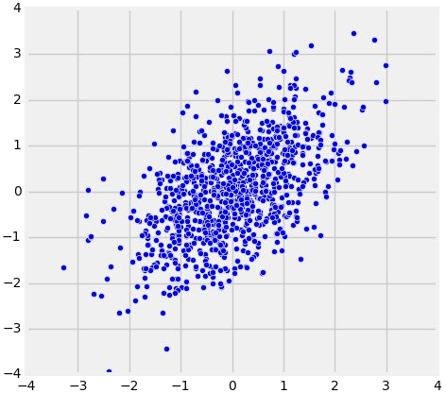
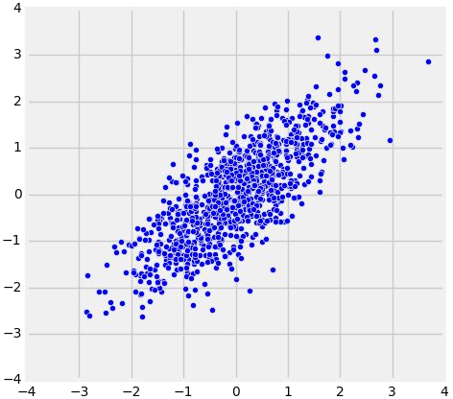
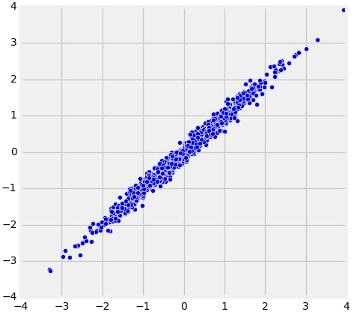
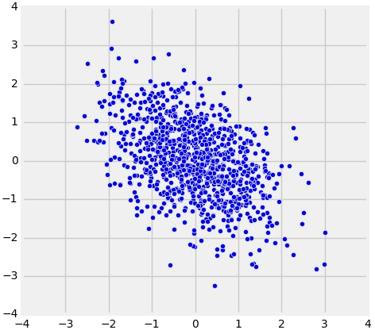
Recap - The Correlation Coefficient
r
Measures linear association
Based on standard units
-1 ≤ r ≤ 1
r = 1: scatter is perfect straight line sloping up
r = -1: scatter is perfect straight line sloping down
r = 0: No linear association; uncorrelated
r = 0
r = 0.2
r = 0.5
r = 0.8
r = 0.99
r = -0.5

Slide 11
Care in Interpretation

Slide 12
Watch Out For ...
False conclusions of causation
Association is NOT causation
Correlation is NOT causation
Nonlinearity
Outliers
Ecological Correlations
(Demo – Notebook 9.1, Nonlinearity, Outliers, and Ecological Correlations)
Notes:
Correlation is a simple and powerful concept, but it is sometimes misused.
Before using r, it is important to be aware of what correlation does and does not measure.
1) Correlation only measures association. Correlation does not imply causation. You have to ensure there are no other confounders
Ex. The chocolate study. Eating chocolate was associated with better heart health
Possible confounders, access to health care, age of the participants, social economic status (access to quality healthcare)
2) Correlation measures only one kind of association – linear
Variables that have strong non-linear association might have very low correlation.

Slide 13
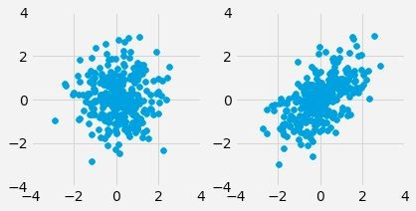
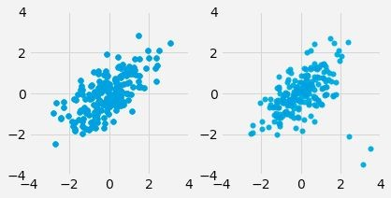
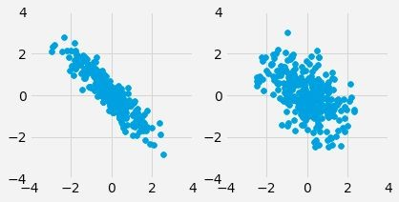
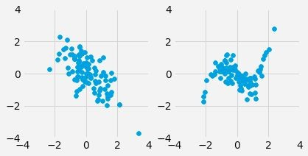
Discussion Question
For each pair, which one will have a higher value of r?
a)
c)
b)
d)

Slide 14
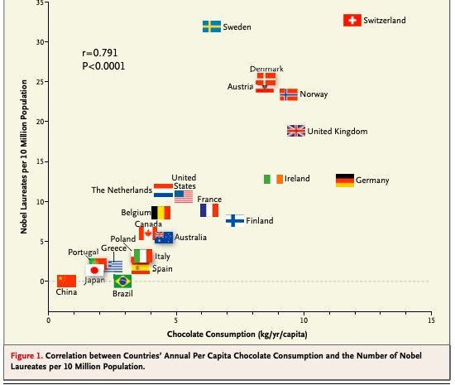
Chocolate and Nobel Prizes
Reference in course text
Notes:
In 2012, a paper in the respected New England Journal of Medicine examined the
relation between chocolate consumption and Nobel Prizes in a group of countries.
The Scientific American responded seriously whereas others were more relaxed.
You are welcome to make your own decision! The following graph, provided in the paper, should motivate you to go and take a look.

Slide 15
Discussion question
True or False?
If x and y have a correlation of 1, then one must cause the other.
If the correlation of x and y is close to 0, then knowing one will never help us predict the other.
If x and y have a correlation of -0.8, then they have a negative association.
Notes:
False
False – We will not be able to predict with a linear classifier, but other classifiers can be used
They have a negative **linear** association

Slide 16
Prediction

Slide 17
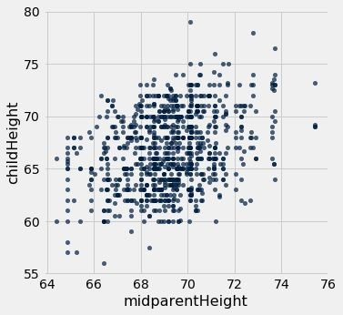
Galton's Heights
Oval shaped
Moderate positive correlation
How can we predict child height from mid-parent height?

Slide 18
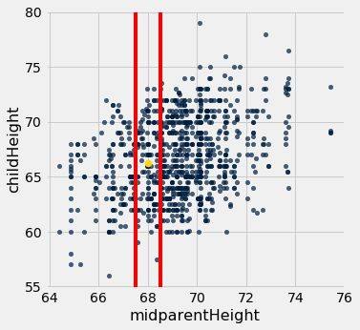
Galton's Heights

Slide 19
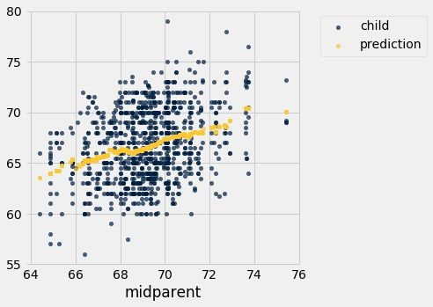
Galton's Heights

Slide 20
Nearest Neighbor Regression
A method for prediction:
Group each x with similar (nearby) x values
Average the corresponding y values for each group
For each x value, the prediction is the average of the y values in its nearby group.
The graph of these predictions is the “graph of averages”.
If the association between x and y is linear, then points in the graph of averages tend to fall on a line.

Slide 21
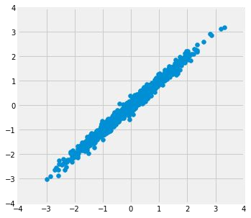
Where is the prediction line?
r = 0.99

Slide 22
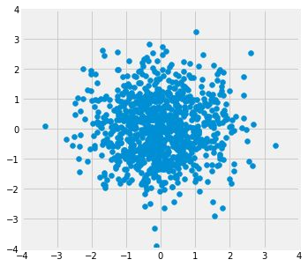
Where is the prediction line?
r=0.0
(Demo – Notebook 9.2,
Prediction lines)

Slide 23
Linear Regression

Slide 24
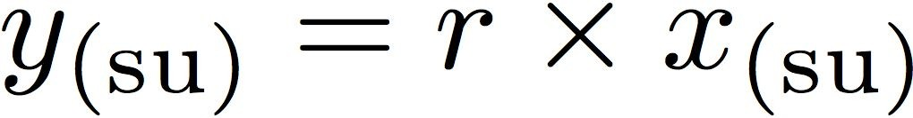
Linear Regression
A statement about x and y pairs
Measured in standard units
Describing the deviation of x from 0 (the average of x's)
And the deviation of y from 0 (the average of y's)
On average, y deviates from 0 less than x deviates from 0
Regression Line
Correlation
Not true for all points — a statement about averages

Slide 25
Slope & Intercept

Slide 26
Regression Line Equation
In original units, the regression line has this equation:
estimated y in standard units x in standard units
Lines can be expressed by slope & intercept

Slide 27
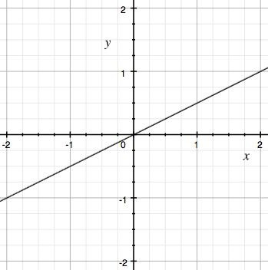
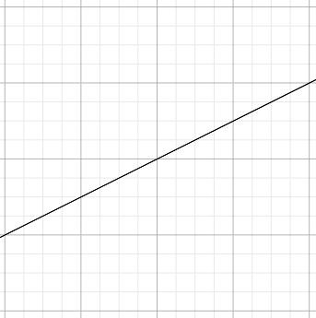

Regression Line
Standard Units
Original Units
(Average x, Average y)
(0, 0)
r
r * SD y
1
SD x
Notes:
In SU, SD of y = 1, so, the vertical connector at x=1, is r*SD y = r*1 = r
In regression, we use the value of one variable (which we will call xx) to predict the value of another (which we will call yy).
When the variables xx and yy are measured in standard units, the regression line for predicting yy based on xx has slope rr and passes through the origin.
In original units then, vertical change = r*SD y, which is not necessarily equal to 1

Slide 28
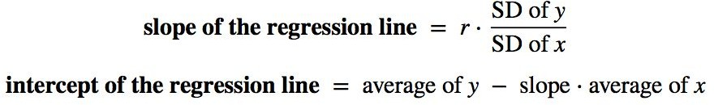
Slope and Intercept
estimate of y = slope * x + intercept
(Demo – Notebook 9.2,
Linear regression: defining the line)
Notes:
Slope is computed as change y/ change x = ((average_y + r*sd_y)– average_y)/ ((average_x + sd_x) – average_x) = r*sd_y/sd_x
Intercept is computed as y – slope * x, point of intersection with y axis is (average_x, average_y), hence, values for x and y are average_x, and average_y repectively

Slide 29
Discussion Question
Suppose we use linear regression to predict candy prices (in dollars) from sugar content (in grams). What are the units of each of the following?
r
The slope
The intercept
Notes:
R – no units
Slope – dollars per gram
In general, the slope of the regression line can be interpreted as the average increase in yy per unit increase in xx. Note that if the slope is negative, then for every unit increase in xx, the average of yy decreases.
Intercept – dollars (dollars – dollars/gram * gram) = dollars – dollars = dollars

Slide 30
Discussion Question
A course has a midterm (average 70; standard deviation 10) and a really hard final (average 50; standard deviation 12)
If the scatter diagram comparing midterm & final scores for students has an oval shape with correlation 0.75, then...
What do you expect the average final score would be for students who scored 90 on the midterm?
How about 60 on the midterm?
Notes:
estimate of child's height = 0.64⋅midparent height + 22.64. This is also known as the regression equation. The principal use of the regression equation is to predict yy based on xx.
What is x? -- midterm
What is y? -- final
Slope = r*(sd_y/sd_x) = 0.75*(12/10) = 0.9
Intercept = average_y – slope*average_x = 50 – (0.9*70) = 50 – 63 = -13
Student got a 90 in midterm, estimated_final_score = slope * x + intercept = 0.9 * 90 +-13 = 81 – 13 = 68
Student got a 60 in midterm, estimated_final_score = slope * x + intercept = 0.9 * 60 +-13 = 54 – 13 = 41

Slide 31
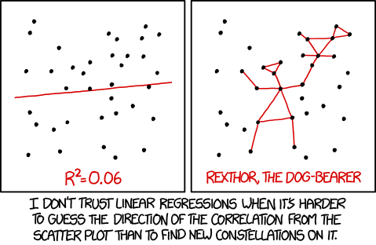
Source: xkcd.com/1725
Notes:
Linear regression is

Slide 32
Linear Regression Recap

Slide 33
Prediction TAsk
Goal: Predict y using x
Examples:
Predict # hospital beds available using air pollution
Predict house prices using house size
Predict # app users using # app downloads

Slide 34
Regression Estimate
Goal: Predict y using x
To find the regression estimate of y:
Convert the given x to standard units
Multiply by r
That’s the regression estimate of y, but:
It’s in standard units
So convert it back to the original units of y

Slide 35
Regression Line Equation
In original units, the regression line has this equation:
estimated y in standard units x in standard units
Lines can be expressed by slope & intercept

Slide 36
Regression Line Equation
In original units, the regression line has this equation:
what we want what we observe
Lines can be expressed by slope & intercept

Slide 37
Least Squares

Slide 38
Discussion Question
USA Congressional Districts, 2016
Based only on the graph, which must be true? Explain.
Going to college causes people to get higher incomes.
For any district, having more college-educated people live there causes median incomes to rise.
For any district, having a higher median income causes more college-educated people to move there.

Slide 39
Error in Estimation
error = actual value − estimate
Typically, some errors are positive and some negative
To measure the rough size of the errors
square the errors to eliminate cancellation
take the mean of the squared errors
take the square root to fix the units
root mean square error (rmse)
(Demo – Notebook 9.3, Regression line vs other lines)
Notes:
Corresponding to each point on the scatter plot, there is an error of prediction calculated as the actual value minus the predicted value. It is the vertical distance between the point and the line, with a negative sign if the point is below the line.
What we need is one overall measure of the rough size of the errors. As we did before, we will eliminate the +s, and –s by squaring the values, then taking the square root to get back to the original units
The errors change depending on the line of estimation used.

Slide 40
Least Squares Line
Minimizes the root mean squared error (rmse) among all lines
Equivalently, minimizes the mean squared error (mse) among all lines
Names:
“Best fit” line
Least squares line
Regression line
(Demo – Notebook 9.3, Root Mean Square Error)
Notes:
Our observations so far can be summarized as follows.
To get estimates of yy based on xx, you can use any line you want.
Every line has a root mean squared error of estimation.
"Better" lines have smaller errors.
Is there a "best" line? That is, is there a line that minimizes the root mean squared error among all lines? Yes, the least square line, AKA, the regression line
By a remarkable fact of mathematics, no other line can beat the low error rate of the regression line.
The regression line is the unique straight line that minimizes the mean squared error of estimation among all straight lines.

Slide 41
Numerical Optimization
Numerical minimization is approximate but effective
Lots of machine learning uses numerical minimization
If the function mse(a, b) returns the mse of estimation using the line “estimate = ax + b”,
then minimize(mse) returns array [a₀, b₀]
a₀ is the slope and b₀ the intercept of the line that minimizes the mse among lines with arbitrary slope a and arbitrary intercept b (that is, among all lines)
(Demo – Notebook 9.3, Numerical Optimization & Minimizing RMSE)
Notes:
First note that a line that minimizes the root mean squared error is also a line that minimizes the squared error.
The square root makes no difference to the minimization.
So we will save ourselves a step of computation and just minimize the mean squared error (mse).
If we use the line prediction = ax+b will have an mse that depends on the slope aa and the intercept bb.
The function lw_mse takes the slope and intercept as its arguments and returns the corresponding mse.
If we experiment with different values, we can find a low-error slope and intercept through trial and error, but that would take a while.
Fortunately, there is a Python function that does all the trial and error for us.
The minimize function can be used to find the arguments of a function for which the function returns its minimum value.
Python uses a similar trial-and-error approach, following the changes that lead to incrementally lower output values.

Slide 42
Errors and Residuals
Notes:
Start by reviewing minimize. Use the demo in notebook 9.3, Non-linear regression for the review

Slide 43
Source: xkcd.com/1725
Notes:
How do we know when we have a good fit for the data? How do we know if the regression line fits the data well?
We run diagnostics

Slide 44
Residuals
Error in regression estimate
One residual corresponding to each point (x, y)
residual
= observed y - regression estimate of y
= observed y - height of regression line at x
= vertical distance between the point and the best line
In other words:
observed y = regression estimate + residual
(Demo – Notebook 9.4, Residuals)
Notes:
Suppose a data scientist has decided to use linear regression to estimate values of a response variable (y) based on a predictor (x).
To see how well this method of estimation performs, the data scientist must examine how far off the estimates are from the actual values.
These differences are called residuals.
In the last demo, we asked whether the quadratic predictor was “better” than the linear one.
Computing and visualizing residuals is one way we can use to answer this

Slide 45
Regression Diagnostics

Slide 46
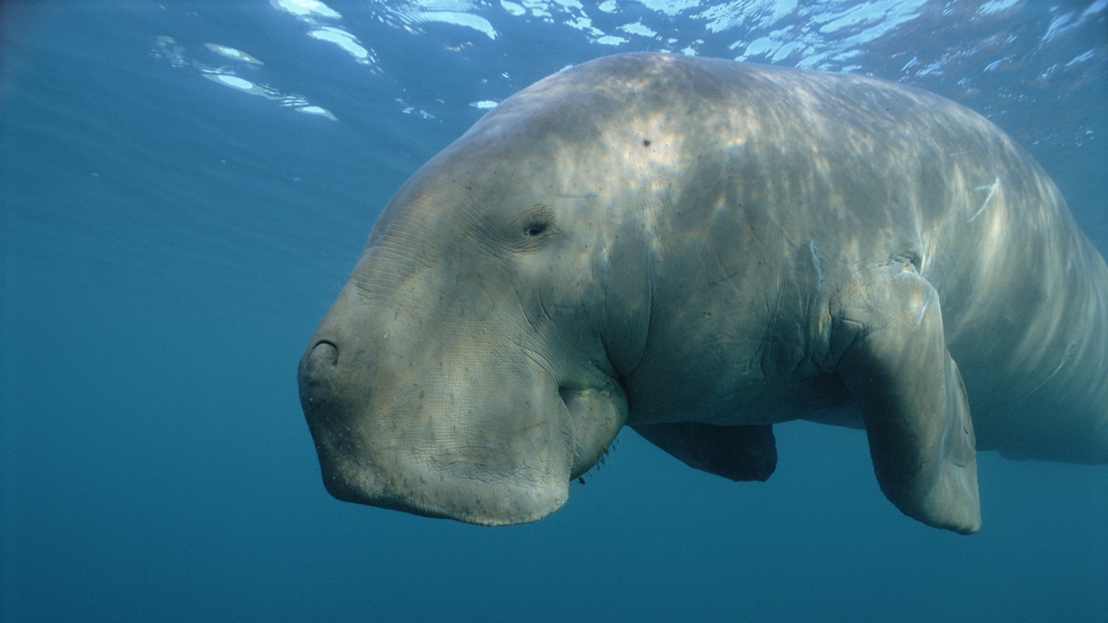
Example: Dugongs
Image Source: National Geographic
(Demo – Notebook 9.4 - Dugongs)

Slide 47
Residual Plot
A scatter diagram of residuals
Should look like an unassociated blob for linear relations
But will show patterns for non-linear relations
Used to check whether linear regression is appropriate
Look for curves, trends, changes in spread, outliers, or any other patterns

Slide 48
Properties of residuals
Residuals from a linear regression always have
Zero mean
(so rmse = SD of residuals)
Zero correlation with x (i.e., the predictor variable)
Zero correlation with the fitted values (i.e., the estimates of the response variable)
These are all true no matter what the data look like
Just like deviations from mean are zero on average
(Demo – Notebook 9.4, Average of Residuals & Residual Plots Show No Trend)
Notes:
We have so far seen how to visually “diagnose” the regression line.
Now, let’s look at how to numerically do so. While we will not proof mathematically these properties, we will compute them in our datasets to convince ourselves that they are true

Slide 49
Discussion Questions
How would we adjust our regression line…
if the average residual were 10?
if the residuals were positively correlated with x?
if the residuals were above 0 in the middle and below 0 on the left and right?

Slide 50
A Measure of Clustering

Slide 51
Correlation, Revisited
“The correlation coefficient measures how clustered the points are about a straight line.”
We can now quantify this statement.
(Demo – Notebook 9.4,
Correlation as a Measure of Clustering)

Slide 52
SD of Fitted Values
SD of fitted values
= |r|
SD of y
SD of fitted values =
|r| * (SD of y)
Notes:
Again, we will not mathematically proof this, however, we will compute it for our datasets and see that it’s true
The proof is outside the scope of this class, but encourage you to take a statistics class if this is something you find interesting and would want to pursue further

Slide 53
Variance of Fitted Values
Variance = Square of the SD
= Mean Square of the Deviations
Variance has weird units, but good math properties
Variance of fitted values
= r² Variance of y

Slide 54
A Variance Decomposition
By definition,
y = fitted values + residuals
Tempting (but wrong) to think that:
SD(y) = SD(fitted values) + SD(residuals)
But it is true that:
Var(y) = Var(fitted values) + Var(residuals)
(a result of the Pythagorean theorem!)

Slide 55
A Variance Decomposition
Var(y) = Var(fitted values) + Var(residuals)
Variance of fitted values
= r²
Variance of y
Variance of residuals
= 1 - r²
Variance of y
Notes:
Show how to obtain the second equation
The first eqn can be rewritten as : (var(y)-var(fitted values)/var(y) = var(y)/var(y) – var(fitted values)/var(y) = 1 – r^2

Slide 56
Residual Average and SD
The average of residuals is always 0
Variance of residuals
= 1 - r² Variance of y
= √(1-r²) SD of y
SD of residuals
(Demo – Notebook 9.4, SD of the Residuals)
Notes:
Take square root of both sides, then move SD of y to the right to get the second eqn

Slide 57
Residual Average and SD
The average of residuals is always 0
SD of residuals | = | √(1 - r²) * SD of y
SD of predictions | = | |r| * SD of y (Demo – Notebook 9.4, SD of the Residuals)
Notes:
Second eqn derived from the eqn in slide 55.
Var(predictions, AKA, fitted_values)/var(y) = r^2
Taking sqrt on both sides provides SD(predictions)/SD(y) = |r|
Hence, SD(predictions) = |r| * SD(y)

Slide 58
Discussion Question 1
Midterm: Average 70, SD 10
Final:
Average 60, SD 15
r = 0.6
Fill in the blank:
The SD of the residuals is .

Slide 59
Discussion Question 2
Midterm: Average 70, SD 10
Final:
Average 60, SD 15
r = 0.6
Fill in the blank:
For at least 75% of the students, the regression estimate of final score based on midterm score will be correct to within
points.

Slide 60
Regression Model

Slide 61
A “Model”: Signal + Noise
Distance drawn at random from distribution with mean 0
Another distance drawn independently from the same distribution
Notes:
Models based on the regression line say that the underlying relation between two variables is perfectly linear;
this straight line is the signal that we would like to identify.
However, we are not able to see the line clearly.
What we see are points that are scattered around the line.
the regression model specifies that the points in the scatter plot are generated at random as follows.
The relation between xx and yy is perfectly linear. We cannot see this "true line" but it exists.
The scatter plot is created by taking points on the line and pushing them off the line vertically, either above or below, as follows:
For each xx, find the corresponding point on the true line (that's the signal), and then generate the noise or error.
The errors are drawn at random with replacement from a population of errors that has a normal distribution with mean 0.
Create a point whose horizontal coordinate is xx and whose vertical coordinate is "the height of the true line at xx, plus the error".
Finally, erase the true line from the scatter, and display just the points created.

Slide 62
What We Get to See
(Demo – Notebook 9.5, Regression model)
Notes:
the regression model specifies that the points in the scatter plot are generated at random as follows.
The relation between xx and yy is perfectly linear. We cannot see this "true line" but it exists.
The scatter plot is created by taking points on the line and pushing them off the line vertically, either above or below, as follows:
For each xx, find the corresponding point on the true line (that's the signal), and then generate the noise or error.
The errors are drawn at random with replacement from a population of errors that has a normal distribution with mean 0.
Create a point whose horizontal coordinate is xx and whose vertical coordinate is "the height of the true line at xx, plus the error".
Finally, erase the true line from the scatter, and display just the points created.
Based on this scatter plot, how should we estimate the true line?
The best line that we can put through a scatter plot is the regression line.
So the regression line is a natural estimate of the true line.

Slide 63
Prediction Variability

Slide 64
Regression Prediction
If the data come from the regression model,
and if the sample is large, then:
The regression line is close to the true line
Given a new value of x, predict y by finding the point on the regression line at that x
(Demo – Notebook (9.5,
Prediction)
Notes:
One of the primary uses of regression is to make predictions for a new individual who was not part of our original sample but is similar to the sampled individuals.
In the language of the model, we want to estimate y for a new value of xx.
Our estimate is the height of the true line at x.
Of course, we don't know the true line.
What we have as a substitute is the regression line through our sample of points.
The fitted value at a given value of x is the regression estimate of y based on that value of x.
In other words, the fitted value at a given value of x is the height of the regression line at that x.

Slide 65
Confidence Interval for Prediction
Bootstrap the scatter plot
Get a prediction for y using the regression line that goes through the resampled plot
Repeat the two steps above many times
Draw the empirical histogram of all the predictions.
Get the “middle 95%” interval.
That’s an approximate 95% confidence interval for the height of the true line at y.
(Demo – Notebook 9.5, Prediction variability and Bootstrapping & Confidence Interval for prediction)

Slide 66
Predictions at Different Values of
x
Since y is correlated with x, the predicted values of y
depend on the value of x.
The width of the prediction’s CI also depends on x.
Typically, intervals are wider for values of x that are further away from the mean of x.
(Demo – Notebook 9.5,
Prediction at Different Values of x)

Slide 67
The True Slope

Slide 68
Confidence Interval for True Slope
Bootstrap the scatter plot.
Find the slope of the regression line through the bootstrapped plot.
Repeat.
Draw the empirical histogram of all the generated slopes.
Get the “middle 95%” interval.
That’s an approximate 95% confidence interval for the slope of the true line.
(Demo – Notebook 9.5,
Inference for the slope)
Notes:
Is our regression line/i.e., model, a good fit for the data?
We make certain assumptions when we use a linear regression for inference. Before doing that, it’s worth checking is our model is a good estimator of the true line?
Our simulations showed that if the regression model holds and the sample size is large, then the regression line is likely to be close to the true line.
This allows us to estimate the slope of the true line.
We’ll repeat the process we followed for obtaining the CI of a prediction

Slide 69


Rain on the Regression Parade
We observed a slope based on our sample of points.
But what if the sample scatter plot got its slope just by chance?
What if the true line is actually FLAT?
(Demo – Notebook 9.5, Rain on the Regression Parade)
Notes:
Suppose we believe that our data follow the regression model, and we fit the regression line to estimate the true line.
If the regression line isn't perfectly flat, as is almost invariably the case, we will be observing some linear association in the scatter plot.
But what if that observation is spurious? In other words, what if the true line was flat – that is, there was no linear relation between the two variables – and the association that we observed was just due to randomness in generating the points that form our sample?
In the demo, we will go through a simulation that illustrates why this question arises.
We will call the function draw_and_compare,
this time requiring the true line to have slope 0.
Our goal is to see whether our regression line shows a slope that is not 0.

Slide 70
Test Whether There Really is a Slope
Null hypothesis: The slope of the true line is 0.
Alternative hypothesis: No, it’s not.
Method:
Construct a bootstrap confidence interval for the true slope.
If the interval doesn’t contain 0, the data are more consistent with the alternative
If the interval does contain 0, the data are more consistent with the null
(Demo – Notebook 9.5,
Testing whether the slope is real, i.e., slope is not zero)
Notes:
To decide whether or not the slope that we are seeing is real, we would like to test the following hypotheses:
Null Hypothesis. The slope of the true line is 0.
Alternative Hypothesis. The slope of the true line is not 0.
We are well positioned to do this. Since we can construct a 95% confidence interval for the true slope, all we have to do is see whether the interval contains 0.
If it doesn't, then we can reject the null hypothesis (with the 5% cutoff for the P-value).
If the confidence interval for the true slope does contain 0, then we don't have enough evidence to reject the null hypothesis. Perhaps the slope that we are seeing is spurious.

Slide 71
Advanced Regression

Slide 72
Advanced Regression
minimize() works no matter what*!
Define a function that computes the prediction you want, then the error you want, for example:
Nonlinear functions of x
Multiple columns of the table for x
Other kinds of error instead of RMSE
Nonlinear functions can get complicated, fast!
(Demo – 9.6)

Slide 73
Prediction
Notes:
Add stuff on multiple regression before this slide
Move to slides for module 10

Slide 74
Guessing the Value of an Attribute
Based on incomplete information
One way of making predictions:
To predict an outcome for an individual,
find others who are like that individual
and whose outcomes you know.
Use those outcomes as the basis of your prediction.
Two Types of Prediction
Classification = Categorical; Regression = Numeric

Slide 75
Prediction Example: Spam or Not?

Slide 76
Machine Learning Algorithm
A mathematical model
calculated based on sample data ("training data")
that makes predictions or decisions without being explicitly programmed to perform the task

Slide 77
Classification

Slide 78

Classification Examples

Slide 79


Classification Examples

Slide 80
Questions?

