Slide 1
Assignment (Part 1):
Deploy 2-tier web application
Using EC2 and RDS database

Slide 2






Architecture & High level steps
High level steps
Route53 Public Hosted Zone
1
Using VPC wizard, create a new VPC, an internet gateway, 2 Public Subnets, 2 Private subnets and corresponding route tables.
EC2 Public IP
Internet
AWS Mumbai Region
Region
2
Launch an EC2 instance in the Public subnet and connect over SSH.
VPC
10.10.0.0/16
Availability Zone
Availability Zone
3
Create MySQL RDS database in the Private subnet
Public subnet
Public subnet
Destination
Target
10.10.0.0/16
Local
0.0.0.0/0
igw-xxxxxx
4
Install a web server on EC2 and configure the web application to connect to RDS database. [sample code provided in the github repo]
Web Server
10.10.0.0/24
10.10.1.0/24
Private subnet
Private subnet
Destination
Target
5
Access web application using EC2 Public IP. Add data from the application screen and verify that data is stored into the backend MySQL database.
10.10.0.0/16
Local
10.10.11.0/24
10.10.12.0/24

Slide 3
Step 1 – Create VPC, Subnets & Route tables
Go to VPC console -> Your VPCs -> Create VPC
  VPC Settings -> select VPC & more
  Name Tag: webapp
  IPv4 CIDR: 10.10.0.0/16
  Number of Availability Zones (AZs): 2
  Number of Public Subnets: 2
  Number of Private Subnets: 2
  Customize subnets CIDR blocks
    Public subnet CIDR in Availability Zone 1: 10.10.0.0/24
    Public subnet CIDR in Availability Zone 2: 10.10.1.0/24
    Private subnet CIDR in Availability Zone 1: 10.10.11.0/24
    Private subnet CIDR in Availability Zone 2: 10.10.12.0/24
  NAT Gateways: None
  VPC Endpoints: None
  Create VPC

Slide 4
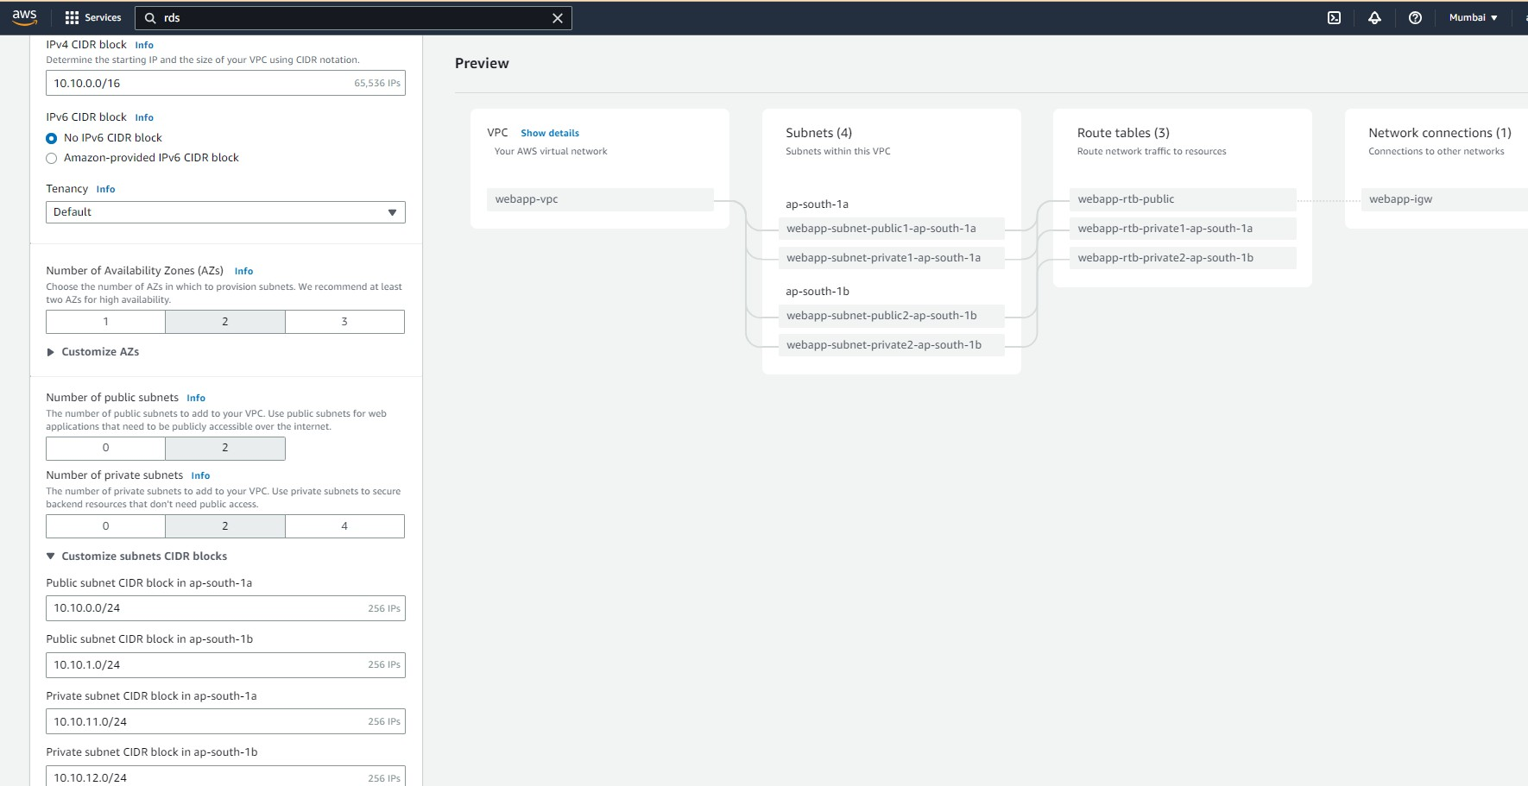
Step 1 – Create VPC, Subnets & Route tables

Slide 5
Step 2 - Launch an EC2 instance and connect
Launch EC2 instance in newly created Public Subnet
  Go to EC2 Service -> EC2 Dashboard -> Launch Instances
  Name: Webserver
  Select AMI: Amazon Linux (default) [by default it should select Amazon Linux 2023 AMI – Free tier eligible]
  Select instance type: t2.micro (default)
  Select key pair : <key-pair that you had created earlier>
    If you don’t see the key-pair in the dropdown then check if you are using the correct AWS region in which you had
previously created key-pair.
    If you still don’t see key-pair, then cancel the ec2 creation flow and first create a new key-pair as described in the
prerequisites section
  Network settings -> Edit -> Select your VPC (webapp-vpc) and you’re a public subnet in availability zone a
  Auto-Assign Public IP: Enable
  Firewall -> Create security group
    Name: webapp-ec2-sg
    Add Inbound Security group rule: SSH (port 22) for source CIDR 0.0.0.0/0
    Add Inbound Security group rule: HTTP (port 80) for source CIDR 0.0.0.0/0
  Configure Storage -> 1 x 8GiB, gp3 (default)
  Launch Instance
  Go to instances page -> Select the instance you just launched -> see the Details -> Copy Public IPv4 address

Slide 6
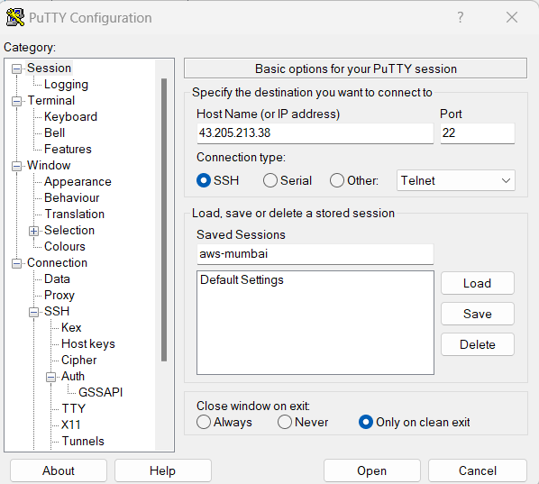
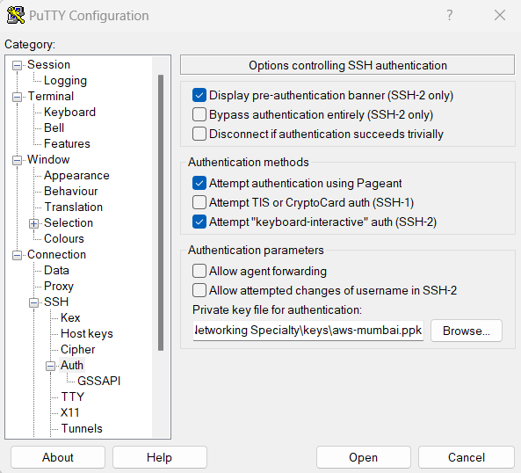
Step 2 - Launch an EC2 instance and connect
Connect to EC2 instance with
Public IP from your workstation
If using Windows workstation:
  Open PuTTy -> In the “Host name”
provide the Public IP of EC2 instance
  Left panel -> SSH -> Auth -> Browse
and select your ssh .pem key file
  Open -> Accept
  Provide username as ec2-user
If using Linux/Mac workstation
Open Terminal and run following
command with correct path for the
.pem key file
$ssh -i <path/to/key.pem> ec2-
user@<ec2-public-ip-address>

Slide 7
Step 3 - Create a RDS database
Go to RDS console
Create DB Subnet group
  Select Subnet Groups from the left panel -> Create DB subnet group
  Name: webapp-db-subnet-group, Description: DB Subnet group
  VPC: select webapp-vpc
  Add Subnets: Availability Zones: Select a and b
  Subnets: Select 10.10.11.0/24 for AZ a and 10.10.12.0/24 for AZ b
  Create
Go to Databases -> Create Database
  Select Standard Create
  Engine Options: Select MySQL
  Templates: Select Free tier
  DB cluster identifier: webapp-db
  Credential Settings -> Master Username: admin, Master password: <password of your choice>, Confirm master password
  Connectivity
    Virtual Private Cloud (VPC): Select webapp-vpc,
    DB Subnet group: Select webapp-db-subnet-group
    Public access: No
    VPC security group (firewall) -> Create new -> Name: webapp-db-security-group
    Database authentication: Password authentication
f.
Additional configuration -> Initial database name: corp
g. Create database & wait for database to be fully created

Slide 8
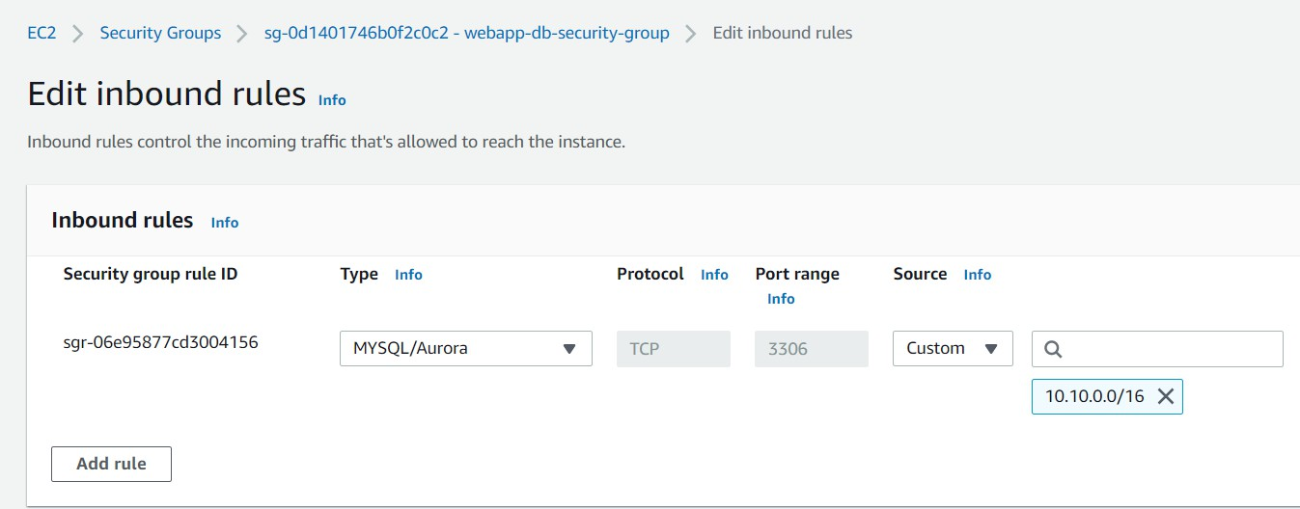
Step 3 - Create a RDS database
Update DB security group to allow inbound traffic from VPC CIDR
  Select the database you just created -> Connectivity & Security -> Click on VPC Security groups link (this should open
EC2 console with DB security group selected)
  Select inbound rules -> Edit inbound rules -> Update the source to 10.10.0.0/16

Slide 9
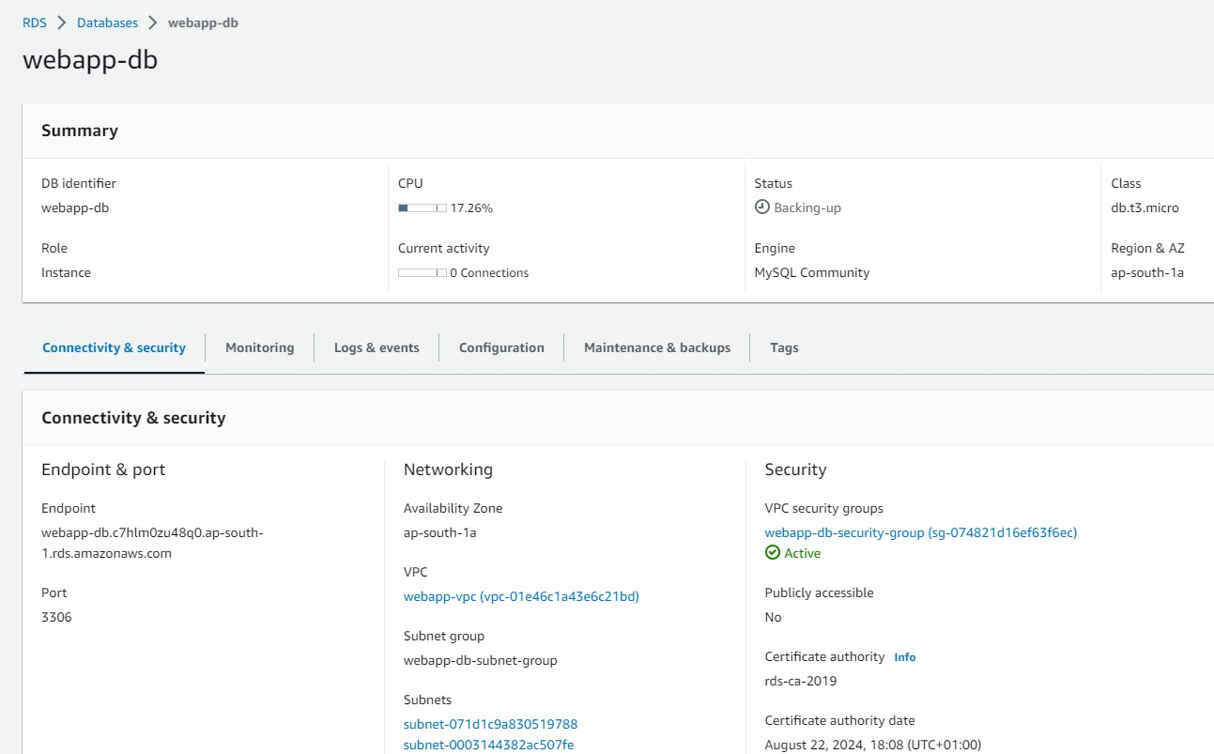
Step 3 - Create a RDS database
DB instance endpoint

Slide 10
Step 4 - Install and configure webapp on EC2
Connect EC2 instance over the SSH using EC2 Public IP
Install Apache web server and PHP packages
$sudo su
$dnf update -y
$dnf install -y httpd php php-mysqli mariadb105
$systemctl start httpd
$systemctl enable httpd
3. Configure DB connection settings
$cd /var/www
$mkdir inc
$cd inc
Create a new file called dbinfo.inc [using your favourite editor like vi or nano] and add following content. Replace the values for the parameters based on your environment
<?php
define('DB_SERVER', 'db_instance_endpoint'); define('DB_USERNAME', 'admin'); define('DB_PASSWORD', 'master password'); define('DB_DATABASE', 'corp');
?>

Slide 11
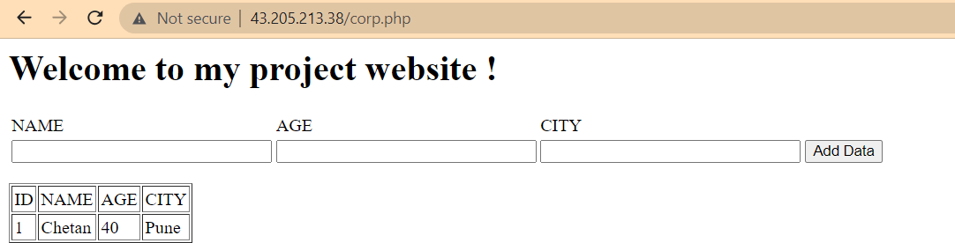
Step 4 - Install and configure webapp on EC2
Create application file corp.php in /var/www/html directory.
  You can use the corp.php file from github repo:
Open your browser and hit the URL http://PUBLICIP/corp.php
Add few sample entries from the form on the webpage

Slide 12
Step 5 – Verify data in the database
1. Install mqsql client in the ec2 instance
# install pip (Amazon Linux 2023 does not have one by default)
$dnf install -y pip
# install dependencies
$dnf install -y mariadb105-devel gcc python3-devel
# install mysqlclient
$pip install mysqlclient
2. Connect to Database and query the data
$mysql -h <database endpoint> -u admin –p
$MySQL [(none)]> connect corp
$MySQL [corp]> select * from EMPLOYEES;
3. Add more data from the web page and see if changes reflect. Optionally insert the data into the database table directly and see if webpage displays the data.
MySQL [corp]> insert into EMPLOYEES values ('2','Pankaj','35','Mumbai'); Query OK, 1 row affected (0.003 sec)

Slide 13
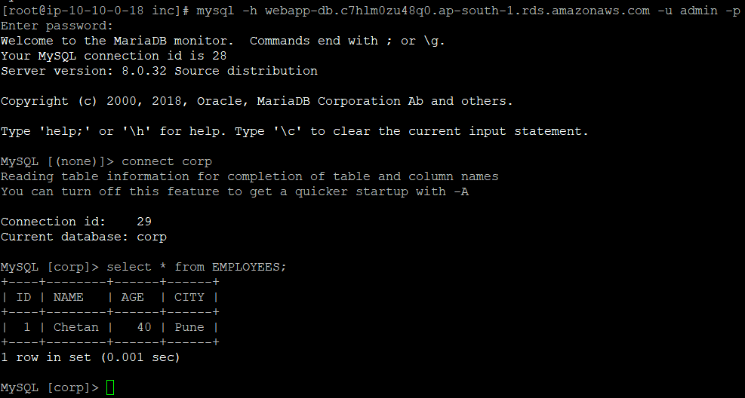
Step 5 – Verify the data into the database

Slide 14
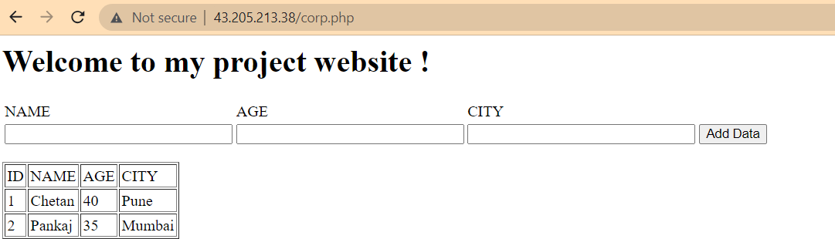
Step 5 – Verify the data from the web page
Congratulations !! You have completed part 1 of the assignment successfully.

Slide 15
Step 6 – Setup Public DNS
Setup the public DNS for your web application
  Assuming you have already got the Public domain name and you have created Route53 Public hosted zone as described
in the pre-requisites section. You can’t proceed with following steps if you haven’t done those steps.
  Go to Route 53 console -> Hosted Zones -> click your domain name
  Create record
    Record name: leave blank
    Record type: A – Routes traffic to an IPv4 address and some AWS resources
    Value: enter the value of Public IP of EC2 instance
    Create records
Verify DNS
  Open browser and access your webapp using http://YOUR_DOMAIN_NAME/corp.php

