Slide 1
GROUP PROJECT · STEP 1 · QUALITY CONTROL
Study B — Group B1 overall QC
Five checks, re-run live on the data by the group's combined document
93
220
14,226
15
6
samples, one visit each
species
genes
cytokine markers
analyst reports merged
Every number in this deck was computed from data/2-workshop2/group_b_contraception — not quoted from any report.
The five workshop checks: sample IDs · library sizes in both count tables · missing metadata · rnaseq_batch × arm · baseline balance.

Slide 2
EXECUTIVE SUMMARY
The five checks — results at a glance
1
Sample IDs match across all tables
PASS
Same IDs in the same ORDER, all four tables (metadata · species · genes · cytokines)
2
Library sizes in both count tables
PASS
Species: 5,247–77,353 (median 29,212) · Genes: 5.86M–24.0M (median 12.86M) — both depth-checked
2b
Which samples have very few reads?
ONE FLAG
B006 at 5,247 reads (18% of median); low tail B083, B065; gene table clean
3
Missing metadata
PASS
0 NA in all 8 columns × 93 rows — but B018 & B029 miss all 15 cytokines
4
rnaseq_batch × arm
BALANCED
51.3% / 50.0% / 50.0% in B1 — but B1 ran deeper (13.7M vs 12.0M): keep batch in the design
5
Arms differed at baseline?
DIRECTIONAL
BV+ 19/39 vs 10/28 and 10/26; Fisher p = 0.454 — not significant, still adjust for bv/pH
Study B · Group B1 overall QC · group_b_contraception
Study B · Group B1 overall QC · group_b_contraception
02
02

Slide 3
CHECK 1 OF 5
Do sample IDs match across all the tables?
PASS
Why it matters: DESeq2 pairs count-matrix columns with metadata rows by position only — a mismatch fails silently.
The test that was run
What the six reports did
setequal() — same set of IDs in every table → TRUE
identical() — same ORDER in species, genes, cytokines vs metadata → TRUE ×3
Coverage: all four tables, including the cytokine file — the one the helper does not auto-check, and the one two analyst reports skipped.
Munya — stopifnot(identical(...)) — hard stop, all 3 tables
Priv — setequal + hand-check of cytokines
Samwl — set AND order across all four tables
Sam / Anthony — all.equal() on species + genes only
Fathy — no explicit check shown — helper trusted
PASS
Same IDs, same order, all four tables. Adopt the hard-stop pattern (Munya's stopifnot) in every analysis script.
Study B · Group B1 overall QC · group_b_contraception
Study B · Group B1 overall QC · group_b_contraception
03
03

Slide 4
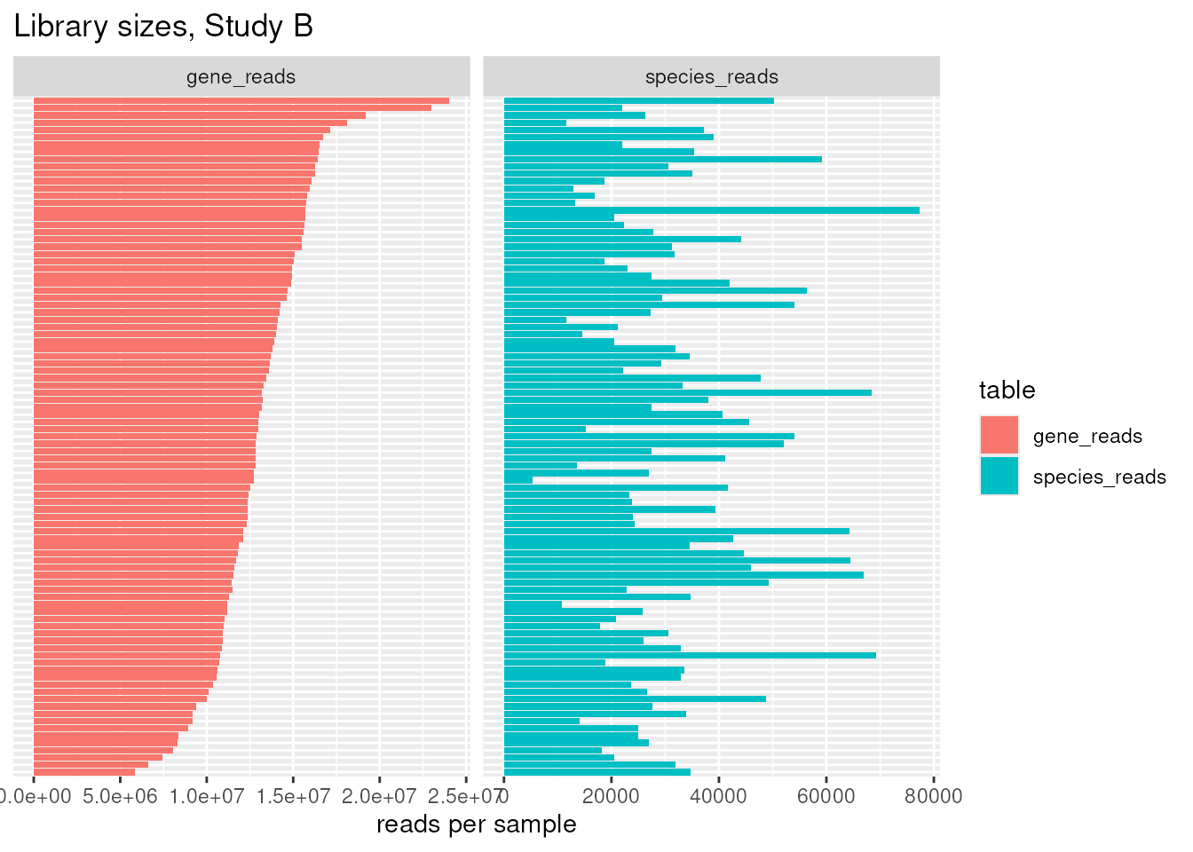
CHECK 2 OF 5
Library sizes in BOTH count tables
PASS
Count table | Min | Median | Mean | Max
Species (microbiome) | 5,247 | 29,212 | 32,365 | 77,353
Genes (RNA-seq) | 5.86M | 12.86M | 13.11M | 24.03M
Who actually checked both?
Both tables: Samwl
Species only: Priv, Fathy
Plots but unnamed samples: Munya
Numbers only: Sam, Anthony
The combined document re-ran the check on both tables and names every low-read sample — the gap all six reports left open.
Flag rules applied: <10,000 reads (species) and <1,000,000 (genes) — the rules both Quarto reports used.
Result: one flagged sample, B006 — see next slide. Gene table clean: min is ~6× the threshold.
Reading the plot: every one of 93 samples per table, sorted. The gene panel's spread is moderate (min = 45% of median) — DESeq2's size factors absorb it.
Study B · Group B1 overall QC · group_b_contraception
Study B · Group B1 overall QC · group_b_contraception
04
04

Slide 5
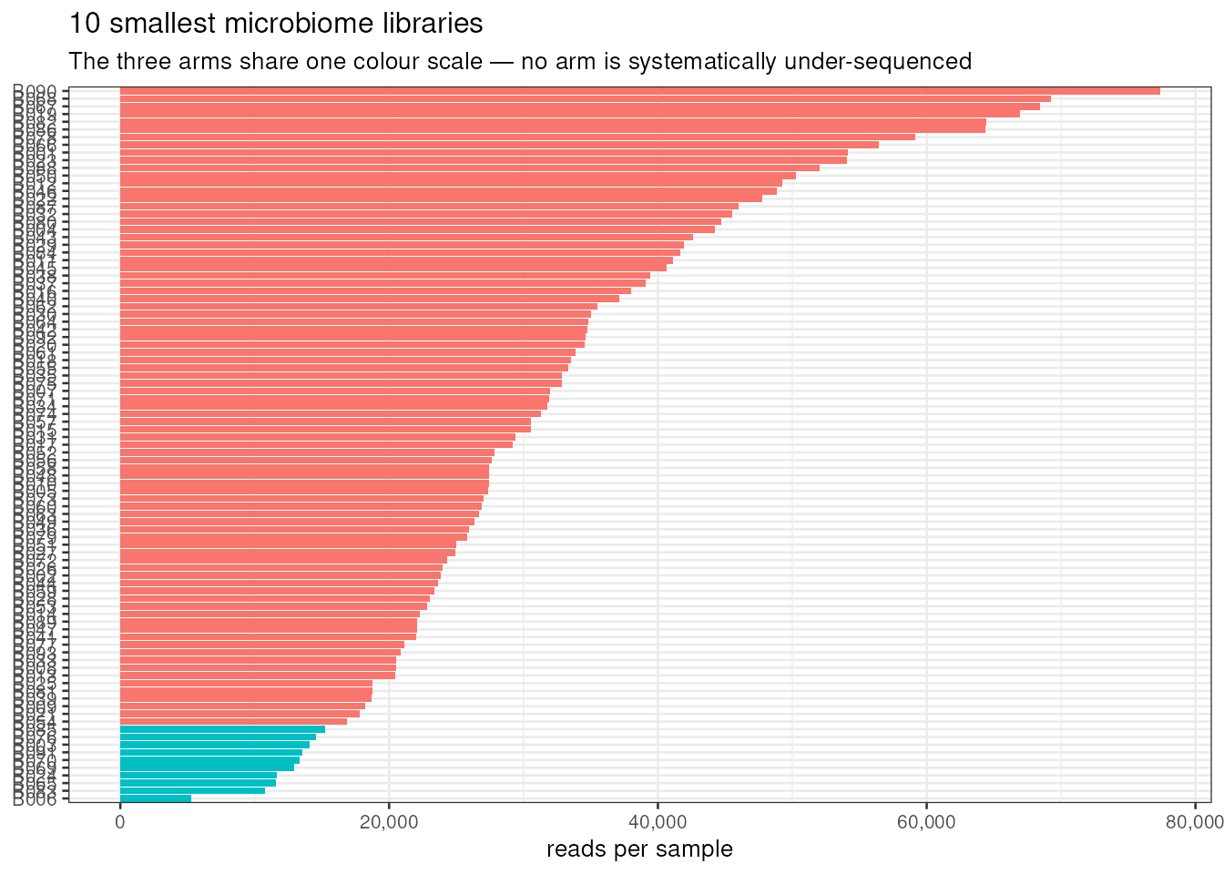
CHECK 2 OF 5 — THE DETAIL
Which samples have very few reads?
1 FLAG
Sample | Reads | vs median | Verdict
B006 | 5,247 | 18% of median | clean outlier — the flag
B083 | 10,756 | 37% of median | low tail, not a gap
B065 | 11,570 | 40% of median | low tail, not a gap
Gene table: lowest is B042 at 5.86M — still 45% of the median (then B071 6.64M, B008 7.45M). No failure-scale outlier; nothing flagged under 1M.
Why one small library matters: percentages from a 5,247-read sample are noisy and can pretend to be biology. Priv's ordination shows B006 inside the cloud — keep, sensitivity-check later.
Two drop rules compared: 10%-of-median cut (2,921) drops NOTHING; visual-gap rule drops B006 only. B006 stays either way — the rule choice is a recorded open question (Sam).
Study B · Group B1 overall QC · group_b_contraception
Study B · Group B1 overall QC · group_b_contraception
05
05

Slide 6
CHECK 3 OF 5
Missing metadata — and the cytokine gap
PASS
Metadata: 0 missing, 93 × 8
The 4th table almost slipped through
All eight columns complete: sample_id, participant_id, arm, bv, nugent, ph, any_sti, rnaseq_batch.
Six reports, one habit: only Priv's and Munya's reports actually ran the is.na() sweep. Sam, Anthony, Samwl and Fathy described the metadata without checking it — we got lucky.
B018 and B029: NA for all 15 cytokine markers — an all-or-nothing gap (2.2% of samples), consistent with a failed lab plate.
Every other sample complete; no negative values anywhere (minimum 0.005).
Decision owed: drop them from cytokine analyses only — open question 7.
Bonus check run live: does the metadata contradict itself?
bv ↔ Nugent cross-tab: 51/51 negative in Nugent 0–3 · 3/3 intermediate in 4–6 · 39/39 positive in 7–10. The two clinical columns never disagree (checked by Priv and Munya independently) — no data-entry surprises.
Study B · Group B1 overall QC · group_b_contraception
Study B · Group B1 overall QC · group_b_contraception
06
06

Slide 7
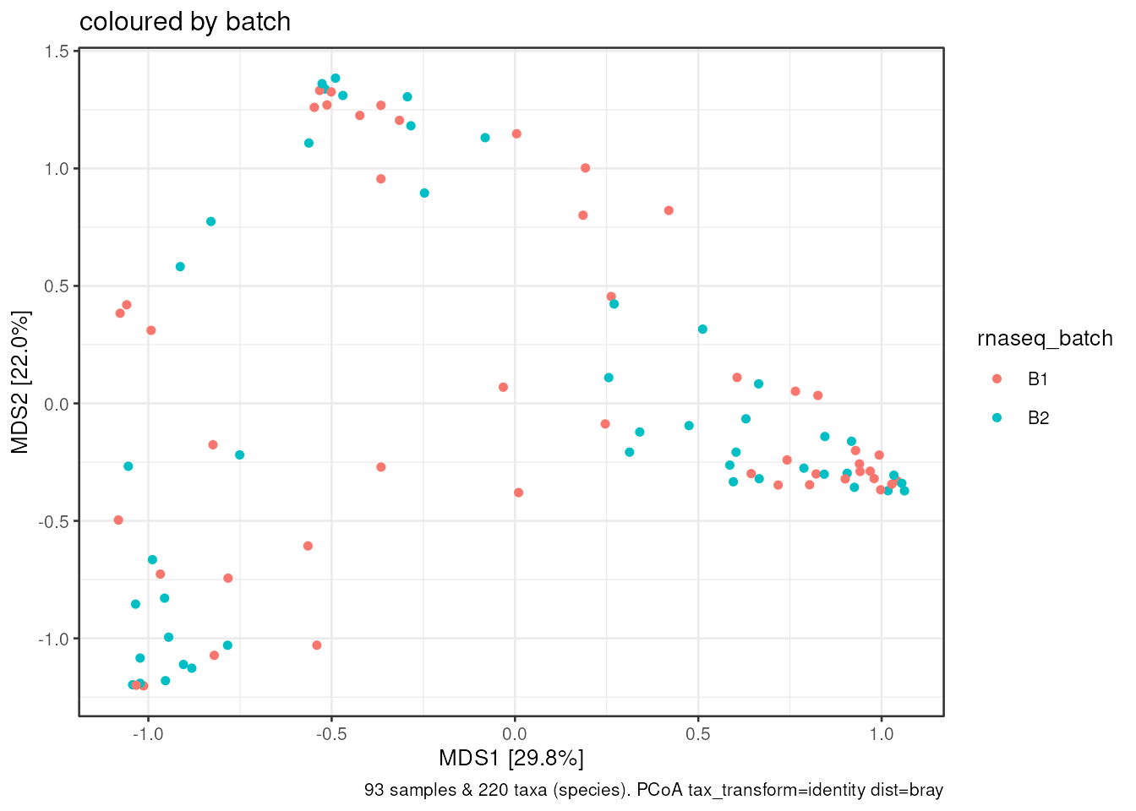
CHECK 4 OF 5
rnaseq_batch × arm — balanced, but not interchangeable
BALANCED
arm | B1 | B2 | % in B1
injectable | 20 | 19 | 51.3%
pill | 14 | 14 | 50.0%
ring | 13 | 13 | 50.0%
The one unanimous check: all six reports produced the same cross-tab. A batch effect cannot masquerade as a method effect by assignment.
But balanced ≠ similar: B1's RNA-seq libraries run deeper — median 13.7M vs 12.0M reads. A depth difference is a batch effect even when the design is balanced.
PCoA coloured by batch: no batch cluster in the ordination — the depth difference does not rearrange the communities. Decision: no batch correction, but rnaseq_batch stays in every DESeq2 design.
Study B · Group B1 overall QC · group_b_contraception
Study B · Group B1 overall QC · group_b_contraception
07
07

Slide 8
CHECK 5 OF 5
Did the arms differ at baseline? Now formally tested
DIRECTIONAL
arm | n | pH | Nugent† | BV+ | STI+
injectable | 39 | 4.86 | 4.6 / 2.0 | 19 | 19
pill | 28 | 4.59 | 3.9 / 2.0 | 10 | 12
ring | 26 | 4.97 | 3.8 / 2.5 | 10 | 17
Sanity check: pH tracks BV
negative
pH 4.4
intermediate
pH 4.7
positive
pH 5.0
† mean / median — medians sit at ~2 in every arm; means are pulled up by the positive arm
Biologically expected — verified.
The study was not randomised. BV leans positive in the injectable arm (19/39 vs 10/28 and 10/26) — the imbalance every report eyeballed.
Now tested: Fisher's exact test on BV × arm gives p = 0.454 — not significant at n = 93. Adjust for bv/pH anyway: it is pre-planned, costs nothing, and may matter at higher power.
Consequence for Step 2: arm contrasts in DESeq2 and per-species tests should carry bv (and pH) as covariates rather than trust the raw arm difference.
Study B · Group B1 overall QC · group_b_contraception
Study B · Group B1 overall QC · group_b_contraception
08
08

Slide 9
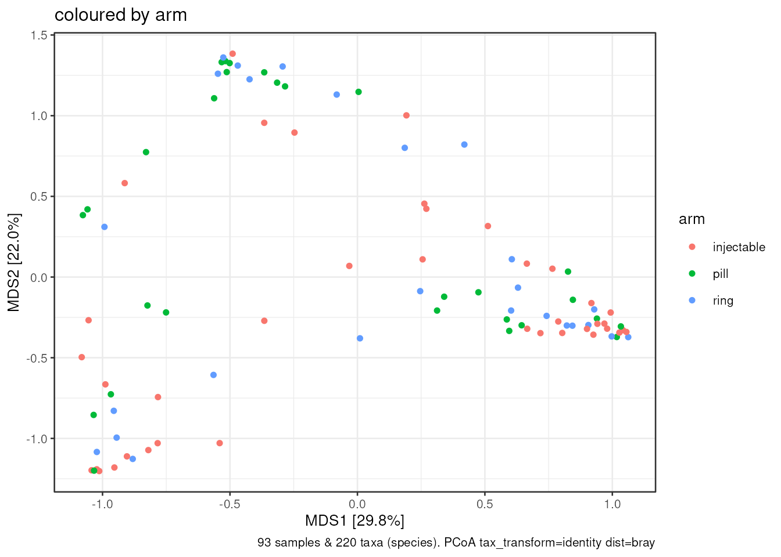
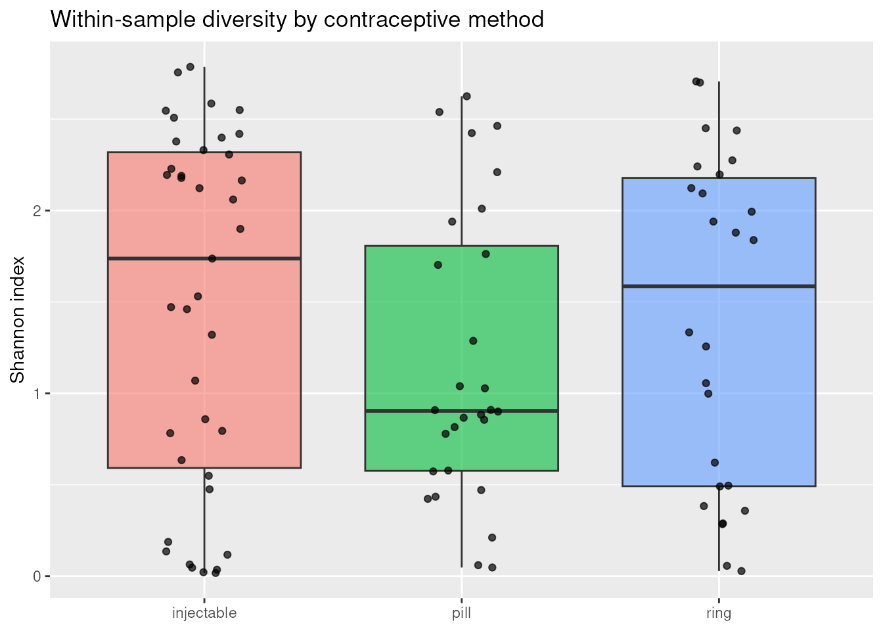
SUPPORTING EVIDENCE
Ordination and diversity — the checks behind the verdict
Bray–Curtis PCoA by arm (Priv, re-run)
Shannon diversity by arm (Samwl, re-run)
Left: arms overlap across the ordination; B006 is not an edge case — evidence for keeping it. Right: medians 1.74 / 0.90 / 1.59 but Kruskal–Wallis p = 0.47 — no significant arm difference.
Study B · Group B1 overall QC · group_b_contraception
Study B · Group B1 overall QC · group_b_contraception
09
09

Slide 10
WHAT REMAINS OPEN
Open questions — owners and status
Species filter: all-zero drop (134) vs ≥10-sample prevalence (62)?
group
OPEN — pick before per-species tests
Low-read rule: 10%-of-median (drops none) vs visual gap (drops B006)?
Sam
OPEN — B006 stays either way
rnaseq_batch in every DESeq2 design?
Anthony
ADOPTED — yes; B1 runs 1.7M reads deeper
B018/B029 dropped from cytokine analyses only?
Anthony · Munya
OPEN — confirm before cytokine models
bv at 3 levels, or merge 'intermediate' (3 people)?
Sam
OPEN — keep 3 levels for now
any_sti as a covariate in arm comparisons?
Sam
OPEN — decided with the baseline model
Formal baseline-balance test
Munya
DONE — Fisher p = 0.454 reported here
Alpha diversity framing (test says noise, Fathy says biology)
group
ANSWERED — p = 0.47; treat as noise
Anthony re-renders the duplicated report
all
PROCESS — outside this document
Study B · Group B1 overall QC · group_b_contraception
Study B · Group B1 overall QC · group_b_contraception
10
10

Slide 11
VERDICT
Safe to analyse — with decisions taken first
All five checks pass on the data.
IDs match in order, metadata is complete, both tables depth-checked, batch balanced, baseline tested.
Nothing must be dropped.
B006 sits inside the ordination cloud; the cytokine gap affects only the cytokine analyses.
Two practice changes adopted.
Keep rnaseq_batch in every DESeq2 design (B1 runs 1.7M reads deeper) · adjust for bv in arm contrasts.
Settle OQ1 and OQ5 before Step 2.
Species filter (134 vs 62) and the low-read rule — both affect every per-species test that follows.
Source: Group B1 overall.html — every number re-runnable via its .qmd; rebuild with quarto render.

