Slide 1
GROUP PROJECT · STEP 2 · FINAL ANALYSIS
Group B — Final answers
Contraception method, vaginal communities, and host gene expression — the merged best-of-two-drafts analysis, re-run with a fixed seed
93
3
32/220
13,760
participants, one visit each
arms: pill · injectable · ring
species kept (95.3% of reads)
genes tested of 14,226
Every number in this deck was computed from data/2-workshop2/group_b_contraception — reported in Group_B_Final_Answers.html.
Module 3 (community composition) · Module 4 (differential expression) · PERMANOVA with betadisper checks · DESeq2 · one shared head-to-head model.

Slide 2
THE QUESTION
What we settled on — in one sentence
“Do the three contraception methods differ in vaginal bacterial community composition — and does the locally-acting ring change host gene expression compared with the systemically-acting methods — or is any apparent pattern better explained by bacterial vaginosis status?”
Q1
Community composition — do pill, injectable and ring users harbour different bacterial communities?
Q2
Host gene expression — does the ring (local hormone) change vaginal tissue gene expression vs pill + injectable (systemic)?
Q3
Head-to-head — which explains host expression better: the woman's community type or her contraceptive method?
Study B · Group B final answers · group_b_contraception
02

Slide 3
METHODS
What we did — and what we filtered, and why
1
QC inherited
93 samples × 1 visit; column↔row order checked before any test.
2
Filter
Species: ≥10 counts in ≥20% of samples → 32 of 220 taxa, 95.3% of reads kept. Genes: ≥10 counts in ≥23 samples (Module 4's quarter rule) → 13,760 of 14,226.
3
Look
Bray–Curtis PCoA (microbiome) and CLR + Euclidean PCoA (genes); axis % reported.
4
Test globally
PERMANOVA (999 permutations, seed fixed) with arm + bv + STI + batch (`by = "margin"`); every PERMANOVA paired with a betadisper spread check.
5
Test gene-by-gene
DESeq2 on raw counts, design ~ batch + bv + delivery; FDR < 5%; robustness: drop bv, and ring vs each systemic arm separately.
Why filter at all: a species seen in only 2 of 93 samples adds large distance to the few pairs it is in but carries no information — it distorts Bray–Curtis for no gain. Rare genes are untestable zeros. Raw counts (never CPM) went into DESeq2, which does its own normalisation.
Study B · Group B final answers · group_b_contraception
03

Slide 4
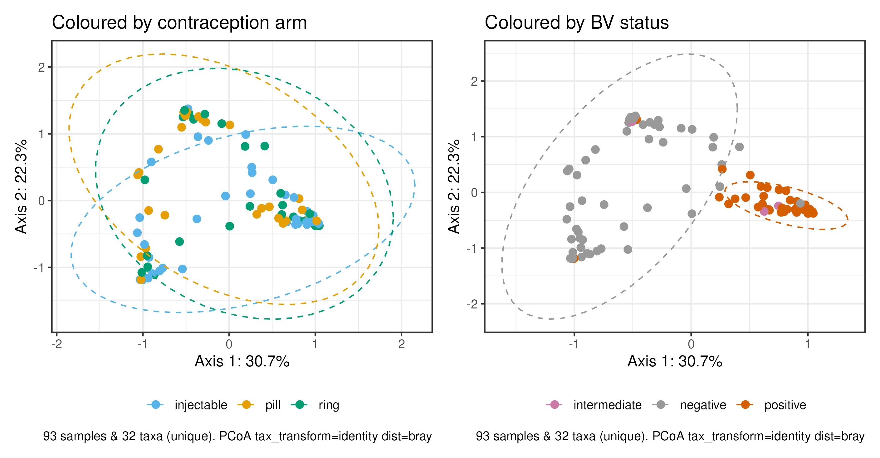
SUB-QUESTION 1 · COMMUNITY COMPOSITION
Bray–Curtis PCoA: the arms overlap — BV owns the map
CAPTION — READ THIS OUT
The same ordination coloured two ways. By contraception arm (left), pill, injectable and ring samples are thoroughly interleaved — no arm forms its own cloud. By BV status (right), BV-positive samples sweep to one side of Axis 1 (30.7% of variation), a Lactobacillus-vs-anaerobe gradient (r = −0.96). PERMANOVA agrees: arm explains ~3% (p = 0.09), BV 23% (p = 0.001).
Q1 · NO
No convincing difference in community composition between the three methods.
Study B · Group B final answers · group_b_contraception
04

Slide 5
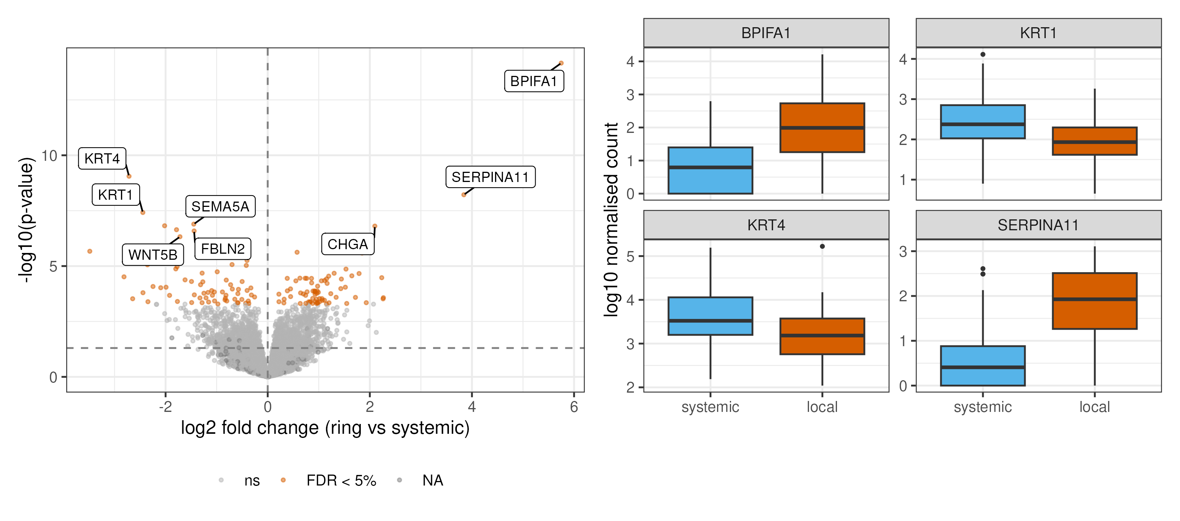
SUB-QUESTION 2 · HOST GENE EXPRESSION
DESeq2: the ring changes 139 host genes at FDR 5%
CAPTION — READ THIS OUT
Left: volcano — 139 genes at FDR 5% (73 up, 66 down in ring users); BPIFA1 is the extreme positive point (+5.8 log2FC), keratins (KRT4, KRT1) down. Right: four top genes as DESeq2-normalised counts — every box separates in the direction of its fold change. The signal survives dropping BV from the design, and all 139 genes point the same way against pill and injectable separately.
Q2 · YES
Yes — a modest but robust host-expression shift with local (ring) delivery.
Study B · Group B final answers · group_b_contraception
05

Slide 6
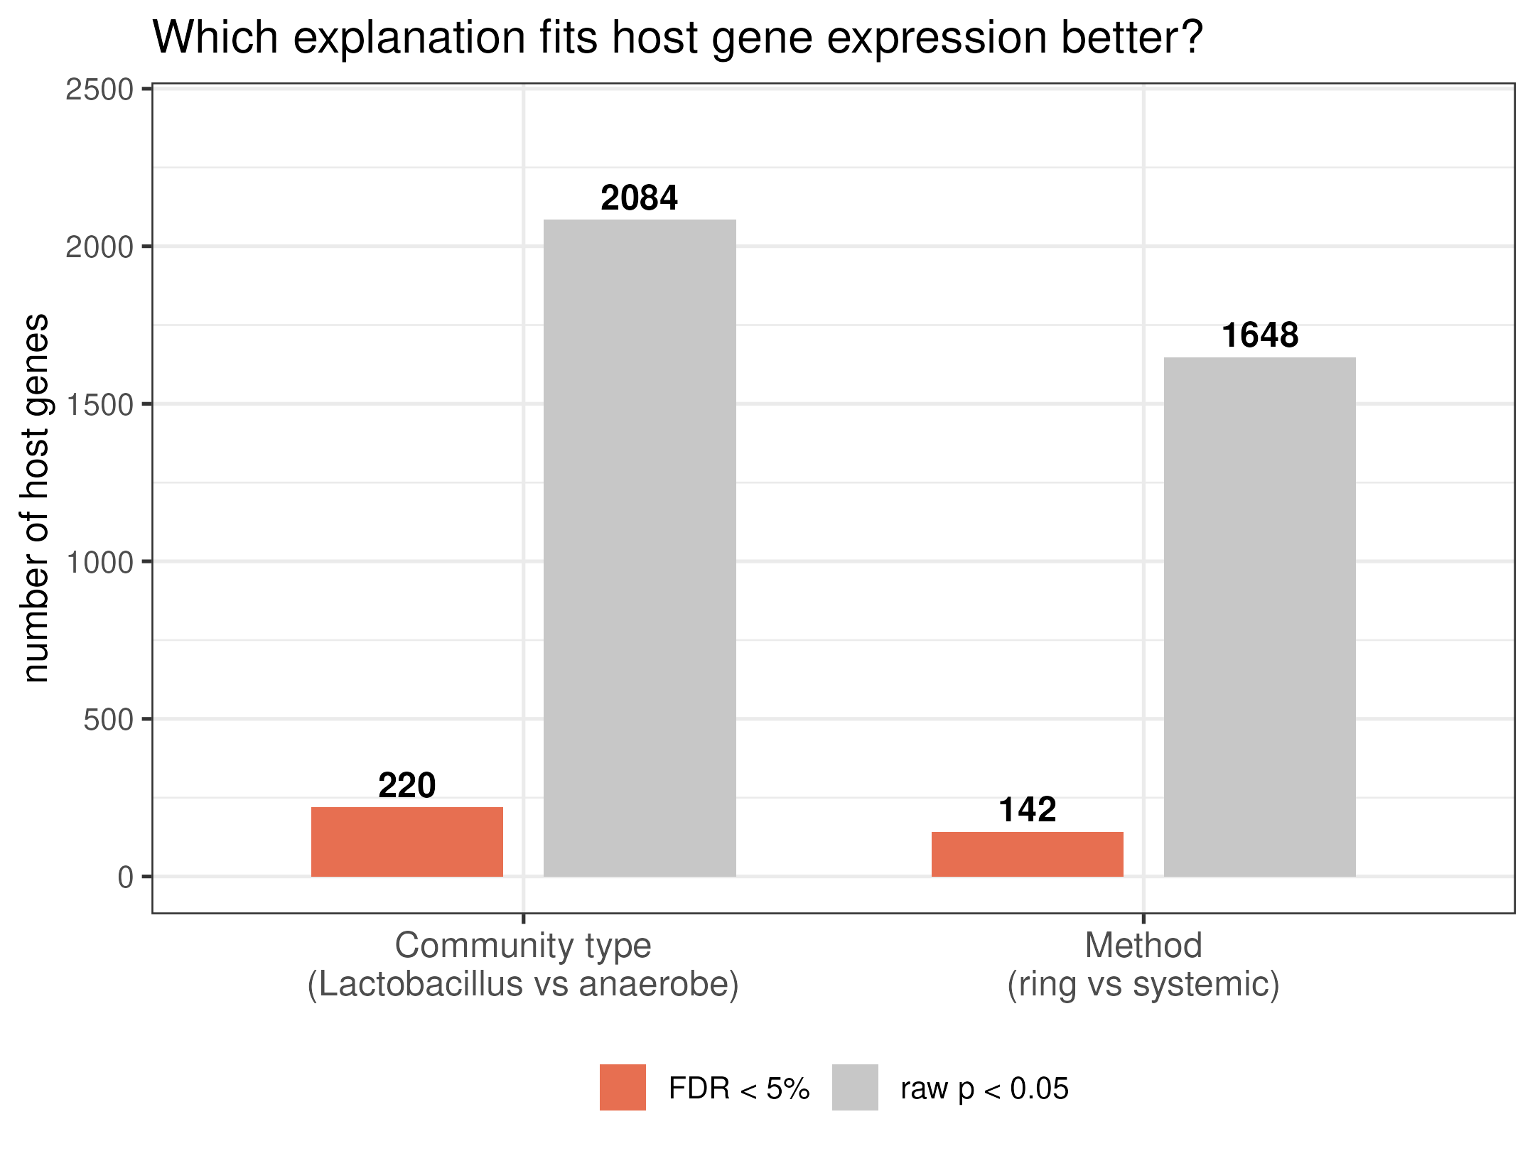
SUB-QUESTION 3 · HEAD-TO-HEAD
One shared model: community type beats method
The fair comparison
Both explanations in one DESeq2 design (~ batch + delivery + community): each term gets credit only for what it explains beyond the other.
220 vs 142 genes at FDR 5% — and the two gene lists share only 25 genes: different expression programs, not one signal seen twice.
PERMANOVA (whole transcriptome): a tie (R² 0.014 vs 0.015) — the community advantage is gene-specific, which is exactly why the gene-by-gene test settles it.
CAPTION — READ THIS OUT
Community type — Lactobacillus- vs anaerobe-dominant, defined from the microbiome table and tested on the gene table (no circularity) — explains more host genes than the method: 220 vs 142 at FDR 5% from one shared model (raw p < 0.05: 2,084 vs 1,648). The effect is directional: 192 of the 220 genes are down in anaerobe-dominant samples.
Q3 · YES
Community type — i.e. dysbiosis — explains host expression better than the method does.
Study B · Group B final answers · group_b_contraception
06

Slide 7
CHOICE WE MADE
The two routes from the QC document — which we kept, and why
Group_B1_overall.html (QC) left one route open: which species filter to use before analysis — open question #1.
ROUTE A — drop all-zero species only
ROUTE B — prevalence rule ✓ KEPT
Keep every species detected at least once: 134 of 220 taxa.
The other 86 species are all-zero noise; but the remaining 134 still include species seen in only a handful of women.
Consequence: Bray–Curtis distances are inflated by rare, uninformative species — more ordination distortion, no extra signal.
Keep only species seen above a prevalence threshold; we tightened the QC's ≥10-sample version to ≥10 counts in ≥20% of samples.
Result: 32 of 220 taxa kept — carrying 95.3% of all reads, so the dropped 188 species were the rare tail, not the biomass.
Consequence: Bray–Curtis measures real abundance differences, not sampling noise.
Why we kept the prevalence route: Bray–Curtis counts up differences between every pair of samples, so rare species add distance without adding information; the filter is the same cutoff the workshop's filter grid picked, and the ordination and PERMANOVA results are stable under it (the CLR sensitivity check agrees).
Second route from the same QC list (open question #5), also settled: low-read samples — the 10%-of-median rule drops nobody, the visual-gap rule drops B006 (5,247 reads); we kept all 93 samples, because dropping B006 moves nothing material.
Study B · Group B final answers · group_b_contraception
07

Slide 8
SOURCE
One source we opened and read ourselves
Love MI, Huber W, Anders S (2014). Moderated estimation of fold change and dispersion for RNA-seq data with DESeq2. Genome Biology 15:550.
genomebiology.biomedcentral.com/articles/10.1186/s13059-014-0550-8 — opened and read (abstract, model & normalisation, and shrinkage sections).
What we took from it: “DESeq2 integrates methodological advances with several novel features to facilitate a more quantitative analysis of comparative RNA-seq data using shrinkage estimators for dispersion and fold change.”
This is why Part 2 feeds DESeq2 raw counts (never CPM or logged): DESeq2 models counts with a negative binomial GLM, estimates size factors itself, and shrinks noisy fold changes of low-count genes toward zero — so our 139-gene list is ranked by stable effects, not low-count noise.
WHY IT MATTERS
The paper's own caveat: a fixed pseudocount “only reacts to one of the sources of uncertainty, low counts” — the mistake our pipeline avoids.
Study B · Group B final answers · group_b_contraception
08

Slide 9
THE ANSWER
Stated as plainly as the data allow
Q1 · Community composition
No. The three methods leave the vaginal community unchanged. Arm explains ~3% of the variation (p = 0.09; 0.06 adjusted) and the one borderline pair fails both the Holm correction and the compositional-distance check. BV status, not the method, owns the map.
Q2 · Host gene expression
Yes, modestly. The ring changes 139 host genes at FDR 5% — protective secretions up (BPIFA1), keratinisation down, prostaglandin pathway up (PTGS2) — and the signal survives every robustness check we ran.
Q3 · Head-to-head
Community type explains more than the method: 220 vs 142 genes at FDR 5% in one shared model. Read plainly: bacterial dysbiosis moves host expression; a well-tolerated contraceptive mostly doesn't.
Caveat we stand behind: BV/dysbiosis is the dominant variable in this cohort (R² ≈ 0.23); with 93 participants, subtle method effects are hard to detect above it.

