Slide 1
DATA SCIENCE FOR BIOLOGY · GROUP B · WEEK 2
Quality control, compared
Three QC reports for Study B (group_b_contraception), read side by side
93
220
14,226
3
samples, one visit each
species
genes
contraceptive arms
Reports compared: 01-qc Priv · 01-qc Samwl · StudyB_QC_Fathy
Five checks asked of every report: sample IDs · library sizes in both count tables · missing metadata · batch × arm · baseline balance.

Slide 2
THE LINE-UP
2
Three reports, three styles, one dataset
01-qc Priv
01-qc Samwl
StudyB_QC_Fathy
Quarto, checks 1–7 + verdict
Quarto, section per question
Hand-written HTML summary
▸ IDs: helper-guaranteed + cytokines checked by hand
▸ Extra: bv ↔ Nugent consistency audit (all 93 agree)
▸ Extra: Bray–Curtis PCoA outliers, by arm and batch
▸ Extra: caught B018 & B029 — all 15 cytokines NA
▸ Not done: gene-table library sizes, baseline table
▸ IDs: same set AND same order, all four tables
▸ Library sizes for BOTH count tables (10k / 1M flags)
▸ Baseline: pH, Nugent, BV, STI per arm
▸ Shannon + Kruskal–Wallis (p = 0.47)
▸ Not done: ordination outlier check
▸ Choices made + batch × arm cross-tab
▸ Library range quoted (min 5,247 — “sufficient”)
▸ Alpha diversity described, no test reported
▸ Recommends poscounts size factors
▸ Not shown: ID checks, gene table, baseline
Study B · group_b_contraception · QC compared
Study B · group_b_contraception · QC compared
02
02

Slide 3
THE FIVE CHECKS
3
Who checked what — the scorecard
Check | Priv | Samwl | Fathy
Sample IDs match across all tables | ✓ helper + cytokines by hand | ✓✓ set AND order, 4 tables | ✗ not shown — helper trusted
Library sizes, both count tables | ✓/✗ microbiome only | ✓ species + genes, 10k / 1M | ✗ microbiome only
Which samples have very few reads | ✓ B006 flagged at <10k | ✓ B006 flagged at <10k | ✗ min quoted, no flag
Missing metadata | ✓ 0 NA + cytokine NAs found | ✓ 0 NA, all 8 columns | ✓ 0 NA stated
rnaseq_batch × arm | ✓ with % in B1 (51/50/50) | ✓ row % + Study A aside | ✓ cross-tab shown
Arms differed at baseline? | ✗ not attempted | ✓ pH, Nugent, BV, STI | ✗ not attempted
Verdict: Samwl is the most complete report; Fathy is the thinnest; Priv is the only one that hunted outliers. No report caught an error the others would call fatal.
Study B · group_b_contraception · QC compared
03

Slide 4
CHECKS 1 & 3 — PASSED EVERYWHERE
4
IDs match, metadata complete — but two extra catches
Sample IDs
Missing metadata
All three reports: pass. read_counts() stops on any mismatch, and Priv additionally verified the cytokine file by hand (setequal + match → TRUE).
Samwl went furthest: identical() checks the column ORDER of species, genes and cytokines against the metadata — what DESeq2 silently relies on.
All three reports: 0 NA across all 8 metadata columns (sample_id, participant_id, arm, bv, nugent, ph, any_sti, rnaseq_batch).
Priv's extra catch: B018 and B029 have NA for all 15 cytokines — fine for microbiome/RNA-seq, fatal for cytokine work.
Only Priv checked — does the metadata contradict itself?
bv vs Nugent: Nugent 0–3 should mean “negative”, 4–6 “intermediate”, 7–10 “positive”. Cross-tab: 51/51, 3/3, 39/39 agree — the two clinical columns never disagree. Priv's choice of cut points (0–3 / 4–6 / 7–10) is a listed choice; alternative was trusting the bv column.
Study B · group_b_contraception · QC compared
Study B · group_b_contraception · QC compared
04
04

Slide 5
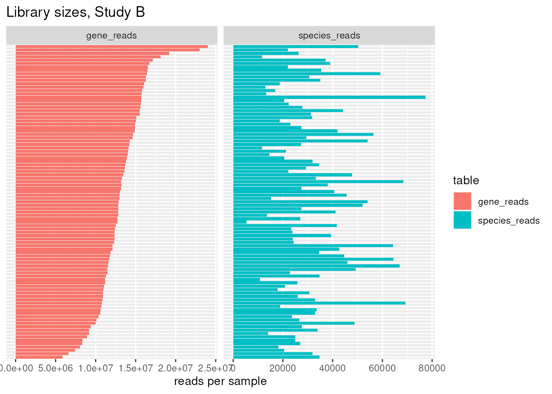
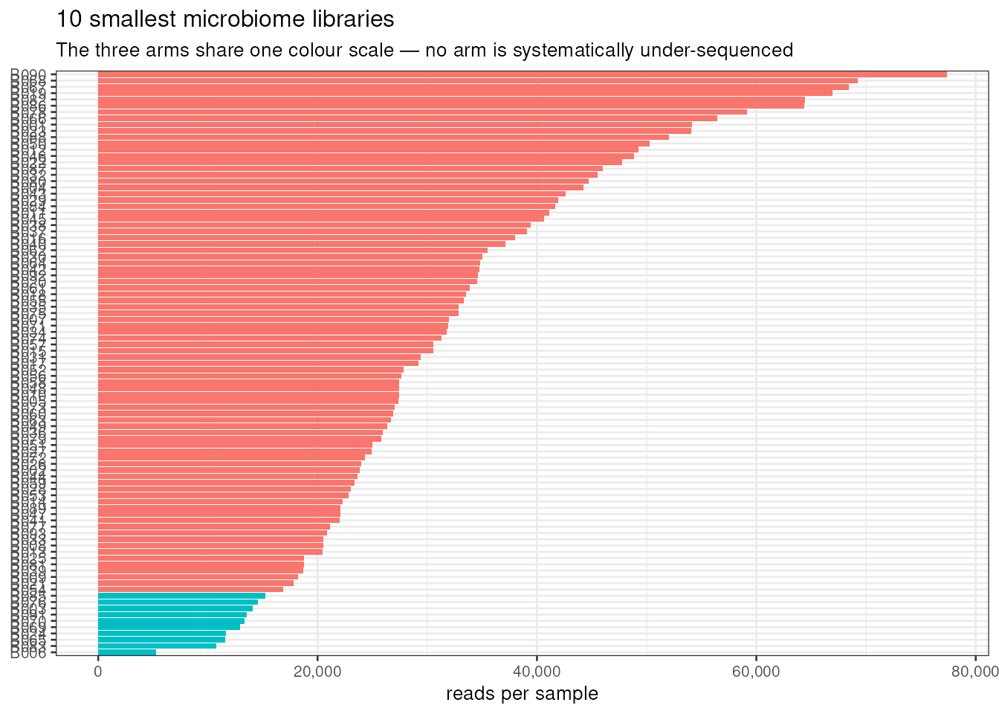
CHECK 2 — THE ONLY GAP BETWEEN REPORTS
5
Library sizes: Samwl read both tables, the others read one
Species table: min 5,247 · median 29,212 · max 77,353 reads.
Gene table: min 5.86M · median 12.86M · max 24.0M reads.
Samwl's thresholds: <10k (species) and <1M (genes). Result: only B006 flagged; gene table clean (min is ~6× the threshold).
The one small sample: B006
5,247 reads ≈ 18% of the median — small but not pathological (the practice data had a 438-read sample).
Priv and Samwl both keep it, pending one question → open-questions slide.
Fathy quotes the same minimum but calls it “sufficient” without flagging the sample.
Top: both tables (Samwl) · bottom: 10 smallest libraries (Priv)
Study B · group_b_contraception · QC compared
Study B · group_b_contraception · QC compared
05
05

Slide 6
CHECK 4 — UNANIMOUS
6
rnaseq_batch × arm: balanced, all three agree
arm | B1 | B2 | % in B1
injectable | 20 | 19 | 51.3%
pill | 14 | 14 | 50.0%
ring | 13 | 13 | 50.0%
Samwl's bonus: Study A cross-check
Study A (probiotic trial): pre/post also balanced 86/90 per batch — the lab randomises well.
Decision recorded
Every arm sits almost exactly half B1, half B2. A batch effect cannot easily masquerade as a method effect.
All three reports cross-tabulated this — the one check with perfect three-way agreement.
Fathy: “we will not apply batch correction for downstream analysis.” Priv's PCoA by batch (next slides) shows no batch cluster.
Why this check matters: Samwl's report is explicit — an unbalanced batch would look exactly like a treatment effect. Skipping the check and “hoping the lab randomised well” is the listed alternative.
Study B · group_b_contraception · QC compared
Study B · group_b_contraception · QC compared
06
06

Slide 7
CHECK 5 — ONE REPORT ONLY
7
Did the arms differ at baseline? Only Samwl asked
arm | n | mean pH | mean Nugent | BV+ | STI+
injectable | 39 | 4.86 | 4.6 | 19 | 19
pill | 28 | 4.59 | 3.9 | 10 | 12
ring | 26 | 4.97 | 3.8 | 10 | 17
How to read it
pH & Nugent are shifted toward dysbiosis in the injectable arm (4.86 / 4.6).
STI+ is 19/39 injectable vs ~half that elsewhere.
The study was not randomised — participants chose their method — so baseline differences are expected, not a data error.
The arms start different (e.g. 19 vs 10 BV-positive) → later models should adjust for BV status and pH rather than trust the raw arm contrast.
Priv and Fathy never ran this check — it is the biggest single coverage gap across the three reports.
Caveat Samwl flags
These are raw means, no formal test — imbalance is documented, not yet tested. Study A's baseline table (probiotic vs placebo) shows the same pattern of near-balance on age and pH.
Study B · group_b_contraception · QC compared
Study B · group_b_contraception · QC compared
07
07

Slide 8
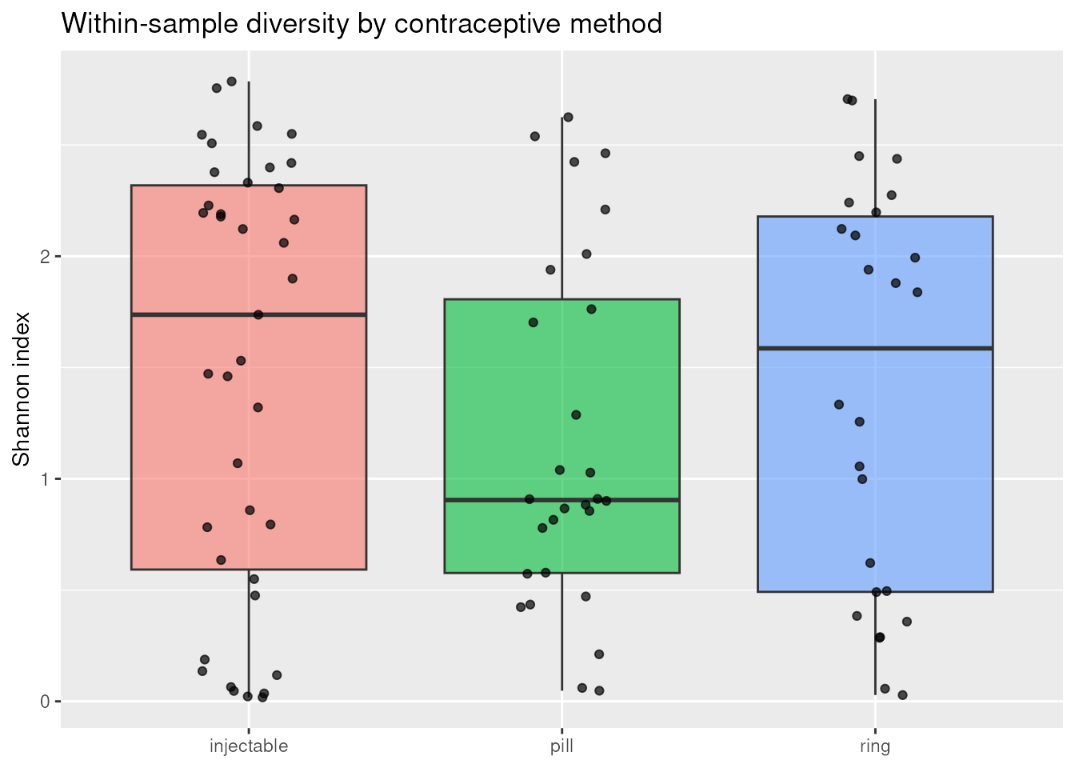
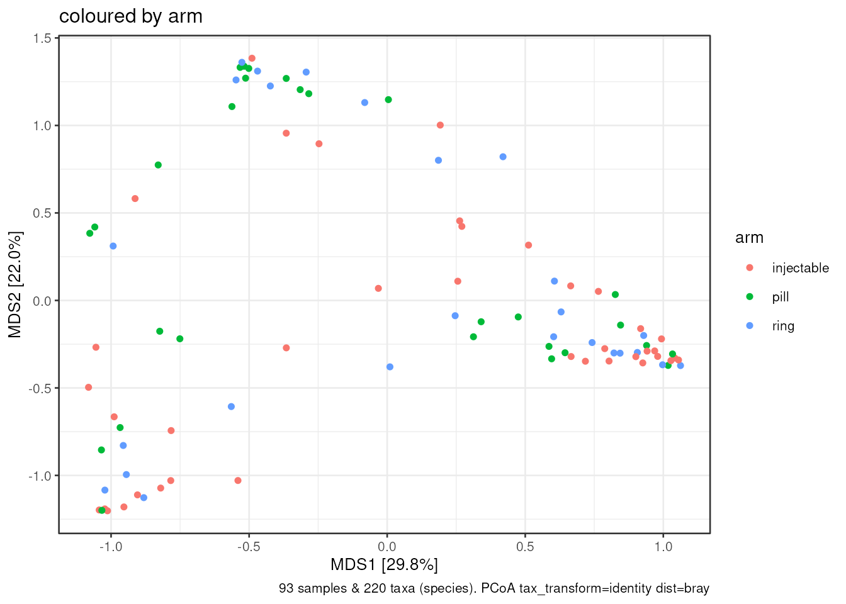
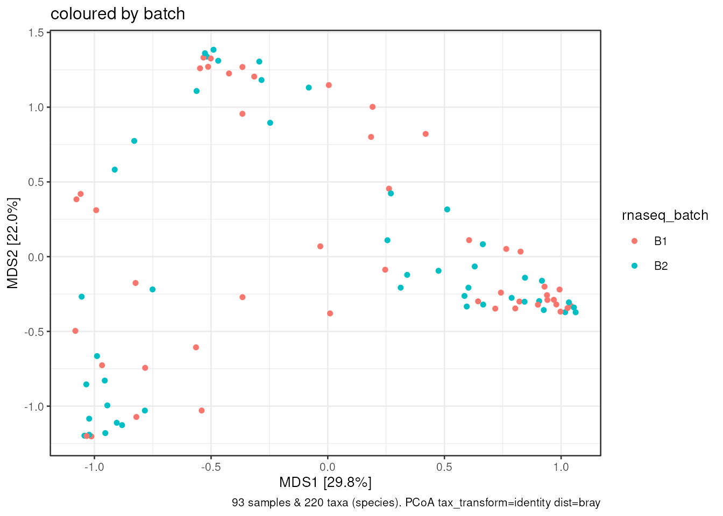
BONUS CHECKS
8
Exploratory pictures: diversity and outliers
PCoA by arm (Priv)
PCoA by batch (Priv)
Shannon: medians 1.74 / 0.90 / 1.59 (injectable / pill / ring); Kruskal–Wallis p = 0.47 — no significant arm difference. Pill arm looks bimodal (some near-0, Lactobacillus-only).
PCoA: no batch cluster in the ordination → visual confirmation of the balanced cross-tab.
Shannon by arm (Samwl)
Fathy describes this same figure as a biological effect (“known effect of oral contraceptives”) — without reporting a test.
Study B · group_b_contraception · QC compared
Study B · group_b_contraception · QC compared
08
08

Slide 9
CHOICES MADE — SIDE BY SIDE
9
All three reports, choice by choice
01-qc Priv — 5 choices
01-qc Samwl — 7 choices
StudyB_QC_Fathy — 3 choices
1. read_counts() helper instead of six manual read_csv() calls
2. Small-library flag at 10,000 reads (alt: 5k flags nothing, 20k flags more)
3. bv ↔ Nugent cut points 0–3 / 4–6 / 7–10 (alt: trust bv)
4. Outlier ordination: Bray–Curtis PCoA on untransformed counts (alt: CLR + Euclidean)
5. Keep all 93 samples, incl. 2 with missing cytokines (alt: drop them everywhere)
1. QC on raw counts, before any transform
2. “Established” species = ≥10 of 93 samples (alt: min read-count rule)
3. Arm summaries as means (alt: medians)
4. Cross-tab batch vs arm — never assume balance
5. QC on all 220 taxa; analysis docs filter to 62
6. Keep all 93; B006 flagged, kept pending ordination
7. Shannon by hand + Kruskal–Wallis (alt: ANOVA on rarefied tables)
1. Keep all 93 samples — min library 5,247 reads is “sufficient”; nothing dropped
2. Keep all 220 taxa for the initial QC
3. Batch highly balanced → no batch correction downstream
Study B · group_b_contraception · QC compared
Study B · group_b_contraception · QC compared
09
09

Slide 10
CHOICES MADE — THE THREE-WAY DIFFERENCES
10
For each difference: can any of us say why?
Difference between the three reports | Why? | Can any of us explain it?
Species filter: all-zero → 134 (Priv) vs ≥10 samples → 62 (Samwl, Fathy >10%) | YES | Priv: don't drag all-zero rows through every distance. Samwl: singletons can't support a 3-arm comparison; Fathy: a strict filter. All explained — but 134 ≠ 62, so the group must pick one.
Outlier check: PCoA (Priv) vs none (Samwl, Fathy) | NO | Samwl's and Fathy's reports never mention ordination — silence, not a stated decision. → open-questions slide.
Alpha diversity: tested, p = 0.47 (Samwl) vs described, untested (Fathy) vs absent (Priv) | NO | Fathy calls it “a known biological effect” with no test; Samwl tested and found nothing. → open-questions slide.
Sample B006: keep pending ordination (Priv, Samwl) vs “sufficient”, no flag (Fathy) | PARTLY | Fathy states a depth-based reason but never engages the ordination edge test the other two defer to. → feeds open question 2.
Batch correction: explicitly skipped (Fathy) vs decision unstated (Priv, Samwl) | YES | Fathy records the decision and says why (balanced cross-tab); the others only show the evidence. → adopt: no batch correction.
Threshold, samples & taxa: 10k flag, keep all 93, QC on all 220 (all three) | SAME | Same choice, same reasoning — no conflict to resolve. Agreed.
Rule used: if any report states its reason, the difference is discussable; where the other reports are silent, the item moves to the group's open-questions slide.
Study B · group_b_contraception · QC compared
Study B · group_b_contraception · QC compared
10
10

Slide 11
OPEN QUESTIONS — THREE REPORTS
11
What each report leaves open, and where they converge
Priv (verdict)
Samwl
Fathy
▸ B006: rerun the analysis without it if it sits at the edge of the ordination — “see whether the answer moves”
▸ 86 all-zero species: filter before the main analyses
▸ Cytokine NAs (B018, B029): cytokine analyses must remember they are missing
▸ DESeq2 size factors: smallest nonzero count is 2 → use poscounts
▸ Filter species present in ≥10 of 93 samples (62 qualify)
▸ Alpha diversity: drop the follow-up unless the BV-adjusted analysis changes the picture
▸ Use poscounts size factors for DESeq2
▸ Strict low-abundance filter: keep taxa present in >10% of samples
▸ (no baseline, ID or outlier questions raised)
Where the three converge
poscounts size factors — all three · low-abundance filter — Samwl (≥10 samples) ≈ Fathy (>10%): effectively the same rule · keep all 93 samples — all three (Fathy implicitly)
Study B · group_b_contraception · QC compared
Study B · group_b_contraception · QC compared
11
11

Slide 12
THE DELIVERABLE
The group's open-questions slide
1
Which species filter do we standardise on?
Priv drops only the 86 all-zero rows (134 species); Samwl and Fathy want a prevalence rule (≥10 samples ≈ >10%). Pick one before any per-species test.
2
Does B006 (5,247 reads) sit at the edge of the ordination?
Priv and Samwl keep it “pending”; Fathy calls the depth “sufficient” without the ordination test. Rerun without B006 and see whether the answer moves.
3
Alpha diversity: signal or noise?
Samwl's Kruskal–Wallis says no arm difference (p = 0.47); Fathy's report reads the pattern as biology. Which framing goes in the final report?
4
Who owns the outlier check?
Priv ran the only ordination (Bray–Curtis, untransformed). Does the group adopt it, or rerun under CLR + Euclidean — Samwl's stated alternative?
5
Cytokines: confirm the B018/B029 rule
Priv proposes dropping them from cytokine analyses only. Fathy and Samwl are silent — needs one group decision.
Verdict: data are fit for analysis — IDs match, metadata complete, batch balanced, no sample must be dropped. Settle the five questions above before the differential tests.

