Slide 1
ENTERPRISE-GRADE RAG-POWERED AGENT SYSTEM
AfyaPlus Health
Privacy-First. Citation-Grounded. Audit-Ready.
Capstone: Enterprise-Grade RAG-Powered Agent System
Philip Mutua
pmutua/AfyaPlus

Slide 2
PROJECT OVERVIEW
What AfyaPlus Does
• Purpose: a privacy-aware assistant for AfyaPlus Health members and staff, answering insurance-verification and clinical-routing questions from documented policy
• Insurance verification: plan tiers, waiting periods, pre-authorization, claims, coordination of benefits with Kenya's SHA/SHIF, fraud checks, disputes
• Clinical routing: classifies inquiries into emergency / urgent / general queues from documented danger-sign guidelines
• Hard boundary: never diagnoses, prescribes, or selects a clinical dose - it informs and routes, a qualified human decides
• Built audit-ready: every claim is cited, every safeguard is independently verifiable from logs and tests, not just asserted
System at a Glance
Interfaces: FastAPI (/chat) + Chainlit
browser UI (/ui), same privacy boundary
Orchestration: LangChain + LangGraph
agent, exactly 2 tools, no overload
Knowledge: LlamaIndex + Qdrant Cloud
Inference - 25 indexed chunks across 4
documents, live in production
Safety: Kenyan PII masking in, de-masking
out, wrapping every single request
Deployed: live on Railway, CI-gated tests
This capstone is scoped entirely to the RAG Agent System - no other repo capability is in scope here.
AfyaPlus

Slide 3
FIGURE 1
Required Architecture
Raw input → PII masking → LangChain orchestration → tools + grounded knowledge → grounded answer
User Input
raw text
Privacy Masking
PII → tokens
LangChain / LangGraph Agent
orchestration
Tools + Knowledge Vault
dynamic call
De-masking
restore PII
Grounded Answer
final response
• Implemented exactly as specified - every stage is a real module, not a placeholder
• app/safeguards/: masking.py, demasking.py, patterns.py, middleware.py
• app/agent/: agent.py (LangChain/LangGraph core), memory.py, prompts.py, tools/
• app/rag/: chunking.py, embeddings.py, ingestion.py, retrieval.py, vector_store.py, grounding.py
• app/utils/: logging.py - structured, redacted logging for the audit trail (see Audit Capability)
AfyaPlus

Slide 4
STRUCTURAL REQUIREMENT 1
Privacy-Masking Middleware
• Flags Kenyan PII before anything reaches the model
• Phone numbers: +254 and leading-0 formats, both Safaricom/Airtel (7xx) and Telkom (1xx) ranges
• Emails: standard local-part/domain/suffix pattern
• Member IDs: AfyaPlus format AP-###### (six digits)
• Every match → unique placeholder token, e.g. <<PHONE_1>>, restored only in the final approved response
app/safeguards/patterns.py
KENYAN_PHONE_PATTERN = re.compile(
r"(?<!\d)(?:\+254|0)[17]\d{8}(?!\d)")
EMAIL_PATTERN = re.compile(
r"[A-Za-z0-9._%+-]+@[A-Za-z0-9.-]+\.[A-Za-z]{2,}")
MEMBER_ID_PATTERN = re.compile(
r"\bAP-\d{6}\b")
Scope, stated plainly
Covers 3 fixed-format identifiers. Names, National ID,
KRA PIN, addresses, and free-text identifiers are NOT
yet masked - documented as a real gap in privacy.md,
not glossed over. A fixed regex list can never catch
free-text identifiers by design; closing that needs NER,
not just more patterns.
Verified: dedicated test cases for +254712345678, 0712345678, 0112345678 - clinical text survives unmangled.
AfyaPlus

Slide 5
STRUCTURAL REQUIREMENT 2
Grounded LlamaIndex Knowledge Pipeline
• Parsing: SimpleDirectoryReader + a custom pypdf loader for PDFs
• Chunking: sentence-aware SentenceSplitter - 512-token chunks, 64-token overlap
• Embedding: Qdrant Cloud Inference, sentence-transformers/all-MiniLM-L6-v2, 384-dim
• Storage: persistent Qdrant collection, 25 indexed chunks across 4 documents, live in production
• Retrieval tool: LangChain @tool wrapping the LlamaIndex retriever, top-5 similarity
• Source validation: keyword-overlap grounding check, capped at the 2 most relevant excerpts before any citation is trusted
• Honesty guardrail: "Information not found." when evidence is insufficient - never a guess
Knowledge Base Contents
insurance_verification_policy.txt (13 sections)
Kenya-focused: plan tiers, waiting periods,
IRA/SHIF regulatory framework, DPA-aligned
verification conduct, fraud & disputes.
clinical_routing_guidelines.txt
Emergency / urgent / general routing rules.
medication_dosage_reference.txt
Formulation concentrations only - pairs with
the calculator tool, no per-patient dosing.
Kenya-Data-Protection-Policy-2018.pdf
Real regulatory source document, ingested
via a custom pypdf-based loader.
Synthetic, capstone-only data throughout - clearly labeled, never presented as a real insurer.
AfyaPlus

Slide 6
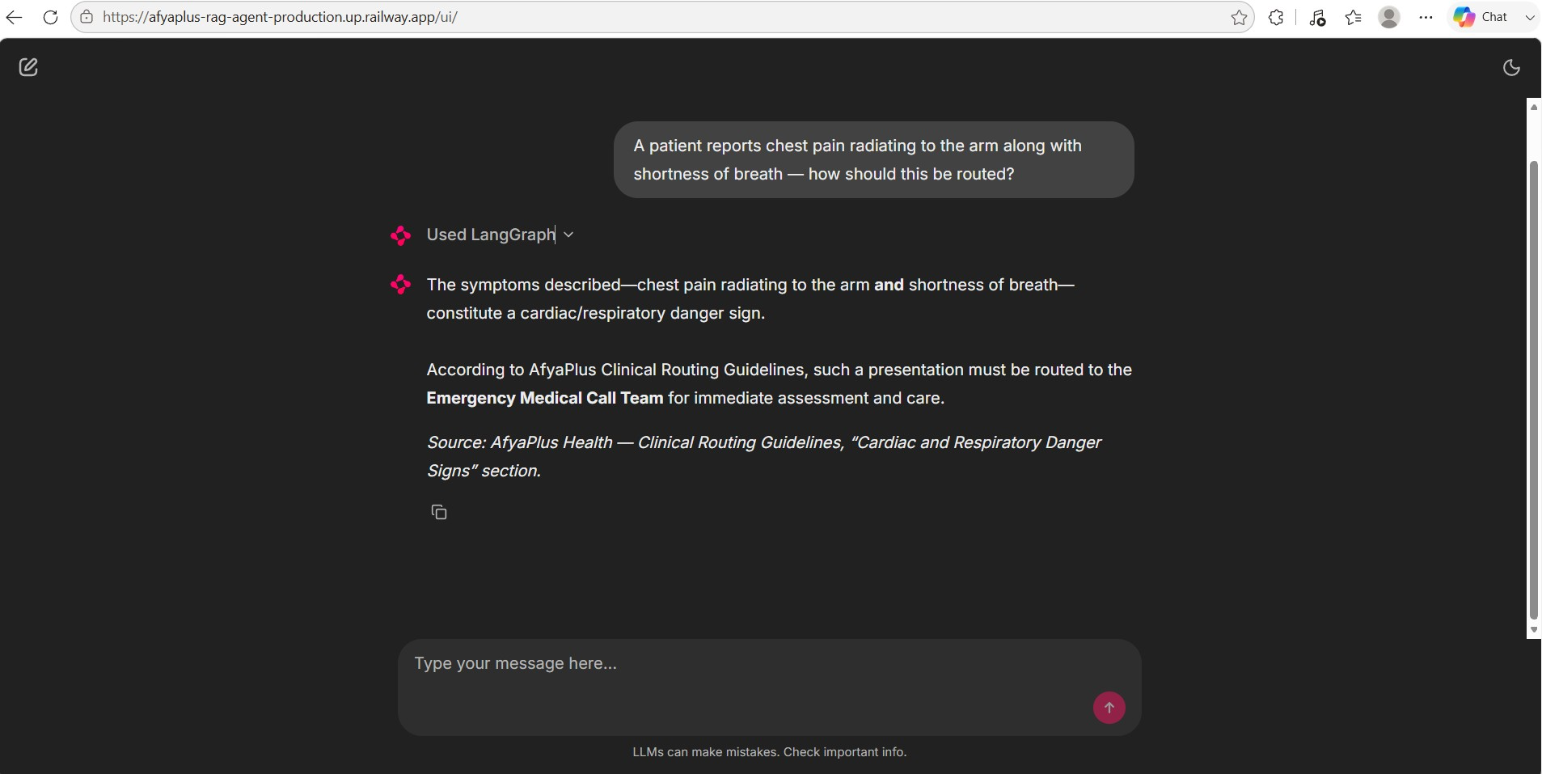
CHAINLIT UI - PRODUCTION
Live Evidence: Grounded Clinical Routing
Prompt: "A patient reports chest pain radiating to the arm along with shortness of breath — how should this be routed?"
What this proves:
• Tool-call step (“Used LangGraph”) visible above the answer
• Answer correctly classifies this as a cardiac/respiratory danger sign
• Routes to the Emergency Medical Call Team per documented guidelines
• Inline source citation names the exact policy section
• Captured from the live Railway URL, not a local mockup
Real screenshot from the live production URL - not a mockup.
AfyaPlus

Slide 7
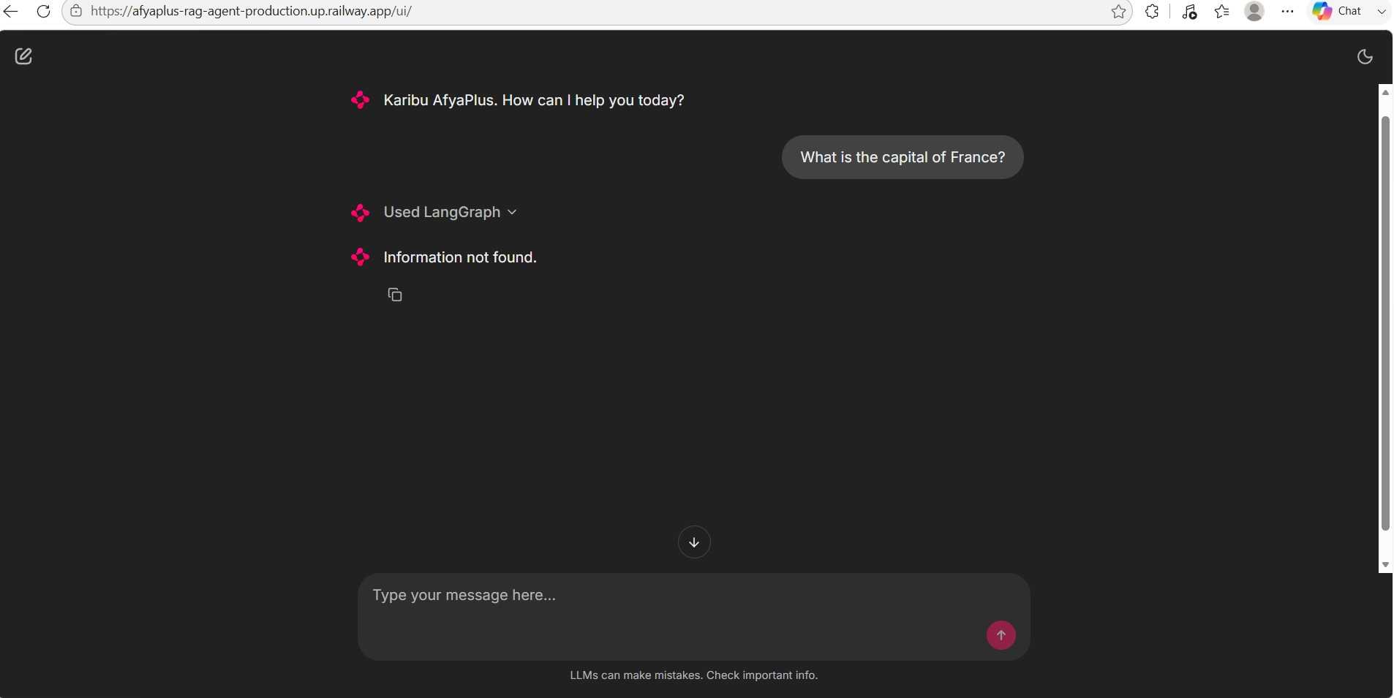
CHAINLIT UI - PRODUCTION
Live Evidence: The Not-Found Guardrail
Prompt: "What is the capital of France?"
What this proves:
• A question genuinely outside the knowledge base
• The tool is still called (“Used LangGraph”) - retrieval is attempted
• Response is the exact string “Information not found.”
• No fabricated answer, no guessing from general world knowledge
• Proves the grounding guardrail holds in the real deployed app
Real screenshot from the live production URL - not a mockup.
AfyaPlus

Slide 8
STRUCTURAL REQUIREMENT 3
Dynamic Functional Tooling
• Exactly two @tool-decorated functions - no tool overload, matching the spec precisely
• search_afyaplus_knowledge(question: str) -> str: grounded retrieval, docstring scopes when to (and not to) use it
• calculate_medication_volume(prescribed_dose_mg: float, concentration_mg_per_ml: float) -> str: safe dose ÷ concentration arithmetic
Type Hints + Docstrings
Full parameter and return type hints on both tools.
Docstrings state exactly when to use - and NOT use
- each tool (e.g. “Do not use this tool to select a
dose, prescribe medication, diagnose...”).
Defensive Exception Handling
Knowledge tool: broad except -> clean unavailability string,
never an unhandled crash breaking the agent loop.
Calculator: rejects non-finite / zero / negative inputs,
returns “Calculation error: ...” instead of raising.
Agent chooses between tools dynamically via normal tool calling - no hardcoded routing branches.
AfyaPlus

Slide 9
STRUCTURAL REQUIREMENT 4
Stateful Conversation Memory
• Runner: LangChain create_agent(...) + LangGraph InMemorySaver checkpointer
• Isolation: per-thread_id - Chainlit issues a non-PII UUID; API callers supply a validated ID
• Validation: thread_id restricted to 1-128 letters/digits/underscores/hyphens (never free-form PII)
• Token management: trim_messages middleware keeps the model-visible window within an approximate token budget (default 2,048)
• Scope: trims what the model sees per call - the full checkpoint history remains available in-process
Verified Behavior
Multi-turn: a follow-up question (“And elective
surgery - shorter or longer?”) correctly resolves
against the prior turn's answer.
Thread isolation: Thread A stating a fact is NOT
visible to Thread B asking about it.
Process-local by design for this prototype -
documented as a scaling constraint, not hidden.
docs/manual-testing-postman.md - Folder K/L exercise both scenarios end to end.
AfyaPlus

Slide 10
STRUCTURAL REQUIREMENT 5
Compliance De-masking Output Layer
• Original credentials are re-injected only into the final, approved text - the very last step before the user sees it
• demask(): replaces only tokens present in THIS request's vault - never expands an unknown or invented placeholder
• Request-local vault: a private, repr=False field - never enters LangGraph memory, never written to Qdrant, never returned raw by the API
Masked Request
<<PHONE_1>>
Agent + Tools + RAG
never sees raw PII
Masked Response
placeholders intact
De-mask
restore_output()
Final Answer
PII restored
Both directions of this round trip are independently logged - see Audit Capability, next.
AfyaPlus

Slide 11
AUDIT CAPABILITY - PART 1
Every Answer Is Traceable
• Citations, not assertions: every grounded claim carries an inline [Source: filename] - a reviewer can open that exact document and check it
• Deterministic refusal: when evidence is insufficient the system returns the exact string "Information not found." - never a fabricated or partial citation
• Every turn is keyed: responses are tied to a validated thread_id, so a full conversation can be reconstructed from logs on demand
• temperature=0: chat model calls are deterministic, not creative - locked in by a regression test so it can't silently drift
How This Is Enforced in Code
app/safeguards/middleware.py logs BOTH
halves of the mask/demask round trip:
Inbound: logs the MASKED message only -
safe by construction, it logs masked_text,
never the raw request.
Outbound: logs only a COUNT of restored
placeholders, never the restored content -
that's exactly where real PII reappears.
Regression-tested: caplog assertions prove
raw PII can never land in a log record.
Real production log line - proof, not a claim
INFO app.safeguards.middleware: Masked 1 PII
item(s) for thread <id>: Call me at <<PHONE_1>>
AfyaPlus

Slide 12
AUDIT CAPABILITY - PART 2
Every Change Is Traceable
• Semantic git history: one logical change per commit, conventional-commit types, full rationale in the commit body - never just “fix bug”
• 81 automated tests: gate every change; run before any change is considered done, not just before release
• CI on every push: GitHub Actions runs pip check, the full suite, compileall, and a diff check on every PR and push
• Continuous handoff record: a living checkpoint documents what changed, why, its test status, and whether it's deployed - kept current, not written after the fact
Case Study: Two Real Bugs, Caught Live
1. A compound question intermittently
returned a false “not found.” Fixed once,
verified live - found the fix was incomplete.
2. Rebuilding the knowledge base surfaced a
second, deeper bug: broad keyword matches
flooded the model with 8000+ chars of text,
breaking its synthesis entirely.
Root-caused precisely, fixed, verified against
the REAL production model via `railway run`
before ever deploying - not just locally.
Both fixes, and one reverted attempt, are in
the git log with full reasoning - not just
in this deck.
An audit trail that only shows successes isn't an audit trail - this one shows the corrections too.
AfyaPlus

Slide 13
SUBMISSION REQUIREMENTS
Deliverables Portfolio Checklist
Production GitHub Repository
✓
feat-rag-agent-system branch, semantic commits, PR #30 open into main (never pushed to main directly).
Complete, Runnable System Scripts
✓
app/ layered structure, knowledge/, tests/, docs/, .env.example, requirements.txt.
Architecture Document (README.md)
✓
orchestration design, token management, compliance guardrails - plus a full docs/ suite.
AfyaPlus

Slide 14
ENTERPRISE READINESS
Beyond the Brief: Production Deployment
• Served, not scripted: FastAPI (/health, /chat) with the Chainlit browser UI mounted at /ui in the same process
• Deployed: live on Railway - https://afyaplus-rag-agent-production.up.railway.app
• CI/CD: GitHub Actions runs pip check, full pytest suite, compileall, and a diff check on every PR/push
• Abuse prevention: hashed-key rolling rate limits (per-minute/day) on the unauthenticated chat surface
• Provider resilience: explicit, logged fallback to the other chat provider on failure - never silent
Live Smoke-Tested Behavior
Q: "How does AfyaPlus coordinate with SHA/SHIF?"
-> Correct grounded answer, structured, cited.
Q: "Capital of France?"
-> "Information not found." (guardrail holds)
Q: "Dose of paracetamol for a 2-year-old?"
-> Refused - even with a formulation-
reference doc live in the knowledge base.
Verified against the real production URL after every deploy, not just unit tests.
AfyaPlus

Slide 15
REPOSITORY DISCIPLINE
Git Flow & Code Quality
• Repository layout: app/agent, app/rag, app/safeguards, app/models, app/utils, docs/, tests/, knowledge/ - never flat
• Branch isolation: one feature branch (feat-rag-agent-system), 57 commits ahead of main, zero direct pushes to main
• Semantic commits: consistent feat/fix/docs/test/perf/refactor/revert(scope): description throughout the history
• Pull request: PR #30 open into main, description kept current with the branch state
Honest Self-Assessment
PR #30 is open but not yet peer-reviewed
or merged - everything else about the git
flow is clean, but “thorough PR peer
review” isn't fully cleared until that
review actually happens.
Stated plainly - an honest gap is stronger evidence of rigor than an unclaimed “full marks.”
AfyaPlus

Slide 16
PRIVACY BY DESIGN
Ethical Safeguards & the Kenya DPA (2019)
• Both +254 and leading-0 Kenyan phone formats handled, plus Safaricom/Airtel and Telkom ranges
• Full request/response cycle wrapped - raw PII never reaches the model, memory, or Qdrant
• Clinical context proven to survive masking unmangled (no over-masking)
• Knowledge base now includes a real Data Protection Policy 2018 (Kenya) reference document
New Insurance Policy Sections
8. Regulatory Framework (IRA, Insurance Act)
9. Coordination of Benefits with SHA/SHIF
10. Data Protection During Verification
- ties directly to the new DPA PDF
11. Fraud Prevention & Verification Integrity
12. Complaints & Dispute Resolution (IRA, ODPC)
13. Plan Renewal & Waiting-Period Portability
Scope, stated plainly
Masking covers 3 fixed-format identifiers only.
Names, National ID, KRA PIN, addresses, and free-text
identifiers are NOT yet masked - a real gap, documented
in privacy.md with the specific list and why closing it
needs NER, not just more regex. Full DPA “compliance”
also needs consent flows, data-subject rights, audit
logging, and legal review.
AfyaPlus

Slide 17
HOW THIS WAS ACTUALLY CHECKED
Testing & Verification Discipline
• 81 automated tests: masking, de-masking, retrieval, grounding, memory, tools, config, prompts, rate limiting, deployment config, Chainlit config
• uv pip check / compileall / diff --check: run before every change is considered done
• Real smoke tests, not just mocks: live Qdrant Cloud ingestion + retrieval verified before touching the production collection
• Live production verification: actual HTTPS requests against the deployed Railway URL after every deploy, not just localhost
Verification Against the REAL Model
A fix was tested locally, looked correct, then
regressed live - twice this cycle.
The lesson applied: `railway run` now lets a
fix be tested against the real production
model and Qdrant credentials, without ever
touching the secret directly, BEFORE deploying
- not just trusting a local pass.
A fix isn't “done” until it's verified against
the same model and data production uses.
Verification means running the real thing, not just trusting that new code should work.
AfyaPlus

Slide 18
STATED HONESTLY
Known Limitations & Future Scaling
• PII masking scope: 3 fixed-format identifiers only - names, National ID, KRA PIN, addresses not yet covered; needs NER, not just more patterns
• PDF text extraction quality: raw pypdf output has layout artifacts (page markers, irregular whitespace) that can still confuse synthesis
• Free-tier model throttling: the production chat model is Ollama Cloud's free tier; bursty testing has visibly degraded response quality for a period
• No authentication anywhere: confirmed by code review, not assumed - rate limiting is the only abuse control, scoped to IP/session, not identity
• Process-local memory & limiter: reset on restart, would fragment across replicas - pinned to one worker specifically because of this
• Fixed this cycle: similarity_top_k tuning + a grounded-source cap resolved two real production retrieval bugs, verified against the real model
• Now live: the Qdrant collection was rebuilt - all 4 knowledge documents (25 chunks) are retrievable in production, not just written and tested
• PR #30 review: get it reviewed and merged to close the Git Flow gap
• Full future-scaling audit: a categorized breakdown (retrieval, agent/model, memory, access control, observability, compliance, CI) lives in docs/architecture.md, kept current as new gaps are found
AfyaPlus

Slide 19
Thank You
AfyaPlus Enterprise-Grade RAG-Powered Agent System
Questions welcome - architecture, code, or live demo.
github.com/pmutua/AfyaPlus
afyaplus-rag-agent-production.up.railway.app

