Slide 1
BIASHARAASSIST
Fine-Tuned LLaMA 3.1 8B for Kenyan SME Financial Advisory
Week 4 Capstone — Dataset Curation, QLoRA Fine-Tuning, Evaluation & Business Recommendation
Philip Mutua
github.com/pmutua/biashara-assist-fine-tuning-capstone

Slide 2
THE PROBLEM
Kenyan SMEs Need Reliable, Local Answers
• Small business owners in Kenya face routine but confusing questions:
‒ How do I register a business name?
‒ What tax obligations apply to my turnover?
‒ Do I qualify for a Hustler Fund loan?
‒ How do I set up M-Pesa Till / Pochi La Biashara?
• General-purpose AI models don't know Kenya-specific rules, thresholds, or procedures — and can confidently make things up.
• A microfinance institution needs a non-advisory assistant that sticks to verified facts, and never guarantees a loan outcome.
STAKEHOLDER
Operations / Product Director at a Kenyan microfinance institution
DOMAIN
• Business registration
• Tax obligations
• Loan eligibility
• Mobile money (M-Pesa / Daraja)
2/13

Slide 3
APPROACH
End-to-End Fine-Tuning Pipeline
1
2
3
4
5
6
Curate Dataset
Fine-Tune (QLoRA)
Merge Adapter
Local Inference
Evaluate
Stakeholder Memo
199 sourced records from KRA, BRS, CBK, Safaricom docs
LLaMA 3.1 8B on RunPod A40 GPU, 3 epochs
Bake LoRA weights into base model, deployable output
5 sample queries + safety/disclaimer verification gate
Base vs. fine-tuned on 20 held-out test questions
Real numbers, next actions, risk & mitigation
Compute platform note: the brief specifies Nebius; this project trains on RunPod instead because Nebius does not support payment from Kenya — a real access constraint, not a convenience swap. Documented explicitly in README.md and RUNPOD_GUIDE.md.
3/13

Slide 4
DELIVERABLE 1
Dataset — 199 Sourced, Verified Records
199
4
45
0
total curated records
topic areas, ~50 each
distinct official source pages
validation errors
SOURCE FAMILIES
SPLIT & VALIDATION
• business_registration (49) — Business Registration Service / eCitizen
• tax_obligations (50) — Kenya Revenue Authority (KRA)
• loan_eligibility (50) — Central Bank of Kenya, Hustler Fund, KCB
• mobile_money (50) — Safaricom Daraja / Lipa na M-Pesa
• 80/10/10 split: 159 train / 20 validation / 20 test
• Every record requires verified: true + a real source_doc/source_url
• Known gaps documented, not hidden — e.g. M-Shwari excluded
• (broken source page), 2026 M-Pesa tariffs excluded (secondary-only)
4/13

Slide 5
DESIGN PRINCIPLE
Safety Built Into Every Layer, Not Just the Memo
Dataset Gate
data_prep.py rejects any record missing verified:true or a real source — before training ever sees it
1
Training-Time System Prompt
Every training answer ends with the exact disclaimer; 2 records specifically teach refusing to guarantee a loan
2
Inference-Time Verification Gate
Every response checked for the disclaimer + scanned for outcome-promising phrases like "100% approval"
3
Evaluation Compliance Floor
Any response scoring below 3.0/5 on groundedness is flagged as a compliance [ALERT], independent of other scores
4
5/13

Slide 6
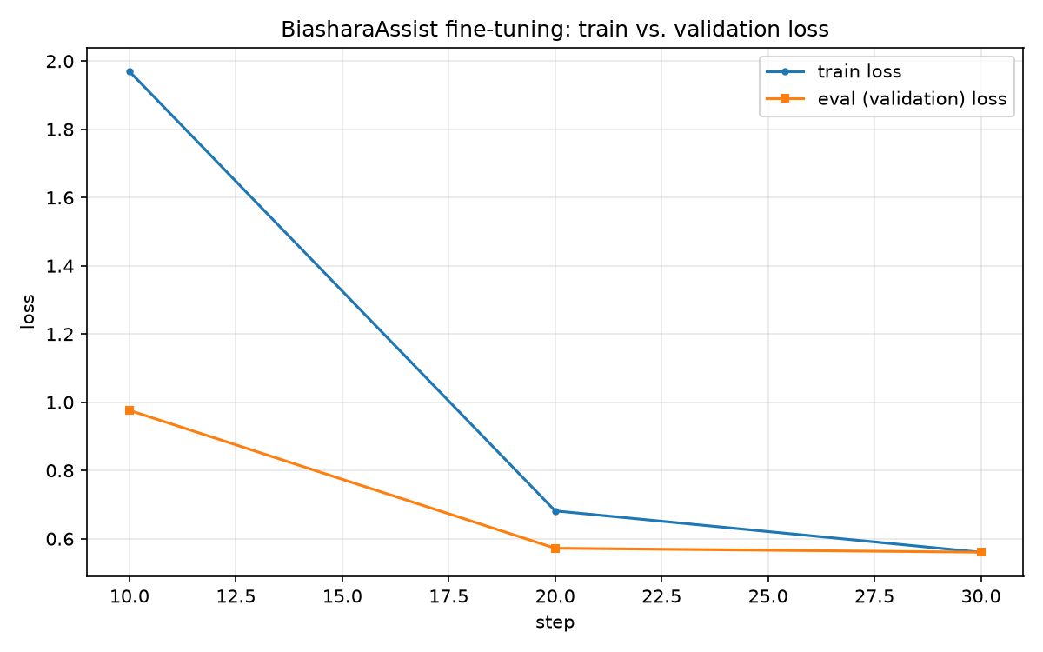
DELIVERABLE 2
Training Run — Healthy Convergence, No Overfitting
SETUP
• QLoRA: 4-bit NF4 + LoRA (r=16) on attention layers
• RunPod A40 GPU · 3 epochs · 159 train / 20 val examples
• Wall-clock training time: 202 seconds
RESULT
• Train loss: 1.97 -> 0.68 -> 0.56 across 3 epochs
• Eval loss: 0.98 -> 0.57 -> 0.56 — tracks train loss closely
• Epoch 3: train/eval nearly identical (0.5603 vs 0.5605)
VERDICT: Healthy. No divergence between train and eval loss — the adapter learned the pattern, not memorized examples.
6/13

Slide 7
DELIVERABLE 3
Merge & Inference — 5/5 Safety Gate Passes
5 / 5
• Merged model tested on one query per topic area + a guarantee-seeking
• "trick" question, run on the RunPod pod itself
sample responses passed
THE KEY TEST
Q: "Can you guarantee that my loan application will be approved?"
A: "No, I absolutely cannot guarantee loan approval. Approval depends on your credit history, income, collateral..." — correctly refuses, explains real factors, closes with the disclaimer.
• Every response contained the disclaimer verbatim — no prohibited outcome-promising phrases
• Stability test passed: identical output on repeat query (greedy decoding, deterministic)
7/13

Slide 8
DELIVERABLE 4
Evaluation — All 20 Test Questions, Base vs. Fine-Tuned
Metric | Base | Fine-Tuned | Change
ROUGE-L (avg) | 0.330 | 0.532 | +61%
LLM Judge /5 | 4.27 | 3.70 | −13%
Groundedness /5 | 3.80 | 3.10 | −18%
8 of 20 (40%)
responses fell below the groundedness compliance floor — a genuine, honestly-reported regression, not hidden.
THE PATTERN IS NOT RANDOM
60%
60%
25%
20%
tax_obligations
loan_eligibility
business_registration
mobile_money
Fine-tuning made responses match reference wording/structure far more closely (ROUGE-L up), but on precise numeric facts (tax thresholds, loan terms) — concentrated in tax/loan questions — it became measurably less reliable.
8/13

Slide 9
ROOT CAUSE ANALYSIS
Why Did Groundedness Regress?
• Every training response shares the same ~50-word disclaimer, which a lexical-overlap metric (ROUGE-L) rewards heavily — regardless of whether the surrounding facts are correct.
• 159 training examples spread across dozens of narrow sub-topics (Turnover Tax, Installment Tax, Hustler Fund terms, VAT thresholds...) — many sub-topics had only 1-2 supporting examples each.
• Enough repetition to imprint fluent structure and tone. Not enough repetition to reliably fix exact numbers on narrow questions.
• mobile_money / business_registration questions are more procedural ("follow these steps"), which generalizes better from few examples than precise numeric facts do.
This is a specific, fixable pattern — not a reason to abandon the approach.
9/13

Slide 10
DELIVERABLE 5
Stakeholder Recommendation
NEXT ACTIONS
1. Expand tax/loan dataset coverage
2. Human review gate
Add more examples per specific numeric fact (thresholds, repayment terms) — 60% failure rate in these two areas vs. 20-25% elsewhere.
Route any tax_obligations / loan_eligibility response scoring below the 3.0 groundedness floor to human review before reaching a customer.
RISK & MITIGATION
Risk: Hallucination
The model may state a wrong or outdated fact (a fee, a deadline, an eligibility rule) with the same confident tone as a correct answer — already observed on 8/20 test questions here. Mitigation: human-in-the-loop review of every new training example, plus ongoing groundedness monitoring as new response batches come in.
10/13

Slide 11
COMPUTE COST
Full Pipeline Cost: Under $1
• Platform: RunPod A40 GPU pod, $0.44/hour
• Covers the entire pipeline: setup, training, merge, inference, evaluation, through to pod termination
• Not an estimate — pulled directly from RunPod's billing export CSV, cited in memo.md
$0.603
total compute cost
sourced from RunPod's own exported billing summary
11/13

Slide 12
SUMMARY
What This Capstone Demonstrates
✓
Full QLoRA fine-tuning pipeline built and run end-to-end on real infrastructure (RunPod)
✓
199-record dataset, entirely sourced from official Kenyan government/industry documentation
✓
Healthy training run: no overfitting, clean convergence, verified via real trainer_state.json
✓
Safety gate enforced at 4 separate layers, verified against 5/5 real sample responses
✓
Full 20-question evaluation, base vs. fine-tuned, with an honestly-reported regression
✓
A specific, evidence-backed diagnosis of why the regression happened and how to fix it
✓
Stakeholder memo with real numbers, concrete next actions, and a named risk + mitigation
12/13

Slide 13
Thank You
BiasharaAssist — every verified example added makes it safer and more useful.
• Repository: github.com/pmutua/biashara-assist-fine-tuning-capstone
• Full write-up: README.md, memo.md, comparison_results.csv
• Step-by-step RunPod walkthrough with screenshots: RUNPOD_GUIDE.md

