Slide 1

NYU CLOUD COMPUTING · SPRING 2026
Research Paper Summarizer
A serverless, event-driven platform on AWS
Pranjal Mishra · Yang Zheng · Shreyas Sankpal · Kerry Huang
Notes:
Hi everyone. We built a serverless platform that searches academic repositories, downloads papers, and produces structured summaries using a large language model on Bedrock. Over the next five minutes we'll walk through the problem, the architecture, the asynchronous pipeline that does the heavy lifting, team contributions, and the numbers it produces.

Slide 2
The problem
arXiv now indexes over 2.4 million preprints. Researchers can't read everything — they need a triage tool that does more than search.
01
02
03
Multi-source search
Structured summary
Grounded follow-ups
Ranked papers from arXiv and Semantic Scholar in 1–2 seconds, deduped by arxivId, DOI, and normalized title.
Five sections — objectives, methodology, results, limitations, contributions — produced asynchronously in roughly 30 seconds.
Talk-to-PDF chat with retrieval-augmented citations against the paper's own chunks, plus a knowledge graph of typed entities.
Operational constraint: AWS managed services only · zero idle cost · reproducible from infrastructure-as-code
Notes:
Three concrete user goals frame what we built. First — multi-source search across arXiv and Semantic Scholar, deduped, in a couple of seconds. Second — a structured summary with five named sections, returned in roughly half a minute. Third — grounded follow-ups: a chat panel that cites the paper's own chunks, plus a knowledge graph of entities and relationships. On top of that, a class-project operational constraint: managed AWS only, and zero cost when nothing's running.

Slide 3
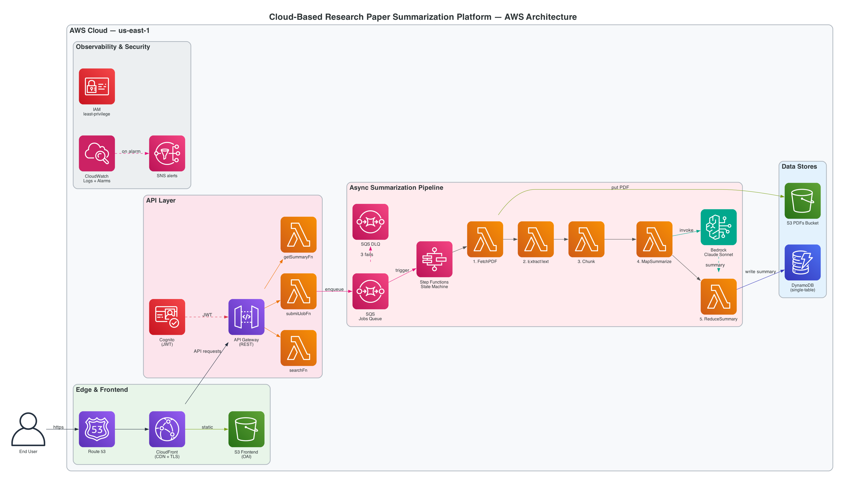
Architecture
15 single-purpose Lambdas · CDK in TypeScript · all communication via API Gateway, SQS, or Step Functions
Edge CloudFront → S3 (frontend) · OAC private bucket
Sync API Cognito JWT → API Gateway → 9 handler Lambdas
Async SQS → Step Functions → 5-state map-reduce pipeline
Notes:
Here's the deployed topology. CloudFront serves the Next.js static export from a private S3 bucket on the left. API Gateway in the middle is the only thing the user talks to dynamically — every route gates on a Cognito JWT before hitting any Lambda. The right side is the asynchronous pipeline: when a user submits a paper, the API writes to DynamoDB, drops a message on SQS, and returns a 202 in well under a second. A trigger Lambda picks up that message and starts a Step Functions execution that fetches the PDF, extracts text, chunks it, runs Bedrock in parallel over the chunks, and reduces back down to a single summary written to DynamoDB.

Slide 4
Why Step Functions, not one big Lambda
FetchPDF
›
ExtractText
›
Chunk
›
MapSummarize
›
ReduceSummary
parallel · capped at 5 concurrent
15-minute Lambda ceiling
Per-chunk retry, not whole-job
Visual debug graph
A 30-page paper with 12 parallel chunks plus reduction can blow past it. Step Functions has no such limit.
If one chunk's Bedrock call is throttled, that chunk retries with backoff — the other 11 succeed once and only once.
Step Functions renders the execution as a diagram. Failures show exactly which state failed and why.
Heavy intermediate data (PDFs, extracted text, chunks) lives in S3 — only S3 keys thread through state inputs to stay under the 256 KB limit.
Notes:
The pipeline is the most interesting design choice in the project. We chose Step Functions over a single fat Lambda for three reasons. First, Lambda has a hard 15-minute timeout — a long paper with parallel chunk summarization plus a reduction can blow past it. Second, Step Functions externalizes retry: if one chunk gets throttled by Bedrock, only that chunk retries while the others succeed once and only once. Third, the execution renders as a visual graph in the AWS console — invaluable when debugging. We also pass S3 keys, not text, between states to stay under the 256 KB Step Functions input limit. The MapSummarize state is highlighted because that's where we cap concurrency at 5 to stay under our Bedrock tokens-per-second quota.

Slide 5
Team contributions
Who did what across the platform
Pranjal Mishra · Architecture & Frontend Lead
Architecture, CDK (all 6 stacks), Next.js frontend, Step Functions design, Bedrock integration, RAG chat, knowledge graph, ops
Yang Zheng · Search Service
searchFn, arXiv API client, Atom XML parser, structured error handling, 14 vitest unit tests
Shreyas Sankpal · Pipeline
Pipeline & orchestration
Kerry Huang · Auth & API
Auth & API
Notes:
Quick run through the team. Pranjal led the architecture — every CDK stack, the Next.js frontend, the Step Functions design, the Bedrock integration, the RAG chat, the knowledge graph, and ops. Yang built searchFn — arXiv API client, Atom XML parser, structured error handling, and 14 vitest unit tests. Shreyas worked on pipeline and orchestration. Kerry covered authentication and API.

Slide 6
What it produces
Numbers from CloudWatch and DynamoDB on the live system
27–50s
$0.20
$0.00
0
end-to-end summary on a real arXiv paper
marginal cost per paper (Bedrock tokens)
monthly cost when no traffic served
messages in the dead-letter queue, ever
Live at d24irdkbe9jj2b.cloudfront.net — verified end-to-end
✓
Email signup with Cognito email verification → SRP login → JWT-protected API
✓
Search on arXiv + Semantic Scholar, dedup by arxivId/DOI/title, paper card UI
✓
Submit → 202 with jobId → poll until done → 5-section summary in ~30 s
✓
Talk-to-PDF chat with cited chunks · related papers · React Flow knowledge graph
Notes:
The numbers come from CloudWatch and DynamoDB on the live deployment. End-to-end summarization on a real arXiv paper completes in 27 to 50 seconds — the variance is driven by chunk count, since the parallel Map state caps wall-clock time at the slowest chunk. Marginal cost per paper is roughly twenty cents in Bedrock token usage. Idle cost is zero — when nobody's using the system, nothing's running, and the bill reflects that. The dead letter queue has stayed empty in production. We verified the complete user flow live: signup with Cognito email verification, SRP login, JWT-protected API calls, multi-source search, submit-and-poll, and the five-section structured summary. The retrieval-augmented features — chat, related papers, knowledge graph — all ship too.

Slide 7

WHAT WE LEARNED
A small piece of well-designed state
supports a broad range of features.
Chunk vectors stored at pipeline time power three downstream features for free: retrieval-grounded chat, related-papers ranking, and the knowledge graph. The same Lambda fleet, the same DynamoDB table, the same Bedrock IAM role.
SHIPPED
NEXT
5-section structured summaries
Multi-source search + dedup
Talk-to-PDF retrieval chat
Knowledge graph + related papers
Per-user quota + content-hash dedup
CloudWatch dashboard, 4 alarms, X-Ray, Budgets
Side-by-side PDF reader (pdfjs-dist)
Cross-paper comparison table
Streaming chat via Lambda Function URLs
Multi-region DR (DynamoDB global tables)
AWS WAF in front of CloudFront + APIGW
Grobid on Fargate for richer extraction
Thanks — happy to take questions.
Notes:
The takeaway I want to leave you with: a small piece of well-designed state — the chunk embeddings we compute once during the summarization pipeline — ends up supporting three different downstream features. The retrieval-grounded chat, the related-papers ranking, and the knowledge graph all run on the same vectors. Looking ahead, the natural next steps are a side-by-side PDF reader using pdfjs-dist, cross-paper comparison views, and streaming chat responses through Lambda Function URLs. On the cloud-engineering side, multi-region DR with DynamoDB global tables, AWS WAF, and a richer PDF parser like Grobid running on Fargate. Happy to take questions.

