Slide 1
NEW YORK UNIVERSITY • DEPARTMENT OF COMPUTER SCIENCE • CLOUD COMPUTING • SPRING 2026
Research Paper Summarizer.
A serverless, event-driven AWS platform that searches arXiv and Semantic Scholar, fetches full-text PDFs, and produces structured five-section summaries in roughly thirty seconds. Built end to end on managed services with zero idle cost.
Pranjal Mishra • Yang Zheng • Shreyas Sankpal • Kerry Huang
FINAL PROJECT
d24irdkbe9jj2b.cloudfront.net

Slide 2
I. SYSTEM OVERVIEW
01 / 08
Triage is the bottleneck.
Search engines surface relevant titles. Citation graphs reveal influence. General-purpose chat assistants will summarize a paper if the user pastes it. None of these, alone, is a workflow.
2.4M+
preprints indexed by arXiv alone, doubling roughly every decade. The platform delivers three composable capabilities on one shared backbone of chunk vectors persisted in Amazon DynamoDB.
01. SEARCH
02. SUMMARIZE
03. GROUND
Multi-source ranked search.
Asynchronous five-section summary.
Retrieval-augmented features.
arXiv and Semantic Scholar invoked in parallel from a single Lambda; results deduplicated by arxivId, DOI, and normalized title in one to two seconds end to end.
Objectives, methodology, results, limitations, contributions. SQS-triggered Step Functions map-reduce. Done in roughly thirty seconds for a typical paper.
Talk-to-PDF chat with cited chunks, related-papers ranking by cosine similarity, and a typed knowledge graph; all from the embeddings the pipeline already wrote.
NYU CLOUD COMPUTING • SPRING 2026
MISHRA • ZHENG • SANKPAL • HUANG

Slide 3
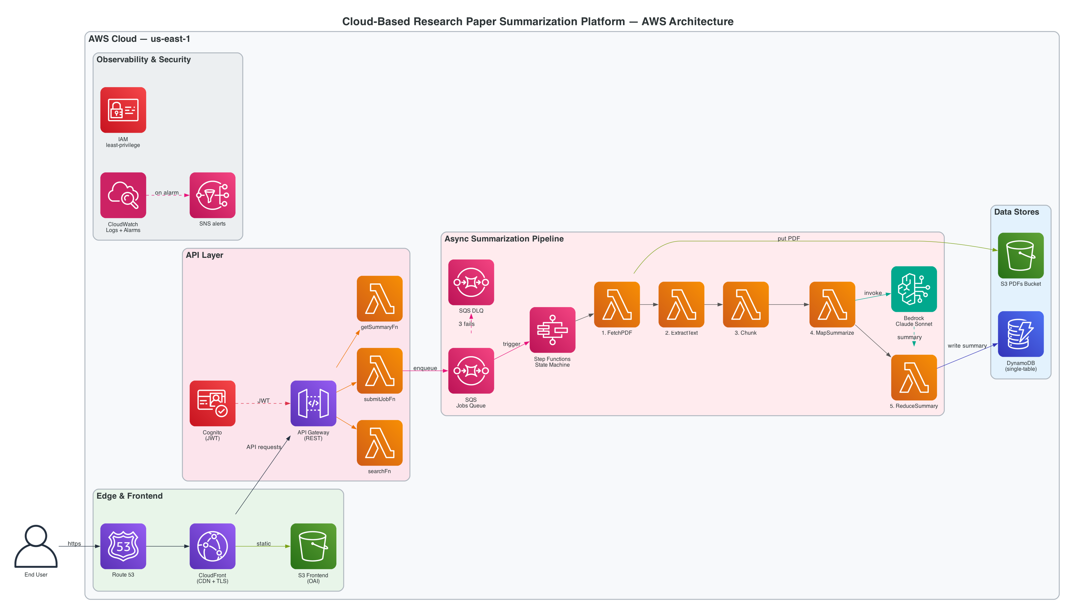
II. ARCHITECTURE
02 / 08
Fifteen single-purpose Lambdas, six CDK stacks, three managed data stores.
Inter-service communication restricted to API Gateway, Amazon SQS, AWS Step Functions, and Amazon DynamoDB. No Lambda directly invokes another Lambda.
NYU CLOUD COMPUTING • SPRING 2026
MISHRA • ZHENG • SANKPAL • HUANG

Slide 4
III. ASYNCHRONOUS DATA PIPELINE
03 / 08
Why a state machine, not one large Lambda.
Map-reduce summarization is the hot path. The five-stage AWS Step Functions execution sidesteps the Lambda fifteen-minute ceiling, isolates per-chunk failures, and keeps state inputs under the 256 KB limit.
STAGE 1
STAGE 2
STAGE 3
STAGE 4 · MAP
STAGE 5
FetchPDF
ExtractText
Chunk + Embed
MapSummarize
ReduceSummary
S3-cached
pdf-parse
~1500 tok / chunk, 400 char overlap
parallel, capped at 5
DynamoDB write
Past the fifteen-minute Lambda ceiling.
Per-chunk retry, not per-job.
S3 keys, not text, in state.
A thirty-page paper, twelve parallel chunks, plus reduction can blow past it. Step Functions has no such limit; long-running orchestration becomes free.
If one Bedrock call is throttled, that chunk retries with exponential backoff. The other eleven succeed once, and exactly once. No duplicate work, no whole-job redo.
Step Functions caps state inputs at 256 KB. Heavy data (PDFs, extracted text, chunks, embeddings) lives in S3. We thread only S3 keys, never bytes.
NYU CLOUD COMPUTING • SPRING 2026
MISHRA • ZHENG • SANKPAL • HUANG

Slide 5
IV. DATA LAYER · SINGLE-TABLE DESIGN
04 / 08
One DynamoDB table. One global secondary index. Every access pattern.
Access patterns are narrow and known in advance. A single-table layout with one GSI keyed on a content hash handles every read, with single-digit-millisecond latency under on-demand billing.
MainTable
Content-hash deduplication via GSI1.
PK = USER#<userId>. SK prefix encodes entity type.
A second user submitting a paper a first user already summarized triggers a GSI1 lookup, copies the existing JOB record, and refunds the second user's quota.
PK
SK
ITEM
USER#u123
PROFILE#
quota, plan
USER#u123
JOB#j789
summary, sections, meanEmbedding
Two S3 buckets, distinct postures.
Frontend bucket: private, served only via CloudFront Origin Access Control. PDFs bucket: 30-day IA transition, 90-day expiration. Storage cost stays flat.
JOB#j789
CHUNK#0
text, 1024-d Titan v2 vector
JOB#j789
CHUNK#1
text, vector
GSI1: PAPER#<sha256>
JOB#j789
cross-user content-hash dedup
Encryption and on-demand billing.
AWS-managed KMS at rest. On-demand DynamoDB billing means storage cost scales with actual usage. Block-public-access enabled on every bucket.
NYU CLOUD COMPUTING • SPRING 2026
MISHRA • ZHENG • SANKPAL • HUANG

Slide 6
V. RELIABILITY · OBSERVABILITY · IAM
05 / 08
Every cross-service call has an explicit failure path.
Idempotent writes, bounded retries, dead-letter quarantine, alarmed observability, least-privilege IAM. Six properties the rubric asks for and the system actually exhibits.
01
02
03
Idempotent by construction.
Retry where it makes sense, DLQ where it does not.
Failures surface, never vanish.
Step Functions execution name derived from jobId; an SQS redrive is rejected as duplicate. Every DynamoDB write keys on jobId, so a replay never corrupts state.
Step Functions retries each task with exponential backoff. SQS redrive policy moves messages to a dead-letter queue after three failed attempts. No infinite loops.
A MarkFailed state catches any uncaught error from any prior state, captures the cause, updates the JOB record to status "failed". The user sees a clean reason.
04
05
06
Observability across every Lambda.
Least-privilege IAM, per function.
No Lambda-to-Lambda direct calls.
Four CloudWatch alarms (DLQ depth, SF failure count, pipeline errors, API errors) wired to SNS email. AWS X-Ray distributed tracing. AWS Budgets at $50 / month.
searchFn cannot read the PDFs bucket. getSummaryFn cannot write DynamoDB. mapSummarize cannot read Cognito. Each Lambda role is the narrowest it can be.
Inter-service communication is API Gateway, Amazon SQS, AWS Step Functions, or Amazon DynamoDB. Never lambda.invoke. A defect cannot cascade by direct call.
NYU CLOUD COMPUTING • SPRING 2026
MISHRA • ZHENG • SANKPAL • HUANG

Slide 7
VI. EVALUATION
06 / 08
Measured against real arXiv submissions.
Numbers below are drawn from CloudWatch metrics and DynamoDB on the live deployment. Not benchmarks. Not promises.
END-TO-END SUMMARY
MARGINAL COST
IDLE MONTHLY COST
DLQ MESSAGES
27–50 s
$0.20
$0.00
0
Submit to "done", chunked, parallel-summarized, reduced. Wall-clock dominated by the slowest chunk plus reduction, not by chunk count.
per paper, dominated by Bedrock tokens. Repeat submissions are free via content-hash deduplication on GSI1.
Every component except Bedrock fits the AWS free tier at our scale. No traffic, no bill. By design, not by accident.
Messages stuck in the dead-letter queue across the deployment. Every failure surfaces with a cause string written to the JOB record.
NYU CLOUD COMPUTING • SPRING 2026
MISHRA • ZHENG • SANKPAL • HUANG

Slide 8
VII. TEAM AND RESOURCES
07 / 08
Built by four people, owned end to end.
Pranjal Mishra
Yang Zheng
ARCHITECTURE, FRONTEND, RAG, OPS
SEARCH SERVICE
Six CDK stacks, the Next.js frontend, the AWS Step Functions state machine, Amazon Bedrock integration, RAG chat with cited chunks, the knowledge graph extractor and visualization, the CloudWatch dashboard, four alarms, AWS X-Ray tracing, AWS Budgets, the deploy automation.
searchFn Lambda, the arXiv API client, the Atom XML parser, parameter validation with structured error handling, and 14 vitest unit tests covering query construction, Atom parsing, and handler edge cases.
Shreyas Sankpal
Kerry Huang
PIPELINE ORCHESTRATION
AUTHENTICATION AND API
Pipeline orchestration design discussions and chunking-strategy review for the map-reduce summarization stages.
Authentication and API design discussions for the Amazon Cognito User Pool, the Secure Remote Password login flow, and the API Gateway authorizer surface.
Thank you. Live demonstration follows.
d24irdkbe9jj2b.cloudfront.net • github.com/pmxlr8/research-summarizer
NYU CLOUD COMPUTING • SPRING 2026
MISHRA • ZHENG • SANKPAL • HUANG

