Slide 1
A Further Look at Transformations
The goal of transformations is to change the numeric scale that we use to represent the variable so that the values on the transformed scale more closely approximate the desired normal distribution or linear relationship with another variable.
Mathematically we can create a different but equivalent set of values for a numeric variable by performing the same arithmetic operation on each value in the set. For example, suppose we represent the earnings of three subjects on the metric variable INCOME as $10,000, $15,000, and $17,000. The interval between the INCOME of subject 1 and subject 2 is $5,000. The interval between INCOME for subject 2 and subject 3 is $2,000. If we add $1,000 to each subjects INCOME to create the transformed variable TINCOME, our three subjects have transformed values of $11,000, $16,000, and $18,000. The actual income of the three subjects did not change, but the way we represented their income on the TINCOME variable is different. The relationships between the three real income values are preserved in the transformed values, i.e. the interval between TINCOME of subject 1 and subject 2 is $5,000. The interval between TINCOME for subject 2 and subject 3 is $2,000.
We can reverse the arithmetic operation on the transformed variable to produce the value of the original variable. In fact, we need to be careful to distinguish between the measurement units of the original variable and the measurement units of the transformed variable. The transformed variable is used in the statistical calculations and the statistical output is expressed in transformed measurement units. In our interpretation, we must reverse the transformation when we want to discuss findings in the original measurement units.
For example, dependent variables like income and housing value are often expressed in logarithmic units because the distribution of the data is skewed by a few extremely large values. If we used our analysis to estimate the value of the dependent variable for some combination of independent variables, the estimate would be in logarithmic units. To make this a useful estimate, we would have to convert the logarithmic estimate back to a decimal value.
A Further Look at Transformations

Slide 2
1. Transformations to Achieve Normality
While there are a variety of transformations, three are usually identified as being effective in inducing normality in a skewed distribution: the logarithmic transformation, the square root transformation, and the inverse transformation. We will look at prototype diagrams for the distributional problems that each is designed to correct.
The formulas for computing transformed variables are all computed for positive skewing. If our distribution is negatively skewed, we apply a reverse-coding process referred to as reflection to reverse the skew of our distribution from negative to positive, and then apply the formula for reducing positive skewing.
Transformations work by changing the relative distance between the numeric values in a measurement scale. Small values are positioned further apart and large values are positioned closer together. In effect, the transformation changes the measurement scale of the horizontal axis of the histogram, spreading out values that are too close together and drawing in values that are spread too far apart.
We will use the SPSS data set World95.Sav to demonstrate examples of various transformations.
A Further Look at Transformations

Slide 3
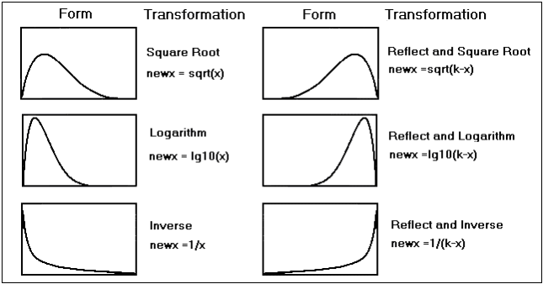
Prototypical Histograms for Non-normal distributions
The forms in the following diagram represent the shape that we might see for the histogram of a metric variable that is not normally distributed. Beside each from is the formula for the transformation that may induce normality for a variable with the displayed histogram. If the variable is positively skewed, we use the formulas in the first column. If the variable is negatively skewed, we reverse the values of the variable (reflection) and apply a formula similar to the transformation in the first column.
A Further Look at Transformations

Slide 4
Reversing the Values of a Variable
We stated above that adding the same number to all values of a variable is an allowable mathematical operation. A number that is added to all values is referred to as a constant and is represented in the formulas by the letter k. The value of the constant for any set of values should be the one unit larger than the largest value of the variable for any case in the sample. For example, if the values of the variable age for some sample are from 21 to 45, the constant that we would choose to reverse code the values is 45 + 1, or 46.
When we reverse code the values for a histogram with negative skewing, we produce a mirror image histogram that is reversed from left to right.
A Further Look at Transformations

Slide 5
The Formulas for Transformations
In the diagram of prototypes for non-normal distributions, the formulas are entered using the SPSS function that would compute the transformation. To compute the transformation, we enter the formula and function as shown in the diagram in the 'Numeric expression:' text box on the 'Compute Variable' dialog box.
When we compute a transformation, we may receive a message on SPSS Output Log that we have performed an illegal mathematical operation, such as:
The argument for the log base 10 function is less than or equal to zero on the
indicated command. The result has been set to the system-missing value.
The argument to the square root function is less than zero. The result has been
set to the system-missing value.
A division by zero has been attempted on the indicated command. The result has
been set to the system-missing value.
To solve this problem, we add a constant to every value for the variable that will prevent the illegal mathematical operation by making the smallest value for any case equal to zero or one. To do this we find the smallest value for any case for the variable and add a constant that would make the smallest value equal to zero or one, depending on which transformation we are using. For example, suppose infants were represented in our data set as 0 years of age and we wanted to do a logarithmic transformation of the variable with the formula 'LG10(age)'. We would receive the message that the argument to the log function is equal to zero for all infants in the sample. To solve this problem, we would add a constant of 1 to the formula for the transformation, 'LG10(age + 1)' and we avoid the error message.
While the diagram of forms and transformations suggests that it would be easy to determine which transformation would be effective for which distribution, it is more difficult in practice. In fact, the usual practice is to compute the set of three transformations and use the one which produces a normal distribution. In many cases, none of the transformations will be effective, in which case, we retain the original variable, noting the violation of the assumption as a limitation in our interpretation.
A Further Look at Transformations

Slide 6
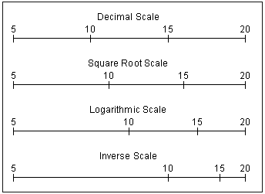
The Measuring Scales for the Transformations
In the following diagram, the values of 5 through 20 are plotted on the different scales used in the transformations. These scales would be used in plotting the horizontal axis of the histogram depicting the distribution. When comparing values measured on the decimal scale to which we are accustomed, we see that each transformation changes the distance between the benchmark measurements. All of the transformations increase the distance between small values and decrease the distance between large values. This has the effect of moving the positively skewed values to the left, reducing the effect of the skewing and producing a distribution that more closely resembles a normal distribution.
A Further Look at Transformations

Slide 7
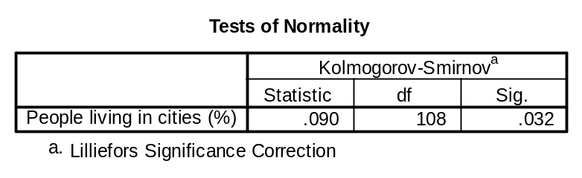
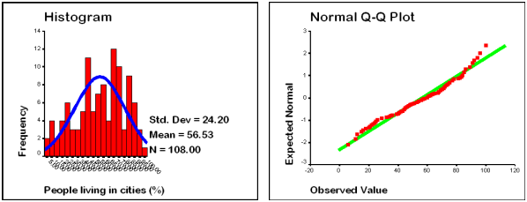
A Variable Correctable with a Square Root Transformation
The SPSS output shown below shows the test of normality, the histogram, and the normality plot for the variable "People living in cities" (urban) from the data set World95. As we can see, the distribution fails the test of normality because of negative skewing (skewness = -0.308 in the table of descriptive statistics). The suggested transformation for this distribution is "Reflect and Square Root." Since the largest percentage of persons living in cities is 100, the formula for the transformation is SQRT(101-urban).
A Further Look at Transformations

Slide 8
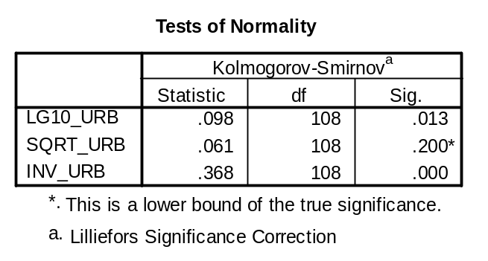
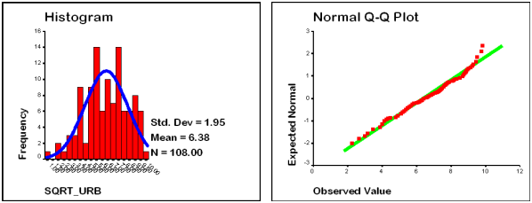
A Distribution Corrected with a Square Root Transformation
While we suspect that the transformation that will be effective is the square root transformation, we will compute all three (logarithmic, square root, and inverse) and choose the one which has the best consequence on the test of normality. As we expected, the table below indicates that the square root transformation, SQRT_URB, creates a distribution that is statistically normal according to the K-S Lilliefors test, though the histogram and normality plot continue to show evidence of slight departures from normality.
A Further Look at Transformations
A Further Look at Transformations

Slide 9
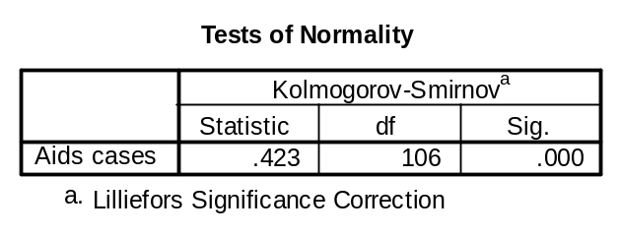
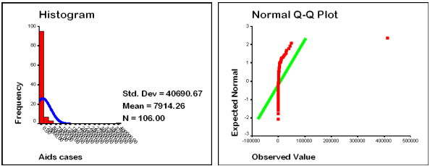
A Variable Correctable with a Logarithmic Transformation
The tests of normality, histogram, and normality plot for the variable Aids cases from the World95 data set are shown below. The variable clearly does not follow a normal distribution. The prototype diagrams for transformations would suggest that an inverse transformation would be effective in achieving normality.
A Further Look at Transformations
A Further Look at Transformations

Slide 10
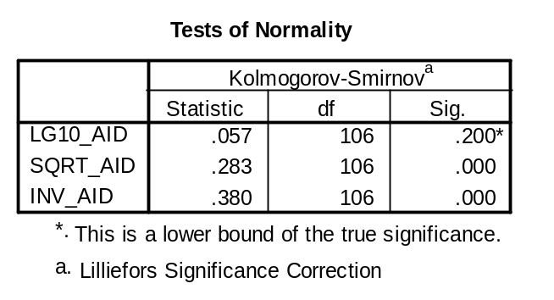
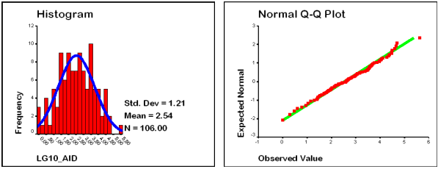
A Distribution Corrected with a Logarithmic Transformation
The logarithmic, square root, and inverse transformations were computed for this variable. The computation for the logarithmic transform issued error messages because some countries had zero aids cases, and the logarithm of zero is not defined mathematically. To correct this error, a constant of 1 was added to the calculations for all cases, so that the formula for the log transformation was LG10(1 + aids).
The test of normality indicates that the log transformation, and not the inverse transformation, is effective in achieving a normal distribution. This may be due in part to the presence of an extremely large value, shown near the right margin of the normality plot for the original variable. If we scan the aids variable in the data editor, we see than the USA has over 400,000 cases, substantially higher than the next largest value of less than 50,000. When an extreme value is included in a chart, it has the effect of compressing the display of the other cases in the data set.
The histogram and normality plot for the transformed aids variable are shown below.
A Further Look at Transformations
A Further Look at Transformations

Slide 11
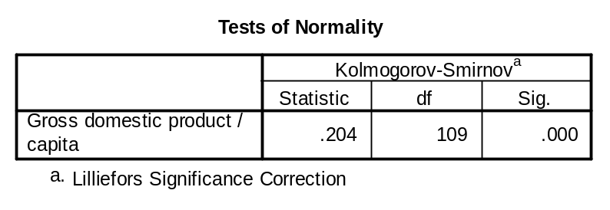
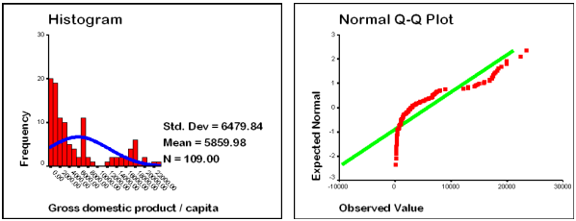
A Variable Correctable with a Logarithmic Transformation
Per capita gross domestic property is the type of variable representing wealth or income that we would expect to be positively skewed by a small number of very large values. The test of normality indicates that the variable is not normally distributed, and the histogram supports the presence of positive skewing.
A Further Look at Transformations
A Further Look at Transformations

Slide 12
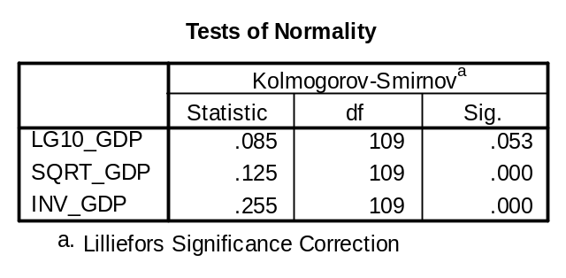
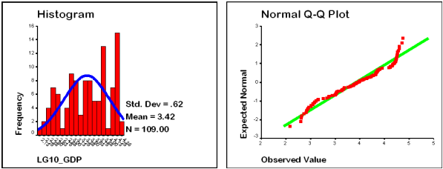
A Distribution Corrected with a Logarithmic Transformation
Since we have learned that we cannot tell from visual inspection which transformation will be effective in inducing normality, we compute the logarithmic, square root, and inverse transformations for the variable.
The tests of normality indicate that we cannot reject the null hypothesis of a normal distribution for the log transformation of the gross domestic product variable. The histogram and normality plot support the conclusion that the violation of normality has been substantially reduced.
A Further Look at Transformations
A Further Look at Transformations

Slide 13
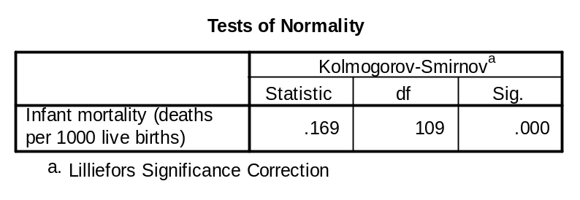
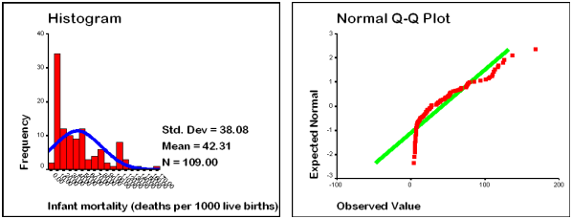
A Variable Not Correctable with a Transformation
The evidence from the test of normality, the histogram, and the normality plot support a conclusion that the variable for Infant mortality is not normally distributed. We would anticipate that one of our transformations would be effective in achieving normality.
A Further Look at Transformations
A Further Look at Transformations

Slide 14
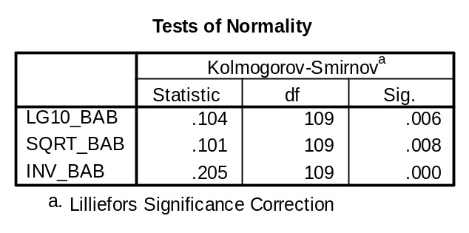
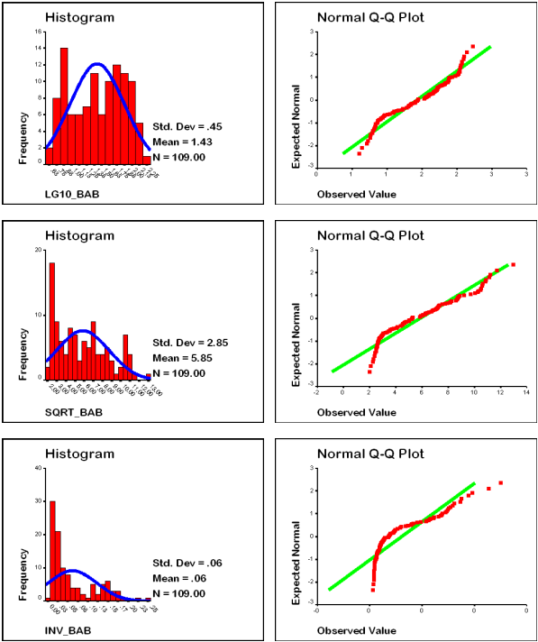
Distributions Failing to Achieve Normality with a Transformation
The tests of normality support a conclusion that the distribution for each of the three transformed variables is not normally distributed. The histograms suggest that the log transformation produces a plot that lacked central tendency, while the square root and inverse transformations failed to substantially reduce the skewness in the original variable.
In further analyses, we would use the original form of the variable, noting in our interpretation and conclusions, the problem with normality for this variable.
A Further Look at Transformations
A Further Look at Transformations

Slide 15
2. Transformations to Achieve Linearity
Transformations to achieve normality operate on a single metric variable. Transformations to achieve linearity operate on a pair of metric variables. Instead of diagnosing the problem with a histogram of a single variable, we examine scatterplots that show the pattern of both variables. The diagnostic diagram of nonlinear patterns and recommended transformations is shown on page 77 of the text.
It is easier to assess nonlinearity by including the fit line or trend line on the scatterplot. Nonlinearity can be identified by a concentration of data points present on one side of the fit line and absent on the other size for some portion of the fit line. The identification of a nonlinear pattern can sometimes be confused with an absence of data points in a problem in which the sample size is small.
SPSS affords us the option of including the value of R² on a scatterplot when we add the fit line to the scatterplot. This option is useful when we are examining the impact of a transformation. If a nonlinear pattern is corrected by a transformation, it will be accompanied by a substantial increase in the value of R². If the value of R² does not change, then either the relationship was already linear or the transformation was ineffective.
Our focus should be on obvious nonlinear patterns; if there is not an obvious problem, we should treat the data as linear.
The mathematical transformations which attempt to induce linearity are very similar to the transformations to induce normality, but the two processes are separate. Two non-normal variables can have a linear relationship and two normal variables can have a nonlinear relationship. We must test our data for each condition separately.
Like the transformations used to achieve normality, transformations to achieve linearity are a trial-and-error process. I typically compute the entire suite of transformations and select the one to include in the analysis after examining the consequence of each.
A Further Look at Transformations

Slide 16
2. Transformations to Achieve Linearity - 2
We must balance the improvement in the analysis with a transformation against the additional complexity required in our interpretation of the results when we must explain the rationale for using the transformation. The use of transformations can feed the suspicion that statistical analysis is a black art and the transformation is being used to produce a specific result. If the gain from the transformation is slight, we may choose to exclude it to avoid the additional burden of interpretation.
In additions to transformations, we can also use polynomial term (variables raised to a power, eq. x2) to correct for nonlinear relationships. Adding a polynomial term can only be done in the context of a statistical analysis like multiple regression, which we will study in the near future. For this exercise, we will examine the outcome of adding a polynomial term in linearizing a relationship without demonstrating the steps required to achieve this outcome.
A relationship can always be improved by adding higher order polynomial terms to the analysis, even when the justification for adding the terms is questionable. To guard against excessive addition of polynomial terms, we should limit the terms to an order that is one higher than the number of times the data pattern changes direction. If the plot of points takes on a U-shape, the points change direction once, and the highest order polynomial we should consider is 2, or a squared term. If the plot of points takes on an S-shape, the points change direction twice, and the highest order polynomial we should consider is 3, or a cubed term.
The following examples of nonlinear relationships are from the data set 'World95'. They were selected to demonstrate some of the possible nonlinear relationships, and the transformations employed to induce linearity.
A Further Look at Transformations

Slide 17
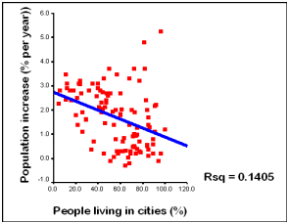
A Weak Linear Relationship
Not all weak relationships are due to nonlinearity. The relationship below would be characterized as a weak relationship by the R² interpretative criteria. There is no evidence of a nonlinear relationship.
A Further Look at Transformations

Slide 18
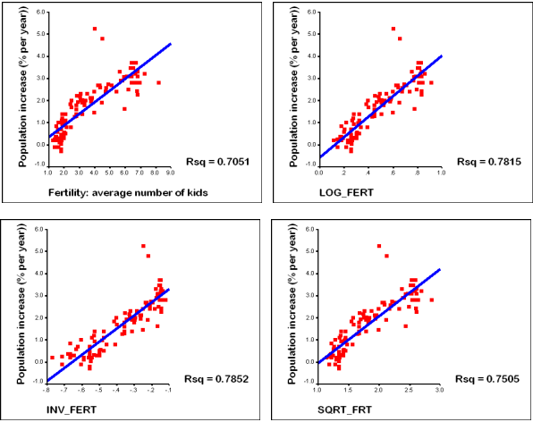
Comparing Effectiveness of Transformations
The relationship between fertility and population increase is shown below on the left of the top row. The evidence of nonlinearity is supported by the concentration of points above the center of the fit line and scarcity of points below the center of the fit line. This pattern closely resembles the generic pattern on panel d of the diagnostic diagram on page 77 of the text, so we compute the recommended log, inverse, and square root transformations.
The results shown below indicate that the inverse transformation is most effective in linearizing the relationship, both in terms of balancing the concentration of data points on both sides of the fit line, and in increasing the size of the R² statistic. The log transformation produces results almost as good as the inverse transformation, and might be selected because log transformations are more common in the research literature than inverse transformations.
A Further Look at Transformations

Slide 19
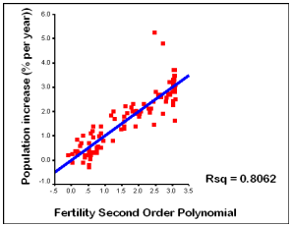
Comparing Effectiveness of Transformations to the Addition of a Polynomial Term
We could also have addressed the nonlinearity by adding a polynomial term for fertility. In this diagram, fertility is represented by the combination of the original fertility variable plus a fertility squared variable. The values plotted on the horizontal axis are the values computed from a regression equation of the relationship between the dependent variable of population increase, and the dependent variables fertility and fertility squared.
The relationship represented by the polynomial equation compares favorably with the results from the inverse and logarithmic transformation of the fertility variable. The selection of one over the other is a matter of preference and ease of interpretation.
A Further Look at Transformations

Slide 20
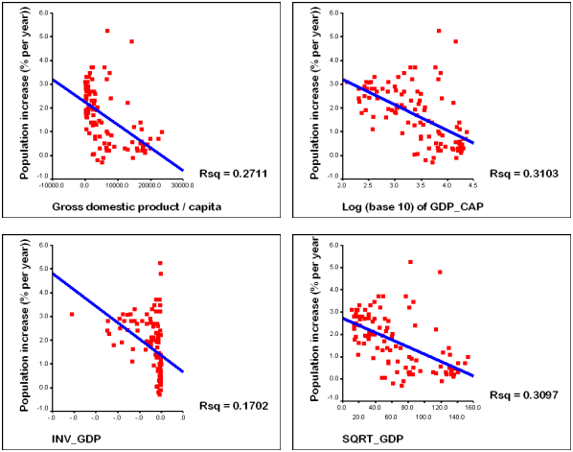
Linearizing Transformations for a Weaker Relationship
The relationship between gross domestic product and population increase is shown below on the left of the top row. The evidence of nonlinearity is supported by the concentration of points below the center of the fit line and scarcity of points above the center of the fit line. This pattern closely resembles the generic pattern on panel c of the diagnostic diagram on page 77 of the text, so we compute the recommended log, inverse, and square root transformations.
The logarithmic transformation does the most effective job in reducing nonlinearity, both in terms of the increase in R² and the redistribution of points along both sides of the fit line. The square root transformation is almost as effective in terms of gain in R², but is less effective in equalizing the distribution of points on both sides of the fit line.
Since the gain in R² is modest for the best of the transformations, the improvement is the analysis is probably not worth the added complexity.
A Further Look at Transformations

Slide 21
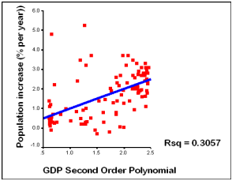
Adding a Polynomial Term to a Weaker Relationship
The results of adding a polynomial term are approximately the same as the results of the log and square root transformation. The weakness in the relationship between these two variables is due to a lack of relationship and not due to the impact of a well-defined nonlinear relationship. The use of a transformation in such circumstances is questionable.
A Further Look at Transformations

Slide 22
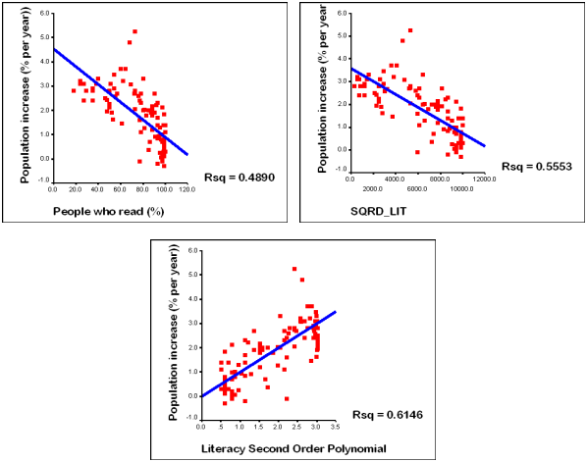
Linearizing Transformations for a Strong Relationship
The relationship between reading literacy and population increase is shown below on the left of the top row. The evidence of nonlinearity is supported by the concentration of points above the center of the fit line and scarcity of points below the center of the fit line. This pattern closely resembles the generic pattern on panel a of the diagnostic diagram on page 77 of the text, so we compute the recommended squared transformation. In addition the results of adding a second order polynomial are shown on the bottom row. The squared transformation does reduce the nonlinearity in the relationship, but is less effective than the addition of the polynomial term, both in terms of linearizing the distribution of points on both sides of the fit line and in terms of the increase in R². The improvement is sufficient to make the addition of the squared term worth including in the analysis.
A Further Look at Transformations

Slide 23
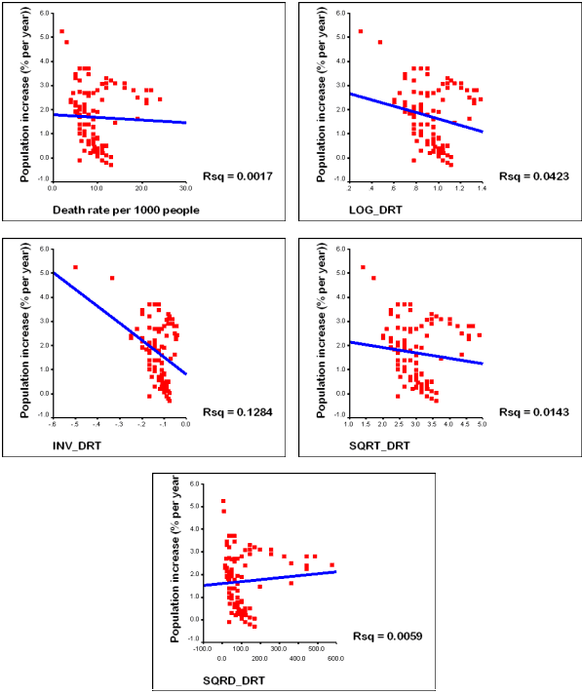
A Well-defined Nonlinear Relationship
In this example, we have a well-defined nonlinear pattern between death rate and population increase that does not clearly resemble any of the generic patterns shown on page 77 of the text.
All four of the transformations for independent variables were computed: log, inverse, square root, and square. The inverse transformation is the only one with an impact on the nonlinearity, and it produced a R² value characteristic of weak relationships.
A Further Look at Transformations

Slide 24
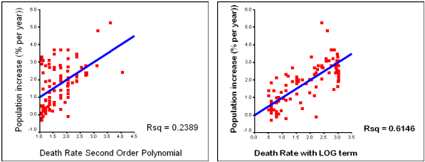
Polynomial Transformation for the Well-defined Nonlinear Relationship
The presence of the well-defined nonlinear relationship prompted the attempt to add several different types of polynomial terms, specifically a squared term and a logarithmic term. While the squared term showed a substantial improvement in linearizing the relationship, the addition of the log term, as shown on the right, produced impressive results indicating that there is a strong relationship between population increase and death rate, when death rate is represented by a combination of the original variable and the a log form of the original variable.
While we can learn to diagnose patterns with greater precision, results like this are often obtained from trial and error exploration.
A Further Look at Transformations

