Slide 1
Estimating Energy Efficiency of Buildings
Matthew Wysocki

Slide 2
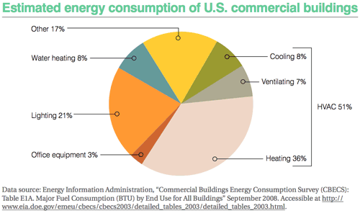
Introduction
Research into building efficiency
Heating, ventilation, and cooling
Software simulations
UCI Machine Learning Repository

Slide 3
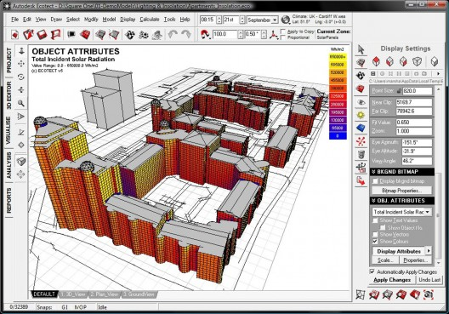
Dataset
Generated using Ecotect
Using 8 different parameters
Relative compactness
Surface area
Wall area
Roof Area
Overall Height
Orientation
Glazing Area
Glazing Area Distribution
Constant volume
Same Materials
768 samples
http://ad009cdnb.archdaily.net/wp-content/uploads/2009/05/1149184021_total-incident-solar-radiation-528x369.jpg

Slide 4
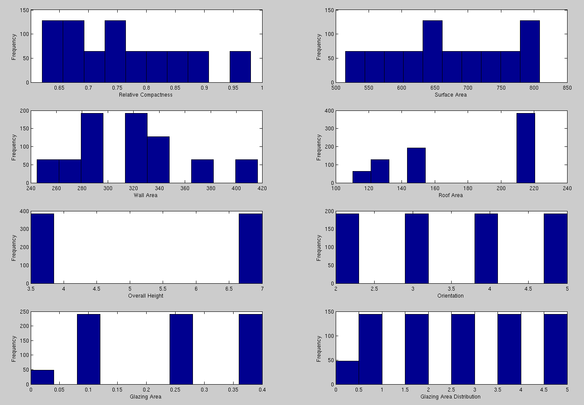

Slide 5
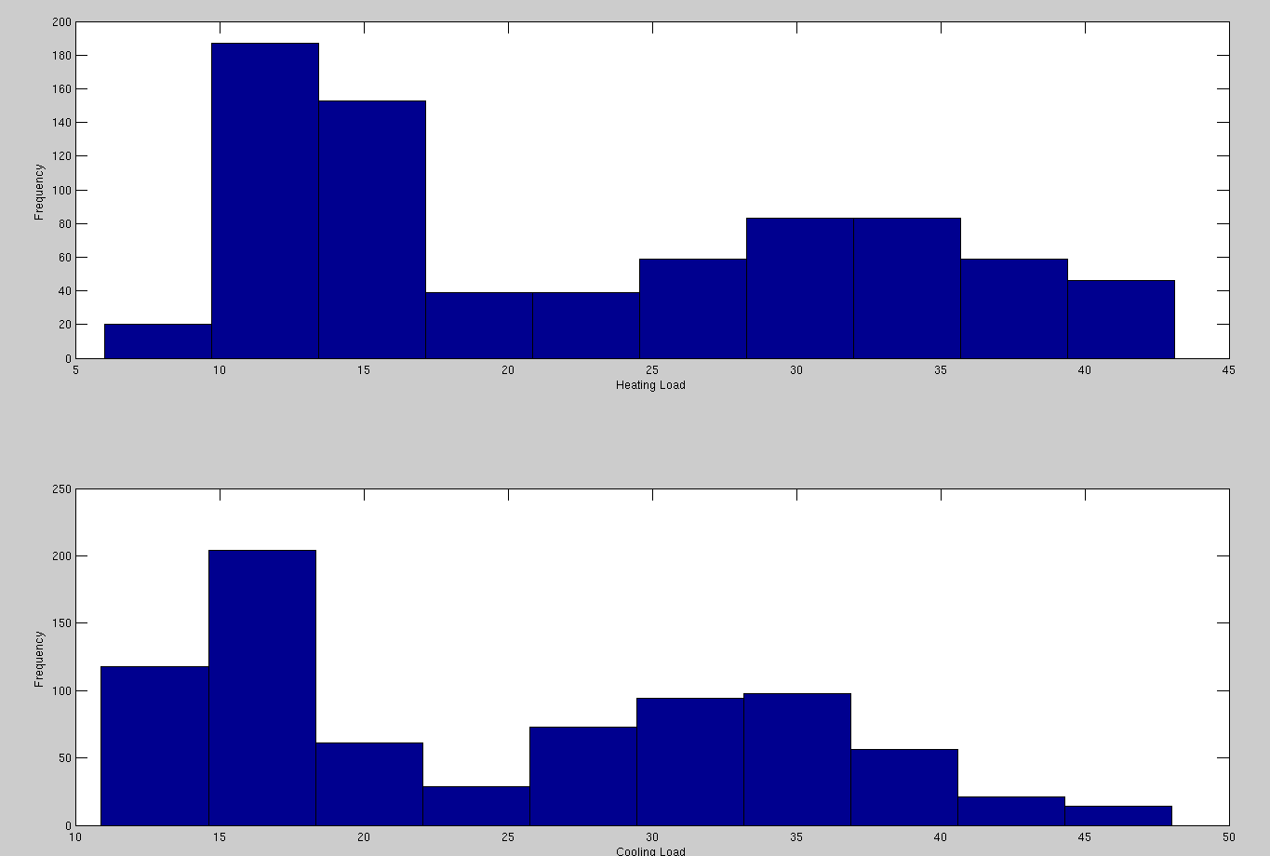

Slide 6
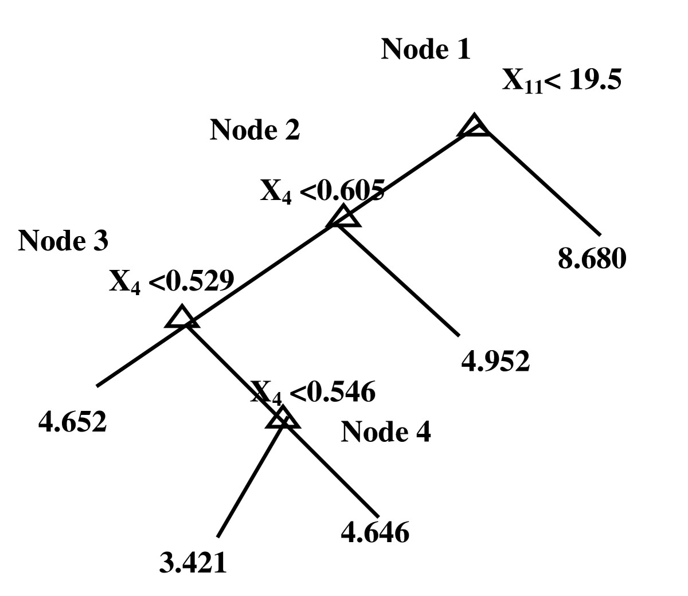
Algorithm
Regression tree
Each node represents a binary decision
Leaves represent outputs
Random forest method
http://www.biomedcentral.com/content/figures/1471-2105-7-101-4-l.jpg

Slide 7
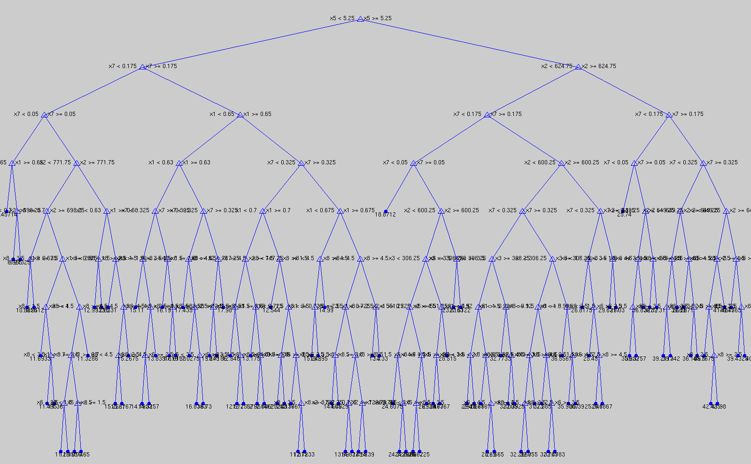

Slide 8
Correlation coefficients (Heating load only)
Input Value | Pearson product-moment coefficient | Spearman’s rank correlation coefficient | Kendall’s rank correlation coefficient
Relative Compactness | 0.6223 | 0.6221 | 0.3541
Surface Area | -0.6581 | -0.6221 | -0.3541
Wall area | 0.4557 | 0.4715 | 0.3424
Roof area | -0.8618 | -0.8040 | -0.6102
Overall height | 0.8894 | 0.8613 | 0.7040
Orientation | -0.0026 | -0.0042 | -0.0031
Glazing Area | 0.2698 | 0.3229 | 0.2632
Glazing Area Distribution | 0.0874 | 0.0683 | 0.0487

Slide 9
Estimating Error
Output variable | Mean Absolute Error | Mean Squared Error | Mean Relative Error
Heating load | 0.52 +- 0.16 | 1.10 +- 0.50 | 2.18 +- 0.61
Cooling | 1.46 +- 0.21 | 6.56 +- 1.57 | 4.61 +- 0.68

Slide 10
Conclusions
Accurate estimates of outputs based on input variables
Good understanding of correlations
Unnecessary to run many simulations

Slide 11
References
Tsanas, A. Xifara: 'Accurate quantitative estimation of energy performance of residential buildings using statistical machine learning tools', Energy and Buildings, Vol. 49, pp. 560-567, 2012
Lee, S., Park, Y., and Kim, C. (2012) Investigating the Set of Parameters Influencing Building Energy Consumption. ICSDC 2011: pp. 211-221.
*Figures without references were generated by me

