Slide 1
Topic Modeling in the Age of Artificial Intelligence
Peter Nadel – Research Technology, TTS, Tufts University
Dr. Rosemary Taylor – Department of Sociology, Tufts University
Kyle Monahan – Research Technology, TTS, Tufts University

Slide 2
What is topic modeling?
Goals:
Take in large corpus and sort documents into topics
In other words, map document organization of the corpus on to a latent structure underlying the corpus
Topic Modeling
Corpus of documents
Topics
Notes:
- Topics represent independent components of the corpus

Slide 3
Previous algorithms: LDA
From Gordon & Nadel 2022: Co-opting “Danger” in Specialized Media for the Police
Famously, Blei 2003 uses Latent Dirichlet Allocation (LDA) for topic modelling
Organizes each text in the document with each row as a document and each column as a unique term (matrix)
Asks what matrices would need to be multiplied together such that we would get back out original matrix
Requires human input – number of topics
Corpus from Police1.com
Selected Topics
Topic 4: protest, george, floyd, minneapolis, black, protestor…
P
Police1 Articles
Topic 7: pandemic, health, coronavirus, department…
Notes:
- using term frequency-inverse document frequency

Slide 4
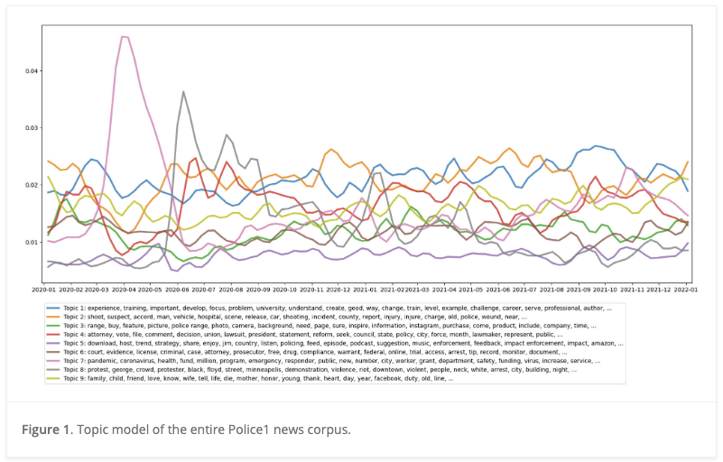
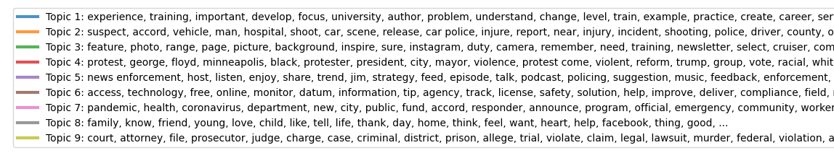
Importance
Time
Topics (Labels)

Slide 5
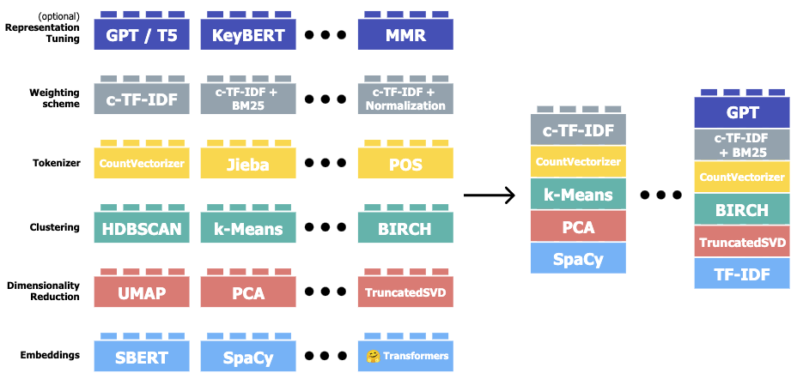
Previous algorithms: BERTopic
Grootendorst 2022 proposes a new method for topic modeling
Embeds text in high-dimensional vector space using a Bidirectional Encoder Representations from Transformers (BERT) model
Uses clustering algorithms like K-Means (and LDA!) to group embeddings
Uses word embeddings, does not require number of topics

Slide 6
Current issues
Number of topics:
LDA requires the number of expected topics as an input to the model
BERTopic allows more flexibility (hyperparameter sensitivity)
Labels:
Both frameworks return lists of words that represents topics
Can require a lot of imagination – how do they connect?
Data-driven nature:
Experts have theories that they are both developing and testing against their data
Cannot easily apply these to the topic model – not conducive to work in the humanities and social sciences
Can we leverage advances in LLMs to resolve these problems?
Notes:
Neither framework supports the level of input needed to make them useful

Slide 7
Guided Topic Modeling (Our approach)
LLM
Q:
Takes in statement of theory/hypothesis (written by expert) in addition to a large corpus (documents).
LLM generates a series of research questions from this statement.
All documents are embedded (as in BERTopic). For each question, collect semantically most similar document from the corpus.
Each most similar embedding becomes a centroid in K-Means clustering – all embedded documents are clustered.
Each cluster is passed to LLM to label with a short description.
Returns labeled documents in an easy-to-use interface (in progress).
Q:
Q:
Q:
Q:
(1) Theory text
(2) Questions
(3) Embeddings
LLM
(6) Labeled documents
(5) Topic Labels
(4) K-Means Clustering

Slide 8
Application: Contaminated Blood documents
Two different datasets:
Documents of the National Public Inquiry (NPI): witness testimony on how contaminated blood affected their lives
Secondary literature on how those effected by disease acquire identities
Enormous dataset – too much for even a team of researchers
Amazing how much Dr. Taylor has collected
Data collection | Amount of files
Written statements | 3,404
Testimonies | 389
Letters | 4,751
Emails | 1,530
Reports | 1,439
Minutes | 1,183
Other sources | 7,458
Total | 20,154

Slide 9
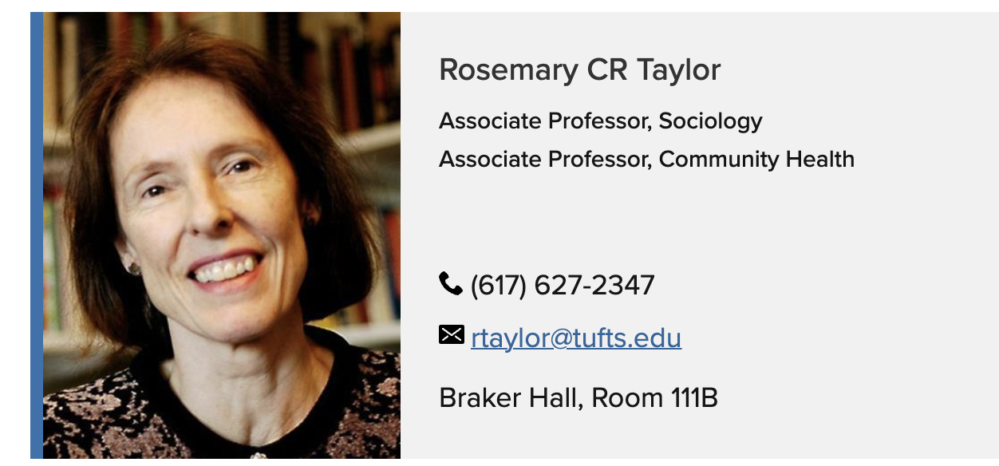
Thoughts from Dr. Rosemary Taylor

Slide 10
Advantages
Human-guided, expert-centered approach allows experts to condition response rather than read their theory into ambiguous topic labels
Modular components can be swapped in and out between theory statements and datasets
Experts can give feedback on LLM-generated questions
One dataset’s identified cluster centers can be applied to another dataset
Secondary sources centroids can be exported to NPI testimony dataset
Embedding models and LLMs can be swapped easily
Can be run on the Tufts HPC (parallelized and batched)

Slide 11
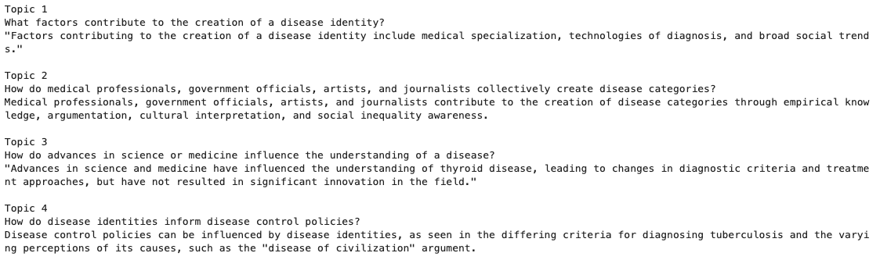
Example of Guided Topic Modelling

Slide 12
Example of Guided Topic Modeling
Topic Number | Generated question | Topic Label
Topic 1 | What factors contribute to the creation of a disease identity? | Factors contributing to the creation of a disease identity include medical specialization, technologies of diagnosis, and broad social trends.
Topic 2 | How do medical professionals, government officials, artists, and journalists collectively create disease categories? | Medical professionals, government officials, artists, and journalists contribute to the creation of disease categories through empirical knowledge, argumentation, cultural interpretation, and social inequality awareness.
Topic 3 | How do advances in science or medicine influence the understanding of a disease? | Advances in science and medicine have influenced the understanding of thyroid disease, leading to changes in diagnostic criteria and treatment approaches, but have not resulted in significant innovation in the field.
Topic 4 | How do disease identities inform disease control policies? | Disease control policies can be influenced by disease identities, as seen in the differing criteria for diagnosing tuberculosis and the varying perceptions of its causes, such as the "disease of civilization" argument.

Slide 13
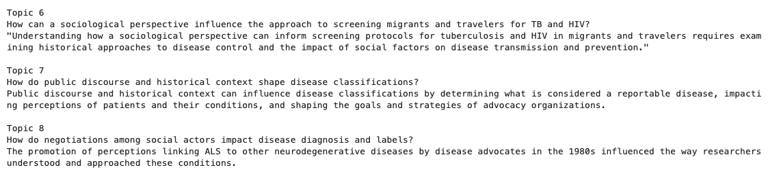
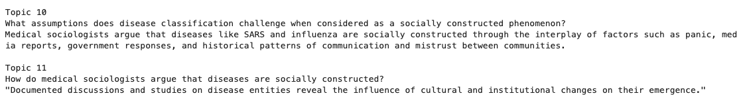
Example of Guided Topic Modelling

Slide 14
Example of Guided Topic Modeling
Topic Number | Generated question | Topic Label
Topic 7 | How do public discourse and historical context shape disease classifications? | Public discourse and historical context can influence disease classifications by determining what is considered a reportable disease, impacting perceptions of patients and their conditions, and shaping the goals and strategies of advocacy organizations.
Topic 8 | How do negotiations among social actors impact disease diagnosis and labels? | The promotion of perceptions linking ALS to other neurodegenerative diseases by disease advocates in the 1980s influenced the way researchers understood and approached these conditions.
Topic 10 | What assumptions does disease classification challenge when considered as a socially constructed phenomenon? | Medical sociologists argue that diseases like SARS and influenza are socially constructed through the interplay of factors such as panic, media reports, government responses, and historical patterns of communication and mistrust between communities.
Topic 11 | How do medical sociologists argue that diseases are socially constructed? | Documented discussions and studies on disease entities reveal the influence of cultural and institutional changes on their emergence.

Slide 15
Ongoing work
User Interface Design
Developing a no-code environment which visualizes documents and labels (topics)
Centroid calculation:
Currently only one document embedding is being used as a centroid
Integrating multiple embeddings is a current statistical challenge
More advanced similarity metrics
Document relevance to a question is calculated with a simple dot product
More advanced methods for this calculation can be drawn from the literature on Retrieval Augmented Generation (RAG)

Slide 16

Thank you for your attention!
Scan to see our GitHub repo!
Please reach out to peter.nadel@tufts.edu for any questions or comments.

Slide 17
Details on LLM Prompt
Question generation prompt:
# Applied Research Task
Given a user provided text, please create a list of distinct topics that the text describes and then for each topic compose a list of 2 to 5 research questions. Delimit topics with `###` and research questions with `\n*`.
Though the input text is very theoretical, these research questions should be as practical as possible, relating the lives of those who the text is about.
Please do not compose questions that discuss promoting equity and social justice, such as: "What are the ethical considerations surrounding the representation of diseases in the media, and how can we ensure that media portrayals are accurate and respectful?" Though these questions are important, they are not relevant to this project.
They will be compared against the testimonies of those suffering from diseases, so it is important that your questions both touch on the theoretical components of the text and this lived experience.
Please compose at least 5 to 10 topics. Do not repeat any questions. Make sure to format your response in markdown.

Slide 18
Details on LLM Prompt
Label generation prompt:
# Labeling task
Based on the following sample of 20 documents and a query, please compose a single-sentence label which describes the relationship between the documents and the query. Do not mention the query or anything about it in the label. Do not provide an explanation of your label.
## Documents separated by new lines
{examples}
## Query
{query}
## Concise, descriptive label

