Slide 1


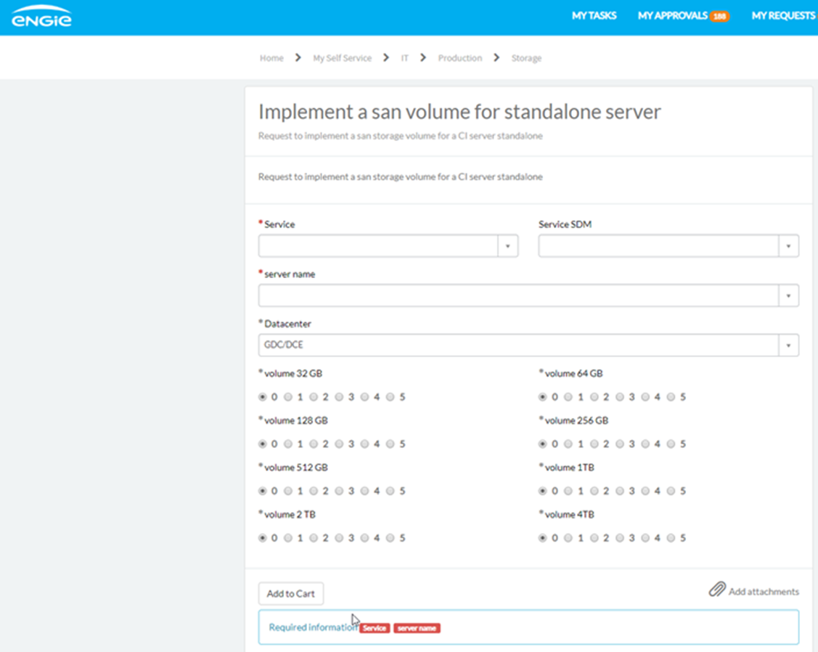











Architecture
Automatisation SAN - DEV
Https
443
Https
443
Https443
Cloud SaaS
Résultat format JSON
Code Http
200/400/500
proxyaimbe
DCE - Intranet
Résultat format JSON
IT2 - Intranet
LSR010550 (10.175.4.98)
7.9
Https 443
2.4.6
Code http 200/400/500
Https 443
1.1.2
4 GB of memory
2 cpu cores
20GB of space
Https 443
3.6.8
Https 443
DCQ - Intranet
IT3 - Intranet
GDC – ENGIE IT
DDC – ENGIE IT
Auteur : Sandrine Ettiradjane
1

Slide 2
Architecture
Automatisation SAN - PROD
Https
443
Https
443
Https443
Cloud SaaS
Résultat format JSON
Code Http
200/400/500
proxyaimbe
DCQ - Intranet
Résultat format JSON
IT2 - Intranet
LSR010551 (10.172.240.61)
7.9
Https 443
2.4.6
Code http 200/400/500
Https 443
1.1.2
4 GB of memory
2 cpu cores
20GB of space
Https 443
3.6.8
Https 443
DCE - Intranet
IT3 - Intranet
GDC – ENGIE IT
DDC – ENGIE IT
Auteur : Sandrine Ettiradjane
2

Slide 3





Architecture
Automatisation NAS - DEV
Https
443
Https
443
Https
443
Https
443
Cloud SaaS
Https443
Cloud SaaS
Https443
Résultat format JSON
Code Http
200/400/500
proxyaimbe
proxyaimbe
DCE - Intranet
LSR010731 (10.175.4.106)
Https 443
IT2 - Intranet
Code http 200/400/500
Résultat format JSON
Https 443
Https 443
Master
Postgres 5432
Postgres 5432
Https 443
LSR010751 (10.175.4.107)
Streaming Replication
Slave
DCQ - Intranet
LSR010752 (10.175.4.108)
IT3 - Intranet
GDC – ENGIE IT
DDC – ENGIE IT

Slide 4



Https 443
Architecture
Automatisation NAS - ACCEPTANCE
Https
443
Https
443
Cloud SaaS
Https443
Résultat format JSON
Code http 200/400/500
proxyaimbe
Https 443
proxyaimfr
Résultat format JSON
Code http 200/400/500
DCE - Intranet
DCQ - Intranet
IT2 - Intranet
Https 443
Postgres 5432
LSR010753 (10.172.240.13)
LSR010754 (10.172.240.42)
Cluster Tower
Master
Https 443
Https 443
Slave
LSR010755 (10.172.240.43)
LSR010756 (10.172.240.60)
IT3 - Intranet
Streaming Replication
GDC – ENGIE IT
DDC – ENGIE IT

Slide 5
Https 443
Architecture
Automatisation NAS - PRODUCTION
Https
443
Https
443
Cloud SaaS
Https443
Résultat format JSON
Code http 200/400/500
proxyaimbe
Https 443
proxyaimfr
Résultat format JSON
Code http 200/400/500
DCE - Intranet
DCQ - Intranet
IT2 - Intranet
Https 443
Postgres 5432
LSRXXXXX (10.XX.XX.XX)
LSRXXXX (10.XX.XX.XX)
Cluster Tower
Master
Https 443
Https 443
Slave
LSRXXXXX (10.XX.XX.XX)
LSRXXXXX (10.XX.XX.XX)
IT3 - Intranet
Streaming Replication
GDC – ENGIE IT
DDC – ENGIE IT

Slide 6
Architecture
Automatisation VM Linux - DEV
A VENIR
Auteur : Sandrine Ettiradjane
6

Slide 7
Architecture
Automatisation VM Linux - ACCEPTANCE
A VENIR
Auteur : Sandrine Ettiradjane
7

Slide 8
Architecture
Automatisation VM Linux - PROD
A VENIR
Auteur : Sandrine Ettiradjane
8

