Slide 1

Arduino Motor Control Workshop
IEEE @ SDSU
Patricia Munn
Feb 6, 2024

Slide 2
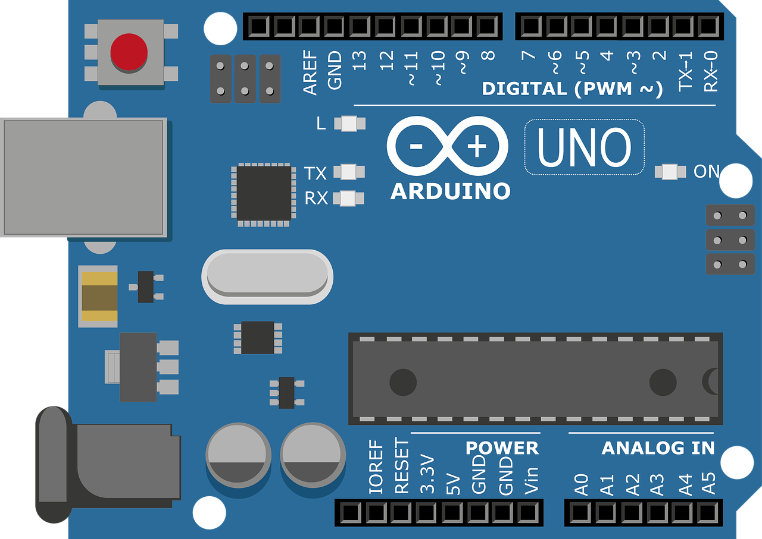
What’s an Arduino?
Open source microcontroller
Used for electronics projects
Allows you to read input or create output
Inputs | Outputs
buttons | LEDs
sensors | motors
data from your computer | data to your computer

Slide 3
How it works
Wire up your components to the Arduino board
Write your code
Upload your code to the Arduino
Profit ???

Slide 4
Go to the Github
https://shorturl.at/nAFNO

Slide 5
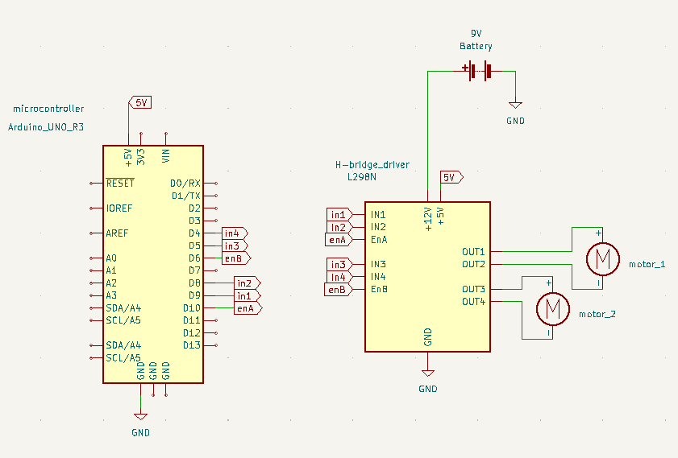
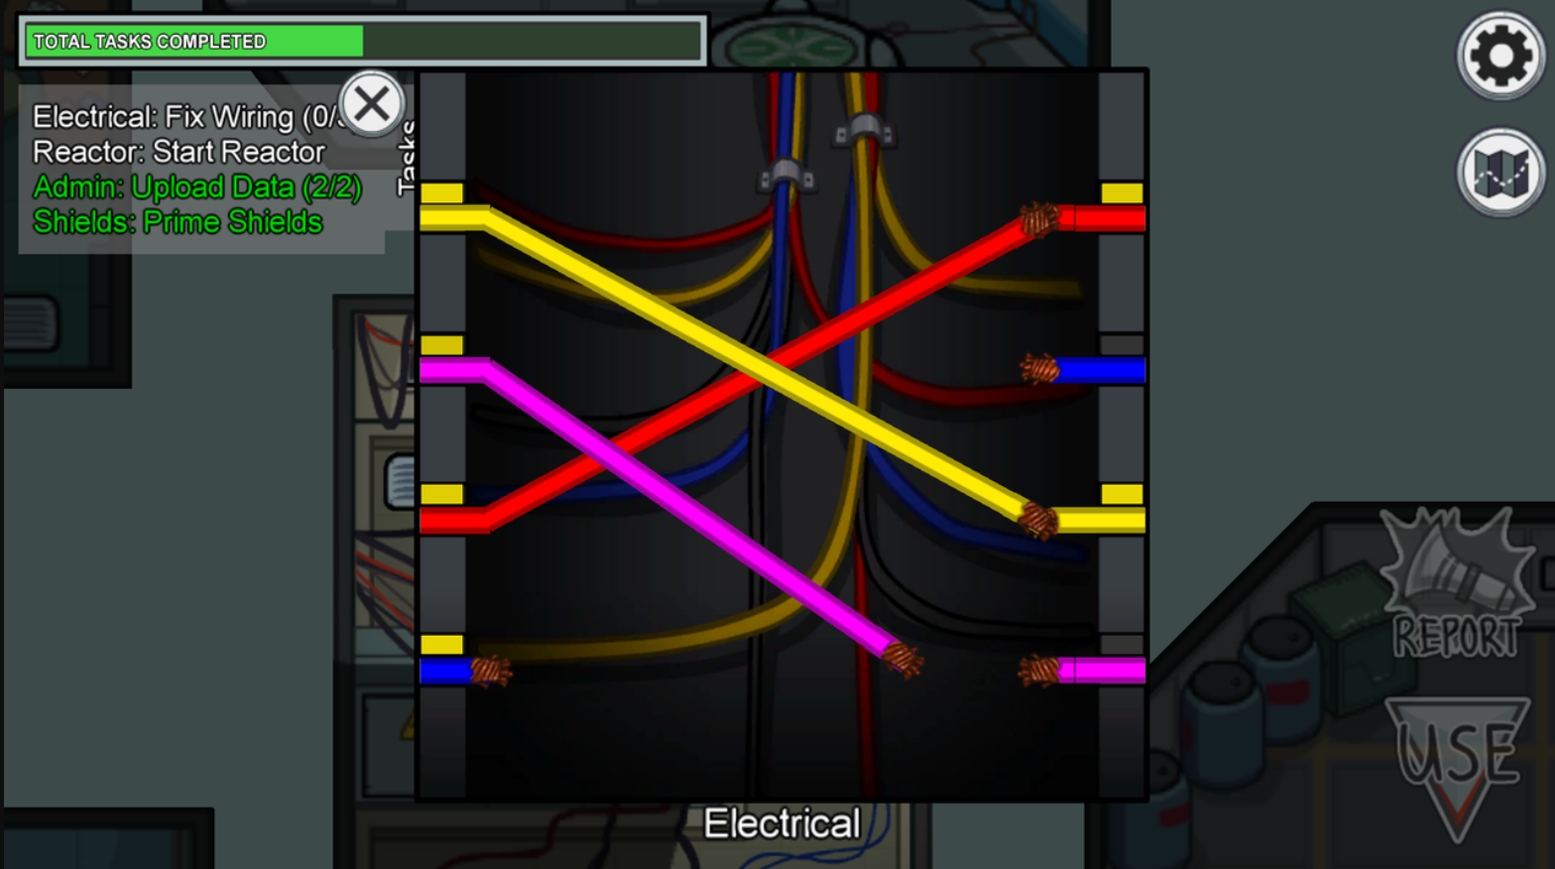
Wire up your components

Slide 6
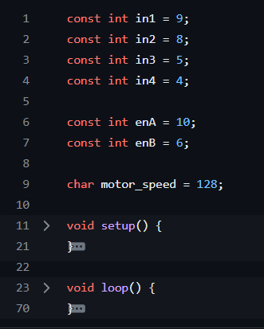
Create your needed variables

Slide 7
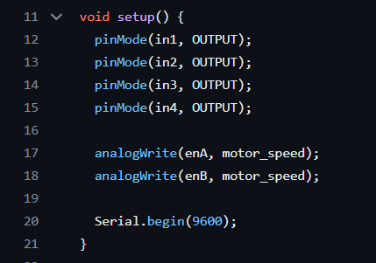
Write your setup() code that will run once
Notes:
FIX ?

Slide 8

Okay, now time to write the loop() code that’ll hold the logic you want to run forever
You, asking what logic?

Slide 9
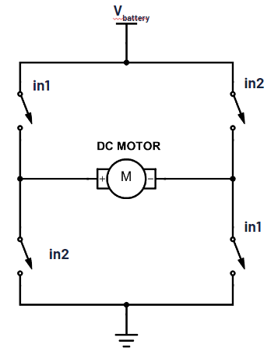
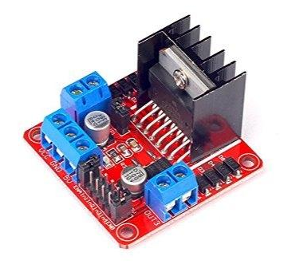
To figure that out, we need to know how this board works

Slide 10
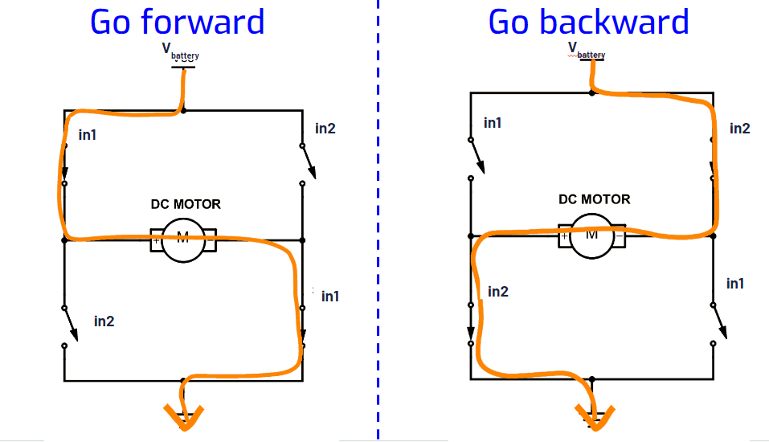
Tell the Arduino to close certain switches to create a path for current

Slide 11
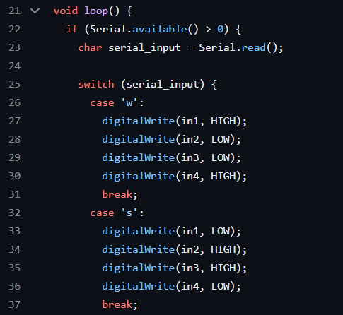
Write your loop() code for
moving forward & backward & stopping
We’ll be using the WASD keys on our keyboard to control our wheels
Notes:
FIX CODE

Slide 12


Upload your code to the Arduino!
Press Verify to check for errors
Press Upload to put your code on the Arduino
motor go brrrr

Slide 13
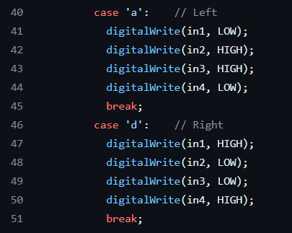
Write your loop() code for
moving left & right
Notes:
FIX CODE

Slide 14
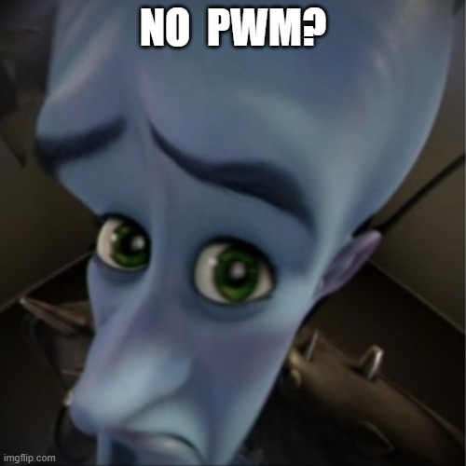
But motors have only one speed : (

Slide 15
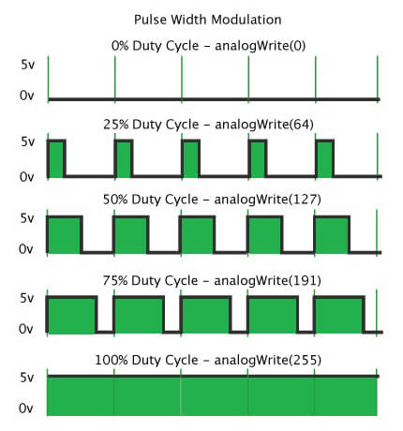
Enter PWM
PWM (Pulse Width Modulation) - changing the % of time a signal is on HIGH voltage
Called the duty cycle
Lowering the duty cycle lowers the average voltage (kinda like tricking the microcontroller into thinking a lower voltage is present)
Making an LED dimmer or a motor slower

Slide 16
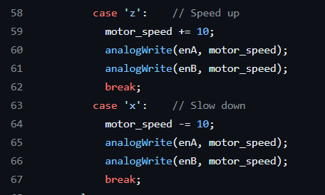
Write PWM in your code to control the motor speed!

