Slide 1
Proposal for CI/CD implementation for our Cloud application

Slide 2
Purpose of this presentation
To explain the current deployment process we follow.
Explain CI/CD process.
How its going to be beneficial to our business development.

Slide 3
Current Deployment Process
CONCERNS OF CURRENT DEPLOYMENT PROCESS:
Different development teams in UdaPeople System working in distributed locations.
Issues while merging the code from different teams and perform flawless deployment.
Complexity of the system with the growing business and customer needs.
Longer duration by waiting for a big release to deployment a new changes.
Innovation is the key for a successful business model. To keep up with the Market and people’s change of mind, every innovation must be deployed and go live faster to compete with the competitors.
How to achieve this flawless and automated deployment in faster pace.
How to achieve in lesser cost within our budget.

Slide 4
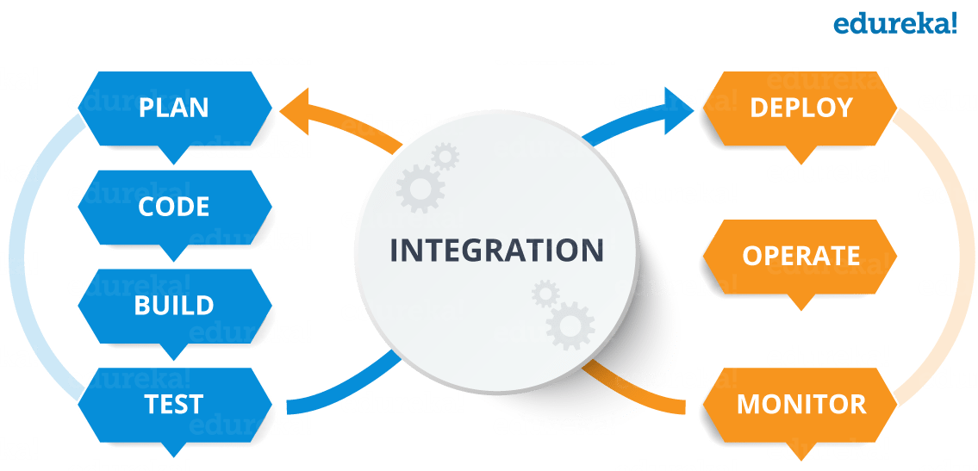
What is CI/CD (Blue Green Strategy )
Integrate and automate code build (Blue ) and production deployment (Green).
Build and quick test to avoid production failure after deployment. This reduces failure cost.
Integrate source code repository with the production server. Any code changes will start from plan till monitor ( refer pic ) process automatically.
Allows bringing the innovation to the market flawlessly and quickly.

Slide 5
Measures to transform to CI/CD Pipeline.
The above chart ( Left side) showing the Product Failure cost how it increases as the complexity of the product increases to cater customer and marker demand.
Right Side chart is showing the delays in the Product release every quarter compare to the original release date.
Every delay cost time and budget which in turn the revenue of the business which can be solved by implementing CI/CD to avoid manual implementation overhead and fully automate with necessary failure steps until Deployment.

