Slide 1
Team Project Final Milestone
Group 1:
Team Members:
Chaithanya Reddy Bogadi - 013803998
Naga Sindhu Korlapati - 012467832
Nandini Puppala - 013752713
Prathusha Koouri - 013710658
Sindhu Ravichandran - 013769821
Venkata Anil Kumar Thota - 012525734
CMPE257-Spring 2019

Slide 2
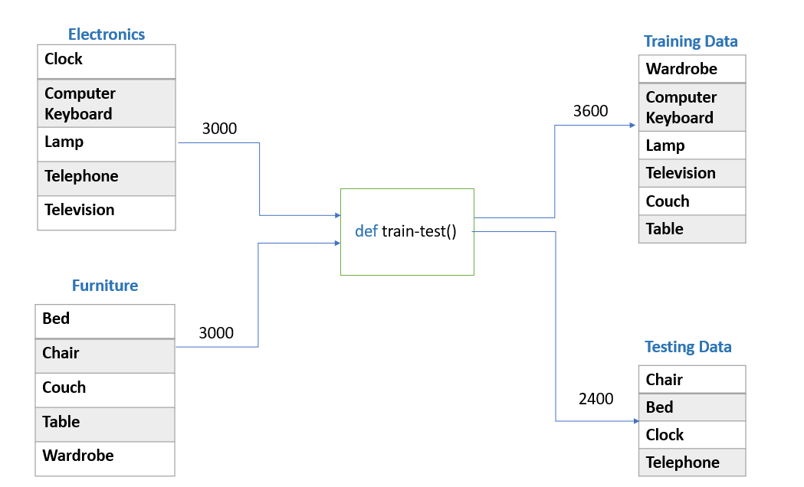
Data Preparation

Slide 3
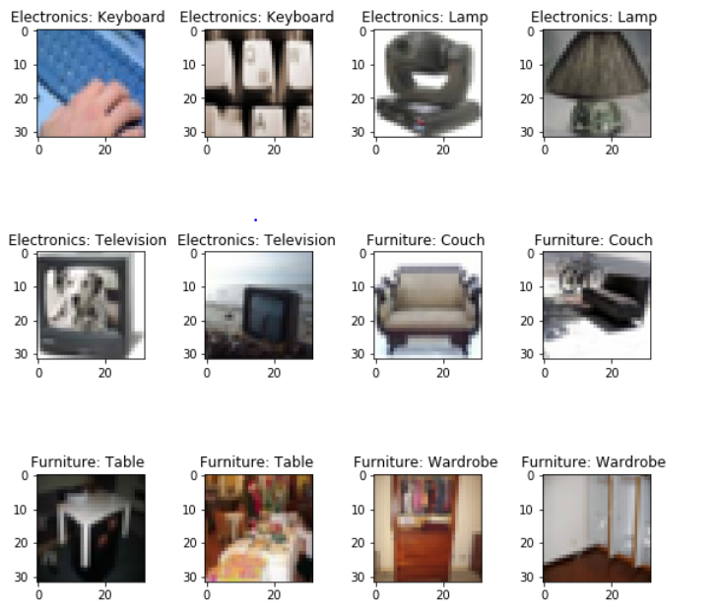
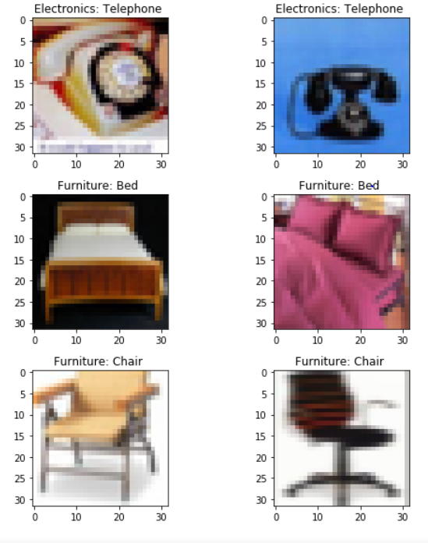
Validation Images
Train Data Test Data

Slide 4
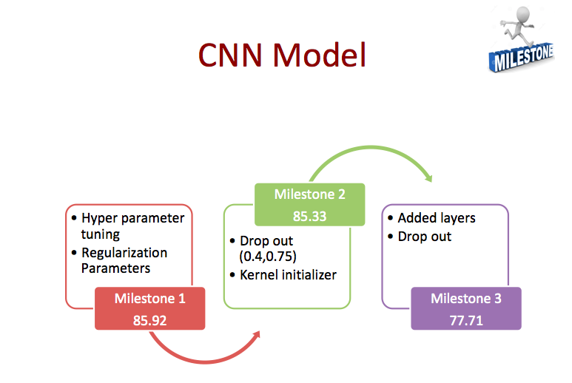

Slide 5
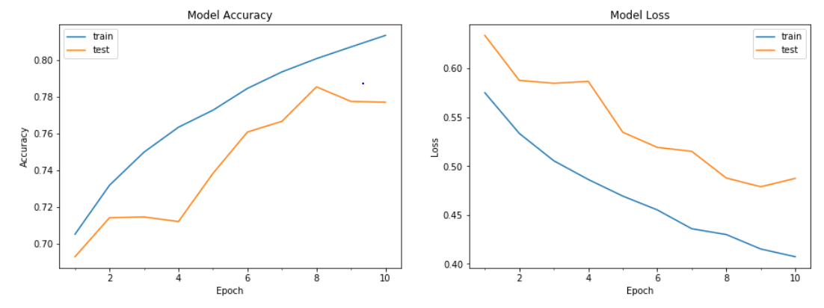
Best Model – CNN
Accuracy – 77.71% Labels = [Clock , Telephone, Chair, Bed]

Slide 6
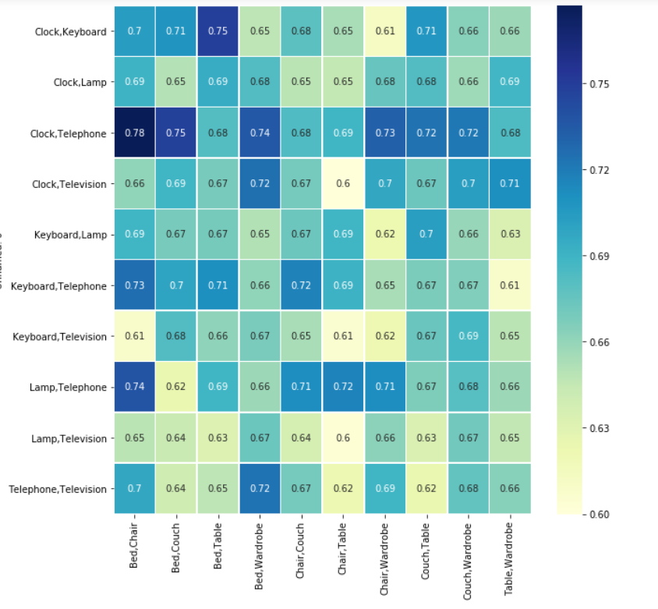
Heat Map of CNN model – Milestone 3

Slide 7
Confusion matrix
We have Considered:
Negative Class – Household Electronics
Positive Class – Household Furniture
True Negatives – 1052
True Positives – 813
False Negatives – 148
False Positives – 387

Slide 8
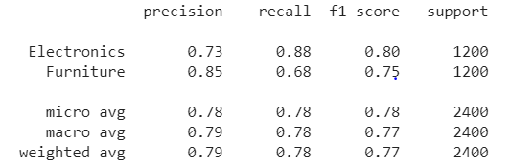
Classification Report

Slide 9
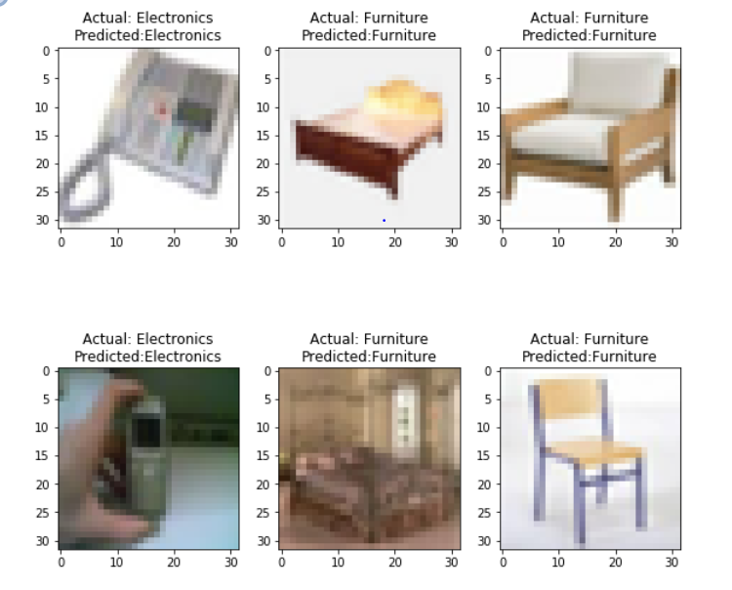
Predicted Images

Slide 10
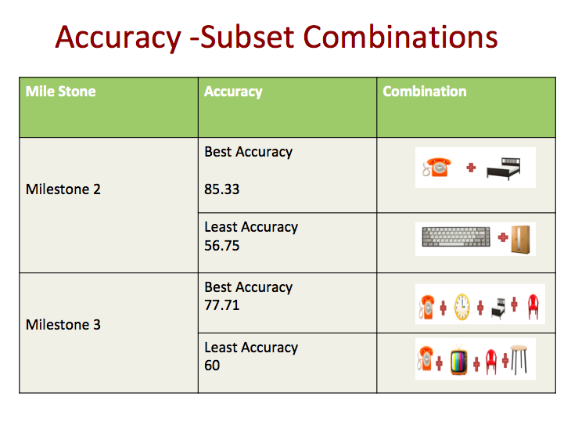

Slide 11
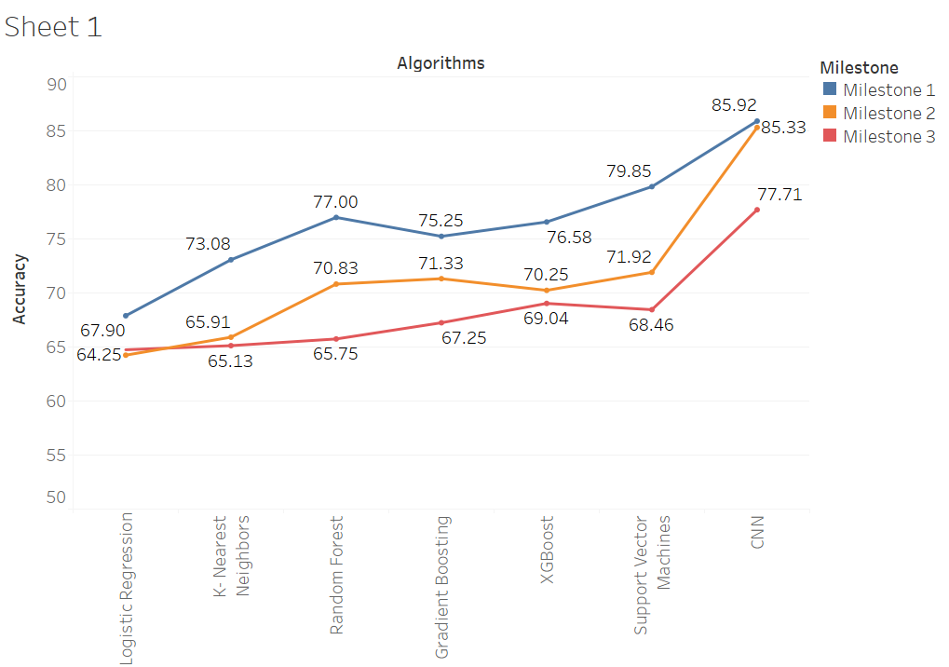
Accuracy in all Milestones

Slide 12


Algorithm | Min | Max | Average | Median | S.D | 25 Percentile | 75 Percentile
Logistic | 50.00 | 64.25 | 58.58 | 60.16 | 4.01 | 56.16 | 61.41
KNN | 41.41 | 65.91 | 56.96 | 57.91 | 6.19 | 54.75 | 61.41
Random Forest | 51.24 | 64.25 | 58.58 | 60.16 | 4.84 | 59.58 | 66.16
XGBoost | 53.42 | 70.25 | 63.05 | 64.67 | 5.07 | 59.92 | 66.25
Gradient Boosting | 55.00 | 71.33 | 63.50 | 64.66 | 4.20 | 61.33 | 66.16
SVM | 51.08 | 71.92 | 64.20 | 66.00 | 5.92 | 63.08 | 68.66
CNN | 56.75 | 85.33 | 69.01 | 69.83 | 8.19 | 62.33 | 75.50
Milestone2
Algorithm | Min | Max | Average | Median | S.D | 25 Percentile | 75 Percentile
Logistic | 53.37 | 64.75 | 58.24 | 58.16 | 2.54 | 56.41 | 60.01
KNN | 47.30 | 65.13 | 56.57 | 57.55 | 4.14 | 53.46 | 59.83
Random Forest | 52.00 | 65.75 | 58.05 | 58.04 | 2.81 | 55.69 | 59.95
XGBoost | 53.75 | 69.04 | 61.93 | 61.95 | 3.49 | 59.51 | 64.67
Gradient Boosting | 55.86 | 67.25 | 61.96 | 61.81 | 2.77 | 60.00 | 64.37
SVM | 54.04 | 68.46 | 62.28 | 63.08 | 3.58 | 59.81 | 64.92
CNN | 60.00 | 77.71 | 67.39 | 67.20 | 3.53 | 65.06 | 69.49
Milestone3

Slide 13
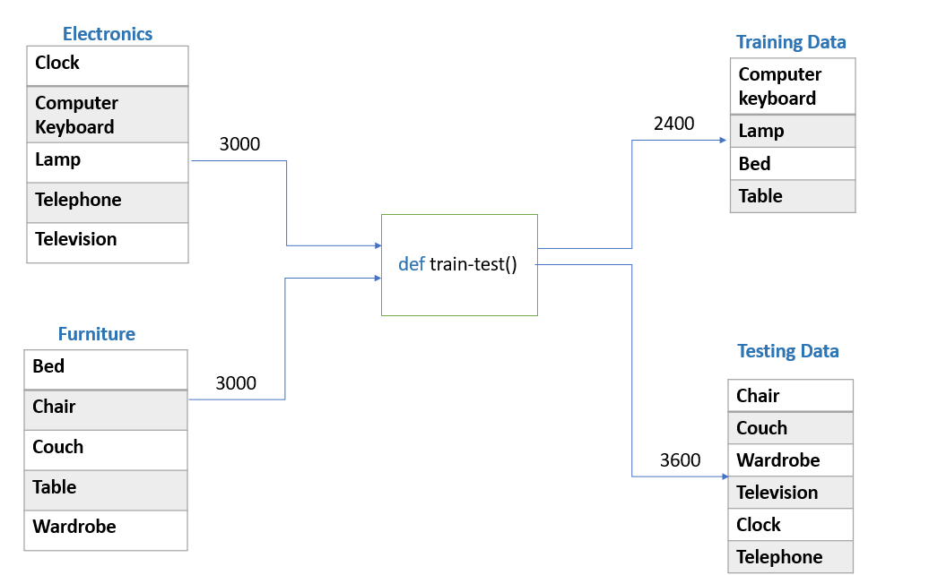
Data Preparation- Bonus

Slide 14
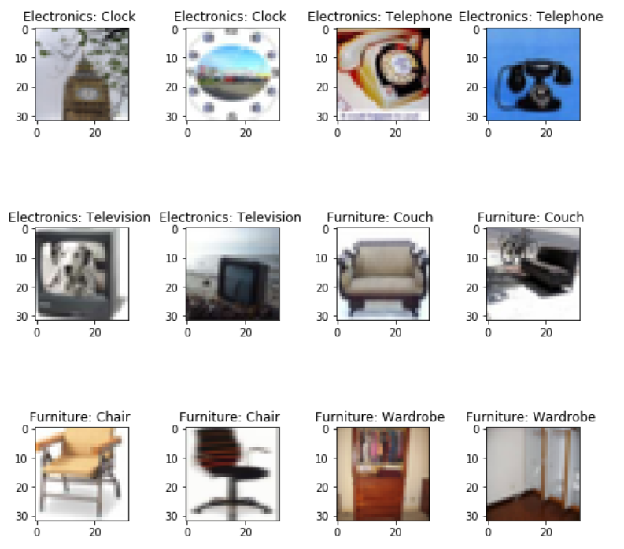
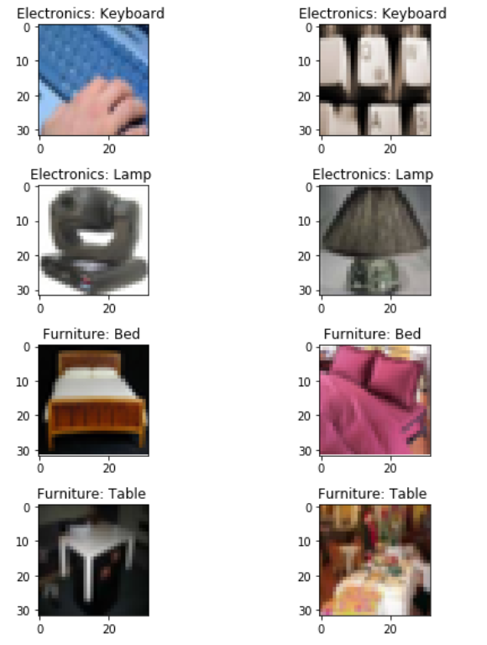
Validation Images
Train Data
Test Data

Slide 15
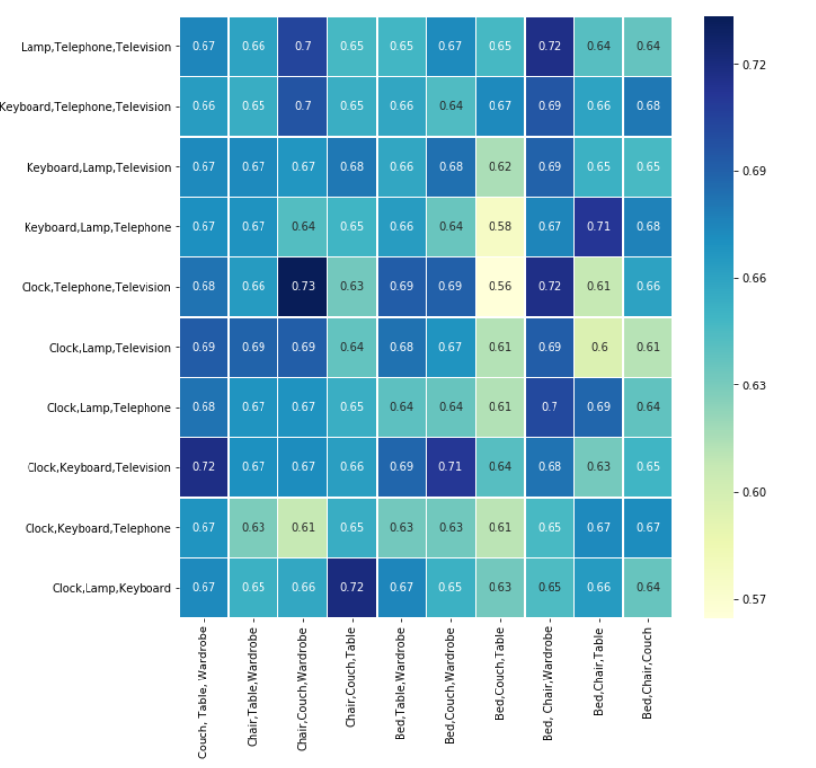
Heat Map of CNN model

Slide 16
Lessons Learnt
•Working with RGB image data •Image Augmentation •Image Conversion to Gray Scale •GridSearchCV •Kernel, bias initialization •Model Save •Using GPU •Robust Model

Slide 17
THANK YOU

Slide 18
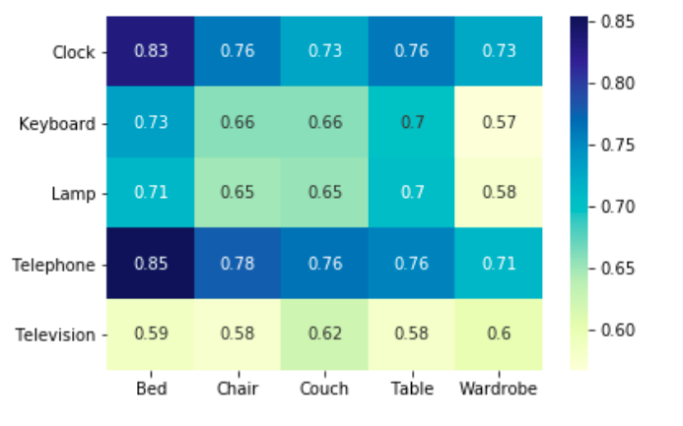
Heat Map of CNN model – Milestone 2

