Slide 1
TEAM PROJECT MILESTONE - 2
Group 1:
Team Members:
Chaithanya Reddy Bogadi - 013803998
Naga Sindhu Korlapati - 012467832
Nandini Puppala - 013752713
Prathusha Koouri - 013710658
Sindu Ravichandran - 013769821
Venkata Anil Kumar Thota - 012525734
CMPE 256 – Fall 2019

Slide 2
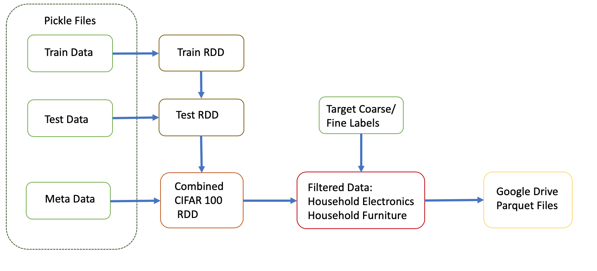
Data Preparation - Milestone 1

Slide 3
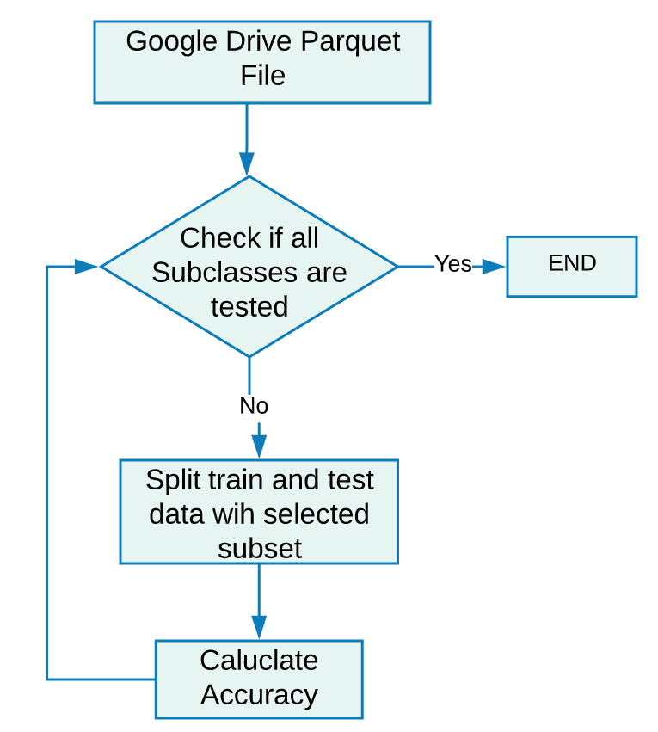
Data Preparation - Milestone 2

Slide 4
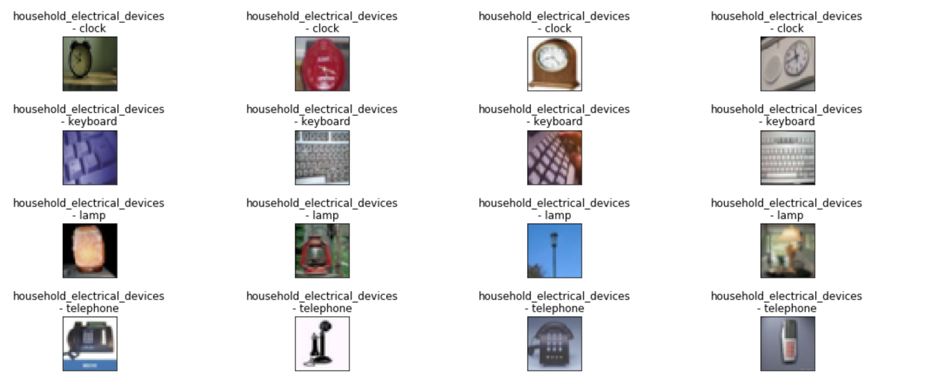
Validation Images - Train Data

Slide 5
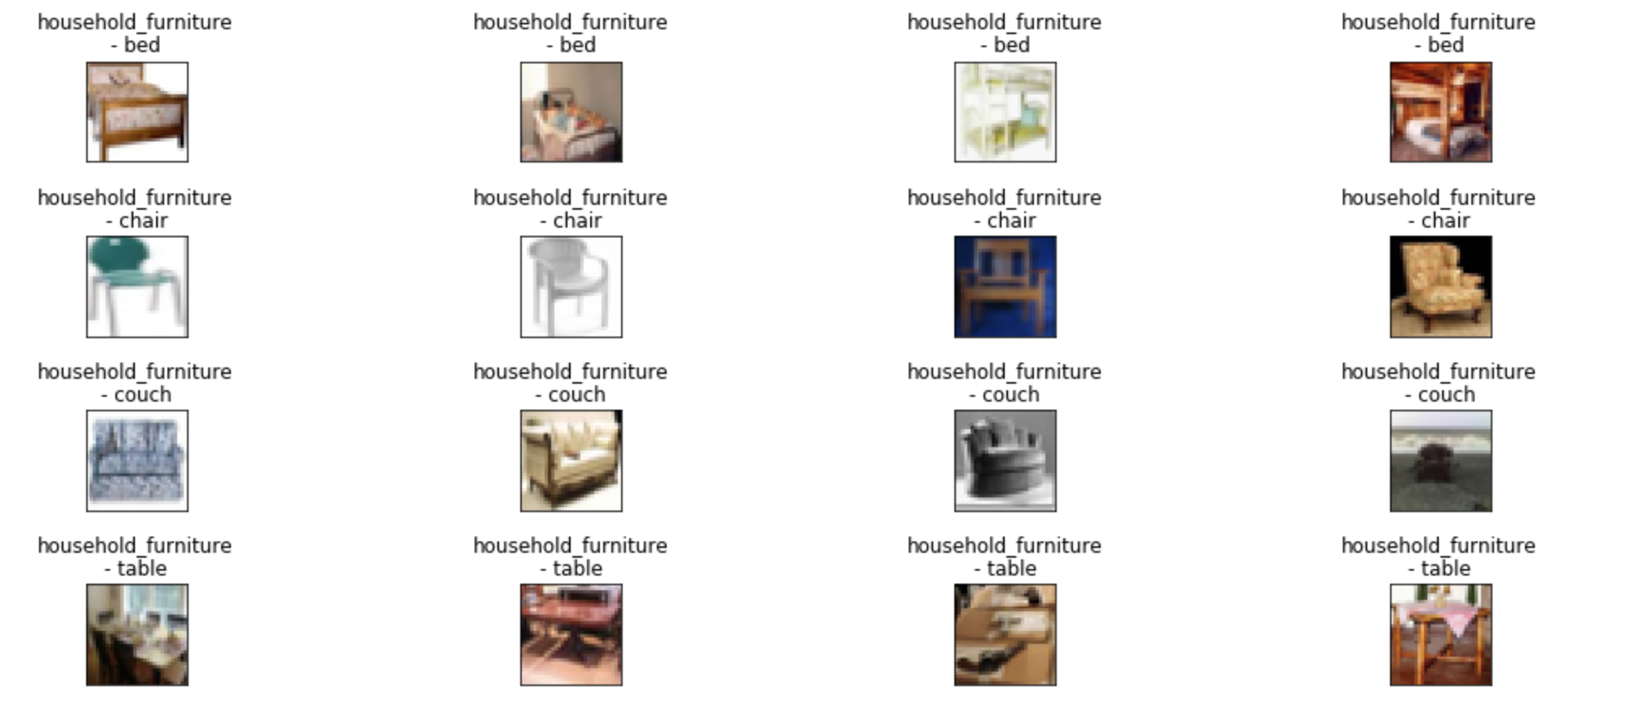
Validation Images - Train Data

Slide 6
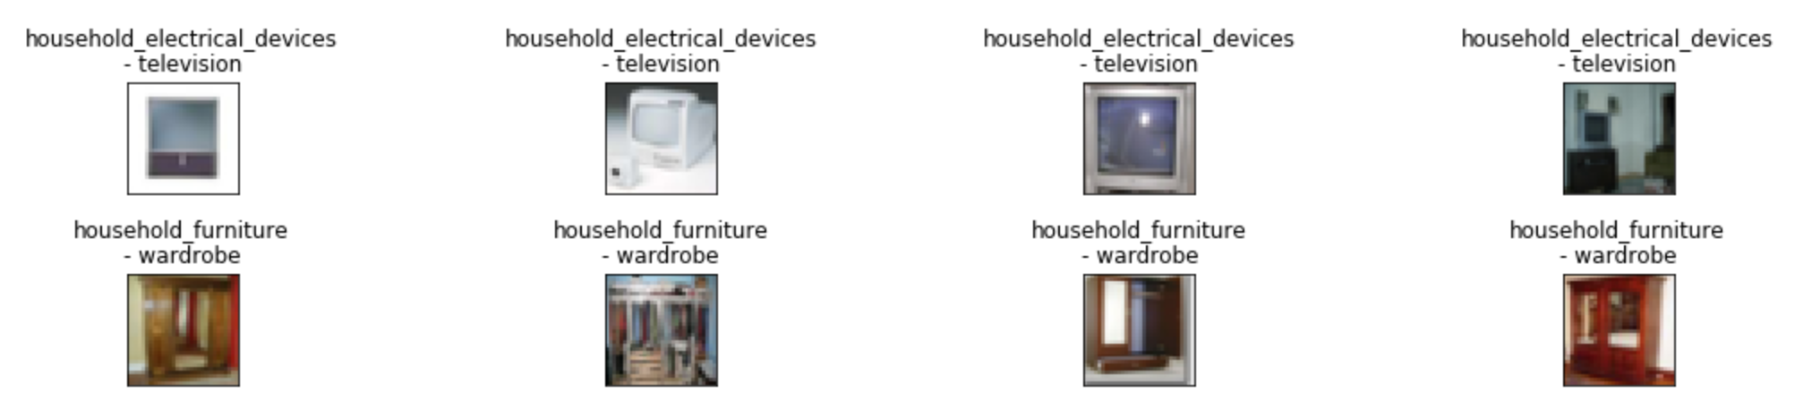
Validation Images - Test Data

Slide 7
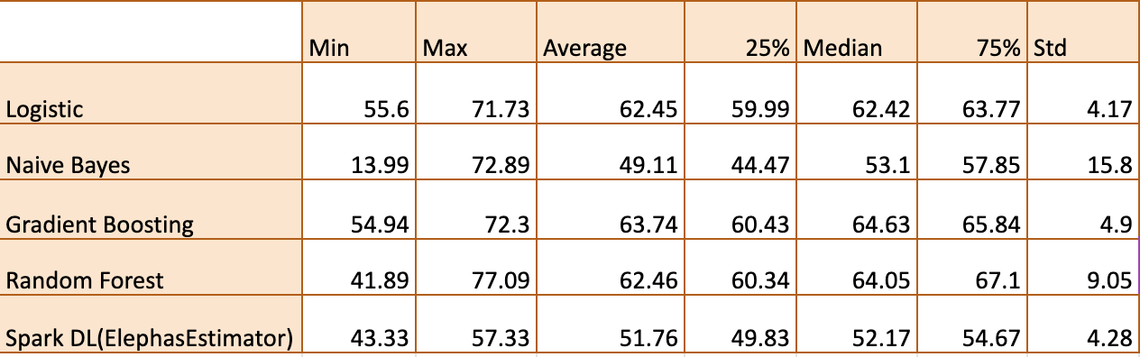
Algorithms Summary
Best Subset – Television and wardrobe
Worst Subset – Television and Chair

Slide 8

CONFUSION MATRIX
We have Considered:
Negative Class – Household Electronics
Positive Class – Household Furniture
True Negatives – 389
True Positives – 453
False Negatives – 211
False Positives – 147

Slide 9
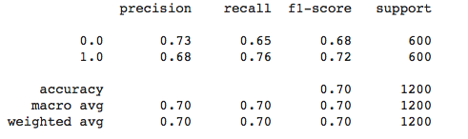
CLASSIFICATION REPORT

Slide 10
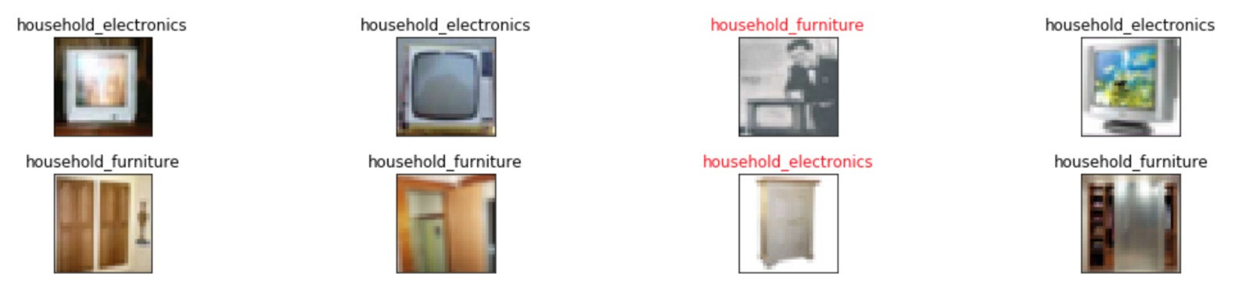
PREDICTED IMAGES

Slide 11
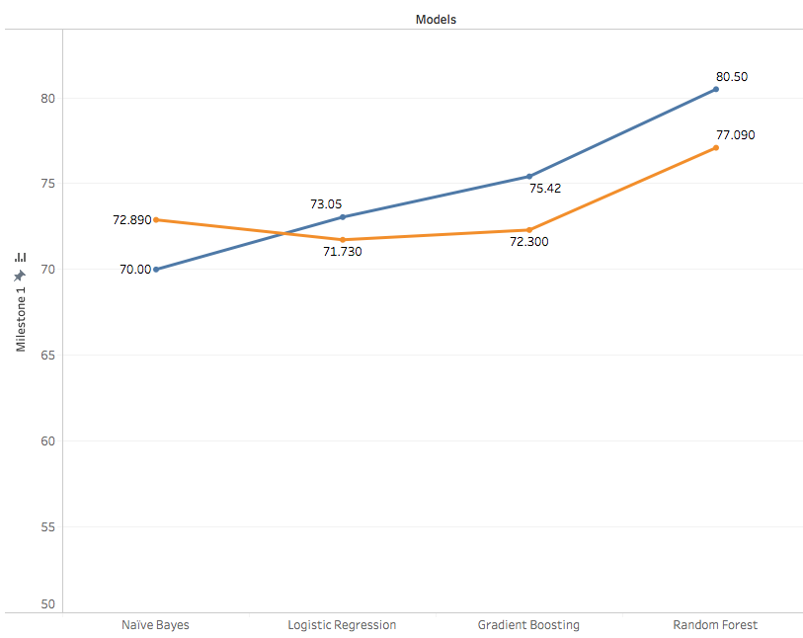

Milestone 1 vs Milestone 2

Slide 12
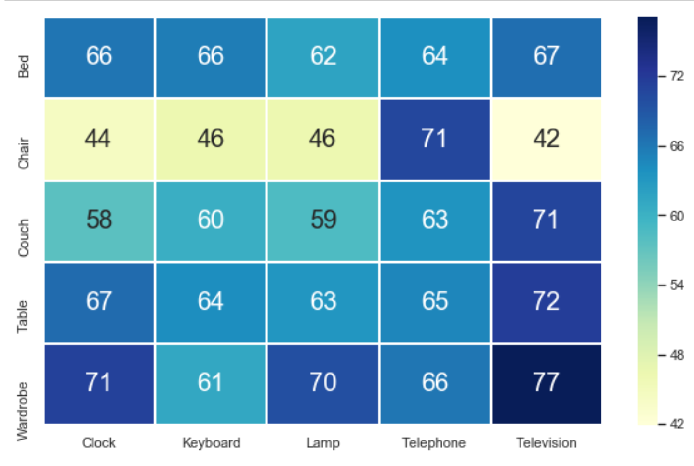
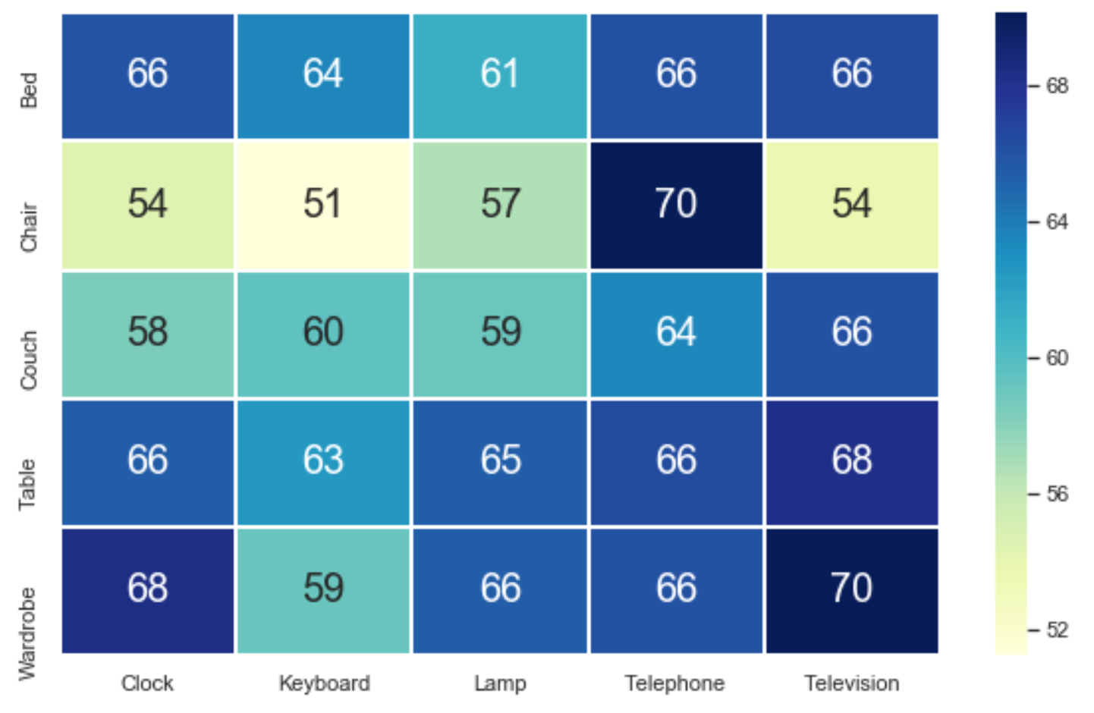
PySpark
Scikit-Learn

Slide 13
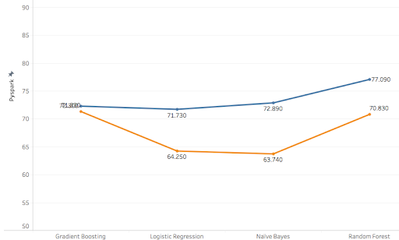

Scikit-Learn vs PySpark Accuracy

Slide 14
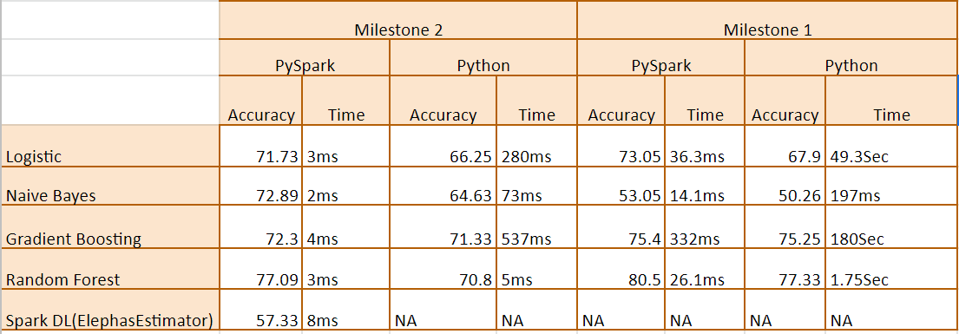
Scikit-Learn vs PySpark Time Comparision

Slide 15
LESSON LEARNED
SparkSession - executor memory and driver memory
Handle image data using PySpark
Learnt when to use RDD and Spark dataframe
Saving Intermediate results using Parquet and Pickle format
Difference between Spark ML and Spark Mlib
Pyspark is built on Spark’s JAVA API
Deep Learning Models in PySpark

Slide 16
ADDITIONAL EXPERIMENTS
Param Grid Builder.
Cross Validation.

Slide 17
Thank You

