Slide 1
Infrastructure as a Platform: What You Need to Know
From ticket-driven to product-centric infrastructure | 10 August 2026

Slide 2
Usage Guidance
The following text was generated using Gartner's AskGartner Generative AI tool. Due to the nature of this technology, some answers may be incomplete or incorrect. Please verify sources. Gartner does not endorse any provider, product, or service. AskGartner answers cannot be quoted externally and may only be shared within your organization, in line with the Licensed User limits in the Gartner Usage Policy and with the accompanying cite "based on AskGartner Generative AI tool". Information sourced from Gartner Peer Insights is drawn from Peer Insights summaries and software reviews submitted by validated technology end-users in accordance with the Peer Insights Community Guidelines and does not represent Gartner opinion.
2

Slide 3
What Infrastructure as a Platform Really Means
3

Slide 4
IaP: Internal Software Product, Not Just Services
Users: Product teams, developers, data scientists consume infrastructure via portals, APIs, CLIs without deep expertise.^{[1][2]}
I&O teams embed governance, security, and compliance directly into the platform—no manual gates.^{[3]}
Consumers self-manage infrastructure; teams create guardrails and enablement.^{[1]}
IaP transforms IT from managing infrastructure for consumers to empowering them within guardrails.^{[1]}
4

Slide 5
Core Principles That Drive Success
5

Slide 6
IaP Principles: Self-Service, Automation, Product Mindset
Self-service with embedded governance: Users provision resources independently; compliance and security are baked in.^{[3]}
Interoperability, automation, and programmability: Infrastructure assets minimize manual touchpoints; APIs enable orchestration; intelligence optimizes workloads.^{[4]}
Product-oriented mindset: Treat infrastructure teams as software product teams—vision, feedback, adoption, iteration.^{[5]}
Modular, reusable components: Standardize anchor platforms for domains (compute, networking, storage, monitoring); layer complementary capabilities to reduce complexity and cost.^{[4]}
6

Slide 7
Why IaP Matters for Capital One
7

Slide 8
IaP's Value: Speed, Compliance, Cost Control, Risk Reduction
Accelerates digital products without sacrificing controls—governance is invisible, not obstructive.^{[6]}
Manages AI infrastructure at scale: Platform teams specialize in GPU optimization, FinOps, and data fabric—generic I&O cannot.^{[6]}
Reduces operational risk: Policy-as-code and automated guardrails catch misconfigurations before production.^{[6]}
Controls costs: Self-service with embedded visibility and chargeback prevents runaway spending.^{[6]}
8

Slide 9
Phased Approach: How to Get Started
9

Slide 10
IaP Rollout Phases: Strategy, Team, MVP, Scale
Phase 1: Strategy & Assessment (1–2 months)
Define anchor platforms for each domain (compute, networking).^{[4]}
Assess current maturity: agility, observability, IaC.^{[2]}
Map user pain points: interview cloud-native, data science, business teams.^{[2]}
Phase 2: Team & Governance (2–4 months)
Form dedicated platform engineering team (full-time roles).^{[7]}
Hire/upskill engineers: IaC, CI/CD, API, cloud-native.^{[7]}
Codify governance principles: security, cost, compliance—become automated policies.^{[7][8]}
10

Slide 11
MVP and Scale: Deliver Value and Optimize
Phase 3: Minimum Viable Product (4–6 months)
Pick one high-value use case (cloud accounts, Kubernetes).^{[6]}
Build iteratively; release early, gather feedback, measure adoption.^{[6]}
Track adoption, time-to-provision, user satisfaction.^{[3]}
Phase 4: Scale & Optimize (6+ months)
Expand to additional domains (networking, storage, observability).^{[4]}
Mandate platform service reuse for efficiency.^{[4]}
Embed
cost governance
and chargeback at every layer.^{[6]}
11

Slide 12
Key Decisions: Choosing Platform Anchors
12

Slide 13
Platform Anchors: Compute, Kubernetes, Networking, Observability
Compute: AWS or Azure (or hybrid)—determines IaC tooling, skills, ecosystem.^{[4]}
Kubernetes: EKS, AKS, or on-prem—enables container orchestration at scale.
Networking/Security: SASE platforms (Prisma, Zscaler)—zero trust and self-service.^{[4]}
Observability: Datadog, Splunk, or cloud-native—unified visibility across environments.
IaC & CI/CD: Terraform/OpenTofu + GitHub/GitLab + ArgoCD—foundation for everything.
Mitigate vendor lock-in: Identify dependencies and risks; document strategy.^{[4]}
Anchor selection is critical: influences skills, contract terms, integrations.
Document contractual and ecosystem dependencies early.
Update anchor decisions as usage patterns evolve and new needs emerge.^{[4]}
13

Slide 14
What Success Looks Like
14

Slide 15
Outcomes: Faster Provisioning, Adoption, Cost Control, Compliance
Faster provisioning: Developers get infrastructure in hours, not weeks.
Higher adoption: Teams use your platform because it's easier than alternatives.^{[5]}
Better cost control: Chargeback & observability reveal waste; platform automation reduces it.
Compliance confidence: Policy-as-code & automated guardrails decrease audit risk.
Team satisfaction: I&O engineers solve strategic problems—not just field tickets.^{[5]}
15

Slide 16
Your Next Move
16

Slide 17
Executive Alignment and Rapid Listening Tour
Secure executive alignment—IaP is an organizational shift, not just technical. Run a rapid listening tour with stakeholders (cloud architects, security, finance, product teams) to validate anchor platform choices and MVP use case. This multi-quarter journey delivers speed, control, and resilience for Capital One.^{[1][6]}
17

Slide 18
References
Strategic Roadmap for Platform-Centric I&O
Get Your Infrastructure Ready for Platforms
Infrastructure Platform Engineering Reference Architecture
The Infrastructure You Need for Platform-Centric I&O
Key Actions to Succeed as a Head of Infrastructure Platforms
The Organizational Mandate: Adopting Infrastructure Platform Engineering to Accelerate AI Value
How to Develop Infrastructure Platform Engineering Teams
Quick Answer: How Can I&O Leaders in China Establish Effective Infrastructure Platform Engineering?
18

Slide 19
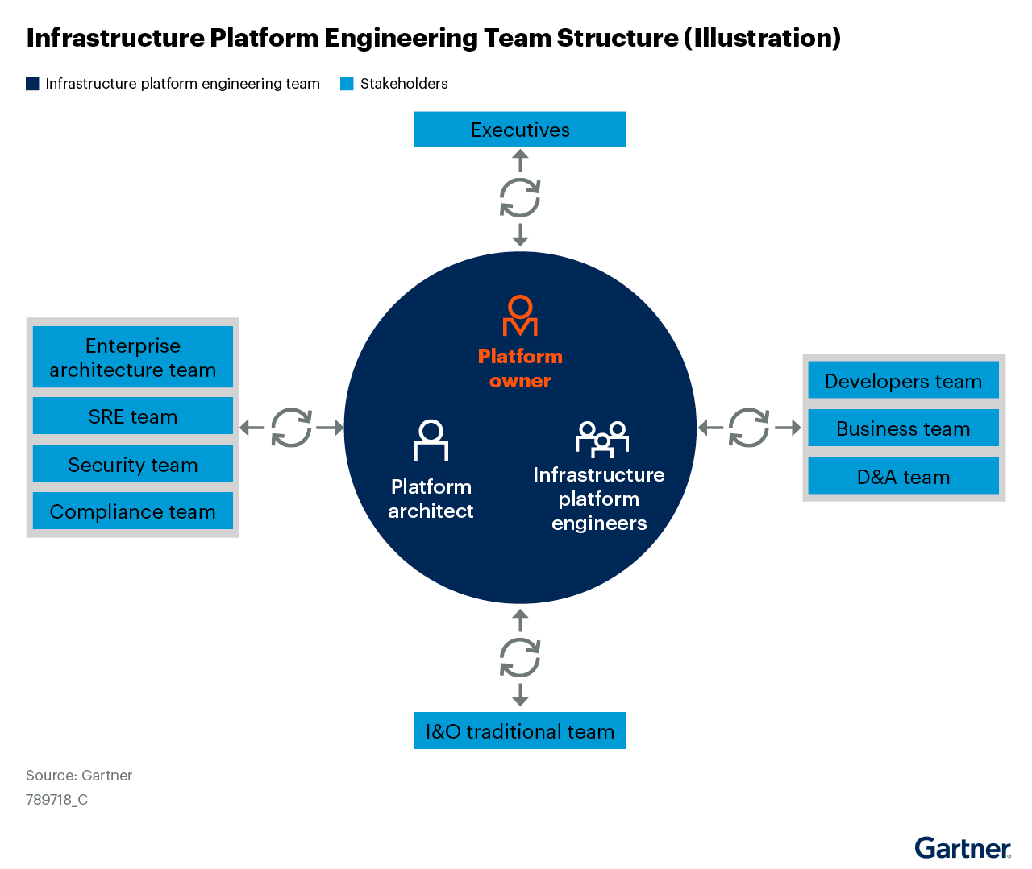
Image Appendix
Image source: Source: Quick Answer: How Can I&O Leaders in China Establish Effective Infrastructure P...
19

Slide 20
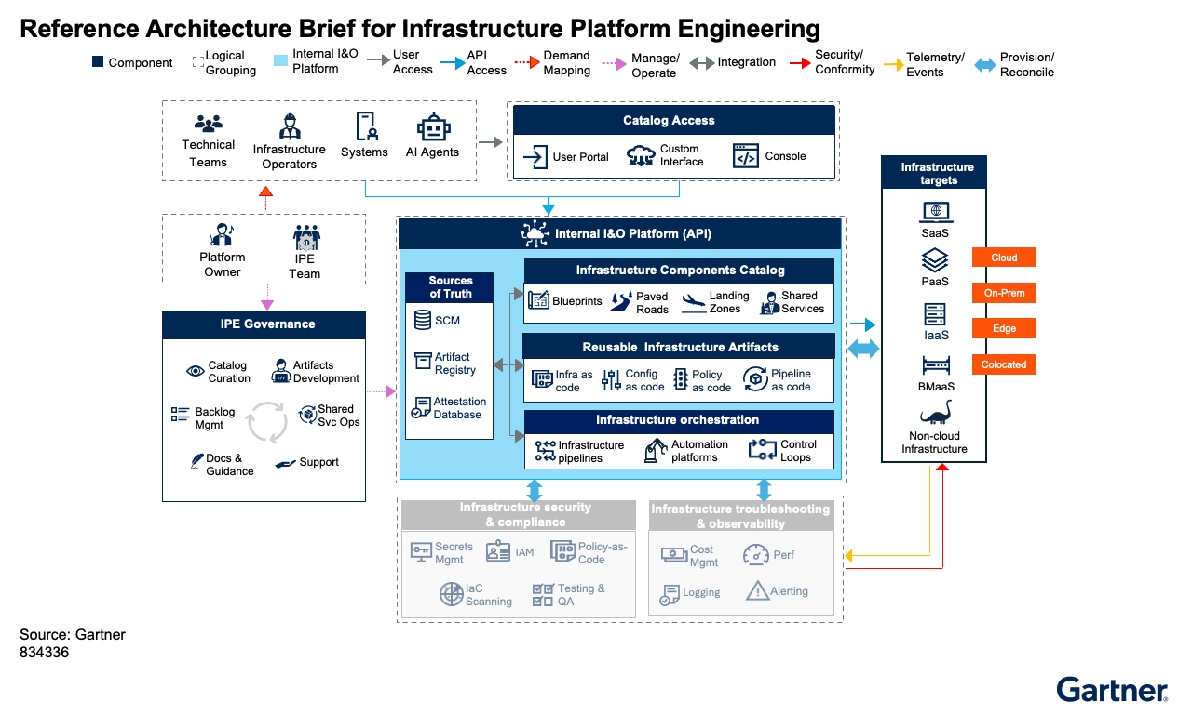
Image Appendix
Image source: Source: Reference Architecture Brief: Infrastructure Platform Engineering
20

Slide 21
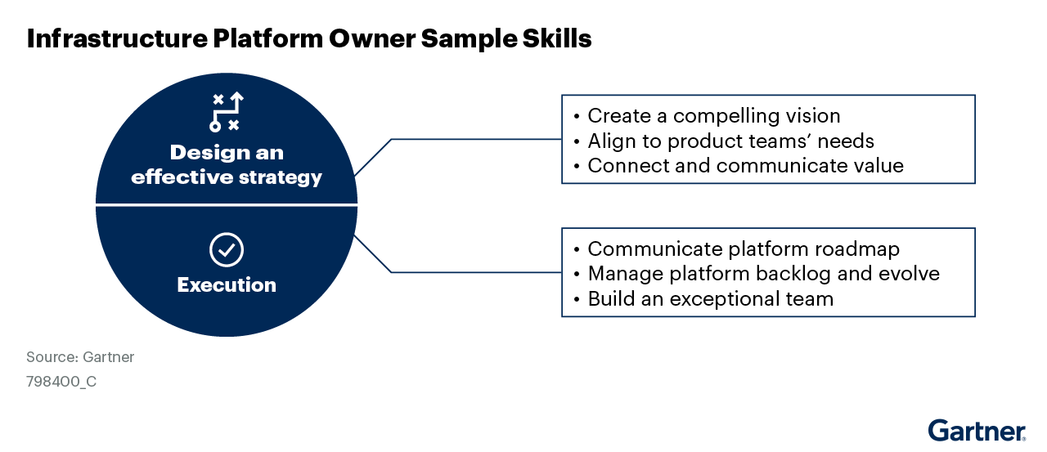
Image Appendix
Image source: Source: How to Develop Infrastructure Platform Engineering Teams
21

Slide 22
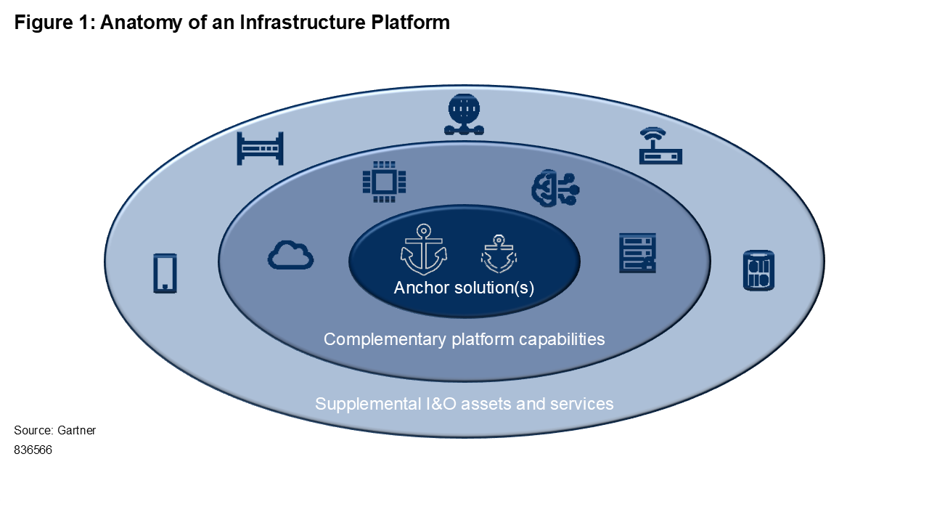
Image Appendix
Image source: Source: The Infrastructure You Need for Platform-Centric I&O
22

Slide 23
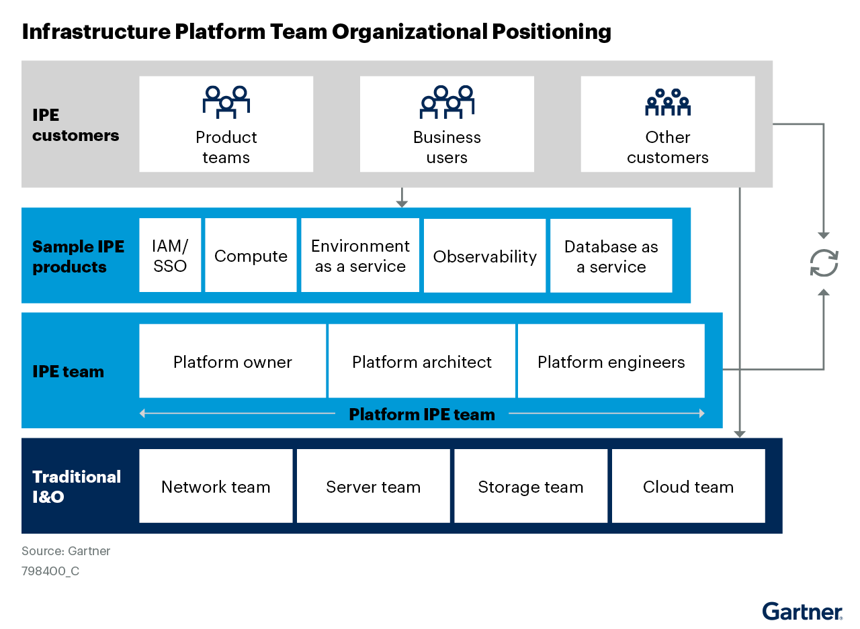
Image Appendix
Image source: Source: How to Develop Infrastructure Platform Engineering Teams
23

