Slide 1
Maximizing Value From Infrastructure Platform Investments
Disciplined engineering, ruthless reuse, and relentless user... | 10 August 2026

Slide 2
Usage Guidance
The following text was generated using Gartner's AskGartner Generative AI tool. Due to the nature of this technology, some answers may be incomplete or incorrect. Please verify sources. Gartner does not endorse any provider, product, or service. AskGartner answers cannot be quoted externally and may only be shared within your organization, in line with the Licensed User limits in the Gartner Usage Policy and with the accompanying cite "based on AskGartner Generative AI tool". Information sourced from Gartner Peer Insights is drawn from Peer Insights summaries and software reviews submitted by validated technology end-users in accordance with the Peer Insights Community Guidelines and does not represent Gartner opinion.
2

Slide 3
The Value Equation: What Drives ROI
Right-Sized Engineering: Avoid over-customization—custom code increases technical debt and costs.^{[1]}
Anchor Platforms: Platform fragmentation increases complexity and reduces value; each domain should have one primary technology.^{[3]}
Enforce Reuse: Reuse reduces ownership cost, cognitive load, and multiplies platform value.^{[3]}
3

Slide 4
Right-Sized Engineering: Avoid Customization Trap
Curate vendor solutions first. Use vendors like AWS, Azure, Kubernetes if they deliver 80%+ of required capabilities.^{[1]}
Custom development only for true differentiators: Integrations, governance, or UX layers solving real user pain.^{[2]}
Set clear charter guardrails: Explicitly define what to build, integrate, or configure; prevent scope creep.^{[1]}
Financial impact: Anchoring strategy saves 30% on platform tech through 2028.^{[3]}
4

Slide 5
Anchor Each Platform With One Primary Technology
Cloud Compute: AWS or Azure (not both unless strategic) — Reduces IaC fragmentation, simplifies skills.^{[3]}
Kubernetes: EKS or AKS (choose based on cloud) — Avoids multi-Kubernetes complexity; standardizes workloads.^{[3]}
Observability: Use a single vendor (e.g., Datadog, Splunk) — Eliminates silos, improves cost visibility, enables unified FinOps.^{[3]}
5

Slide 6
Enforce Reuse—Make It Non-Negotiable
Create a capability inventory. Document platform offerings (cloud, Kubernetes, networking, AI) and publish widely.^{[3]}
Require justification to build new tools: Teams must show why existing platforms can't meet needs.^{[3]}
Co-invest with enterprise architecture. Maintain reference architectures; put platform reps on governance committees.^{[3]}
Enforcing reuse reduces TCO, lowers team cognitive load, and amplifies platform network effects.^{[3]}
6

Slide 7
Ownership and Team Structure
Dedicated Platform Owners: Assign a single, accountable leader per platform—strategy, roadmap, quality, user feedback.^{[1][4]}
Cross-Functional Teams: Architect, automation engineer, software engineer, product manager, operations—agile squad.^{[1]}
Skip generalists: Borrow experienced agile squads from dev teams for skill transfer.^{[1]}
Co-Invest With Leaders: Fund platforms jointly with Finance (FinOps/Cost), Security (CISO), Data (CDAO), AI (CAIO).^{[1]}
Solves shared problems; funds platforms as strategic investments, not siloed I&O costs.^{[1]}
7

Slide 8
User Experience and Value Leakage
Focus on Developer Experience: Measure CES, CSAT, NPS; target CES low friction, CSAT 4+/5, NPS 50+.^{[4][5]}
Make Self-Service Invisible: Documentation, API/CLI/UI options, guided onboarding, tool integration.^{[6]}
Internal Developer Platforms (IDP): Unified interfaces shield teams from cloud and policy complexity.^{[6]}
Trap: Policy Fragmentation: Cross-domain teams use disparate tools—build policy orchestration layers, inventory policies, use AI for contradictions.^{[6]}
Trap: Over-Engineering: Ruthlessly retire low-usage features, use 80/20 rule; route niche needs to self-service.^{[1]}
Trap: Disconnect From Business Outcomes: Link platform adoption to faster deployment, cost, compliance; use SIR storytelling framework.^{[7]}
8

Slide 9
Measurement: Showing Value to Stakeholders
Adoption: % teams onboarded, feature/API usage (monthly).^{[4]}
Experience: CES, CSAT, NPS (monthly/quarterly).^{[5]}
Operations: Uptime, DORA metrics (monthly).^{[4]}
Business: Time to provision, cost per workload, self-service rate (quarterly).^{[4]}
Compliance audit readiness: Key business metric for Capital One; quantify reduced manual compliance.^{[4]}
Track these metrics in four buckets: Adoption, Experience, Operations, Business for full value visibility.
Tie metrics back to user trust, predictability, delivery efficiency, and direct business impact.
9

Slide 10
Your 90-Day Play: Actionable Steps
Week 1–2: Audit platforms & integration complexity; identify anchors per domain.^{[3]}
Week 3–4: Map reuse landscape; identify existing capabilities and duplication.
Week 5–6: Assign platform owners; define 'just enough' engineering scope for top platforms.^{[1]}
Week 7–8: Co-design minimum viable platform experience for a high-value user persona.^{[4]}
Week 9–12: Launch pilot; measure CES, adoption, provisioning time; iterate based on feedback.^{[5]}
Outcome: Validate a strategy for Capital One’s next wave of platform value and scale.
10

Slide 11
Core Principle: Compounding Value Through Discipline
Platforms deliver maximum value when right-sized, clearly owned, and deeply integrated into user workflows. Avoid chasing technical perfection; focus on measurable impact and consistent discipline to drive sustainable results.^{[1]}
11

Slide 12
References
Invest "Just Enough" in Infrastructure Platform Engineering to Deliver Sustainable Value
How to Structure Your Infrastructure Platform Engineering Journey
The Infrastructure You Need for Platform-Centric I&O
Drive Business Agility With Infrastructure Platform Engineering
Three Strategies to Improve the Developer Experience in Infrastructure Platforms
Enabling Developer Self-Service With Unified Policy Orchestration
Accelerate Platform Engineering Adoption With the Art of Storytelling
12

Slide 13
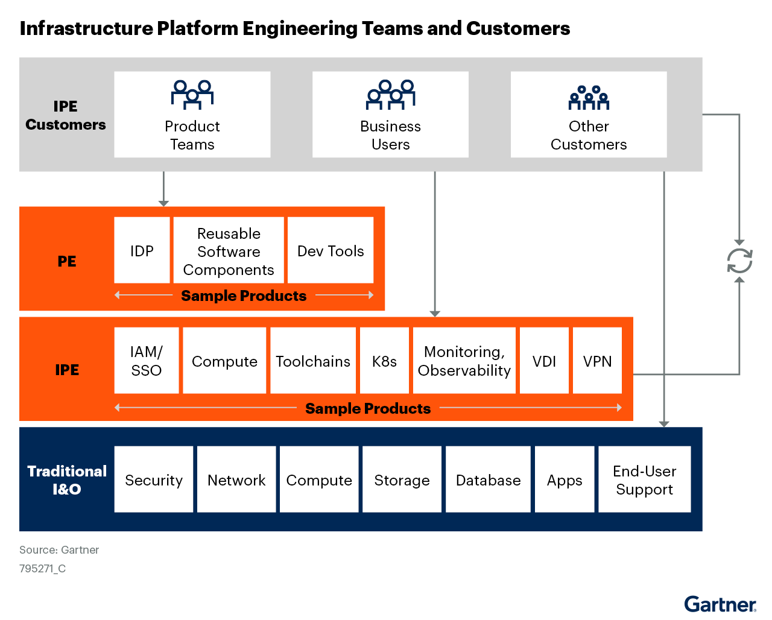
Image Appendix
Image source: Source: Drive Business Agility With Infrastructure Platform Engineering
13

Slide 14
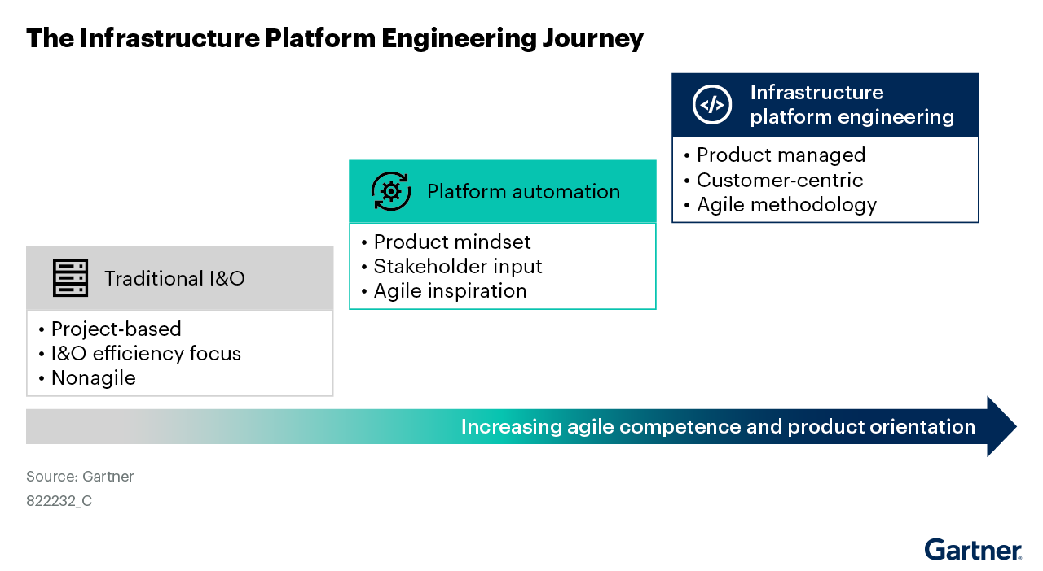
Image Appendix
Image source: Source: How to Structure Your Infrastructure Platform Engineering Journey
14

Slide 15
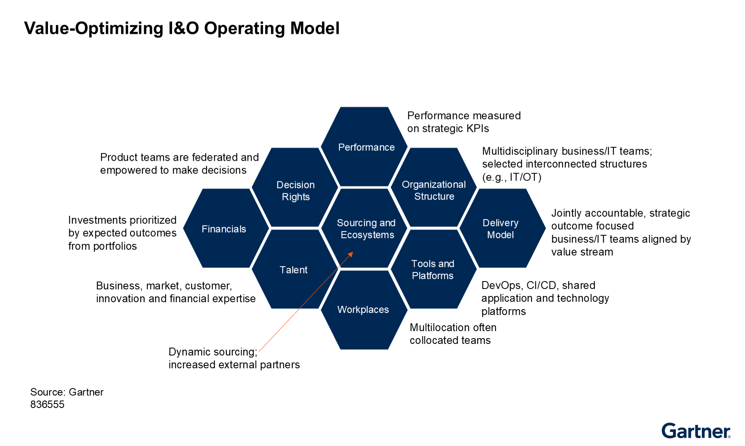
Image Appendix
Image source: Source: Blueprint for Platform-Centric I&O
15

Slide 16
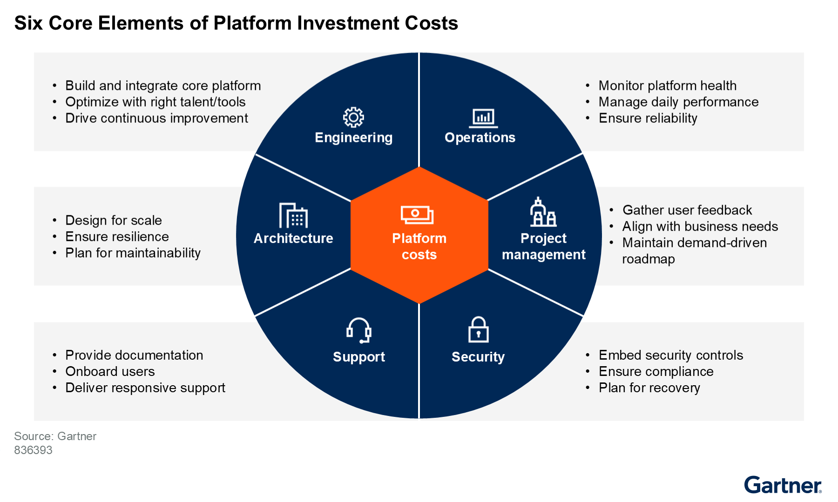
Image Appendix
Image source: Source: Invest “Just Enough” in Infrastructure Platform Engineering to Deliver Sustaina...
16

Slide 17
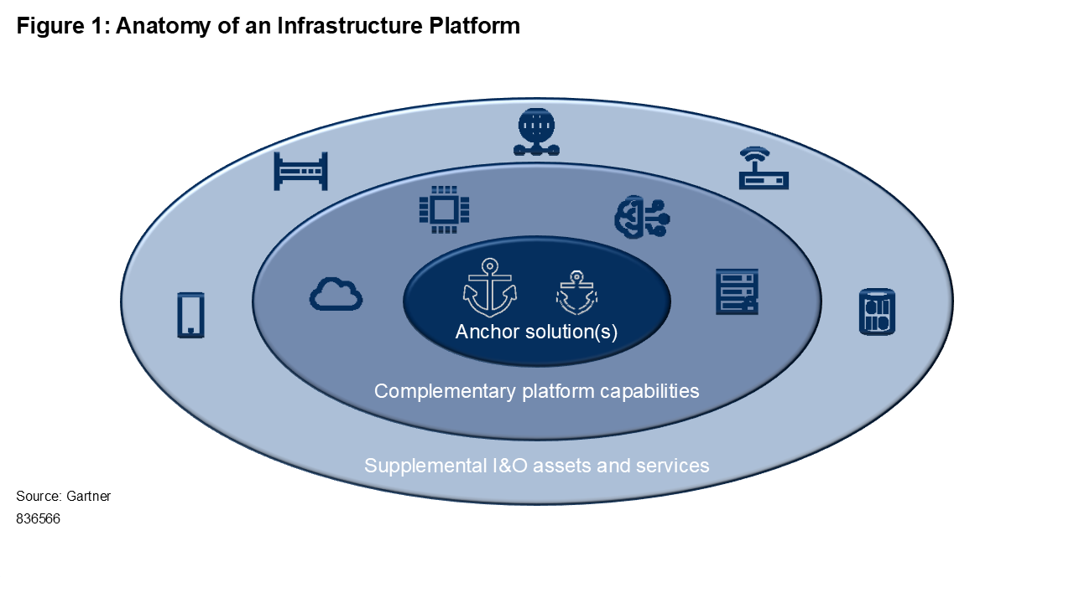
Image Appendix
Image source: Source: The Infrastructure You Need for Platform-Centric I&O
17

