Slide 1
Measuring Infrastructure Platform Engineering Success
Balanced metrics for adoption, experience, operations, and o... | 10 August 2026

Slide 2
Usage Guidance
The following text was generated using Gartner's AskGartner Generative AI tool. Due to the nature of this technology, some answers may be incomplete or incorrect. Please verify sources. Gartner does not endorse any provider, product, or service. AskGartner answers cannot be quoted externally and may only be shared within your organization, in line with the Licensed User limits in the Gartner Usage Policy and with the accompanying cite "based on AskGartner Generative AI tool". Information sourced from Gartner Peer Insights is drawn from Peer Insights summaries and software reviews submitted by validated technology end-users in accordance with the Peer Insights Community Guidelines and does not represent Gartner opinion.
2

Slide 3
The Four Pillars of IPE Measurement
3

Slide 4
Customer Experience Metrics: How Easy Is It To Use?
Consumer Effort Score (CES): Measures ease-of-use for provisioning infrastructure, app deployment, or network configs. High CES signals friction and risk of shadow IT.^{[1][2]}
Customer Satisfaction (CSAT): Tracks short-term sentiment post-feature release; usually on a 1–5 scale.^{[1]}
Net Promoter Score (NPS): Gauges loyalty; would users recommend your platform? Assessed quarterly or biannually.^{[1]}
Reporting cadence: CES: continuous, CSAT: after major changes, NPS: every quarter.^{[1]}
4

Slide 5
Adoption & Engagement Metrics: Are Teams Actually Using It?
Platform Adoption Rate: % of eligible teams onboarded: (Onboarded/Eligible) × 100. Vital during rollout.^{[3]}
Platform Consumption Rate: % of actively engaged teams: (Active/Onboarded) × 100. Shows sustained use.^{[3]}
API Consumption Rate: APIs consumed vs. available; reflects integration and cross-team collaboration.^{[3]}
Feature Utilization & Abandonment: Which features see use, and which are ignored or dropped.^{[1]}
Reporting cadence: Monthly for adoption and consumption; quarterly for API consumption.^{[3]}
5

Slide 6
Operational Performance Metrics: Is It Reliable and Efficient?
Platform Reliability (Uptime): % uptime per month. SLA compliance is critical for financial services.^{[2][3]}
Deployment Speed: Time from request to provisioning. Compare to baseline for improvement.^{[4]}
Mean Time to Detect (MTTD): How quickly anomalies are found. Enables proactive prevention.^{[4]}
DORA Metrics: Deployment frequency, lead time, change failure rate, MTTR. Indicate delivery pipeline health.^{[2]}
Mean Time to Recover (MTTR): How fast issues are fixed. Lower is better.^{[2]}
Reporting cadence: Uptime monthly; DORA metrics monthly or quarterly.^{[3]}
6

Slide 7
Business Outcome Metrics: Is It Moving the Business Forward?
Technical Debt Reduction: (Baseline debt – Current debt)/Baseline debt × 100; measured in cost/budget.^{[3]}
Value Enhancement Score: Does the platform accelerate cloud adoption, cut costs, or mitigate risk? Tie to KPIs.^{[5]}
Self-Service Rate: % of tasks teams handle without ticketing/manual work. Higher = more efficiency.^{[1]}
Cost Control Metrics: Track service catalog use, chargeback, budget variance, FinOps effectiveness.^{[6]}
Reporting cadence: Tech debt quarterly, value & cost metrics monthly to quarterly.^{[3]}
7

Slide 8
Building Your Measurement Dashboard
8

Slide 9
Integrated Dashboard: Sentiment + Outcomes
Experience: CES, CSAT, NPS
Audience: Platform team, product leadership
Cadence: Monthly/quarterly
Adoption: Adoption, consumption, API usage
Audience: Head of I&O, CFO
Cadence: Monthly
Operations/Business: Uptime, DORA, tech debt, cost
Audience: DevOps, CTO, business units
Cadence: Monthly/quarterly
9

Slide 10
Metric Ownership & Regulated Industry Considerations
Assign ownership for each metric category.
Finance should own cost metrics; Security must own risk/compliance KPIs.^{[1][6]}
For regulated industries (e.g. banking), ensure reporting aligns with audit and regulatory requirements.
10

Slide 11
Defining Success and Continuous Improvement
11

Slide 12
Targets For Success: What Do Good Metrics Look Like?
Adoption: Aim for 60%+ within 6 months; 80%+ in 12 months.
CSAT/NPS: Target CSAT ≥ 4/5, NPS ≥ 50 indicates strong advocacy.
Uptime: ≥ 99.5% for financial services (regulatory standard).
MTTR: Should trend down steadily, showing platform improvements.
Self-service rate: 70%+ of routine tasks resolved without tickets.^{[4]}
Industry benchmarks vary by maturity and domain; directional improvements matter more than static targets.
12

Slide 13
Establishing Feedback Loops and Action-Oriented Roadmap
Use a centralized dashboard linking sentiment and business metrics for actionable insights.^{[1]}
Monthly reviews with platform teams and stakeholders close the loop.
Adjust priorities based on feedback — low CES + high adoption = users are using, but struggling.
Example: Redesign provisioning wizard if cloud account CES is low, even with strong adoption.
13

Slide 14
Your Next Move: Get Started With Essentials
Focus on key metrics: Adoption rate, CSAT, uptime, and one business metric (e.g., deployment speed or tech debt reduction).
Avoid "boiling the ocean"—start with 4–5 metrics and add depth gradually.
Assign owners for each metric today; begin reporting within 30 days.
14

Slide 15
References
Three Strategies to Improve the Developer Experience in Infrastructure Platforms
Drive Business Agility With Infrastructure Platform Engineering
A Head of I&O's Guide to Building and Operating High-Impact Platform Teams
Quick Answer: How Can I&O Leaders in China Establish Effective Infrastructure Platform Engineering?
How to Achieve Cloud Platform Operations Success
Prioritize Employee Experience for Infrastructure Platform Engineering Success
15

Slide 16
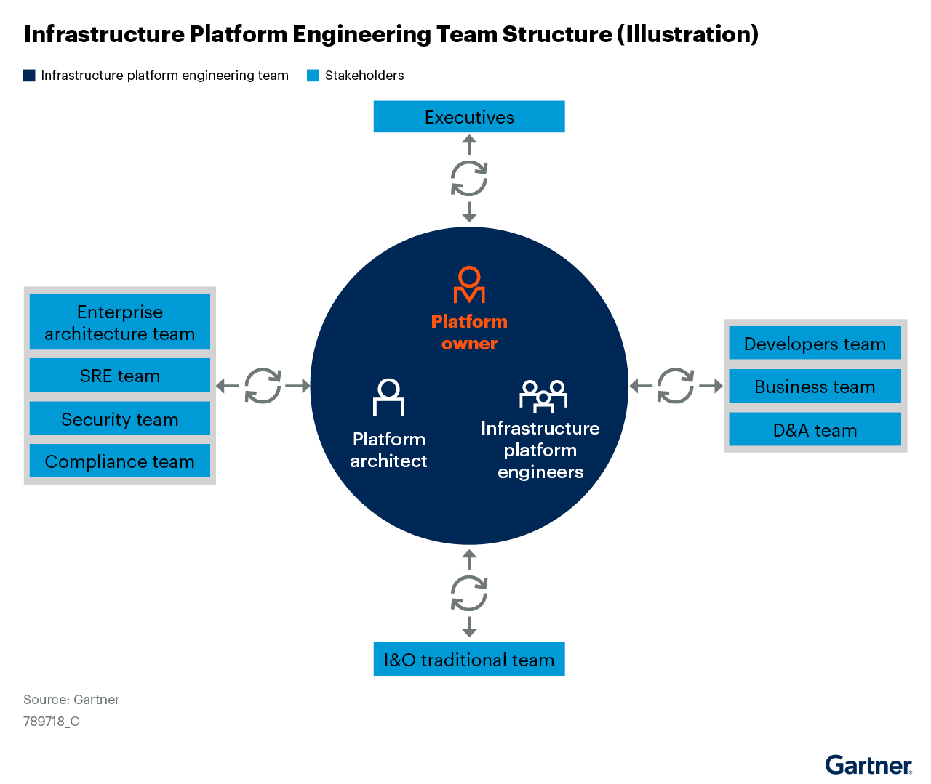
Image Appendix
Image source: Source: Quick Answer: How Can I&O Leaders in China Establish Effective Infrastructure P...
16

Slide 17
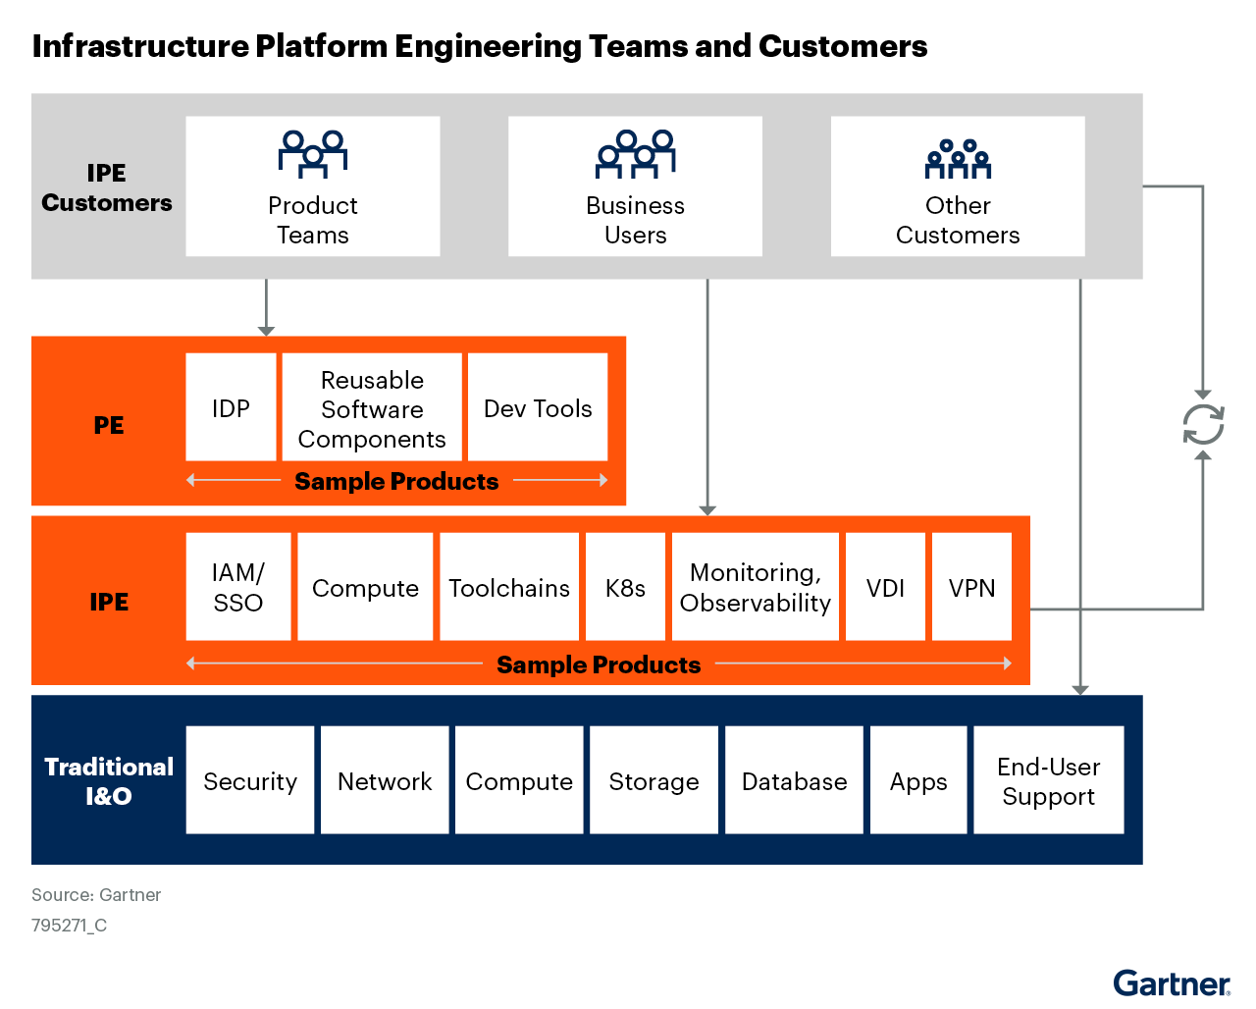
Image Appendix
Image source: Source: Drive Business Agility With Infrastructure Platform Engineering
17

Slide 18
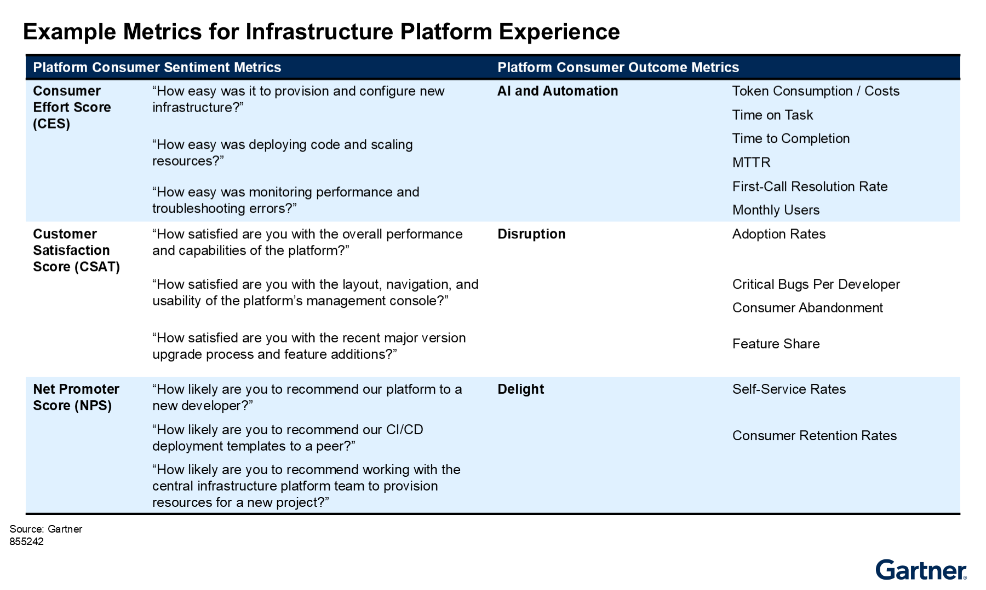
Image Appendix
Image source: Source: Improve the Developer Experience in Infrastructure Platforms With Self-Service
18

Slide 19
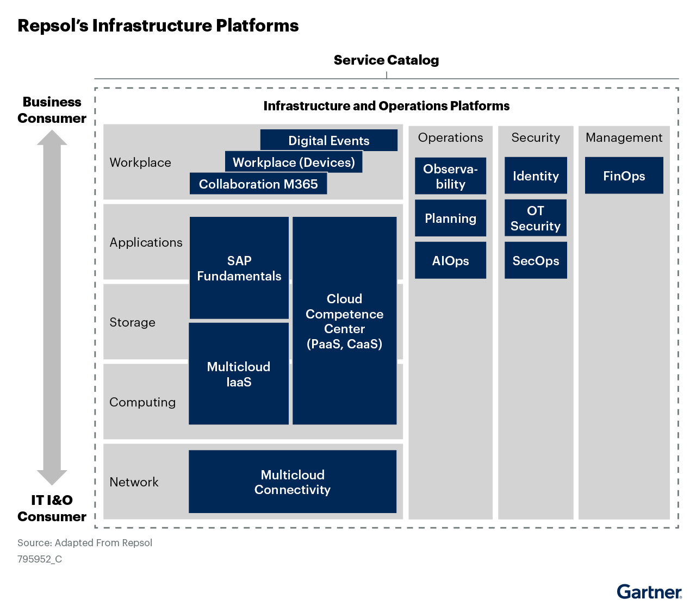
Image Appendix
Image source: Source: Improve the Developer Experience in Infrastructure Platforms With Self-Service
19

Slide 20
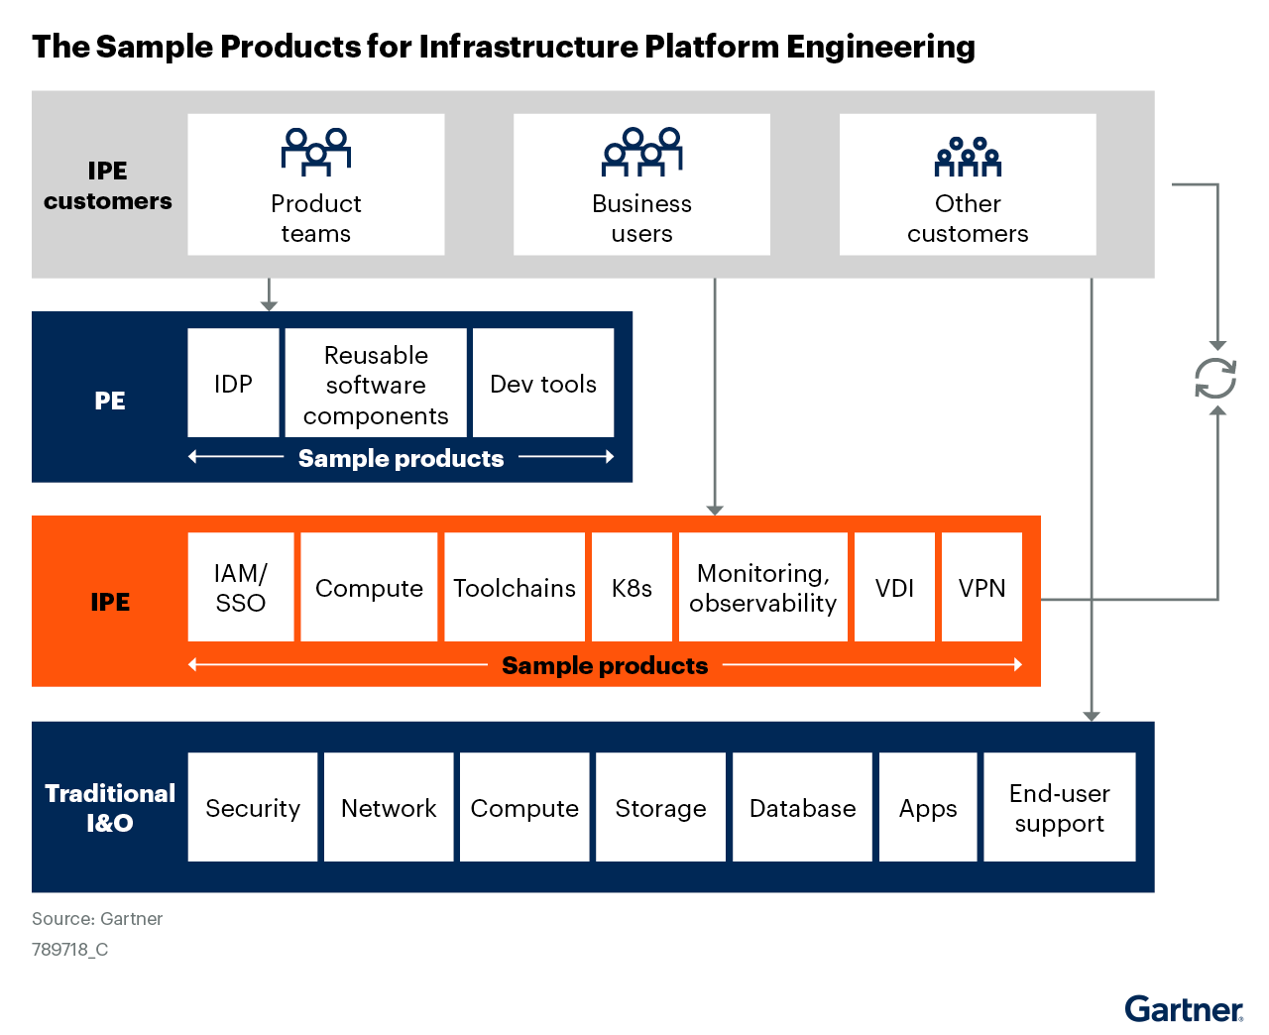
Image Appendix
Image source: Source: Quick Answer: How Can I&O Leaders in China Establish Effective Infrastructure P...
20

