Slide 1


Hybrid Models for Medication and Adverse Drug Events Extraction (University of Utah @ n2c2 Nov 2, 2018)
Kelly Peterson^{1,4}, Jianlin Shi², Alec Chapman³, Hannah Eyre^{1,4,5}, Heather Lent^{1,4}, Kevin Graves², Jianyin Shao², Subhadeep Nag², Olga Patterson^{1,2,4}, John F. Hurdle²
¹Division of Epidemiology, Department of Internal Medicine, University of Utah
²Department of Biomedical Informatics, University of Utah
³Health Fidelity, San Mateo, CA, USA
⁴VA Salt Lake City Health Care System
⁵School of Computing, University of Utah
Notes:
It’s an honor to be here today.
I have the privilege of sharing the work and submissions that we made as a team from the University of Utah in Track 2 of n2c2 identifying and relating Adverse Drug Events.
My name is Kelly Peterson.
I am here today representing a talented team of faculty, staff, students and former students all affiliated with the University of Utah in various ways whether through the Division of Epidemiology, Dept of Biomedical Informatics, or School of Computing
Additionally, a number of us work in Veterans Affairs working on challenges in NLP and Machine Learning projects as part of VINCI and the Salt Lake City IDEAS center.

Slide 2
Overview
Intro
Background
Annotation
Task 1 (NER)
Task 2 (RE)
Task 3 (integrated)
Conclusion
Background
Additional Annotation
Task 1: Named Entity Recognition
Task 2: Relation Extraction
Task 3: End-to-end
Conclusion and Future Work
Notes:
As an overview, first I’ll give a brief background on this work. Then I’ll give details on our methods and results for the 3 tasks of this Track and I’ll finish with some conclusions and ideas on future work.

Slide 3
Thanks
Intro
Background
Annotation
Task 1 (NER)
Task 2 (RE)
Task 3 (integrated)
Conclusion
Appreciation to the n2c2 organizers for Tracks 1 and 2
Notes:
Before I continue, we would like to thank the n2c2 organizers of these challenges for Track 1 and Track 2. This was a tremendous amount of work, but it’s very important for the fields of clinical informatics and it has been challenging and interesting to participate in them.

Slide 4
Background
Intro
Background
Annotation
Task 1 (NER)
Task 2 (RE)
Task 3 (integrated)
Conclusion
Some of our components and modeling infrastructure developed previously
UMass organized NLP Challenges for Medication and Adverse Drug Events (MADE 1.0)
Yu H, Jagannatha A, Liu F, and Liu W. 2018. NLP Challenges for Detecting Medication and Adverse Drug Events from Electronic Health Records (https://bio-nlp.org/index.php/announcements/39-nlp-challenges).
Workshop and summary March 2018
Several reports in Journal of Machine Learning Research v90 and upcoming publications
Notes:
To give some background, a number of our methods and ideas were previously developed as some of this team participated in the MADE 1.0 challenge organized by University of Massachusetts.
We’re sharing several new ideas here today, but some components and infrastructure started earlier this year.
For more information on those submissions including ours if I move too quickly, please see volume 90 of the Journal of Machine Learning Research.

Slide 5
Background : Submissions
Intro
Background
Annotation
Task 1 (NER)
Task 2 (RE)
Task 3 (integrated)
Conclusion
Submit max 3 submissions for each Task
9 total submissions
Notes:
Also, to explain what we will share, we did submit the maximum number of submissions for each task.
I will go through each of these 9 submissions as we look at results

Slide 6
OVerview
Intro
Background
Annotation
Task 1 (NER)
Task 2 (RE)
Task 3 (integrated)
Conclusion
Background
Additional Annotation
Task 1: Named Entity Recognition
Task 2: Relation Extraction
Task 3: End-to-end
Conclusion and Future Work
Notes:
First, I’d like to share our approach, methods and results for Task 1 : Named Entity Recognition.

Slide 7
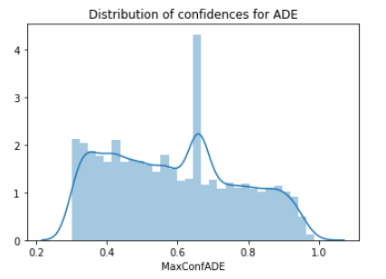
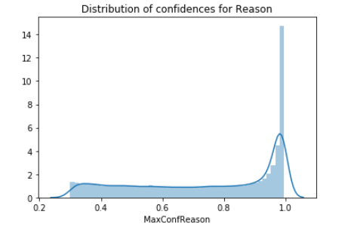
Additional Annotation
Intro
Background
Annotation
Task 1 (NER)
Task 2 (RE)
Task 3 (integrated)
Conclusion
Team Goal: Push ADE/Reason performance
Performed rapid annotation:
Trained an initial model
Inference on thousands of unlabeled MIMIC documents
Stratified sample from low/mid/high of confidence ranges
Sampled more ADE (left) than Reason (right)
Notes:
Although the challenge metrics are based on micro-averaged F1 for all labels, we wanted to push performance of ADE and Reason
So we performed rapid annotation where we trained a model and then performed inference on thousands of unlabeled MIMIC documents.
Next, we took a sampling of both ADEs and Reason predictions and sampled among the lower, middle and upper end of their confidence distributions
Shown here is ADE on the left and Reason on the right.

Slide 8
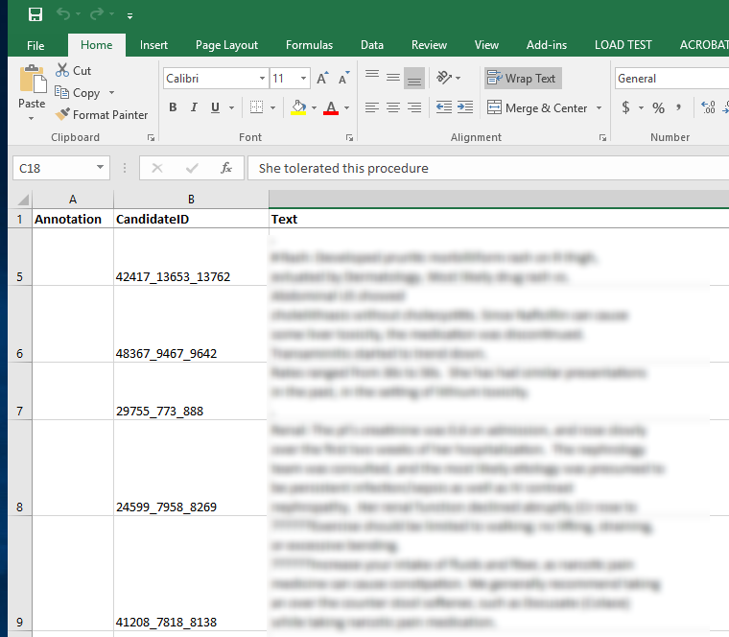
Additional Annotation (cont)
Intro
Background
Annotation
Task 1 (NER)
Task 2 (RE)
Task 3 (integrated)
Conclusion
Annotator reviewed snippets
Thank you Dave Kotter
Assigned either:
ADE only
Reason only
None, Both or “cannot determine”
Completed 1,321 snippets in 4 hours
Annotated Label | Count
ADE | 784
Reason | 303
Other | 234
Notes:
The annotator then reviewed snippets surrounding these predictions
Then, using a very complicated tool called Excel, they assigned a single character to assign whether the snippet contained ADE only, Reason only or if there was neither or cannot be determined.
From this, we gathered over 700 additional ADE annotations and over 300 Reason annotations.
In later slides, this set was used by some but not all of our model trainings and submissions.

Slide 9
OVerview
Intro
Background
Annotation
Task 1 (NER)
Task 2 (RE)
Task 3 (integrated)
Conclusion
Background
Additional Annotation
Task 1: Named Entity Recognition
Task 2: Relation Extraction
Task 3: End-to-end
Conclusion and Future Work
Notes:
First, I’d like to share our approach, methods and results for Task 1 : Named Entity Recognition.

Slide 10

Task 1 overview
Intro
Background
Annotation
Task 1 (NER)
Task 2 (RE)
Task 3 (integrated)
Conclusion
Raw Clinical Text
Predicted Entities
<Drug>
<Dosage>
…
...
Named Entity Recognition
<Drug>
<ADE>
…
...
Notes:
Task 1 is taking raw clinical text and emitting the spans and types of predicted entities such as Drug, Dosage, ADE, etc.

Slide 11
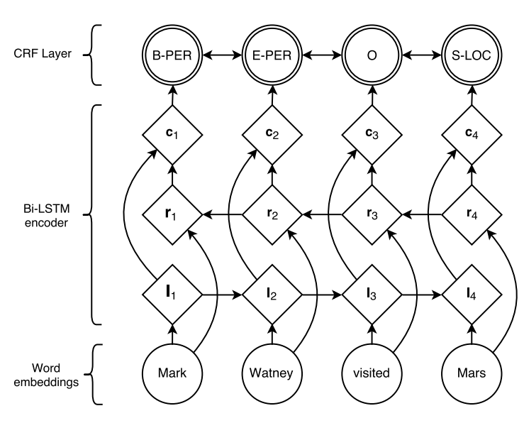
Bi-LSTM-CRF
Intro
Background
Annotation
Task 1 (NER)
Task 2 (RE)
Task 3 (integrated)
Conclusion
‘anago’ Bi-LSTM-CRF implementation*
Includes character embedding
400 dim embeddings trained from MIMIC-III
*https://github.com/Hironsan/anago
Source: Lample G, Ballesteros M, Subramanian S, Kawakami K, Dyer C. Neural architectures for named entity recognition. arXiv preprint arXiv:1603.01360. 2016 Mar 4.
Notes:
One of the models we used as a baseline is what we called our “vanilla Bi-LSTM-CRF model”.
Since we’ll likely see several of these today, I won’t go into great detail, but one outline of the architecture is shown on the right.
Specifically, we started with a Python library which implements a similar architecture with the Keras library.
This implementation also includes a layer of character embeddings which would go <HERE>.
Finally, as our embeddings, we used a set of pretrained 400 dimensional word embeddings that were trained from documents in MIMIC-III.

Slide 12
Augmented Bi-LSTM-CRF: Utilizing additional resources
Intro
Background
Annotation
Task 1 (NER)
Task 2 (RE)
Task 3 (integrated)
Conclusion
Word and character embeddings are powerful
Many existing resources from NLM, FDA, previous challenges we can utilize
Goal: Augment Bi-LSTM-CRF with tags enabled by existing resources
Notes:
Building on that baseline, we build what we call our augmented Bi-LSTM-CRF model.
Certainly, word and character embeddings are powerful but there are additional resources that we want to leverage from NLM, FDA and previous challenges which contain important and often curated knowledge.
So our goal was to augment the previous architecture by applying existing knowledge resources.

Slide 13
Augmented Bi-LSTM-CRF: Resources for sequence feature tags
Intro
Background
Annotation
Task 1 (NER)
Task 2 (RE)
Task 3 (integrated)
Conclusion
Resource
Tags available in resource
RxNorm
Drug
Disorder
FAERS
(FDA Adverse Events Reporting)
Drug
Reason
ADE
UMLS
(“DISO” semantic group)
Disorder
N2C2
(all vocab for tags to the right)
Drug
Reason
ADE
I2B2
(2009 Medications; 2010 Relations)
Drug
Disorder
SemEval
(2015 Analysis of Clinical Text)
Disorder
Notes:
On the left are some of the resources that we used to augment the model and on the right are the right are the resources that are available from each of these.
<Explain each of these down the list>

Slide 14
Augmented Bi-LSTM-CRF Example: Input with semantic representation tag features
Intro
Background
Annotation
Task 1 (NER)
Task 2 (RE)
Task 3 (integrated)
Conclusion
Nitroprusside for chest pain
B-Drug
O
O
O
O
O
B-Reason
I-Reason
O
O
O
O
O
O
B-Disorder
I-Disorder
Training
Labels
B-Drug
O
B-Reason
I-Reason
Notes:
Here is an example of a short 4 word sentence.
Each row is analogous to a “channel” for labels of Drug, Reason. ADE or Disorder.
This illustrates that since we combine multiple resources, some text spans like “chest pain” may have multiple labels attached.
So above this line are features going into the model and just to illustrate what that training labels might actually be, I’ve given some possible examples of gold training data below.

Slide 15
Augmented Bi-LSTM-CRF Example: Input with semantic representation tag features
Intro
Background
Annotation
Task 1 (NER)
Task 2 (RE)
Task 3 (integrated)
Conclusion
Rash secondary to aspirin
O
O
O
B-Drug
B-Reason
O
O
O
B-ADE
O
O
O
B-Disorder
O
O
O
Training
Labels
B-ADE
O
O
B-Drug
Notes:
Meanwhile, others may have ADE as shown in this red “channel” and both of the other tags as well.
Again, below I’ve given some possible examples of gold training data below.

Slide 16
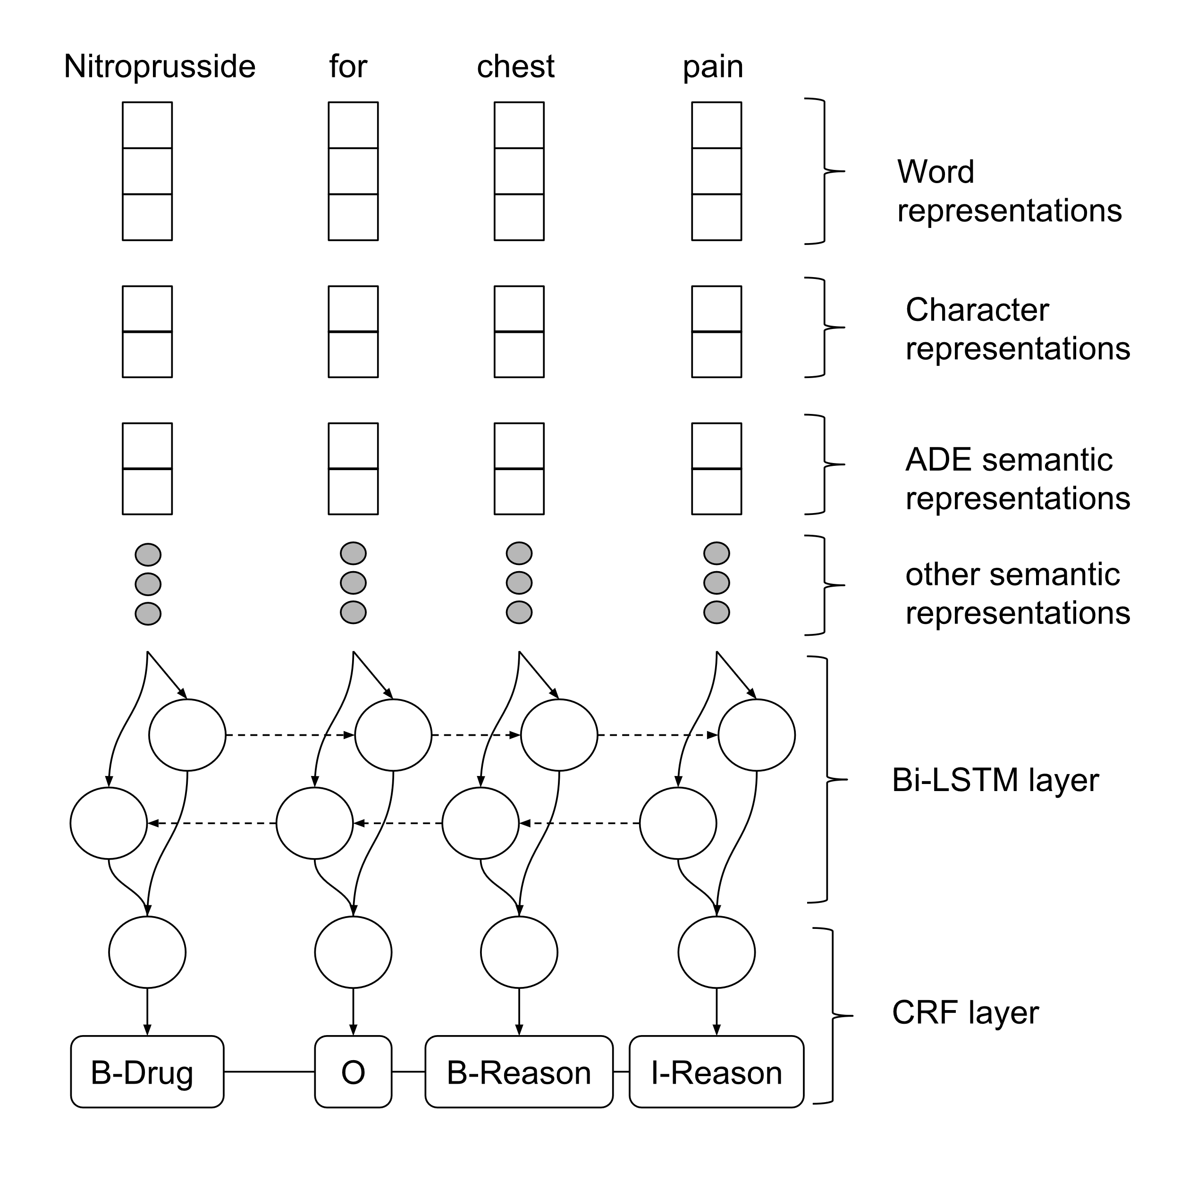
Augmented Bi-LSTM-CRF model
Intro
Background
Annotation
Task 1 (NER)
Task 2 (RE)
Task 3 (integrated)
Conclusion
Notes:
Here is an example of this augmented model architecture.
It’s very similar to the other architecture in that it includes word and character representations.
However, it also includes the other “semantic representations” or “tags” which were applied to each token according to our augmented resources.

Slide 17
“Two stage” ADE/REASON labeling model (labeling and classification)
Intro
Background
Annotation
Task 1 (NER)
Task 2 (RE)
Task 3 (integrated)
Conclusion
Motivation: Identifying ADE vs Reason is a difficult task requiring wide context
Proposal:
First stage predicts labels all types
Second stage receives any candidate of “ADE or Reason or Sign/Symptom” to perform a finer classification
IBM team did something similar in MADE 1.0
Goal: Improve ADE/Reason performance from candidates and context
Notes:
The third model we propose as a “two stage labeling model”.
Since identifying ADE vs Reason is a challenging task requiring context for disambiguation, we propose two stages:
The first stage predicts labels for all types, but a second stage considers any candidate marked up as ADE or Reason or a Sign/Symptom and then makes a classification of one of these or None of them
In the MADE 1.0 challenge, the IBM team did something similar to this.
The goal is to improve the performance of the ADE and Reason labels given these candidates and context.

Slide 18
“Two stage” ADE/reason labeling model
Intro
Background
Annotation
Task 1 (NER)
Task 2 (RE)
Task 3 (integrated)
Conclusion
n2c2 Bi-LSTM-CRF
Non-augmented
MADE 1.0 CRF
Includes sign/symptom label with no drug relation
MADE 1.0 model:
“Fast and Accurate Adverse Drug Event labeling without a GPU”
GitHub source available
Monday 5pm session
Poster #84
ADE and Reason candidates
Training label assigned by overlap with gold
Feature Extraction:
2 sentence context
Upstream entity predictions
Features between candidate and nearest Drug
Lexicon lookups (FAERS, MedEx)
Word embedding clusters
Logistic Regression classification:
{ADE, Reason, None}
Submission only augmented ADE (not Reason and did not “change” predictions)
Notes:
In our submission, the labels and candidates come from both our n2c2 trained model but also from a model we trained during MADE 1.0.
This model was helpful since that datasets included a label for Signs and Symptoms which had no cause-effect relationship with a Drug entity.
For each candidate, we extract features from a 2 sentence context where features include upstream entity predictions, features about the candidate and the nearest Drug, some lexicon lookups and also clustered word embeddings.
In the end, there is a simple model (Logistic Regression) which emits a label of ADE, Reason or None.
Full disclosure : Development was late. Due to limited time remaining, we only “kept” ADE candidate predictions ignoring the “Reason” label and we did not “change” upstream predictions.
Finally, as a plug, I will be presenting a poster on this here at AMIA Monday night, so if you want to hear about our fast training model that did not require a GPU, come find this poster.

Slide 19
Additional Annotation: clarification on submissions
Intro
Background
Annotation
Task 1 (NER)
Task 2 (RE)
Task 3 (integrated)
Conclusion
Still need to measure impact of annotation more closely, however…
NER model | Additional Annotation Data Used? (ADE and Reason annotations only)
Bi-LSTM-CRF | Yes
Augmented Bi-LSTM-CRF | No
“Two stage” model | Yes
Notes:
While we still need to measure the potential impact of our training data, I would like to orient a bit before we see these results…
All of our NER models used this additional training data besides the Augmented Bi-LSTM-CRF.
Although confusing, I mention this for a reason before we see the results…

Slide 20
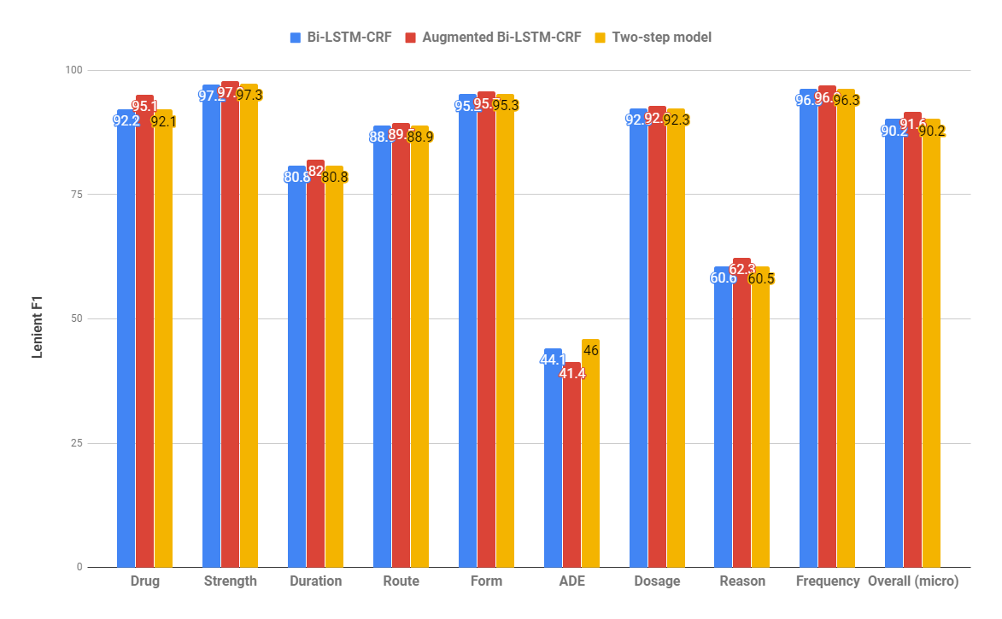
Task 1 Results
Intro
Background
Annotation
Task 1 (NER)
Task 2 (RE)
Task 3 (integrated)
Conclusion
Notes:
Here are the results of these 3 models for each label and overall.
The best performance overall and for most labels was the augmented model which included additional resources for labeling.
Overall lenient F1 is 91.6
However, the best performance we were able to achieve on the ADE label was with the two-stage which increased the F1 of our ADE label to 46.

Slide 21
OVerview
Intro
Background
Annotation
Task 1 (NER)
Task 2 (RE)
Task 3 (integrated)
Conclusion
Background
Additional Annotation
Task 1: Named Entity Recognition
Task 2: Relation Extraction
Task 3: End-to-end
Conclusion and Future Work
Notes:
Next, I’ll cover our approach and results for the next task which is Relation Extraction.

Slide 22

Task 2 overview
Intro
Background
Annotation
Task 1 (NER)
Task 2 (RE)
Task 3 (integrated)
Conclusion
Predicted Entities
Entity Relations
<Drug>
<Dosage>
…
...
<Drug>
HAS
<Dosage>
Relation Extraction
<Drug>
CAUSED
<ADE>
<Drug>
<ADE>
…
...
Notes:
In this task, we assume that we already have predicted entities. These may or may not be correct but we then determine the type of the relationship if there is one.

Slide 23
Relation extraction methods
Intro
Background
Annotation
Task 1 (NER)
Task 2 (RE)
Task 3 (integrated)
Conclusion
Identify all possible relations in text from entity pairs
Identify discriminatory features
Train machine learning algorithm to classify each pair instance
Notes:
Here are the 3 steps of how we approach this.
The first step is to identify possible relationships between entity pairs.

Slide 24
I. Identify possible relations
Intro
Background
Annotation
Task 1 (NER)
Task 2 (RE)
Task 3 (integrated)
Conclusion
Restrict to legal combinations
e.g. Drug -> Route, Drug -> Reason, Drug -> ADE, etc
Restrict to pairs within 3 sentences
“The patient is being treated for lymphoma.
The patient received one cycle of fludarabine.
He is on Velcade 2 weeks out of each month.
The patient is currently on aspirin 100 mg a day.”
Notes:
The first step is to restrict relationships to legal entity pair combinations such as Drug and its Route or Drug and its Reason.
Next, given our observation in the data we elected to restrict the candidate relations to only those occurring within 3 sentences of each other.
In a sentence like this one, here would be 2 underlined candidates for LYMPHOMA within the highlighted region.
However, we do not consider ASPIRIN as a candidate since it is outside our 3 sentence context threshold.

Slide 25
Relation extraction methods
Intro
Background
Annotation
Task 1 (NER)
Task 2 (RE)
Task 3 (integrated)
Conclusion
Identify all possible relations in text from entity pairs
Identify discriminatory features
Train machine learning algorithm to classify each pair instance
Notes:
Next, we identify and extract features to classify the relationship.

Slide 26
II. Identify features
Intro
Background
Annotation
Task 1 (NER)
Task 2 (RE)
Task 3 (integrated)
Conclusion
Information about the two entities
Other entities between the two candidates?
Text/distance between the entities
Notes:
These features primarily center on the two entities, information between them including other entities and the text and distance between them.

Slide 27
Text/Types of Candidate Entities
Intro
Background
Annotation
Task 1 (NER)
Task 2 (RE)
Task 3 (integrated)
Conclusion
“3. Fludarabine monotherapy in --- Date ---. With 1 cycle, he developed pancytopenia”
Entity Types: <DRUG> → <ADE>
Text in Entities: “fludarabine” → ”pancytopenia”
Notes:
As an example, we encode features that the entities here are <DRUG> and <ADE>
Additionally, we encode features about the text spanned in these entities.

Slide 28
Entities between Candidate
Intro
Background
Annotation
Task 1 (NER)
Task 2 (RE)
Task 3 (integrated)
Conclusion
“3. Fludarabine monotherapy in --- Date ---. With 1 cycle, he developed pancytopenia”
Entities Between: <DURATION>
# Entities Between: 1
Notes:
We also encode features about the entities between where we see <DURATION>
We encode here that there is a total of 1 entity in between our candidate pair.

Slide 29
Token / pos tags
Intro
Background
Annotation
Task 1 (NER)
Task 2 (RE)
Task 3 (integrated)
Conclusion
“3. Fludarabine monotherapy in --- Date ---. With 1 cycle, he developed pancytopenia”
N-Grams between: [“monotherapy”, “<NUM>”, “cycle”, “monotherapy in”, “he developed”, ...]
POS Tags between: [“NNP”, “CD”, “JJ”, ...]
Notes:
Next, we encode some surface-level features about the tokens between including unigrams and n-grams found between the candidate pair.
Tags for part of speech also become features.

Slide 30
Distance between
Intro
Background
Annotation
Task 1 (NER)
Task 2 (RE)
Task 3 (integrated)
Conclusion
“3. Fludarabine monotherapy in --- Date ---. With 1 cycle, he developed pancytopenia”
Number of Tokens: 12
Number of Sentences: 2
Notes:
Finally in our feature recipe, we include features for the count of tokens between these entities and the number of sentences total to include them.

Slide 31
Relation extraction methods
Intro
Background
Annotation
Task 1 (NER)
Task 2 (RE)
Task 3 (integrated)
Conclusion
Identify all possible relations in text from entity pairs
Identify discriminatory features
Train machine learning algorithm to classify each pair instance
Notes:
As our last step, we train machine learning models to classify these candidate pair instances.

Slide 32
III. Classification Logic
Intro
Background
Annotation
Task 1 (NER)
Task 2 (RE)
Task 3 (integrated)
Conclusion
“none”
Strength -> Drug
Dosage -> Drug
Candidate Pair
Binary Classifier
Duration -> Drug
Multiclass
Classifier
Frequency -> Drug
Form -> Drug
Route -> Drug
Reason -> Drug
ADE -> Drug
Notes:
The logic for classifying relationship consists of two classifiers :
The first is a classifier which predicts whether there should be a relationship or None.
The second is a multi-class classifier which predicts which class given the pair and its features.

Slide 33
III. Relation model training
Intro
Background
Annotation
Task 1 (NER)
Task 2 (RE)
Task 3 (integrated)
Conclusion
Random Forest Classifiers
Parameters
max_depth = 20
max_features = None
min_samples_leaf = 2
min_samples_split = 2
n_estimators = {10, 20, 100}
Varied this for submissions
Top 1000 features for each classifier
Notes:
Both of the classifiers shown previously are Random Forest classifiers.
For both, the depth of trees is limited to 20 with other parameters shown below.
For our submissions, we varied the number of trees allowed for the models where we submitted model predictions with 10, 20 and 100 trees.

Slide 34
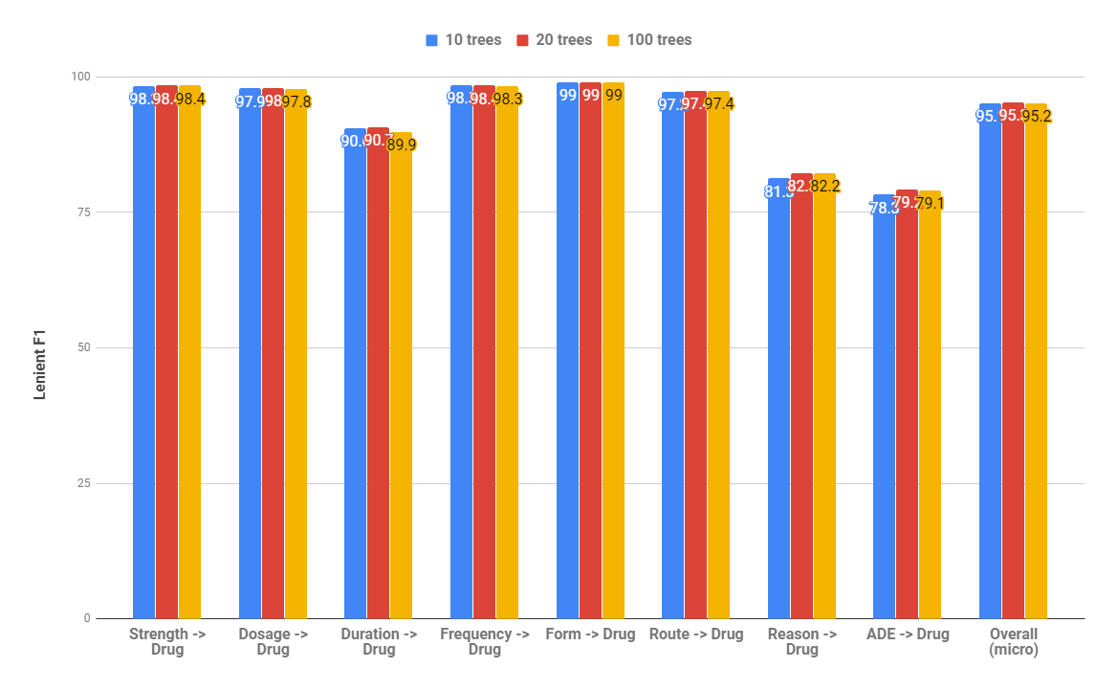
Task 2 results
Intro
Background
Annotation
Task 1 (NER)
Task 2 (RE)
Task 3 (integrated)
Conclusion
Notes:
On this slide, you can see that the performance on many of the relationship types is nearly identical.
If you have very good eyesight, you might see that allowing 20 trees performed better than the default of 10 in scikit-learn.
However, there wasn’t much of an improvement increasing from 20 to 100.

Slide 35
OVerview
Intro
Background
Annotation
Task 1 (NER)
Task 2 (RE)
Task 3 (integrated)
Conclusion
Background
Additional Annotation
Task 1: Named Entity Recognition
Task 2: Relation Extraction
Task 3: End-to-end
Conclusion and Future Work
Notes:
Next, I’ll explain our methods and results for the end-to-end integrated task.

Slide 36
Task 3 overview
Intro
Background
Annotation
Task 1 (NER)
Task 2 (RE)
Task 3 (integrated)
Conclusion
Raw Clinical Text
Predicted Entities
Entity Relations
<Drug>
<Dosage>
…
...
<Drug>
HAS
<Dosage>
Named Entity Recognition
Relation Extraction
<Drug>
CAUSED
<ADE>
<Drug>
<ADE>
…
...
Task 3 Methods:
No extra processing
NER predictions simply passed to the Relation prediction models
Notes:
In this final task, we proceed from raw text to predicted entities to their appropriate relationships.
As a bit of a spoiler alert, our methods for Task 3 performed no extra processing.
Rather, our NER predicted are simply passed to our Relation models for prediction.

Slide 37
Task 3 submission strategy
Intro
Background
Annotation
Task 1 (NER)
Task 2 (RE)
Task 3 (integrated)
Conclusion
Task 3 submissions varied the NER input for each
“Vanilla Bi-LSTM-CRF”, Augmented Bi-LSTM-CRF, Two stage NER model
RE model parameters held constant:
max_depth = 20
n_estimators (trees) = 10
Notes:
For our strategy of submissions for Task 3, we simply varied the NER model for each of our 3 submissions
Meanwhile, the RE models were held constant where the max_depth was 20 and number of estimators or trees was the scikit-learn default of 10.

Slide 38
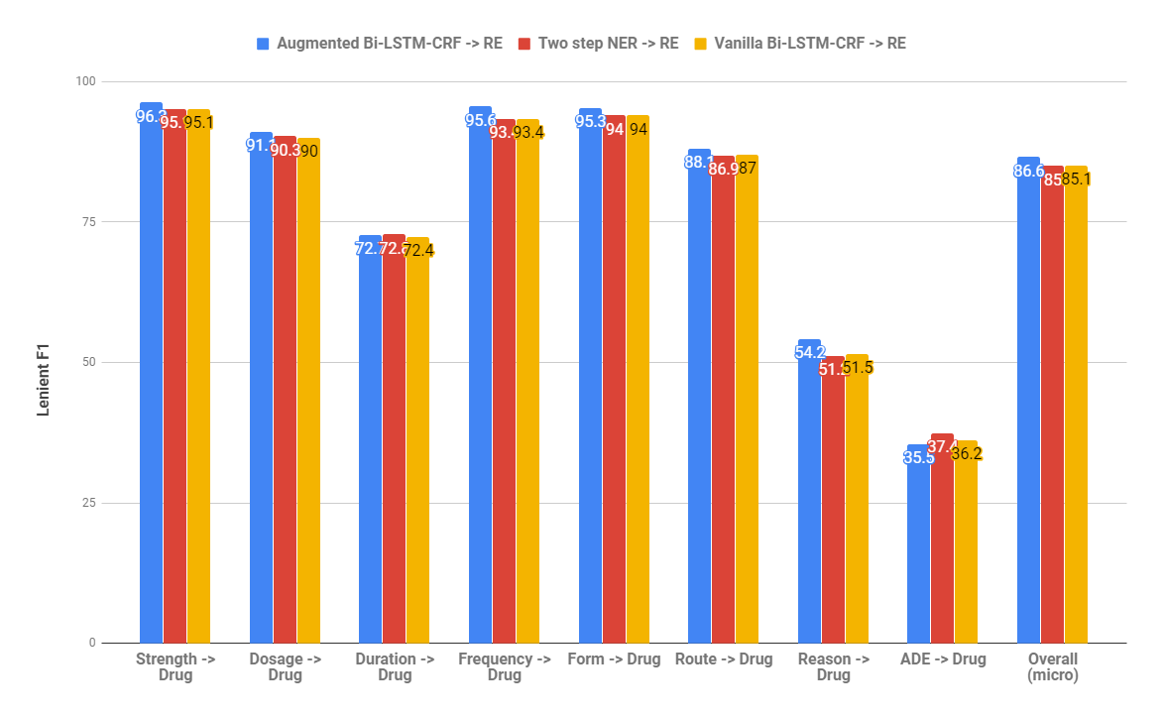
Task 3 Results
Intro
Background
Annotation
Task 1 (NER)
Task 2 (RE)
Task 3 (integrated)
Conclusion
Notes:
Again , the best performance on most labels and also the overall performance for F1 was the augmented Bi-LSTM-CRF model.
The top end-to-end performance achieved 86.6 Micro-averaged F1.
Meanwhile, the best performance on the ADE label was the NER model which performed labeling and classification (or disambiguation of ADEs) as two stages.

Slide 39
OVerview
Intro
Background
Annotation
Task 1 (NER)
Task 2 (RE)
Task 3 (integrated)
Conclusion
Background
Additional Annotation
Task 1: Named Entity Recognition
Task 2: Relation Extraction
Task 3: End-to-end
Conclusion and Future Work
Notes:
Now I’d like to wrap up with our conclusions and future work.

Slide 40
Conclusion and future work
Intro
Background
Annotation
Task 1 (NER)
Task 2 (RE)
Task 3 (integrated)
Conclusion
Deep neural sequence labeling models aided by existing semantic resources (UMLS, FAERS)
Our top performing submission for overall F1
Challenging to assign drug-causation status during labeling, so second-stage could prove useful
Best ADE performance but possibly improved by more “candidates” besides MADE 1.0 model
Additional training data improved ADE
Needs measuring
Relation extraction system benefits from simple surface features and high level features (entities)
Need to measure contribution of using 2 classifiers
Consider features from word embeddings
Potential upcoming usage in Veterans Affairs
Notes:
To conclude, we found that deep neural networks for sequence labeling can be aided by additional semantic resources such as the UMLS and FDA reporting and not strictly word embeddings.
This model did achieve our highest micro F1 and best performance on most labels.
Next, since assigning drug-causation status during token labeling is very difficult, we believe that a second-stage could be useful.
I say “believe” since it’s not a huge improvement and we also ran out of time and were not successful in implementing additional “candidate generation” besides our MADE 1.0 model.
As with the point above, this would likely benefit from using additional lexical resources like UMLS, FAERS, etc
Finally, our relation extract system does benefit from relatively simply surface features and higher-level features such as predicted entities.
Going forward, we would like to measure the contribution of using 2 classifiers in our approach to this dataset.
We would also like to consider other powerful features such as those from word embeddings.

Slide 41
References
Chapman AB, Peterson KS, Alba PR, DuVall SL, Patterson OV. Hybrid system for adverse drug event detection. In International Workshop on Medication and Adverse Drug Event Detection 2018 May 16 (pp. 16-24).
Dandala B, Joopudi V, Devarakonda M. IBM Research System at MADE 2018: Detecting Adverse Drug Events from Electronic Health Records. In International Workshop on Medication and Adverse Drug Event Detection 2018 May 16 (pp. 39-47).
Huang Z, Xu W, Yu K. Bidirectional LSTM-CRF models for sequence tagging. arXiv preprint arXiv:1508.01991. 2015 Aug 9.
Lample G, Ballesteros M, Subramanian S, Kawakami K, Dyer C. Neural architectures for named entity recognition. arXiv preprint arXiv:1603.01360. 2016 Mar 4.
Shi, Jianlin, and John F. Hurdle. Trie-Based Rule Processing for Clinical NLP: A Use-Case Study of n-Trie, Making the ConText Algorithm More Efficient and Scalable. Journal of Biomedical Informatics, August 6, 2018. https://doi.org/10.1016/j.jbi.2018.08.002.
Yu H, Jagannatha A, Liu F, and Liu W. 2018. NLP Challenges for Detecting Medication and Adverse Drug Events from Electronic Health Records (https://bio-nlp.org/index.php/announcements/39-nlp-challenges).
Notes:
With that, I would like to thank you for your attention and I welcome any questions on this work.

