Slide 1
Estimating Genetic Effects Across Lipid Traits Jointly
Pradeep Natarajan
Sarah Urbut

Slide 2
The Problem: Interrogate 2.4 million SNPS across 4 traits jointly
MLE summary statistics available across LDL, HDL, TG and TC from N = 89K
The goal: to combine information across SNPs and across phenotypes to improve power and reveal underlying patterns of sharing
Avoid simply looking for intersection underestimates sharing, misses power
Report an Effect size rather than Simply Significance
existing methods typically focus only on testing for significant effects in each condition, and not on estimating effect sizes
Effect Size: Quantitative Heterogeneity
Capture systematic heterogeneity (structured effects)
identify new characteristic patterns of sharing: not same size or sign in all tissues

Slide 3
Patterns of sharing
All SNPs belong to a finite number of classes
Each class is characterized by a continuous patterns of sharing across conditions (but not necessarily limited by ‘on/off’ distinction
Posterior estimates on any SNP are nudged towards the globalpatterns of patterns of sharing according to their best pattern ‘fit’

Slide 4

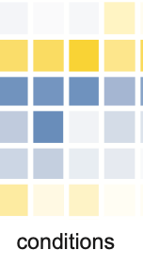
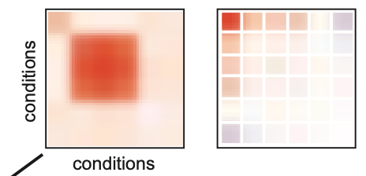
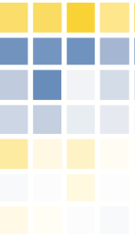


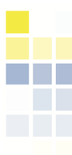
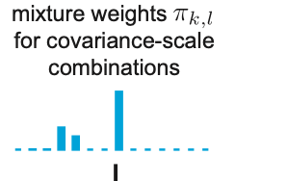
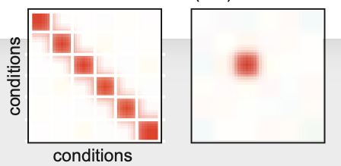
Overview
Select Strongest Signal
(max across conditions, 1 per LD Block)
Compute data-drive estimates of ‘sharing’
Covariance matrices, U_{k}
SNP (over all locations)
Compute posterior estimates on ANY snp (e.g. effect size, lfsr)
That are jointly ‘shrunken’ by larger data set to exploit sharing and increased precision
Conditions (lipid phenotype)
Expand by a grid of scaling factor, omega
Return relative weights,
Add in canonical covariance matrices, U_{k}
Adapted from Urbut et al, NG 2019

Slide 5
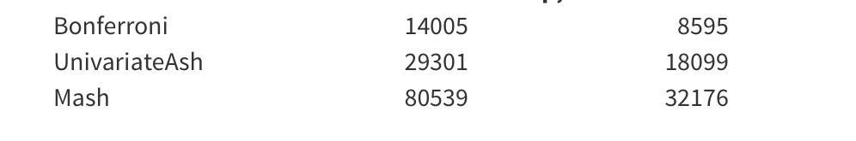
Power
First considering all 2.4 million x 4 conditions possible associations (9.74 M)
Univariate Shrinkage methods double power over Naiive P Val threshold of 5 e -8
Joint Approach 2.5 fold increase
Over All associations SNPs significant in at least one condition
Then consider each of 1704 LD blocks to see if a jointly shrunk SNP contains a significant (LFSR < 0.05) association in each condition
Choose lowest association in each condition, maximum number of 1704 per condition
Return list of ’best SNP’ per condition, per block to avoid LD
119 SNPS significant and max in their block and shared between LDL and TG
HDL | 1081
LDL | 490
TG | 1031
TC | 643

Slide 6
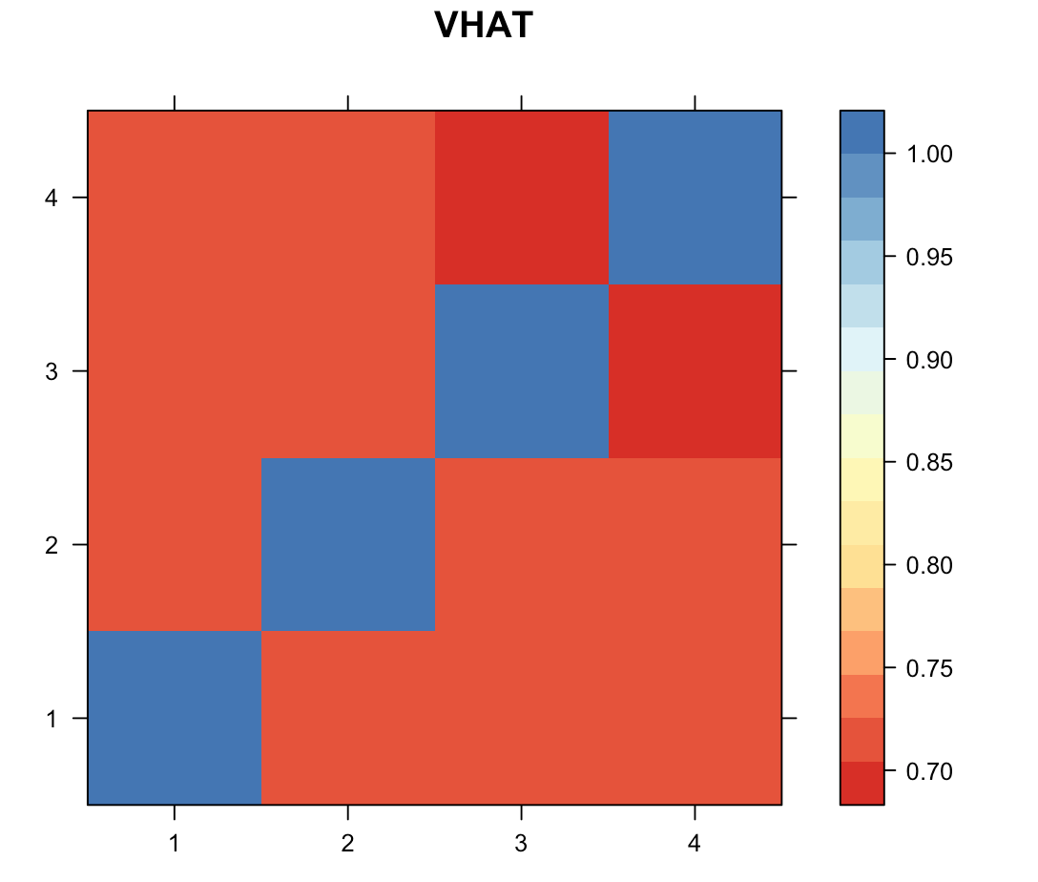
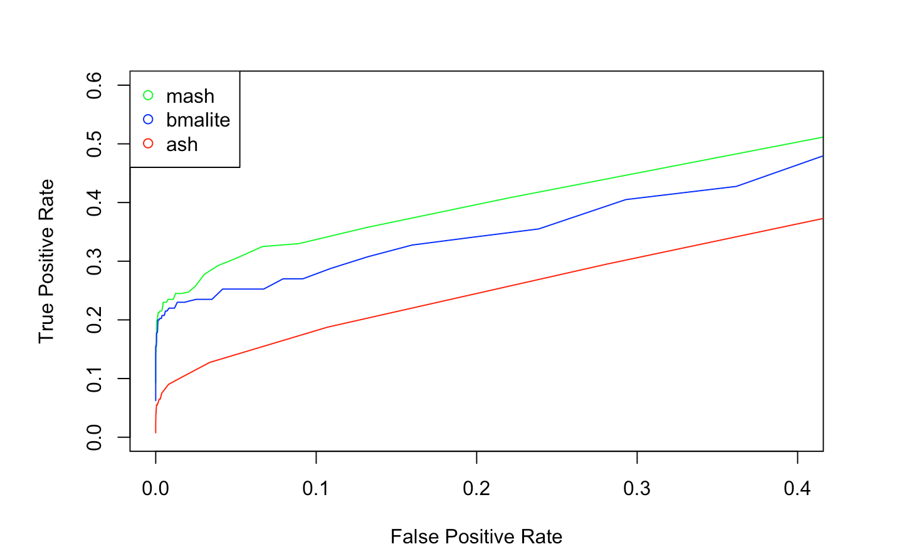
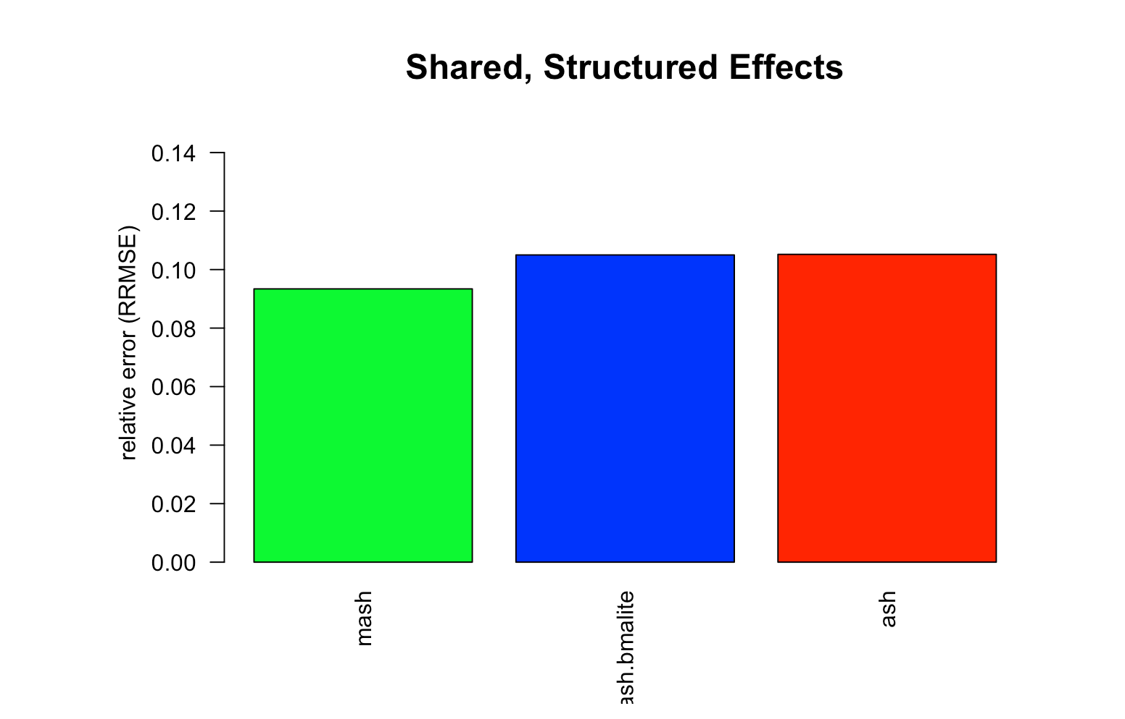
But are these real?
Simulate data from empirical covariance matrices, 1% signal, true effects on same scale as observed
Use correlated error matrix (rho ~ 0.8))
Beats univariate and configuration approaches in both accuracy and power

Slide 7
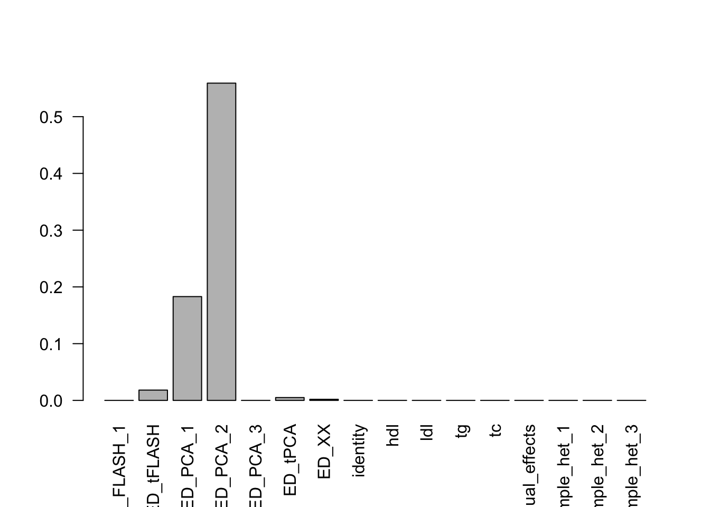
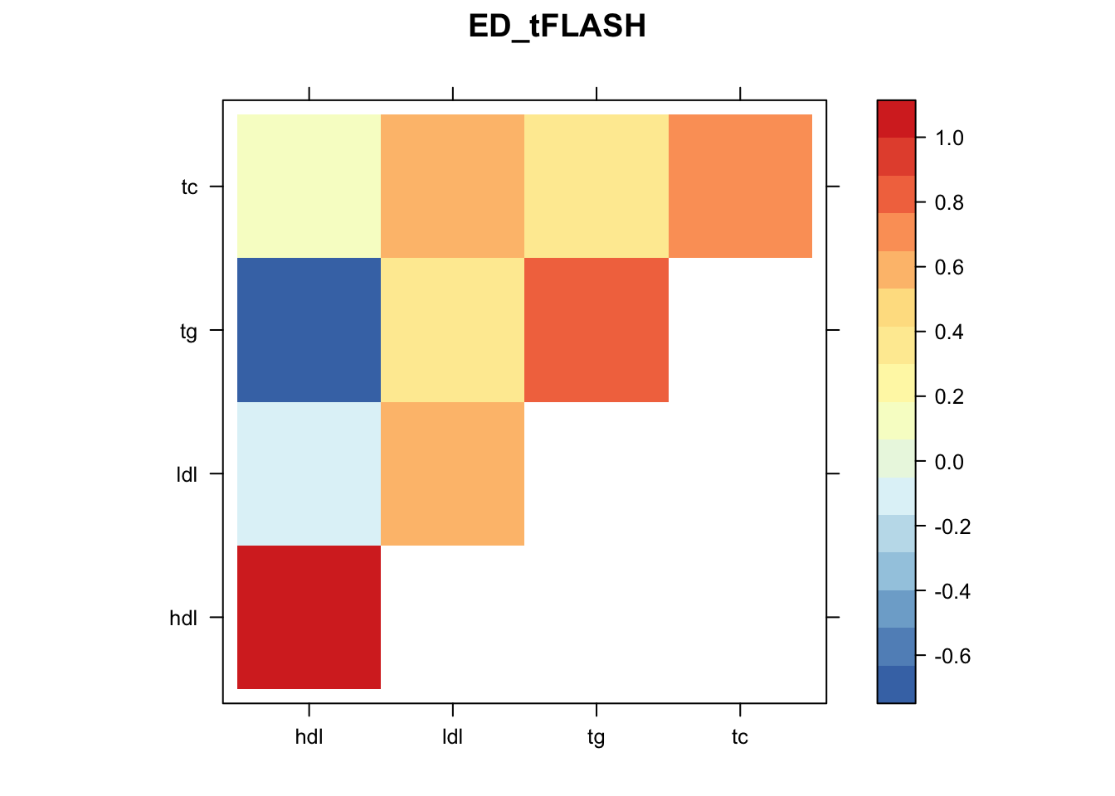
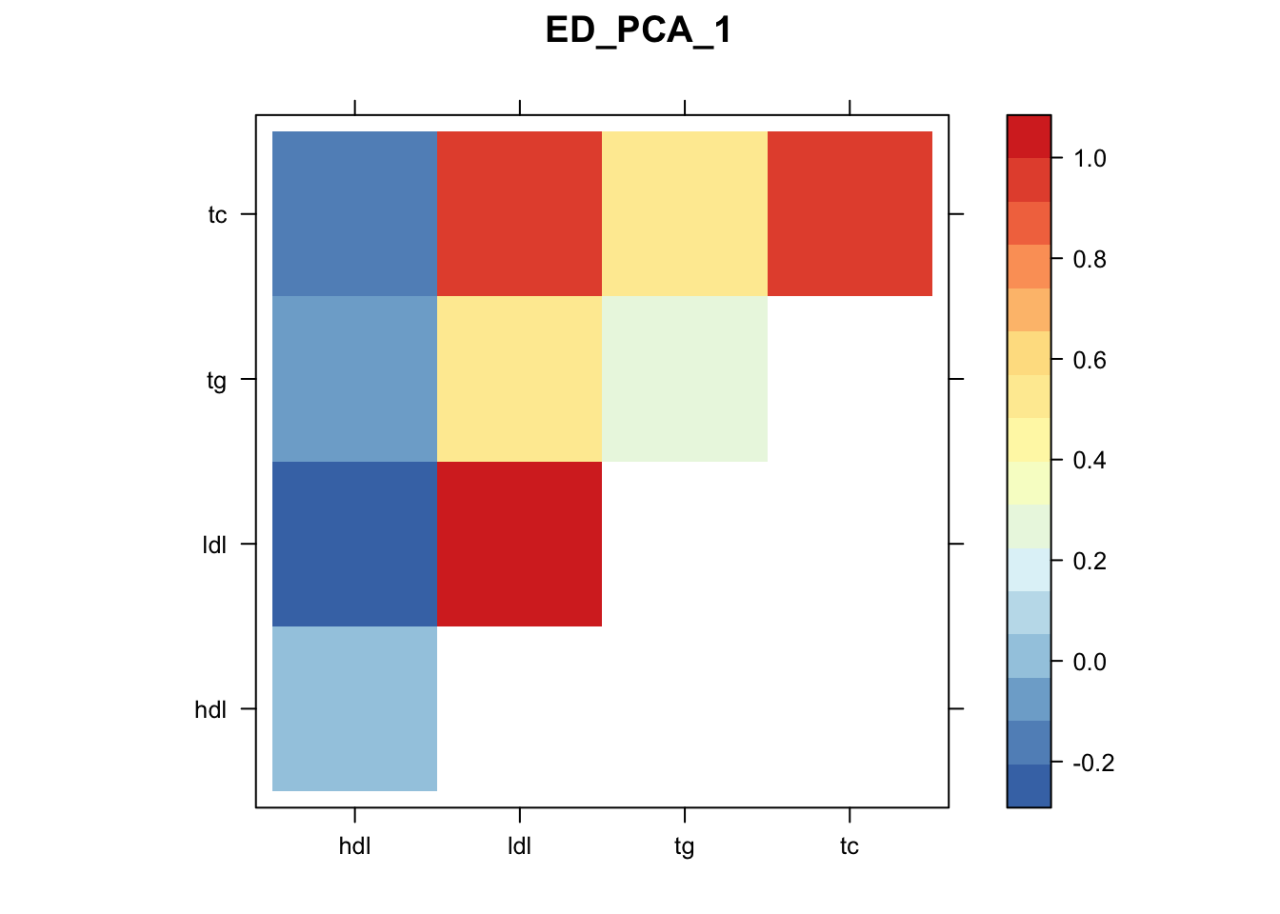
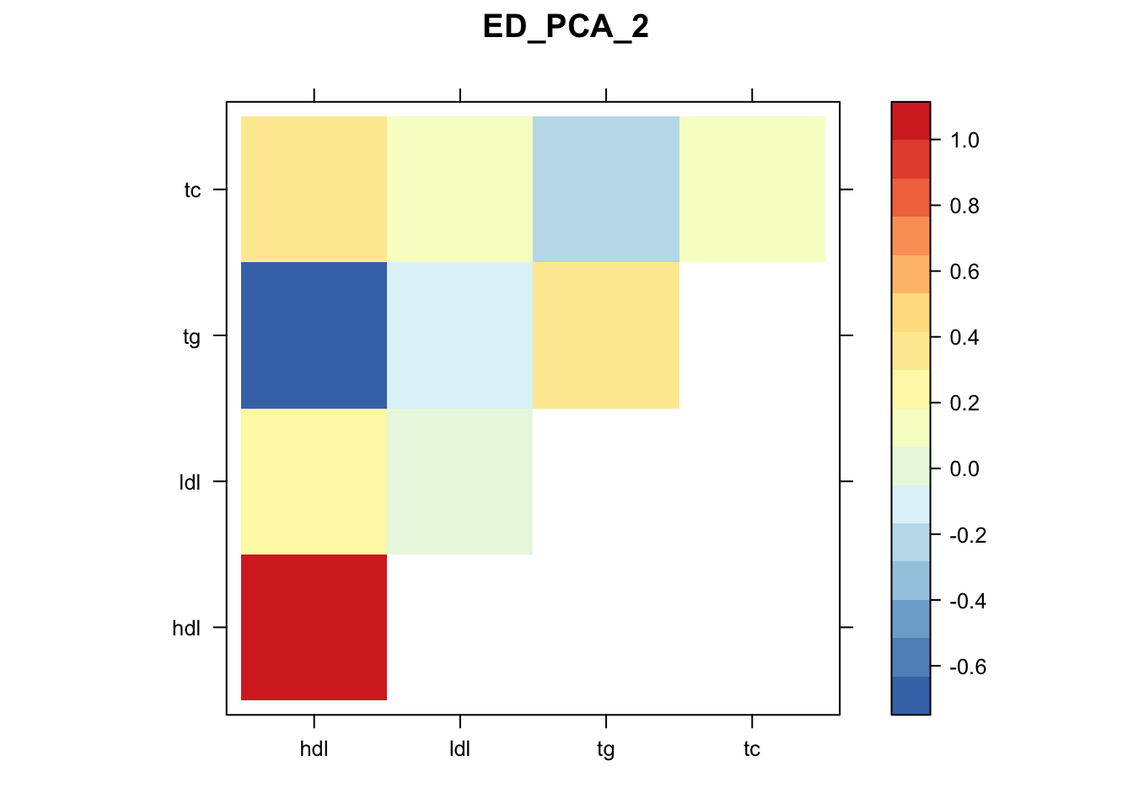
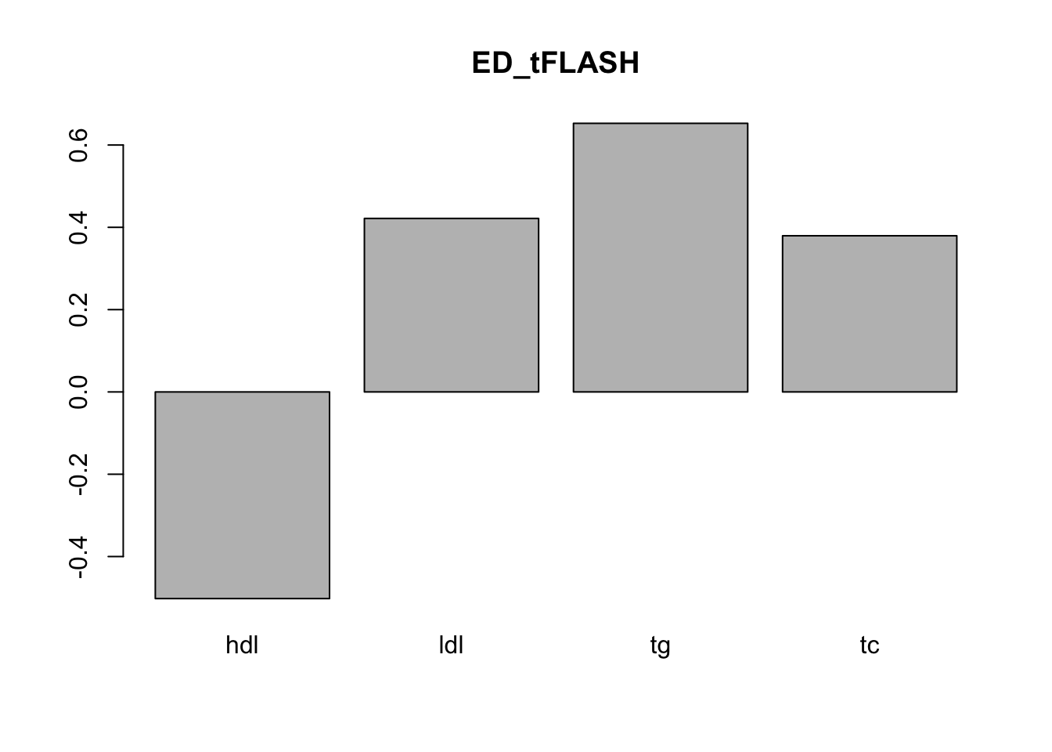
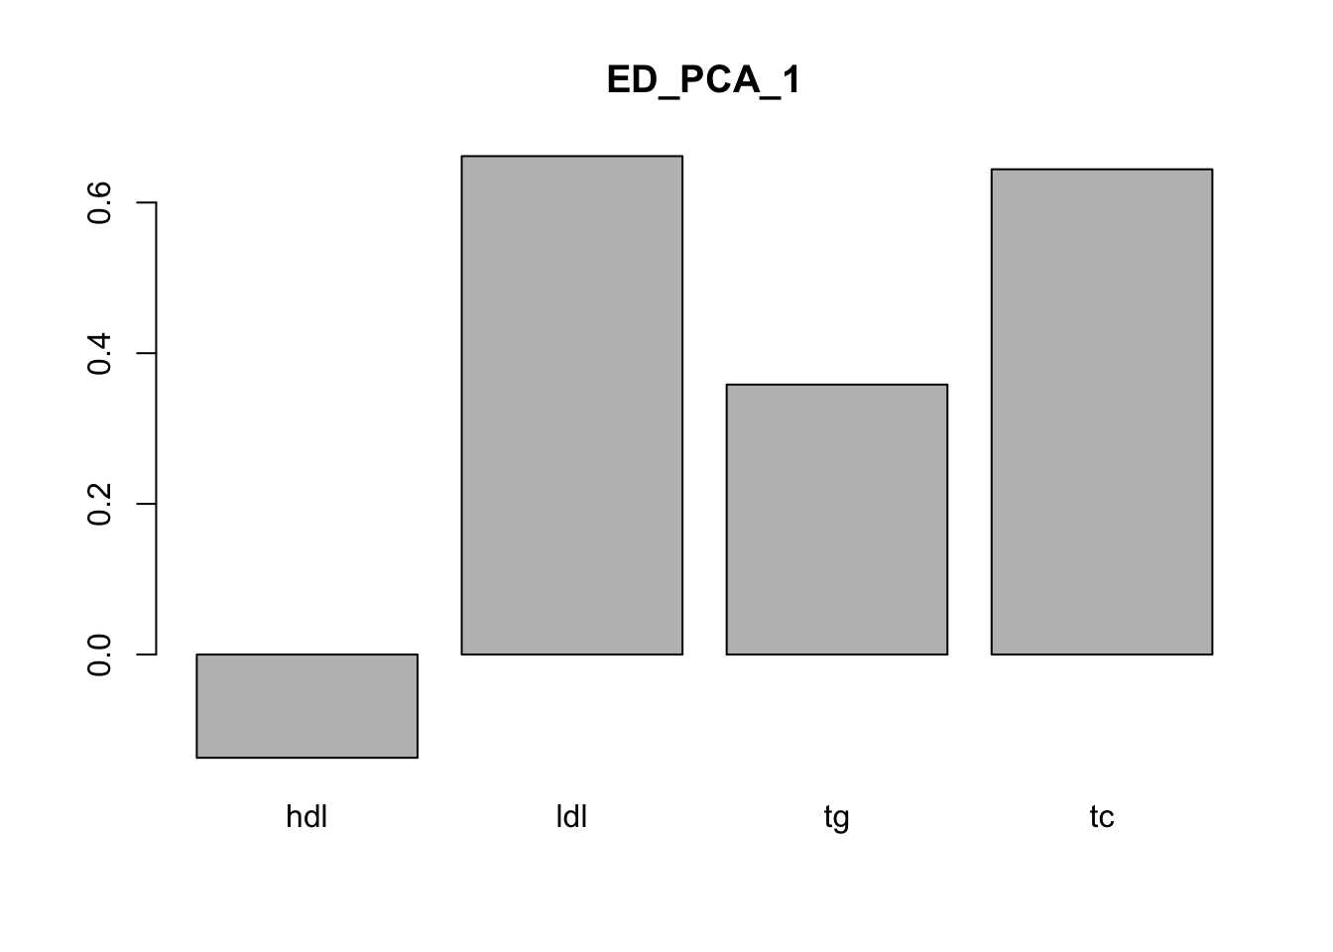
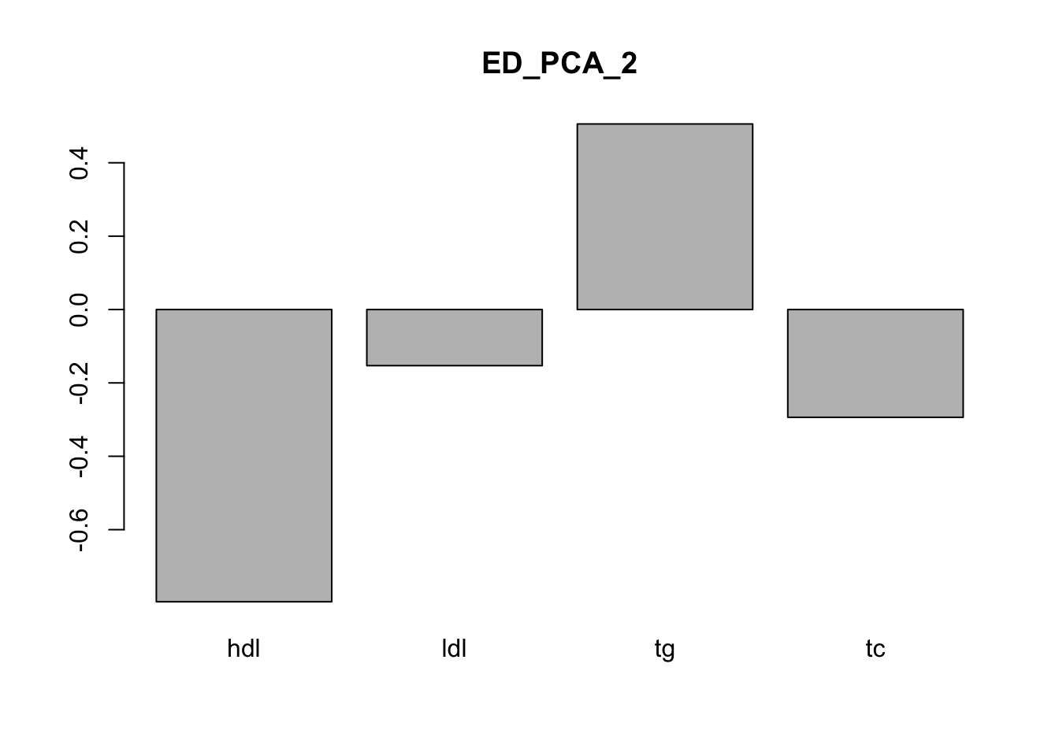
Patterns of Sharing
Majority loading on data-driven covariance matrices that reflect a high degree of sharing

Slide 8
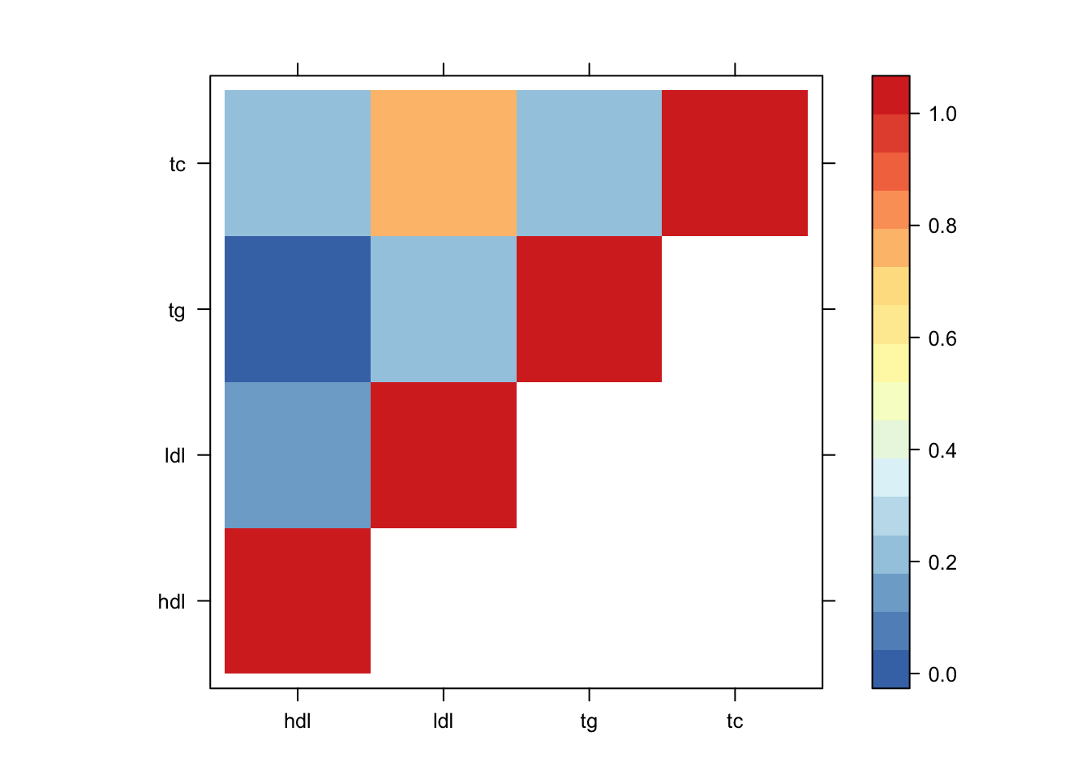
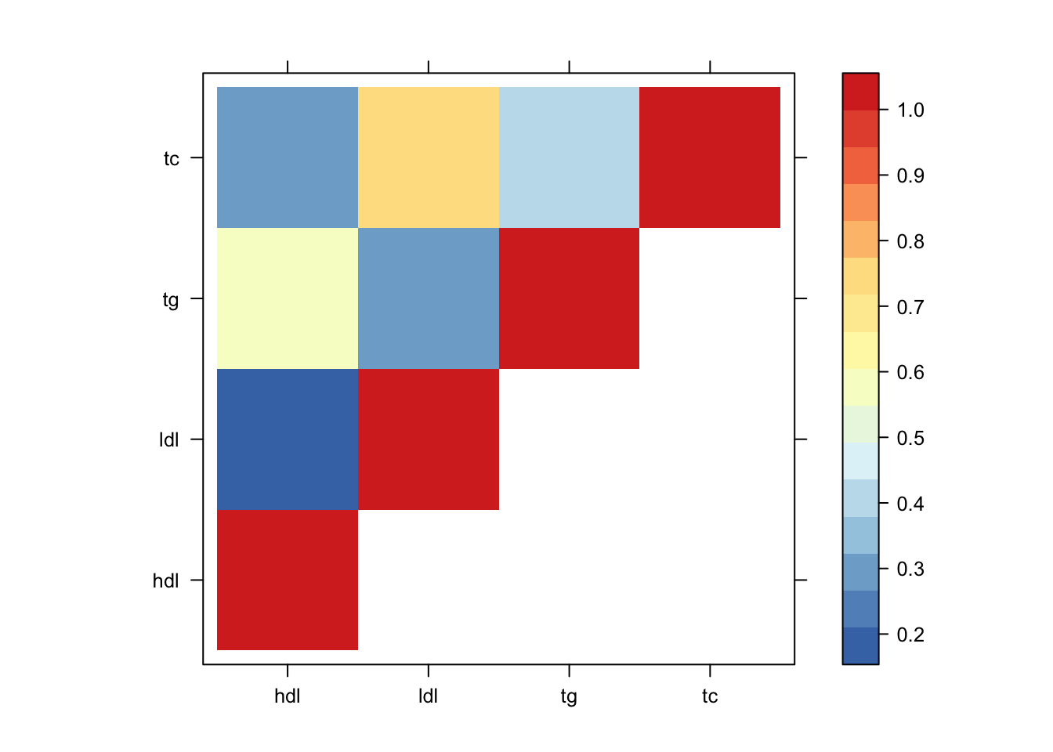
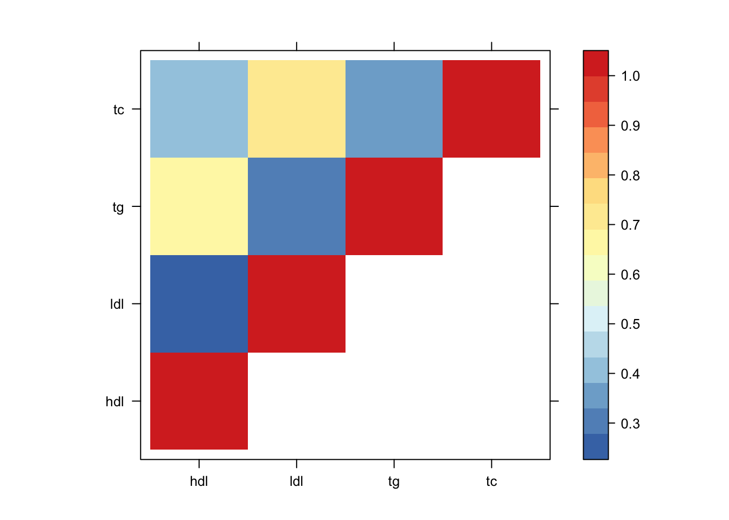
Sharing by Magnitude
Proportion of effects that are significant in at least one and within 2 fold magnitude (or absolute mag)
Shared by Magnitude
Shared by |Magnitude|
Shared by Significance

Slide 9
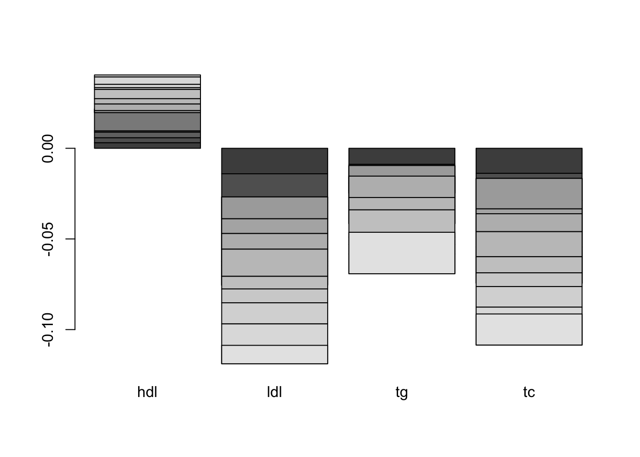
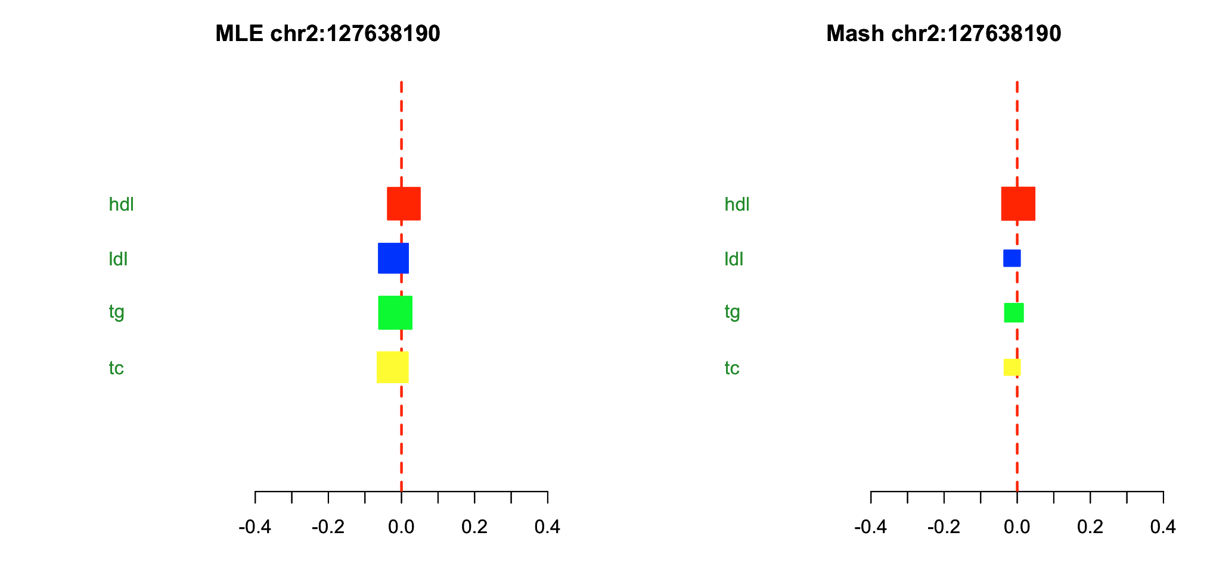
Candidate List
SNPS that are max within block and significant at least at lfsr < 0.05, and shared by LDL and TG, and not HDL
Intersect with CAD risk
Downstream bitrait MR?
Shrink Error, nudge towards significance in LDL and TG due to heavy weight on sharing

