Slide 1



COMPONENT DIAGRAMM TEMPLATE

Slide 2
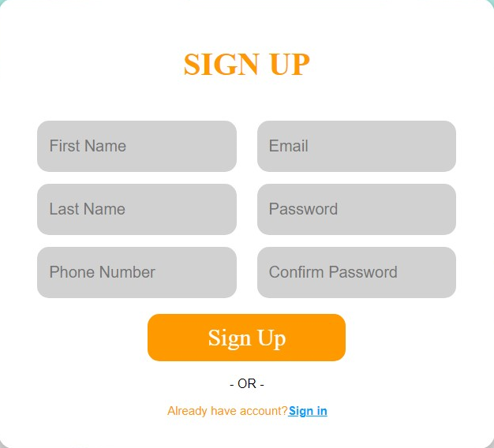
Update Component Diagram Sign-Up
EMIT
<App>
<sign-up>
<Sign-up>
User
Adduser
- Phone number is nullable
- Password must be greater than 8
- Password must be validated
- Email must be availible

Slide 3
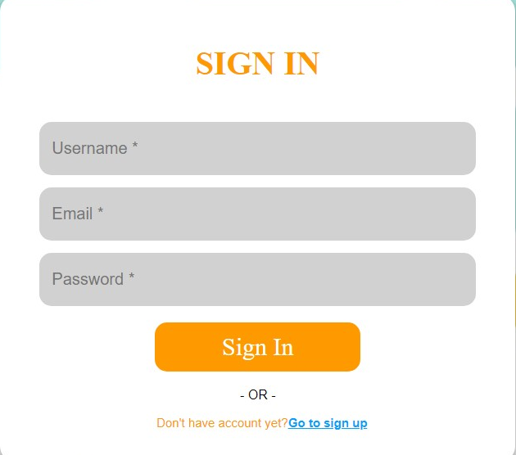
Update Component Diagram Sign-In
EMIT
<App>
<sign-in>
<Sign-in>
User
Sign-in
- We don’t check the username
- Check email is matching
- Check password is matching
- Display message if password and email is not valid

