Slide 1
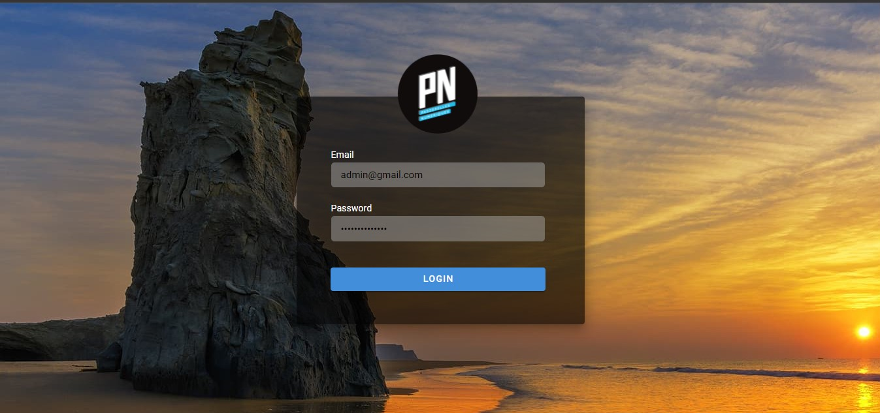
Group 2 : Mock up VC2 Part2
Sign In

Slide 2
Navigation as an Admin user
Navigation as a SA officer
Navigation as a Student

Slide 3
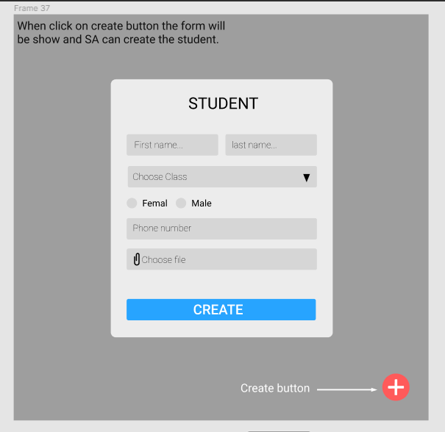
Create student

Slide 4
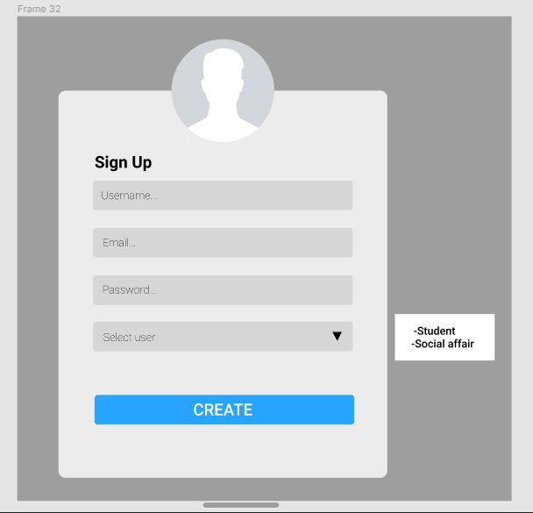
Create user account

Slide 5
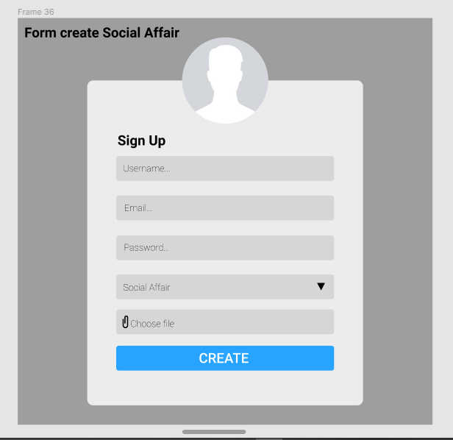
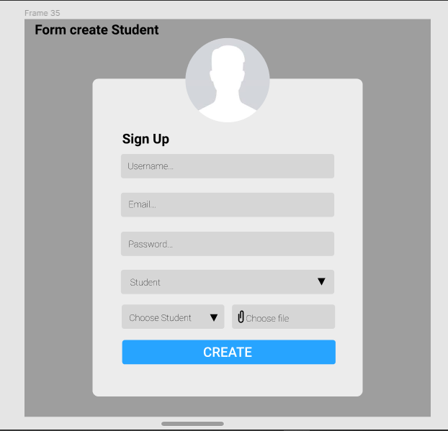
Create user for student

Slide 6
Create user for SA officer

Slide 7
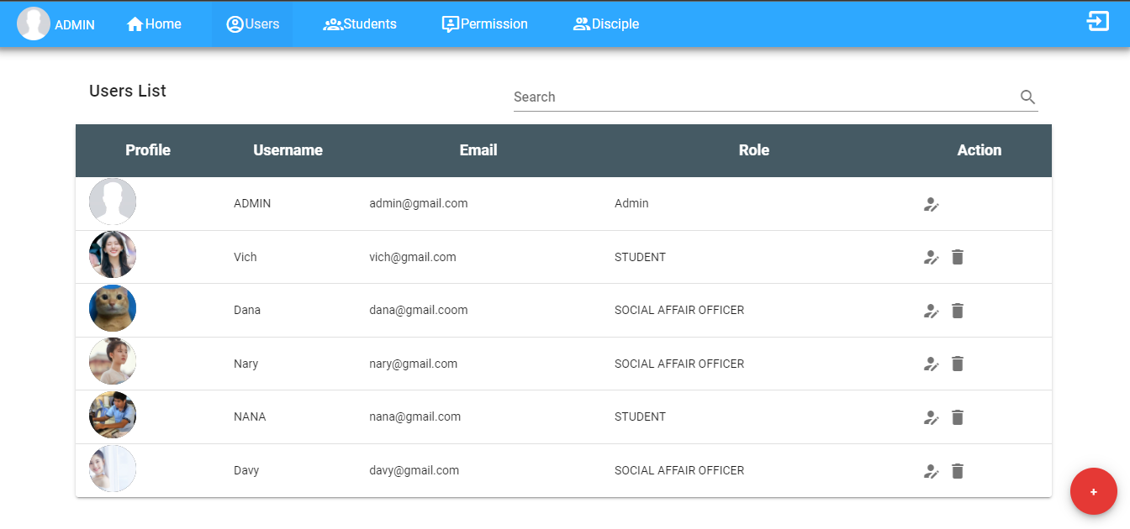
List of users

Slide 8
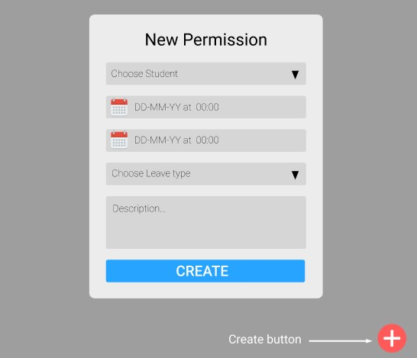
Form create permission

Slide 9
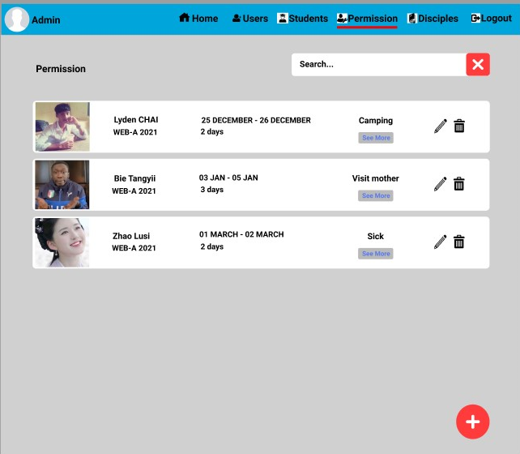
Permission Card

Slide 10
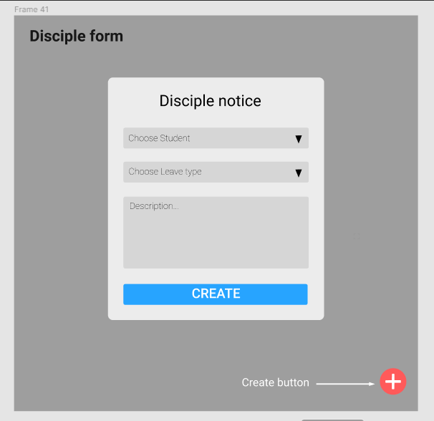
Disciple form

