Slide 1
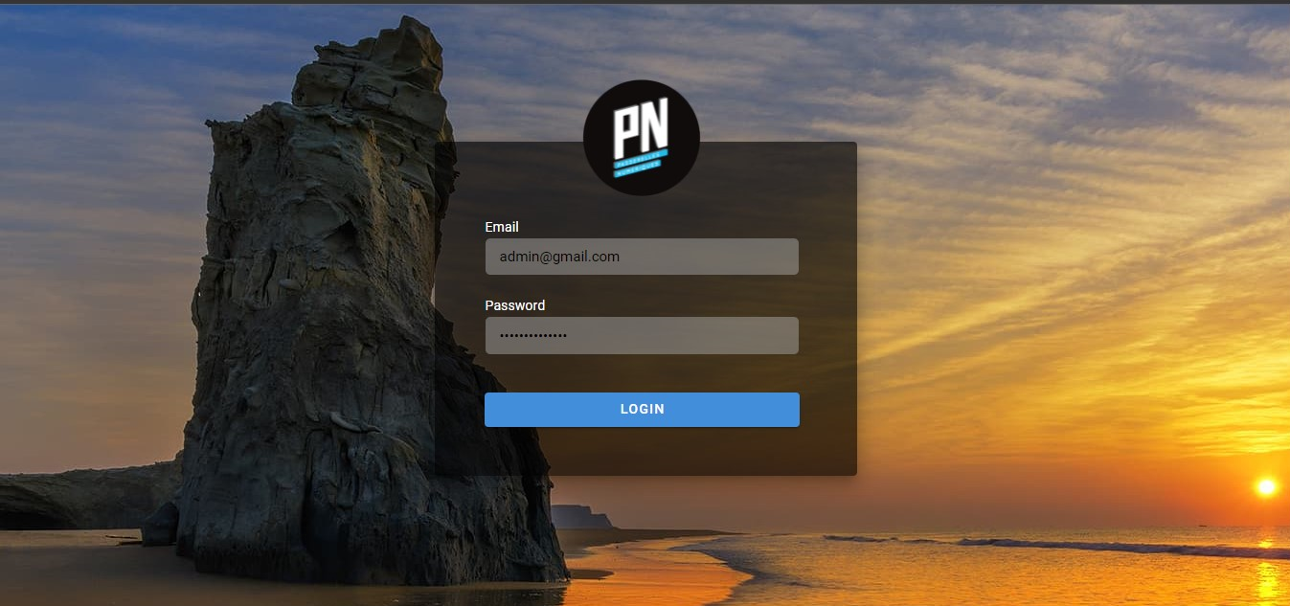
Group 2 : Mock up VC2 Part2
Sign In

Slide 2
Navigation as an Admin user
Navigation as a SA officer
Navigation as a Student

Slide 3
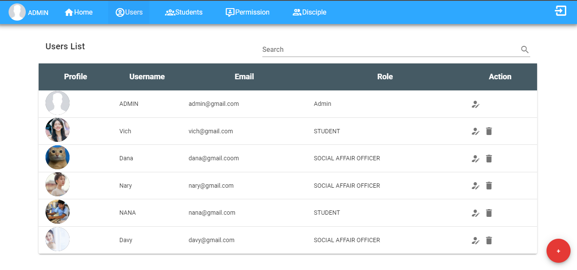
Users card

Slide 4
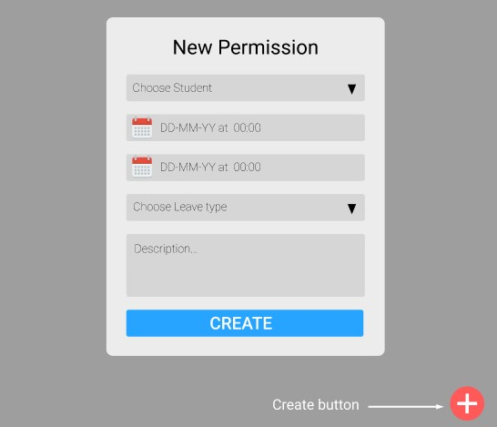
Form create permission

Slide 5
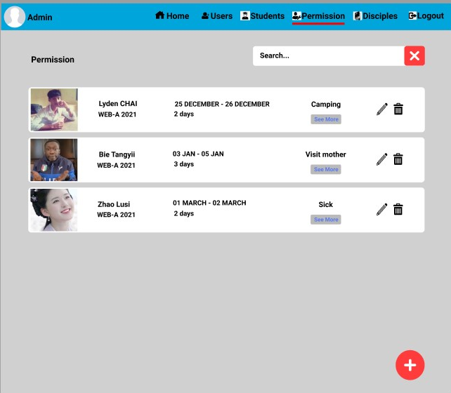
Permission Card

