Slide 1
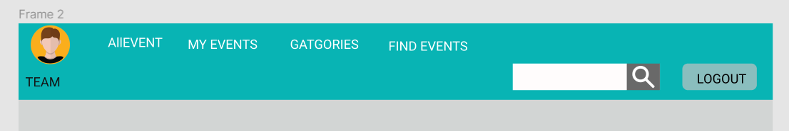
Mockup Menu

Slide 2
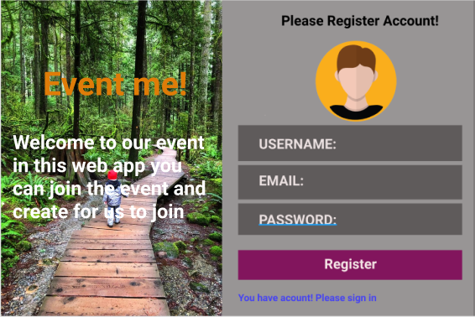
Mockup Sign in/Sign up

Slide 3
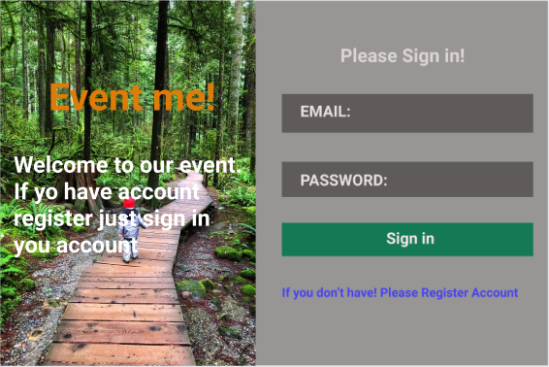
Sign in

