Slide 1
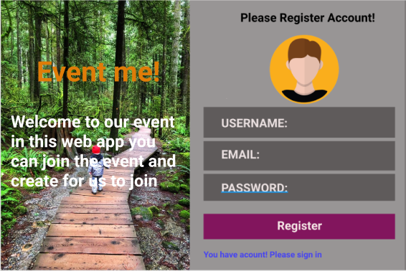
Mockup Sign in/Sign up

Slide 2
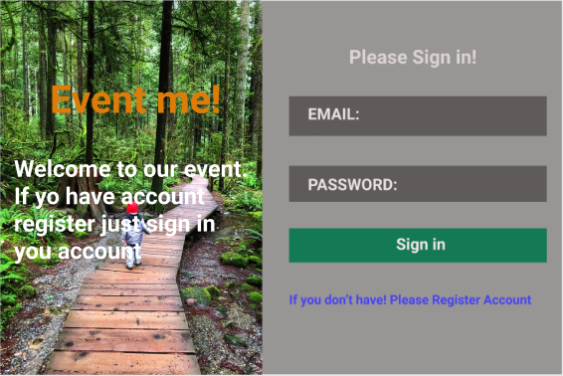
Sign in

