Slide 1
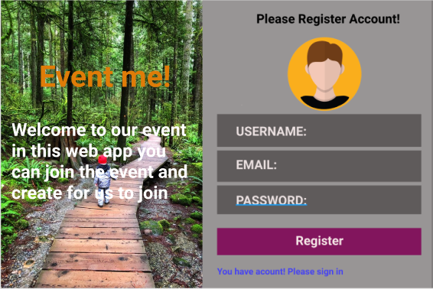
Mockup Sign in/Sign up

Slide 2
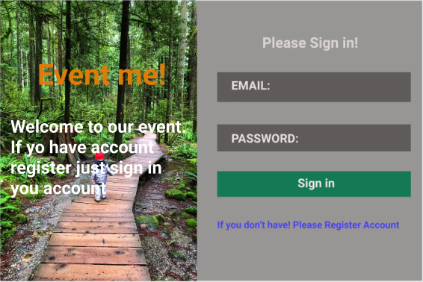
Sign in

Slide 3
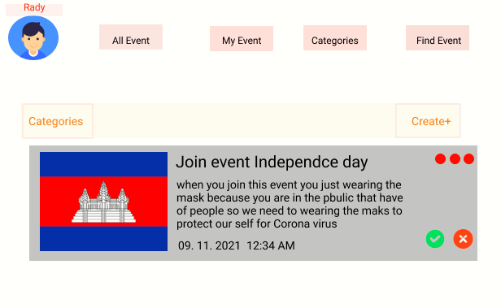
Mockup on all Event
Mockup Categories

Slide 4
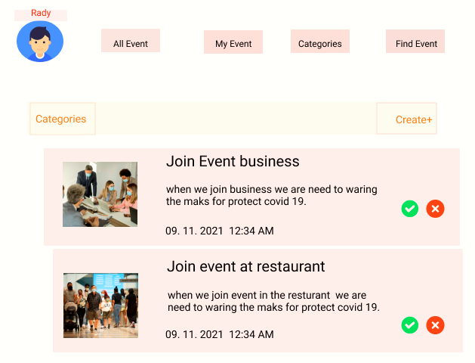
Mockup on My Event
Mockup Categories

Slide 5
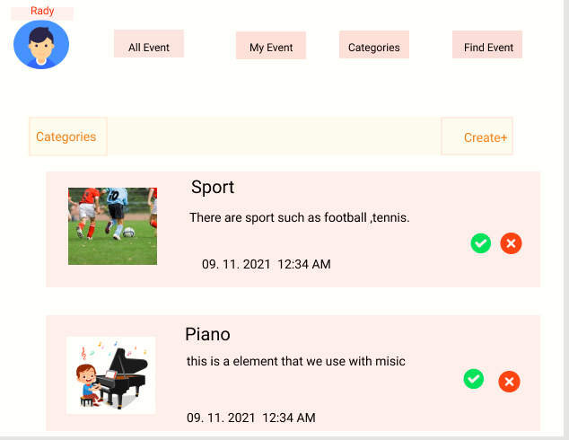
Mockup on My Categories
Mockup Categories

Slide 6
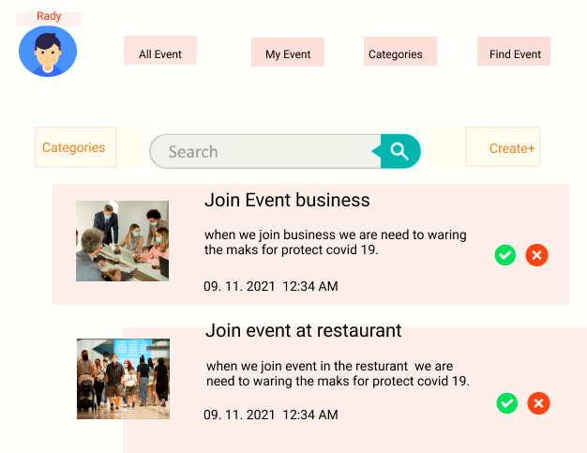
Mockup on Find Event
Mockup Categories

