Slide 1



COMPONENT DIAGRAMM TEMPLATE

Slide 2
<app>
<app>
PROVIDE
Students[]
Students[]
Students[]
// A component with a list of student as data
// app provides students to anymore
INJECT
<dialog>
<app>
PROPS
<card>
Students[]
Students[]
Students[]
Students[]
student
// dialog gets students from a provider
// app send student to card
<router-view>
// Vue JS built-in component
EMIT
<parent>
<from>
Students[]
Students[]
valided
// from send the event validated to parent

Slide 3
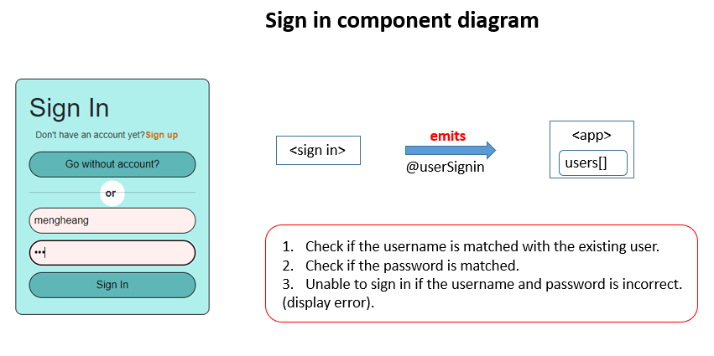

Slide 4
