Slide 1



COMPONENT DIAGRAMM TEMPLATE

Slide 2
<app>
<app>
PROVIDE
Students[]
Students[]
Students[]
// A component with a list of student as data
// app provides students to anymore
INJECT
<dialog>
<app>
PROPS
<card>
Students[]
Students[]
Students[]
Students[]
student
// dialog gets students from a provider
// app send student to card
<router-view>
// Vue JS built-in component
EMIT
<parent>
<from>
Students[]
Students[]
valided
// from send the event validated to parent

Slide 3
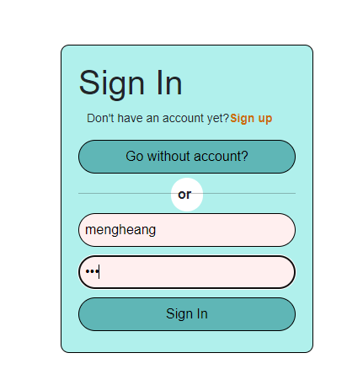
Sign in component diagram
emits
<app>
<sign in>
@userSignin
users[]
Check if the username is matched with the existing user.
Check if the password is matched.
Unable to sign in if the username and password is incorrect.
(display error).

Slide 4
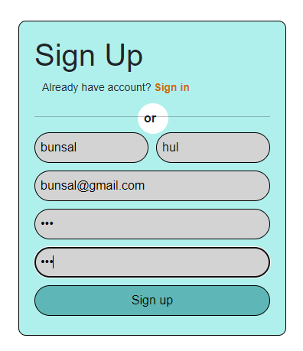
Sign up component diagram
emits
<app>
<sign up>
@userSignup
users[]
Validation of the form.
Check if the email is not existed in the database. (unique email)
Check the if the password and the password confirmation are
absolutely the same, if not display error or something.
4. If everything is input correctly, then add the new user into the user list.

Slide 5
PROPS
user
App
Menu
EMITS
signout

Slide 6
PROPS
event
Event component diagram
<Add>
EMITS
show event form
eventName
PROPS
event
<events>
<Event_Form>
App
Events[]
EMITS
New event
PROPS
event
<Event_Card>
EMITS
isEditing (eventId)
isDelete (eventId)

