Slide 1
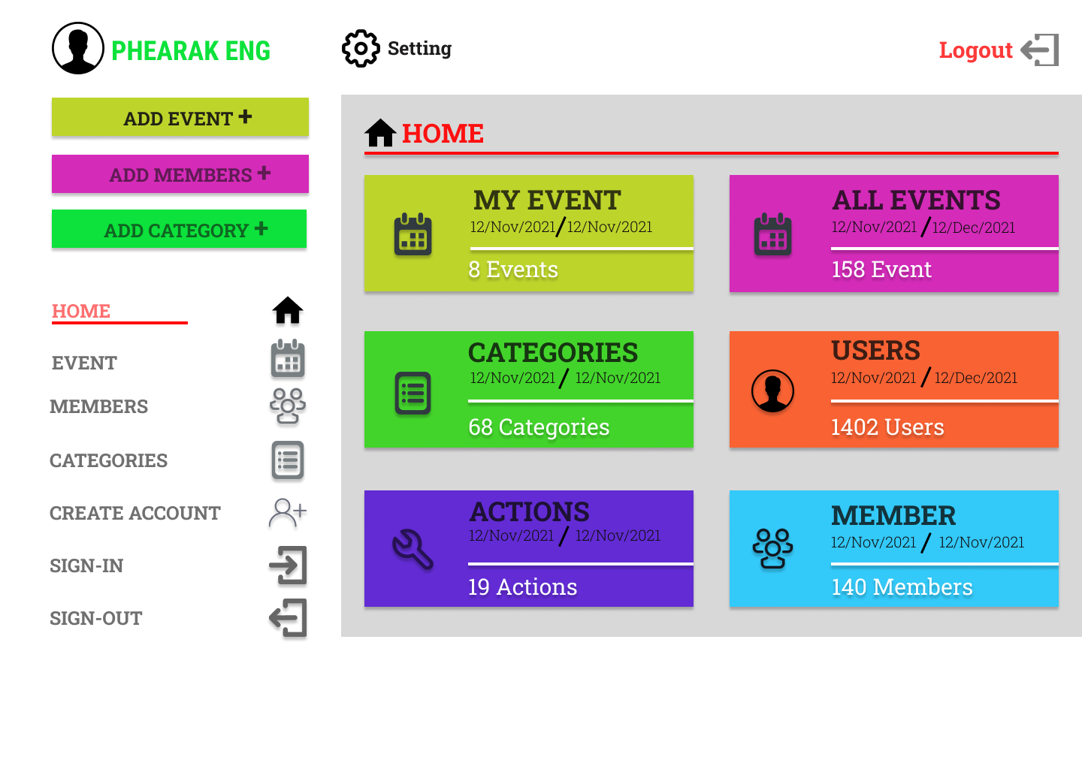
MENU-BAR(Home Page)

Slide 2
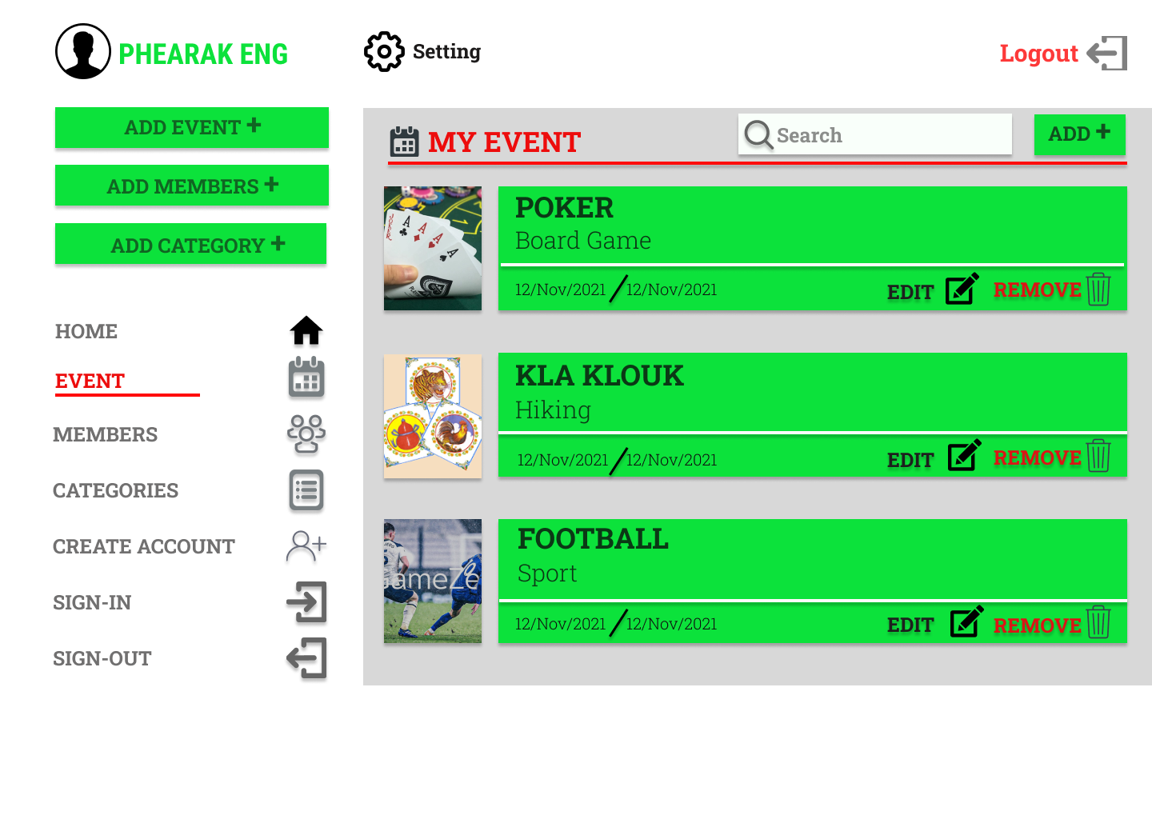
EVENT PAGE

Slide 3
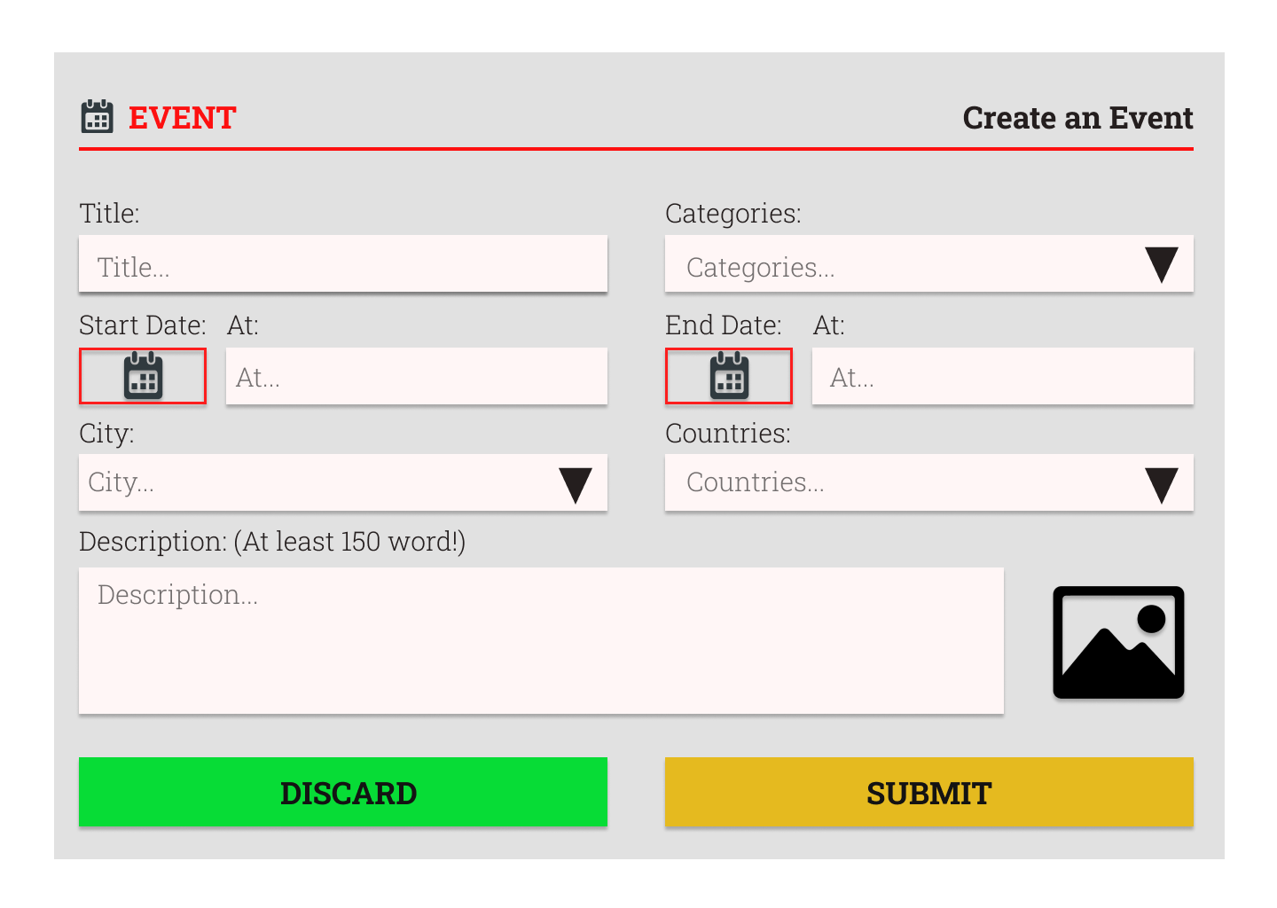
CREATE EVENT

Slide 4
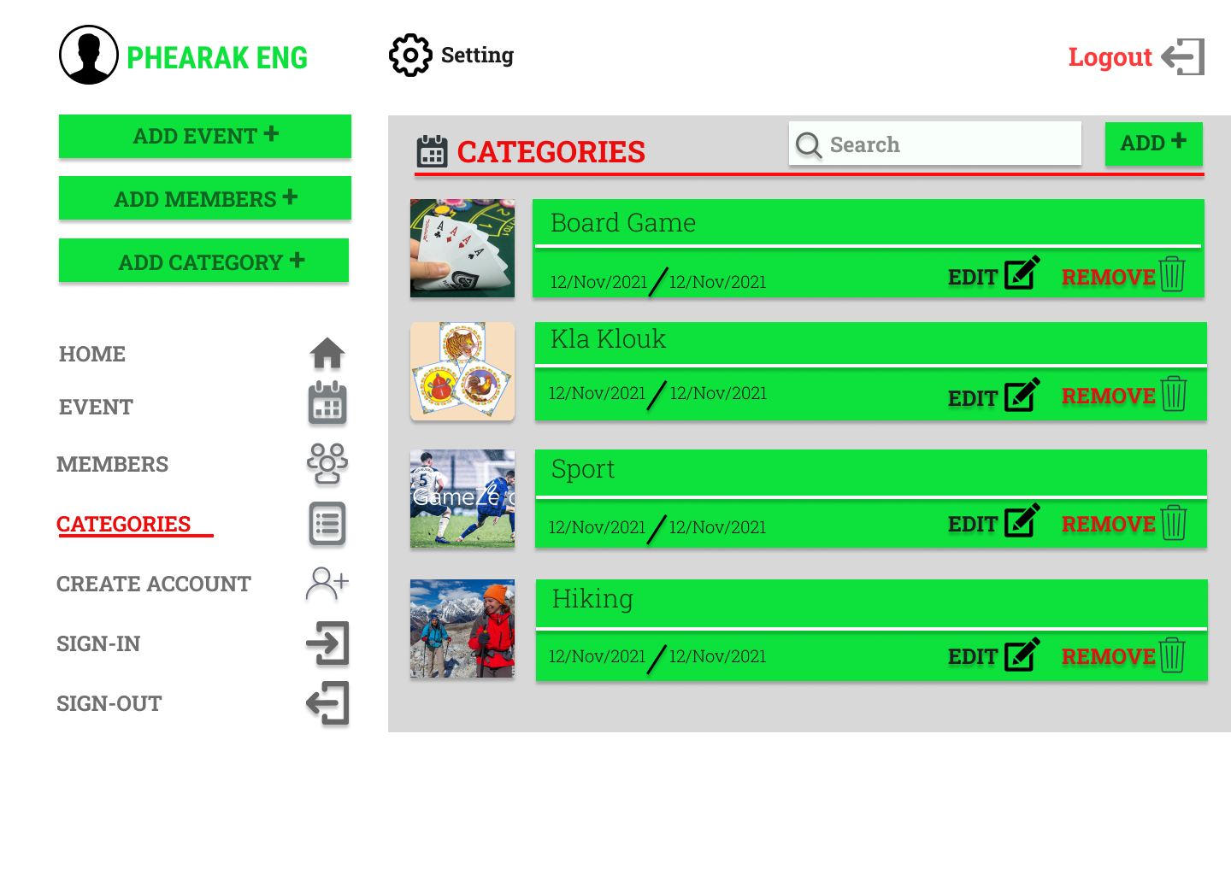
CATEGORIES PAGE

Slide 5
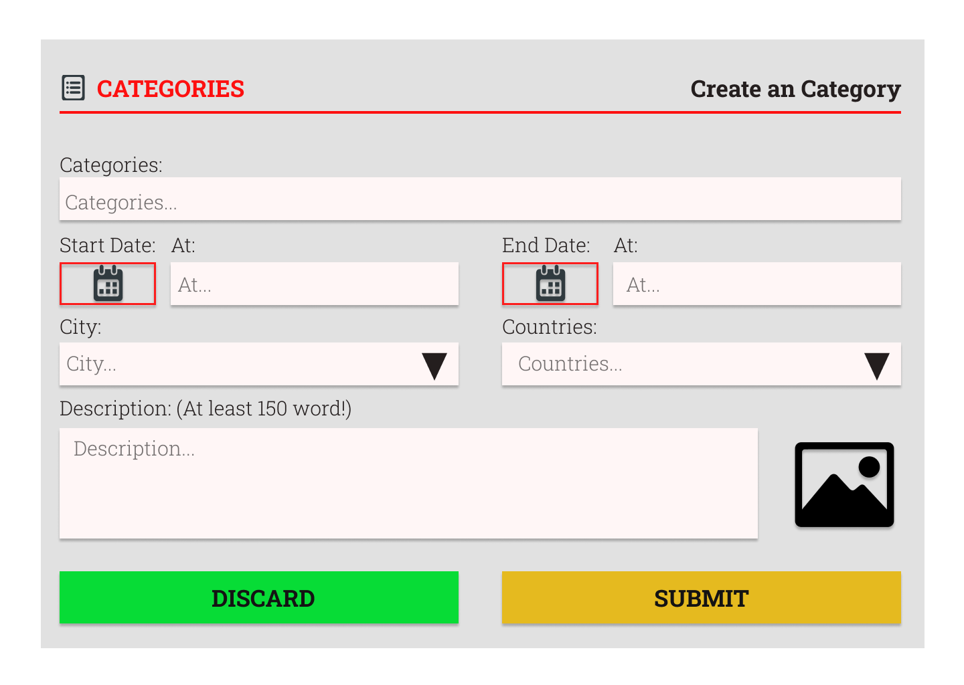
CREATE CATEGORY

Slide 6
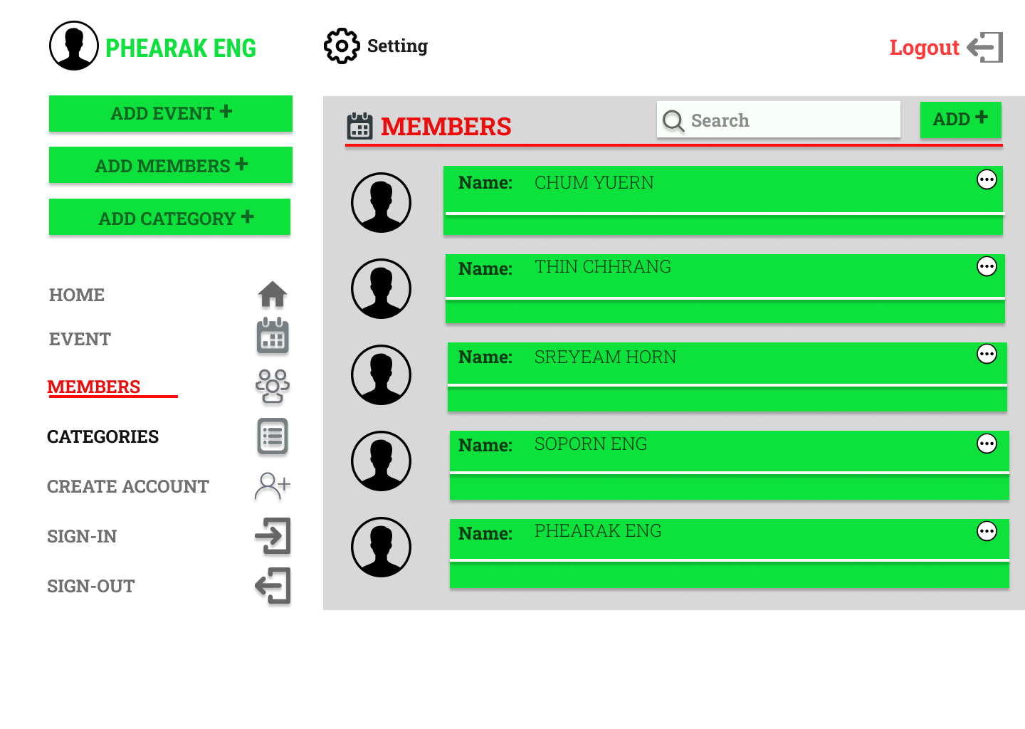
MEMBER PAGE

