Slide 1
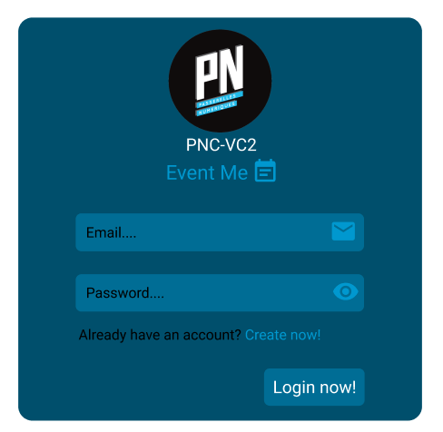
Notes:
Bg form: #004F6C
Bg input and btn: #006D95
Icon Event Me Create now! color: #0098CF

Slide 2
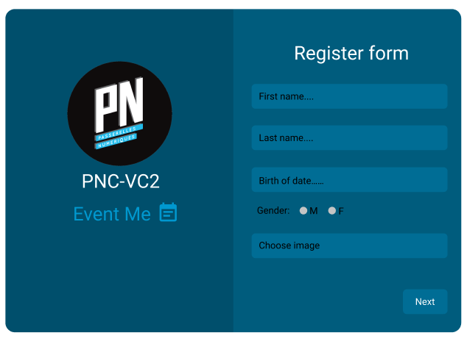
Notes:
Bg left: #004F6C
Bg right: #005C7D

Slide 3
