Slide 1



COMPONENT DIAGRAMM TEMPLATE

Slide 2
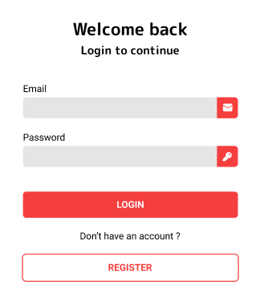
Sign in Component Diagram
Emit
<app>
<log-in>
user
Users
WHAT WILL HAPPENED:
Compare or check of email, and password match to the information that we signed before.
If email and pass don’t match, cannot login.

Slide 3
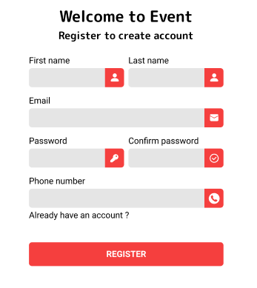
Sign up Component Diagram
Emit
<app>
<register>
user
Users
WHAT WILL HAPPENED:
Check if the validation doesn’t match or doesn’t have in the data (new user).
Need to confirm password if the confirm pass match to the password, then we can register

Slide 4
<app>
PROVIDE
<navigation>
Events[]
<router-view>
/home
/my-event
/joined
/category
<home-view>
<my-event-view>
<joined-view>
<category-view>
<event-card>
<event-card>
<event-card>
<event-card>

Slide 5
<app>
<app>
PROVIDE
Students[]
Students[]
Students[]
// A component with a list of student as data
// app provides students to anymore
INJECT
<dialog>
<app>
PROPS
<card>
Students[]
Students[]
Students[]
Students[]
student
// dialog gets students from a provider
// app send student to card
<router-view>
// Vue JS built-in component
EMIT
<parent>
<from>
Students[]
Students[]
valided
// from send the event validated to parent

