Slide 1
Group 7 VC 2
MOCKUP DESIGN

Slide 2
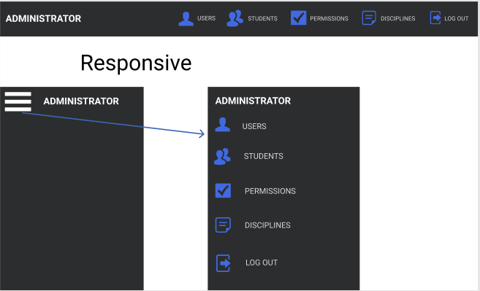
Menu Bar Mock up for SA Coordinator

Slide 3
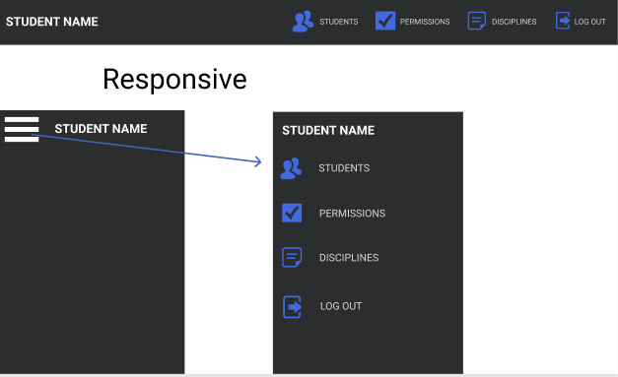
Menu Bar Mock up for STUDENT

Slide 4
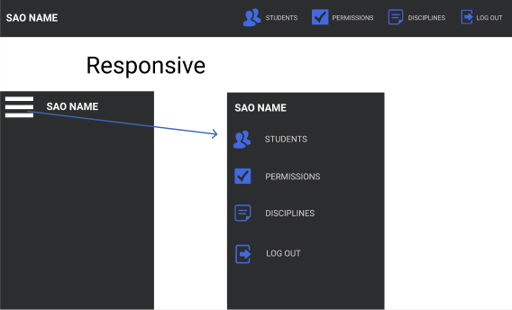
Menu Bar Mock up for Social Affair Officer

