Slide 1
Group 7 VC 2
MOCKUP DESIGN

Slide 2
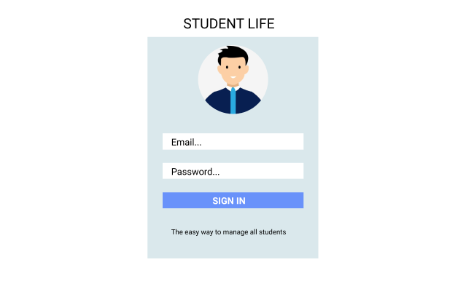
Sign In Mock up

