Slide 1



COMPONENT DIAGRAMM TEMPLATE

Slide 2
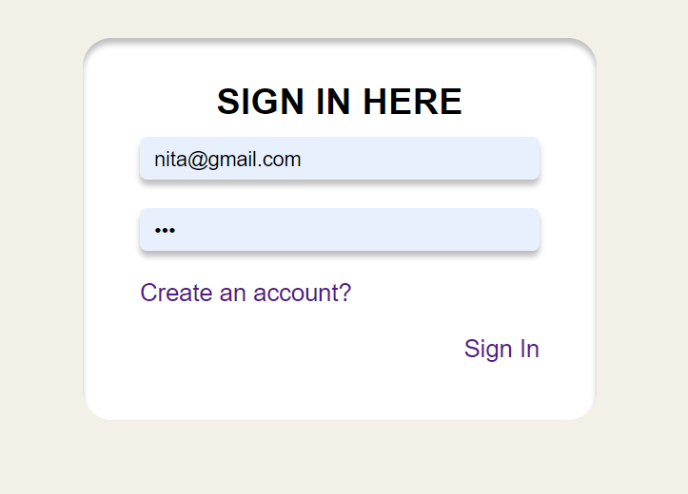
Sign in component
<sign-in>
- Check email is matching
- Check password is matching
- Display message if password and email is not valid
<app>
emit
<sign-in>
user [ ]
@signIn

