Slide 1



COMPONENT DIAGRAMM TEMPLATE

Slide 2
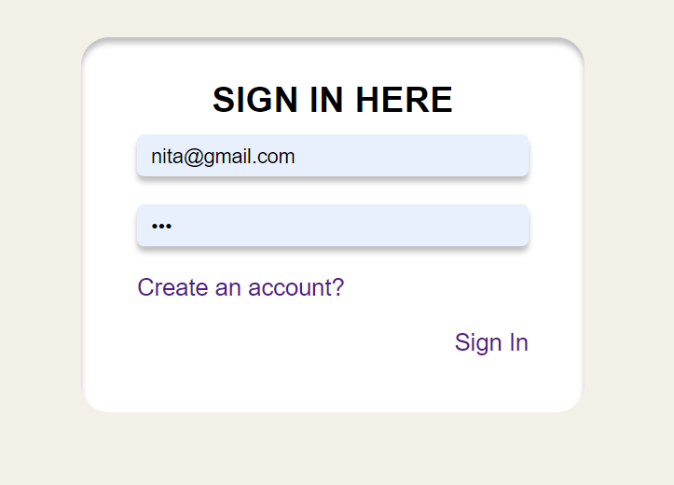
Sign in component
<sign-in>
- Check email is matching
- Check password is matching
- Display message if password and email is not valid
<app>
emit
<sign-in>
user
@signIn

Slide 3
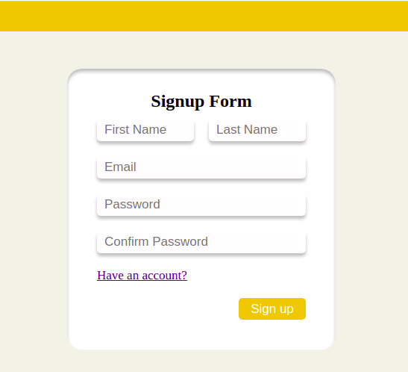
Sign up component
<sign-up>
<app>
emit
<sign-up>
- Password must be greater than 8
- Password must be validated
- Email must be availible
user
@addUser

Slide 4
<menu-bar>
<App>
PROPS
<Menu-bar>
User
EMIT
loggedOut

Slide 5
Category Component
EMIT
<add-search>
showCategoryFrom
categoryName
PROPS
<App>
<category-view>
EMIT
categories[ ]
<category-form>
newCategoryData
EMIT
- <add-search> contain add+ button and search bar
- <category-form> is shown when we click add+
<category-card>
categoryId
IsEditing
isDelete

Slide 6
My Event Component
EMIT
<add-search>
showEventFrom
eventName
PROPS
EMIT
<App>
<my-event-view>
<my-event-form>
myevents[ ]
newEventData
EMIT
<my-event-card>
- <add-search> contain add+ button and search bar
- <my-event-form> is shown when we click add+
eventId
IsEditing
isDelete

