Slide 1



COMPONENT DIAGRAMM TEMPLATE

Slide 2
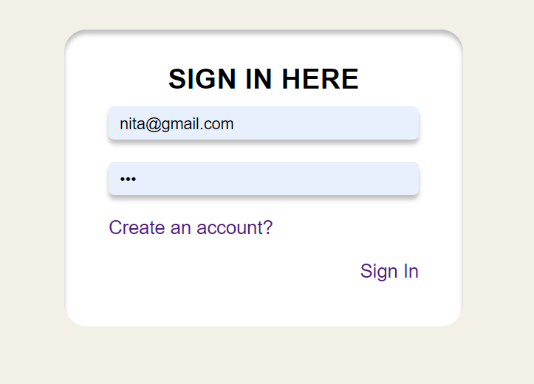
Sign in component
<sign-in>
- Check email is matching
- Check password is matching
- Display message if password and email is not valid
<app>
emit
<sign-in>
user
@signIn

Slide 3
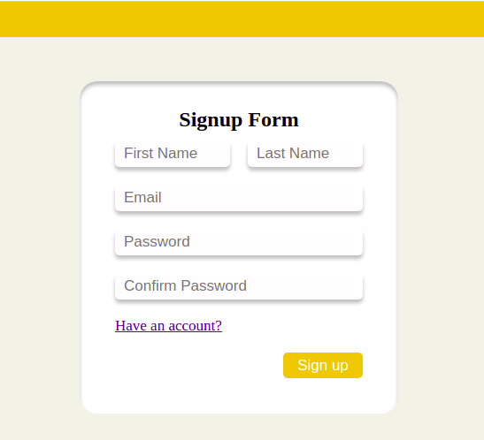
Sign up component
<sign-up>
<app>
emit
<sign-up>
- Password must be greater than 8
- Password must be validated
- Email must be availible
user
@addUser

Slide 4
<menu-bar>
<App>
PROPS
<Menu-bar>
User
EMIT
loggedOut

Slide 5
Category Component
- <add-search> contain add+ button and search bar
- <category-form> is shown when we click add+
PROPS
category
<add-search>
EMIT
showCategoryFrom
categoryName
PROPS
category
<App>
<category-form>
<category-view>
EMIT
categories[ ]
newCategory (categorytData)
PROPS
category
<category-card>
EMIT
isEditing
(categorytId)
isDelete
(categoryId)

Slide 6
- <add-search> contain add+ button and search bar
- <event-form> is shown when we click add+
My Event Component
PROPS
event
<add-search>
EMIT
showEventFrom
PROPS
eventName
event
<App>
<my-event-form>
<my-event-view>
EMIT
events[ ]
newEvent (evenytData)
PROPS
event
<my-event-card>
EMIT
isEditing
(eventId)
isDelete
(eventId)

