Slide 1

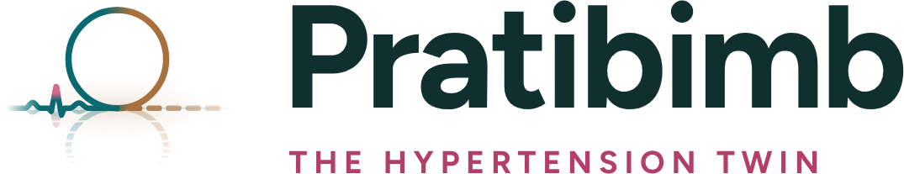
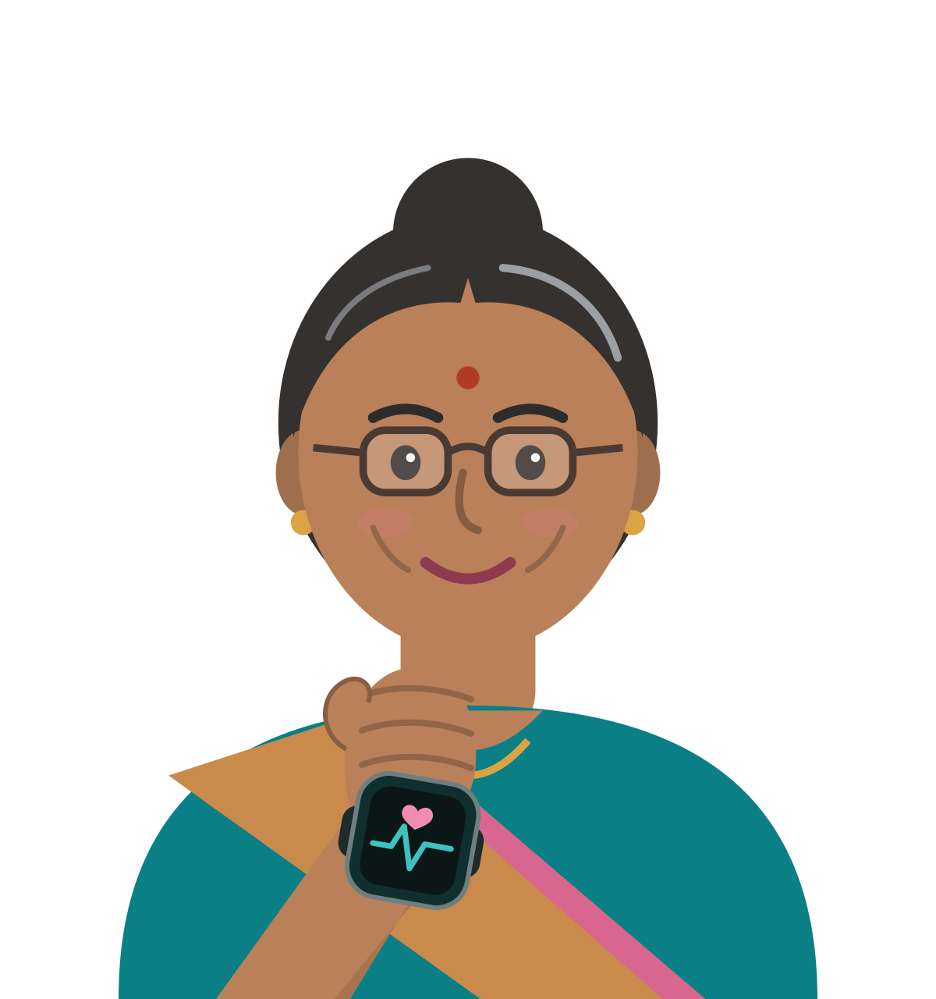

HAPPIEST HEALTH
DIGITAL TWIN CHALLENGE 2026
DIGITAL TWIN CHALLENGE 2026 | PHASE 1 | PROTOTYPE AND CODE
PRATIBIMB
Reflection, in Hindi and Sanskrit. A digital twin of one patient's body that fuses the health record with a budget watch and a home BP cuff, and warns the doctor up to 72 hours before a strain episode.
SUBMITTED BY
Team AMAZE
Nikita Pandey (team leader) | Suraj Aryan
IIM Lucknow, PGP in Sustainable Management
Live demo pratibimb-pi.vercel.app Code github.com/pndynkt/Team-AMAZE_IIM-Lucknow

Slide 2
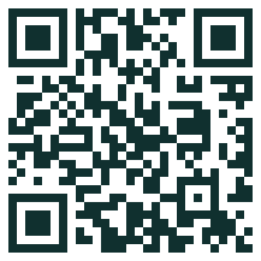
















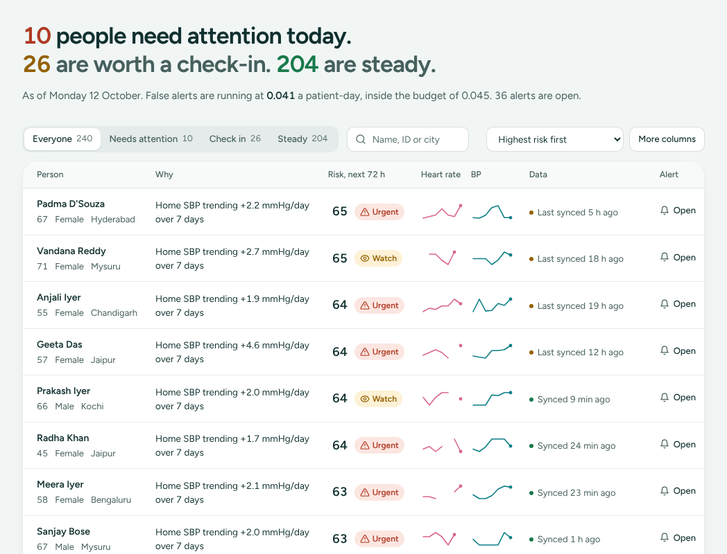
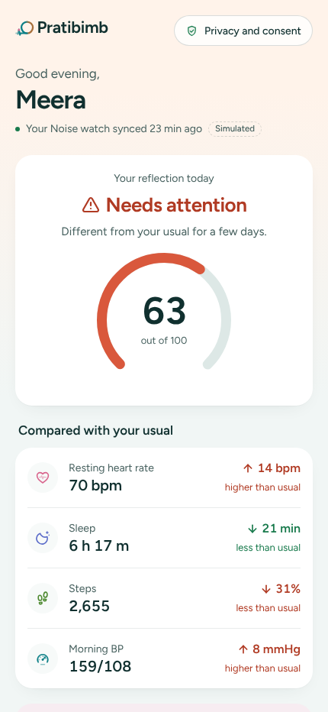



PRATIBIMB AT A GLANCE
Read every night against the patient's own body. Pratibimb learns how one person responds to sleep and walking and alerts only on what those habits cannot explain: 70% of strain episodes caught, a median 48 hours early, at 1 false alert per 22 patient-days.
SCAN FOR THE
LIVE DEMO
no sign-in
TEAM AMAZE
IIM LUCKNOW
PGPSM
DIGITAL TWIN CHALLENGE 2026
A digital twin for Indian adults with high blood pressure, on the watch they already own
WHO WE BUILD FOR
SEE A1
THE CONDITION
SEE A1
WHAT THE EVIDENCE SAYS
SEE A1
WHAT BLOCKS EARLY WARNING
THE EVENT WE PREDICT
SEE A3
Meera Iyer, 58 | Patient, Bengaluru
THE PATIENT
24%
of Indian
men
21%
of Indian
women
WATCHES ARE EVERYWHERE: 91.6% of smartwatches sold in India cost under US$50 (IDC)
So: build on the watch people own
One rule for
everyone
Alarm
fatigue
72 hours ahead
a strain episode, scored every night
Wants: to stay well and out of hospital
Pain: feels fine until the day she does not
have high blood pressure (NFHS-5). It is quiet: strain builds for days before a surge, a clinic or an ER visit.
Gets: one line in Hindi or English, her best habit
ALARMS DROWN DOCTORS: fixed thresholds flagged 55.8% of readings in one study
So: every alert sits inside a budget
Watches sync
once a day
Colds and late
nights look alike
Against her own normal
heart rate up, HRV down, sleep and steps down, home BP climbing
01 WHAT WE FOUND
Dr Kavya Rao | Physician, 240 patients
THE DOCTOR
Wants: to know whom to call today
Heart
rate
BODIES DIFFER: in our cohort, an hour less sleep moves heart rate 0.3 to 2 bpm
So: learn each person's own response
Amber, not red
the model warns days ahead; SOS and 112 stay with people
Pain: threshold alarms on half of all readings
Gets: a risk-sorted list inside an alarm budget
No record
context
Privacy and
trust
Anita Iyer, 34 | Daughter-in-law
THE FAMILY
Home
BP
A COLD LOOKS LIKE STRAIN: heart rate rises in both; BP rarely does
So: fuse the home BP cuff with the watch
Not a diagnosis
decision support for a registered doctor
Wants: to know when to step in
Pain: hears only once it is an emergency
3 Oct
Meera: both climb above her own usual range (grey)
12 Oct
Each barrier maps to the answer that removes it (A1)
Gets: a consented SOS ladder, one tap to 112
THE WHITE SPACE: WHAT EACH APPROACH USES
SEE A2
HOW THE TWIN DECIDES, ON MEERA
SEE A3
TWO STREAMS, ONE PERSON
SEE A2
WHAT THE DOCTOR AND PATIENT SEE
SEE A5
Health record
Watch
Home BP cuff
Own baseline
Own response
Calibrated
Alarm budget
Score
HER USUAL
+13.8 bpm over her usual
HEALTH RECORD (STATIC)
WATCH AND CUFF (NIGHTLY)
1
Demographics
Resting heart rate, HRV
FUSE AND DECIDE
24% in 72 h, score 63
5
2
HER RESPONSES
4 slopes, 109 calm days
Past diagnoses (SNOMED CT)
Sleep stages: deep, REM
Threshold alarms
2/7
Lab results (LOINC)
Step count
02 WHAT WE BUILT
Medicines and adherence
SpO2, breathing rate
Overnight HR rule
2/7
Genetic marker, family history
Home BP cuff, mornings
Framingham score
1.5/7
Same model, no twin
5.5/7
EXPLAINED OR NOT
+12.6 bpm her habits miss
4
3
BORROW FROM ALL
57% weight on her own data
THE TWIN
PRATIBIMB
7/7
240 synthetic patients x 120 days, 342 labelled episodes, seed 42
Uses it
Partly
Not used
Only Pratibimb fills all seven
Only the change her habits cannot explain becomes the warning
Doctor: 240 people sorted by 72 h risk, reasons in words
Meera: one status, in her language
RESULTS ON PATIENTS THE MODEL NEVER SAW
SEE A4
THE TWIN LEARNS THE PERSON
SEE A4
ALERTS INSIDE THE BUDGET
SEE A4
GATED ROADMAP
SEE A6
BUILT TO BE TRUSTED
AUROC (0.5 is guessing)
Episodes caught at the budget
Sleep to heart rate
0.71
70%
50%
91%
Now
Prototype live
25 tests
3 check no future data leaks
Pratibimb: all streams + twin
0.876
70%
Walking to BP
0.67
All streams, no twin
0.851
64%
M0 to 3
ABDM sandbox, app
MIT, public
code, model card, live demo
03 PROOF AND PATH
Walking to heart rate
0.66
Watch + cuff + twin
0.870
72%
episodes caught
caught 48 h or more early
of the alarm budget used
M3 to 6
Silent clinic pilot
Watch only + twin
0.804
55%
Sleep to HRV
0.59
4 consents
one per stream, DPDP-ready
Overnight HR rule
0.708
42%
Match with each hidden true slope (r)
M6 to 12+
CDSCO filing
Health record only
0.578
15%
18 to 30% less error than one slope for everyone
1 false alert per 22 patient-days; median warning 48 hours before the event
Diamond = gate: each phase starts only when the last gate is met
0 doses
changed by the app, ever
Mean of 3 patient splits. Budget: 0.045 false alerts a patient-day.
THE ANSWER
Read every night against the patient's own body, alert only on what her habits cannot explain, and let people own the emergency. Decision rule for a pilot: proceed only if alerts stay inside the budget on real, consented data.
ASSUMPTIONS: all data is synthetic (240 patients x 120 days, seed 42); personas are illustrative; results are means of three patient splits on unseen patients.
SOURCE: NFHS-5 (J Health Popul Nutr, 2023); IDC India wearables, Q2 2026; arXiv 2603.09052; repository MODEL_CARD.md and ALGORITHM.md

Slide 3
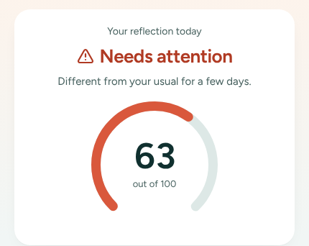
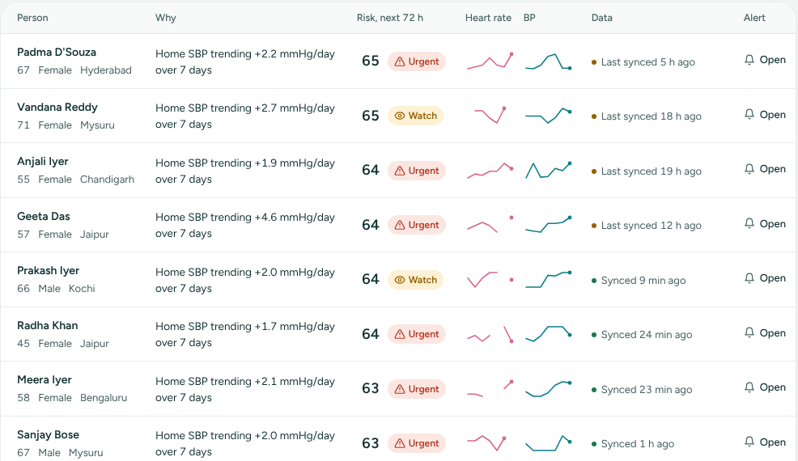
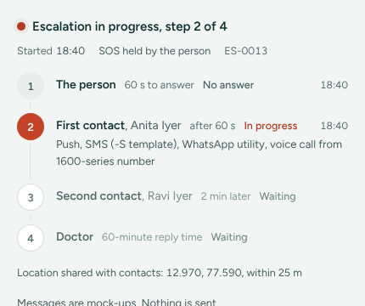

A1
About 1 in 4 Indian men and 1 in 5 women have high blood pressure, and strain builds for days on watches nobody reads; the warning has to be personal and fit inside an alarm budget
Condition in India
Use case
Condition: hypertension with cardiovascular risk. Event: a strain episode starting within 72 hours. Personas are illustrative; Meera Iyer (P-0007) is a synthetic patient.
FOUR FACTS THAT SHAPE THE DESIGN
SEE S1 TO S4
MEERA'S LAST 21 NIGHTS: RISK SCORE
SEE A5
WHO WE DESIGN FOR
SEE A5
24% | 21%
of Indian men | women have high BP
NFHS-5, 2019 to 21 (S1). Quiet and chronic: strain builds over days.
So: Pick hypertension; warn days ahead
90
watch off 9 and 10 Oct;
the cuff kept reporting
Meera Iyer, 58 | Patient, Bengaluru; hypertension, past heart attack
Wants: to stay well and out of hospital
urgent line
63
Pain: feels fine until the day she does not
91.6%
of smartwatches sold in India cost under US$50
IDC, Q2 2026 (S2). They log heart rate, sleep and steps nightly.
So: Build on the watch people already own
60
Gets: one sentence in Hindi or English, her best habit, SOS
WHAT THEY SEE
Dr Kavya Rao | Physician; 240 patients on remote watch
30
check-in line
Wants: to know whom to call today, and why
55.8%
of readings flagged by fixed thresholds
One remote-monitoring study (S3). Doctors stop looking.
So: Every alert sits inside an alarm budget
Pain: threshold alarms on half of all readings
Gets: a risk-sorted list inside an alarm budget
WHAT THEY SEE
0
22 Sep
27
2
7
12 Oct
Anita Iyer, 34 | Meera's daughter-in-law; first contact
0.3 to 2
bpm change in next-night heart rate per hour of sleep lost
Person to person, in our cohort (S4). One rule cannot fit all.
So: Learn each person's own response
Steady
Check in
Urgent
Wants: to know when to step in
Score 0 to 100 from the trained model. The twin kept scoring while the watch was off, using the home BP cuff.
Pain: hears only once it is an emergency
Gets: a consented SOS ladder with one tap to 112
WHAT THEY SEE
THE EVENT, DEFINED AGAINST HER OWN NORMAL
SEE A3
WHAT BLOCKS EARLY WARNING, AND THE ANSWER TO EACH
SEE A3 TO A6
Signal | Rule (against her own baseline) | Meera on 12 Oct | Sign
Overnight resting heart rate | above her 28-night usual range | 70.3 bpm vs 53.5 to 59.5 | Up
HRV, 7-night mean | below her smallest worthwhile change | 3.56 vs 3.67 to 3.80 lnRMSSD | Down
Home systolic BP | 7-day trend climbing | 159 mmHg, +2.1 mmHg a day | Up
Sleep and steps | falling below her usual week | 6 h 17 m; 2,655 steps (31% under) | Down
Event day | BP surge, or an unplanned clinic or ER visit | episode under way | Event
One rule for everyone
bodies differ 0.3 to 2 bpm
Her own baseline and response slopes
SEE A3
Alarms on half of readings
doctors stop looking
Calibrated score inside an alarm budget
SEE A4
Colds and late nights
look like strain on the wrist
Home BP cuff plus the twin-adjusted signal
SEE A3
Watches sync once a day
no minute-level stream
Nightly scoring; freshness on every row
SEE A5
Horizon: onset within 72 hours, scored every night from whatever the watch synced. The model owns the amber tier; SOS, family contacts and 112 own the red tier. We never claim heart-attack detection.
Emergencies need people
no watch detects heart attacks
Consented SOS ladder, one tap to 112
SEE A5
Privacy and trust
health data, family contacts
Consent per stream; opt out of AI
SEE A6
SO WHAT
The data already arrives every night; what is missing is reading it against each person's own normal, inside an alarm budget a doctor can live with.
ANNEXURE A1 | personas are illustrative composites; Meera, Kavya and Anita are synthetic; scores from the hosted demo
SOURCE: S1 NFHS-5 via J Health Popul Nutr 2023; S2 IDC India wearables Q2 2026; S3 arXiv 2603.09052; S4 cohort slopes, docs/MODEL_CARD.md
3

Slide 4
A2
Two synthetic streams fused into one person: a FHIR health record and a nightly watch-and-cuff stream for 240 patients, read by a twin engine behind one API
Data fusion
Synthetic data
No real patient data anywhere: the generator is seeded (42) and hides each person's true responses so the twin can be checked; every field below is in the FHIR export.
THE STATIC RECORD (EHR)
MEERA, SYNTHETIC
THE NIGHTLY STREAM (WATCH AND CUFF)
MEERA, 12 OCT
THE SYNTHETIC COHORT
SEE DATA_SOURCES
Field | Standard | Meera Iyer
Demographics | FHIR Patient | 58, female, Bengaluru; ABHA masked
Past diagnoses | SNOMED CT | Essential hypertension; IHD; MI (history)
Lab results | LOINC | HbA1c 5.8%; LDL 130; eGFR 83
Medicines | MedicationStatement | Amlodipine 5 mg; atorvastatin; aspirin
Adherence | dose log | missed amlodipine on 3 Oct
Genetic marker | polygenic risk tier | medium (simulated)
Family history | FamilyMemberHistory | father: heart attack at 61
Static risk | Framingham 2008 | 12.1% over 10 years (intermediate)
Signal | Source | Meera on 12 Oct
Resting heart rate | watch, 5-minute samples | 70.3 bpm overnight
HRV (RMSSD) | watch, overnight | 28.6 ms (ln 3.35)
Sleep and stages | watch: deep, REM, efficiency | 6 h 17 m; 81% efficiency
Step count | watch | 2,655 (usual about 4,000)
SpO2, breathing | watch | 97%; 14.1 breaths a minute
Home BP | cuff, mornings | 159/108 mmHg
Sync | Health Connect, HealthKit | hourly to daily; 23 min ago
CGM | not needed for BP | diabetes read from HbA1c
240
patients
120
days each
28,685
patient-days
342
strain episodes
LOOKS LIKE TROUBLE, BUT IS NOT (PLANTED SO THE MODEL MUST TELL THEM APART)
Missed doses
767
Late nights
756
Travel days
290
Colds
242
Each person also carries hidden true responses to sleep and walking, so A4 can test whether the twin finds them.
ARCHITECTURE: TWO STREAMS IN, A WARNING AND A LADDER OUT
SEE ARCHITECTURE.PDF
TECHNICAL STACK
SEE README
HEALTH RECORD
PHYSIOLOGY ENGINE
PREDICTION
ACTION LAYER
PEOPLE
Layer | Choice
Data | Python, NumPy, pandas; FHIR R4; seed 42
Twin engine | per-person regression, AR(1) errors, DerSimonian and Laird
Model | LightGBM, Platt scaling, SHAP, quantile forecasts
API | FastAPI, Pydantic v2, SQLite, server-sent events
Front end | React 18, TypeScript, Vite, Tailwind, Recharts
Standards | FHIR R4, ABDM WellnessRecord, SNOMED CT, LOINC
Quality | 25 pytest tests, Docker, MIT licence
FHIR R4 bundles
SNOMED CT, LOINC
masked ABHA
1 baseline: 28 and 60 nights
2 slopes on calm days
3 empirical Bayes pooling
4 twin-adjusted signals
the twin: how this
one body responds
LightGBM fusion
+ 8 facts from the record
monotone constraints
Platt calibration
thresholds from a budget
18 quantile forecasts
SHAP reasons
FastAPI, SQLite, live stream
alerts and budget meter
what-if simulator
SOS ladder, consent
append-only audit
FHIR, ABDM export
doctor console
patient app
(English, Hindi)
family contacts
112: always a
human tap
WATCH AND CUFF
companion app reads
Health Connect, HealthKit
POST /api/ingest
FUSION
The record does not just add columns: it tells the twin how to read the watch, so a beta blocker or diabetes changes what a rise in heart rate means.
ANNEXURE A2 | all data synthetic; Meera's values are from the hosted demo on 12 Oct 2026
SOURCE: backend/twin/data (generator); docs/DATA_SOURCES.md; docs/DEVICE_SYNC.md; docs/architecture.pdf
4

Slide 5
A3
The twin compares tonight with Meera's own body: 13.8 bpm above her usual, only 1.3 explained by her habits, so 12.6 bpm becomes a calibrated 24% warning
Predictive model
Personalisation
Five steps, each with the trained model's real output for Meera Iyer on 12 October 2026. Every slope and baseline uses only earlier days (three automated leakage tests).
FIVE STEPS, WORKED ON MEERA
SEE ALGORITHM.MD
1
HER USUAL
2
HOW HER BODY RESPONDS
3
BORROW FROM THE GROUP
4
EXPLAINED OR NOT
5
FUSE AND DECIDE
Compares tonight with her own last 28 nights (heart rate, BP) and 60 nights (HRV), never with other people
On calm days only, learns how tomorrow's heart rate, HRV and BP move with today's sleep and steps
Pulls her slope toward the group by exactly how unsure it is (DerSimonian and Laird)
Subtracts what her own sleep and steps explain; recomputed daily from earlier days only
LightGBM on twin signals, BP trend and 8 record facts; calibrated; thresholds from the budget
+13.8 bpm
4 slopes
57%
+12.6 bpm
24%
usual 56.5, tonight 70.3
from 109 calm days; errors widened for day-to-day drift
weight on her own data; slope -1.41 vs group -1.03
unexplained; BP +16 mmHg her activity cannot explain
in 72 h (likely 17 to 28%); usual 0.7%; score 63, urgent
features/build.py
models/physiology.py
models/physiology.py
models/physiology.py
models/fusion.py
STEP 4: WHERE TONIGHT'S +13.8 BPM COMES FROM
BPM
STEP 3: HOW MUCH TO TRUST HER OWN DATA
SLEEP TO HR
STEP 5: FROM SIGNAL TO DECISION
FUSION.PY
+12.6
+13.8
her data -1.69 (noise 0.37)
steady
check in (30)
urgent (60)
group -1.03
Meera 63
10
-2.0
-1.5
-1.0
24% chance of a strain episode in 72 hours (likely 17 to 28%); her usual 0.7%
bpm per extra hour of sleep
twin -1.41
Weight on her own data = spread² / (spread² + noise²) = 0.43² / (0.43² + 0.37²) = 57%
Twin slope = 57% x (-1.69) + 43% x (-1.03) = -1.41
What goes in | Guardrail
Twin-adjusted heart rate, HRV, BP | monotone: more sleep or walking never raises risk
7-day home BP trend; sleep debt; activity | Platt calibration: 20% means about 20%
8 record facts: Framingham, genetic tier, adherence, diabetes, prior MI, CKD, family history, beta blocker | urgent line = most sensitive cut within 0.045 false alerts a patient-day
5
+1.9
-0.6
100%
+1.3
Meera: 109 calm days, 57%
0
Shorter sleep
(11 Oct, 1.4 h less)
More steps
(about 1,500)
Explained by
her habits
Unexplained:
the warning
Tonight vs
her usual
Explained = her slopes (fitted on earlier days only) x her habits: (-1.38) x (-1.38 h) + (-0.43) x (+1.50 thousand steps) = +1.3 bpm. Home BP: +16 mmHg above what her activity explains.
0
calm days logged: 0 to 120
Top reasons for Meera: home BP rising 2.1 mmHg a day; BP +16 mmHg unexplained; heart rate +13 bpm unexplained.
New users start at the group; the slope becomes theirs as calm days add up
THE TWIN
A late night is explained by her own slope and stays quiet; strain that her habits cannot explain becomes the warning.
ANNEXURE A3 | slopes are per extra hour of sleep or 1,000 steps; every value is computed by the trained model
SOURCE: docs/ALGORITHM.md; backend/twin/models/physiology.py and fusion.py; tests/test_leakage.py
5

Slide 6

A4
On patients the model never saw, the twin lifts AUROC from 0.851 to 0.876 and catches 70% of strain episodes a median 48 hours early, at 1 false alert per 22 patient-days
Predictive model
Honest evaluation
Patient-level 5-fold cross-validation, repeated on three patient splits (seeds 42, 43, 44); every number is the mean of the three. Synthetic cohort: real-world results will be lower.
ABLATION: WHAT EACH STREAM ADDS
SEE MODEL_CARD
TWIN LIFT HOLDS ON EVERY SPLIT
MIN, MEAN, MAX
THE CUFF KEEPS COLDS FROM BECOMING ALARMS
Model
Record
Watch
Cuff
Twin
AUROC
AUPRC
Caught at budget
48 h+
AUROC
Pratibimb: all streams + twin
0.876
0.218
70%
50%
With twin
0.876
242 cold-like windows
Watch + cuff + twin
0.870
0.214
72%
51%
No twin
0.851
233
All streams, no twin
0.851
0.189
64%
45%
Episodes caught at the budget
164
173
With twin
70%
Watch only + twin
0.804
0.136
55%
37%
No twin
64%
Overnight HR rule (NightSignal-style)
0.708
0.091
42%
19%
Better AUROC on 3 of 3 splits. Catch rate moves up to 19 points between splits of 240 people, so every headline is a three-split mean.
Health record only
0.578
0.042
15%
15%
Watch only
Watch + cuff
All streams
Cold-like windows that raised an alarm, at 90% episode sensitivity. A cold raises heart rate; it rarely raises BP for a week.
AUROC bar starts at 0.5 (guessing). The record raises ranking more than timing; its real job is reading the watch right.
DOES THE TWIN LEARN THE RIGHT PERSON?
HIDDEN TRUTH KNOWN
NEXT 3 DAYS: MEERA'S HEART RATE (BPM)
P10 TO P90
HONEST LIMITS
Response the twin learns | Match with truth (r) | Twin error | One-slope error | Error cut | 80% band holds
Sleep to next-night heart rate | 0.71 | 0.28 | 0.40 | 30% | 72%
Walking to next-morning BP | 0.67 | 0.30 | 0.42 | 28% | 74%
Walking to next-night heart rate | 0.66 | 0.09 | 0.12 | 25% | 76%
Sleep to next-night HRV | 0.59 | 1.32 | 1.60 | 18% | 75%
75
today
Synthetic labels: real-world results will be lower
65
Published anchors: NightSignal 80% sensitivity (infections); EDI AUROC 0.76
watch off
Nightly, not live: budget watches sync hourly to daily
55
her usual range
6 Oct
15 Oct
Not heart-attack detection: acute events go to SOS and 112
The generator plants each person's true slopes, so recovery can be checked directly. Error is mean absolute error in each slope's own unit; one-slope uses the population average for everyone.
Tomorrow 67 bpm (likely 63 to 73). Day-1 error: 2.5 bpm heart rate, 6.2 mmHg BP; 73% of readings land inside the P10 to P90 band.
Record adds ranking: not much timing
PROOF
The lift comes from the twin on every split, and the cuff keeps colds from becoming alarms; these are synthetic results, so the next test is a real clinic.
ANNEXURE A4 | budget = 0.045 false alerts a patient-day; 342 episodes in 28,685 patient-days; three patient splits
SOURCE: docs/MODEL_CARD.md; backend/artifacts/model_card.json; tests/test_leakage.py; NightSignal and EDI as cited in the model card
6

Slide 7
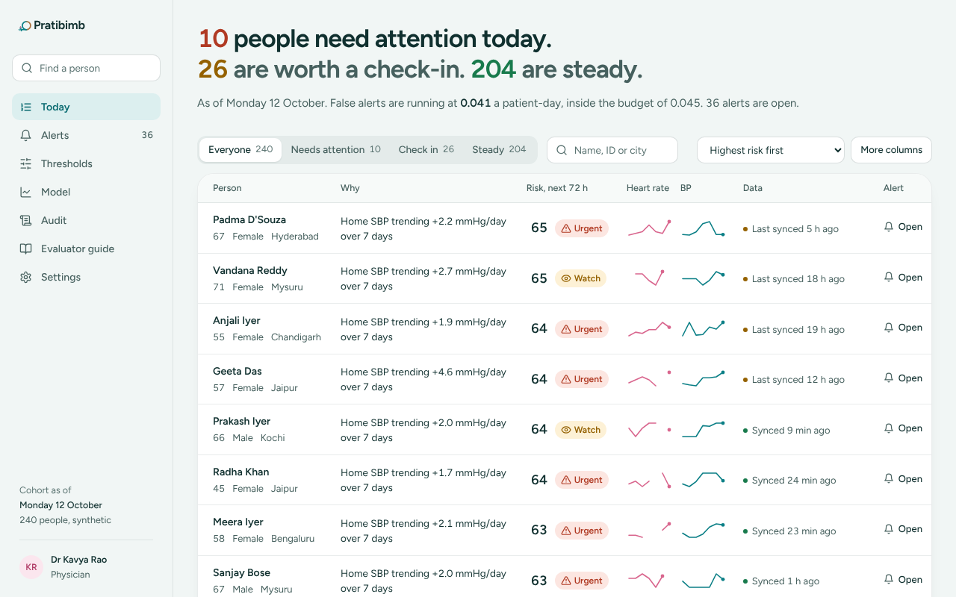
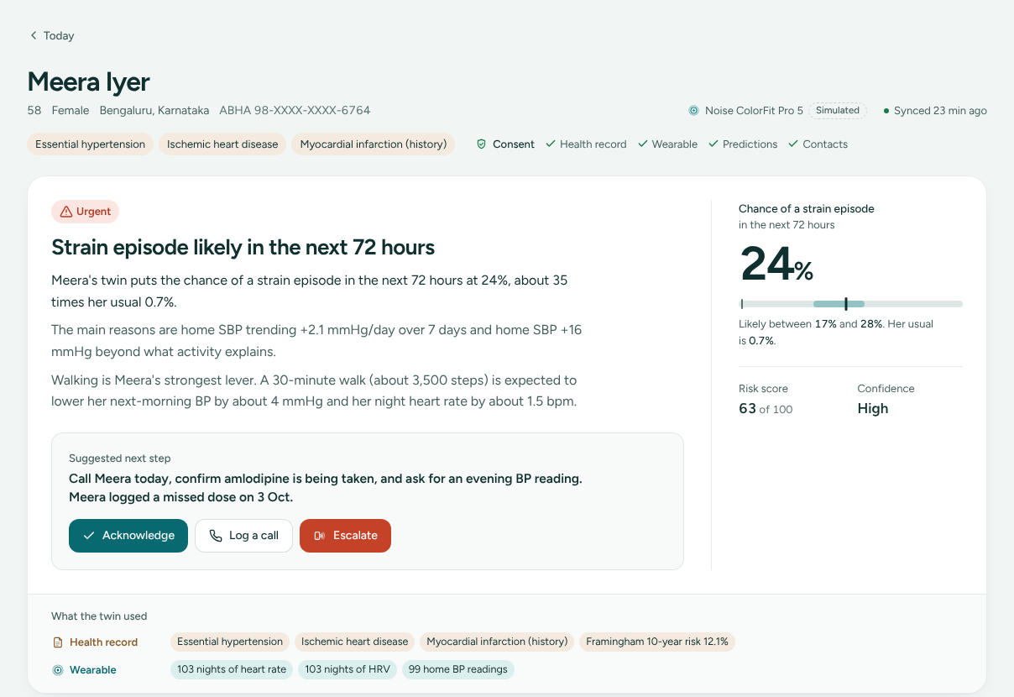
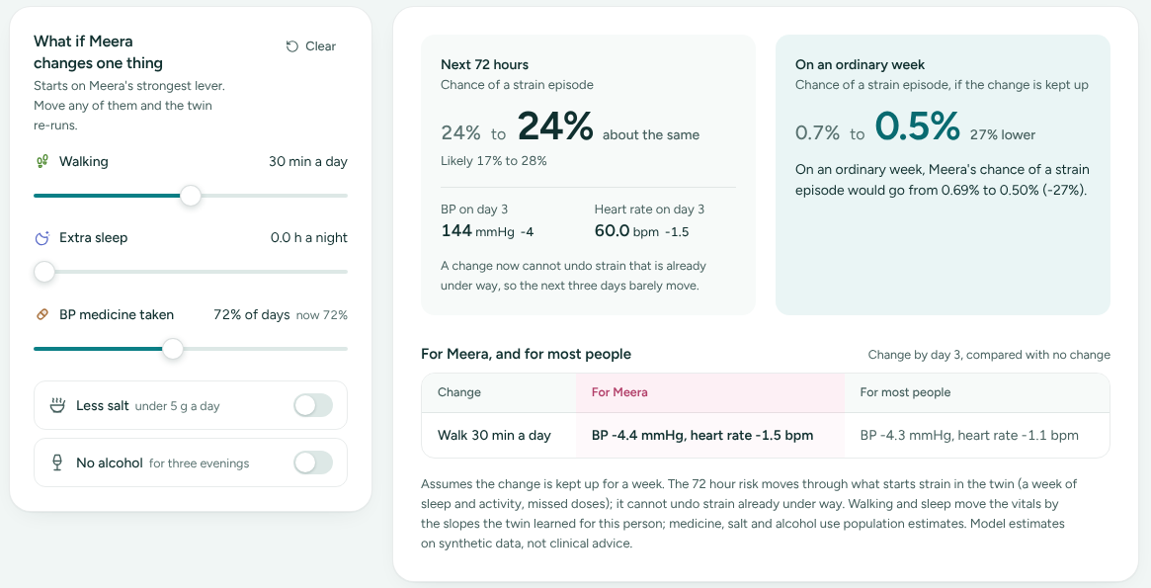
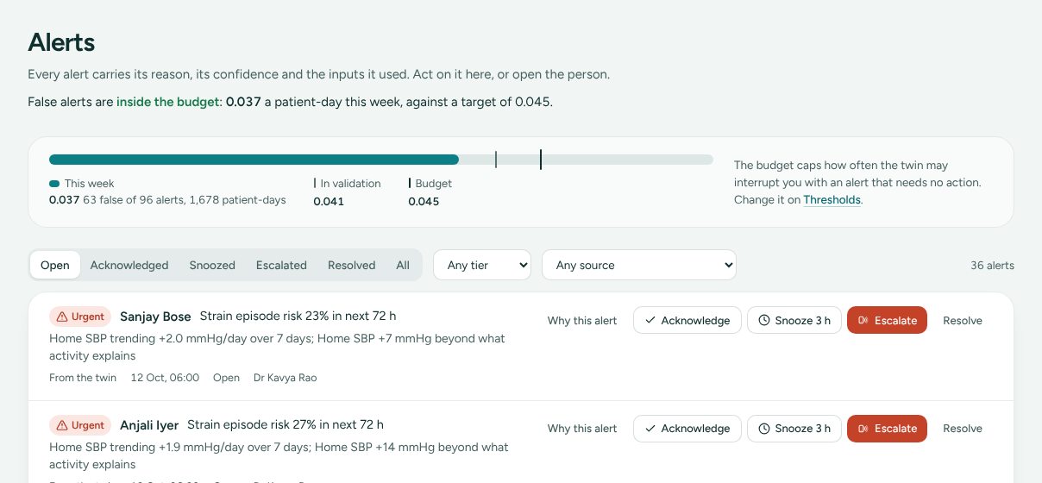
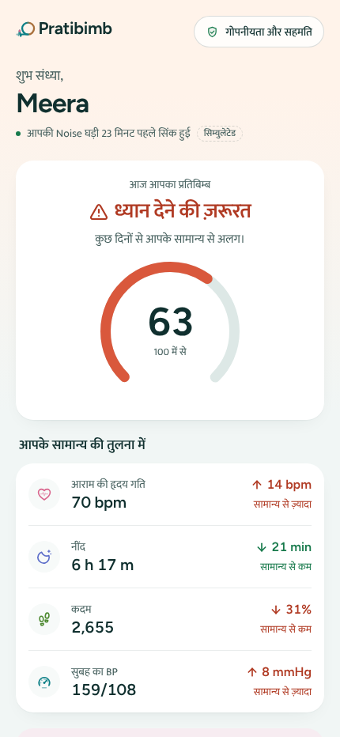
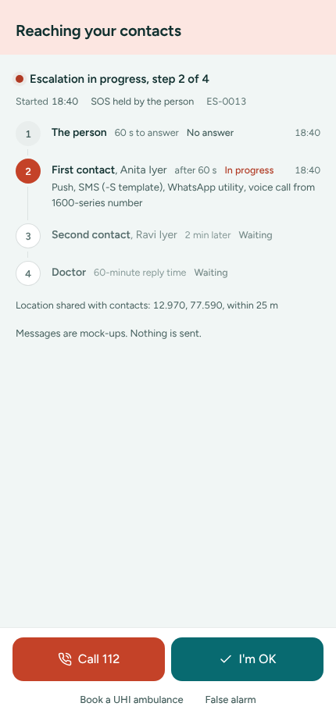
A5
The doctor sees who needs attention and why, tries changes on the patient's own body and acts; the patient gets one plain sentence, her best habit and a safe SOS ladder
Doctor dashboard
Patient app
Live at pratibimb-pi.vercel.app with no sign-in; the online demo replays real output from the trained model on the synthetic cohort.
TODAY: WHO NEEDS ATTENTION
DOCTOR CONSOLE
TWIN PAGE: WHY, AND WHAT TO DO
MEERA'S PAGE
1
1
10 urgent, 26 check-in, 204 steady
out of 240 people on 12 Oct
1
24% in 72 hours
likely 17 to 28%; her usual 0.7%
2
3
4
2
Sorted by 72 h risk
with the reason in plain words
2
Three sentences
the chance, the reasons, her best lever
2
1
3
Trend lines
heart rate and home BP, last week
3
Next step
call Meera, confirm amlodipine, evening BP
4
Data freshness
budget watches sync hourly to daily
3
4
What the twin used
record and watch, side by side
4
WHAT IF: ON HER OWN SLOPES
SIMULATE TAB
ALERTS INSIDE A BUDGET
ALERTS PAGE
MEERA'S PHONE AND THE SOS LADDER
PATIENT VIEW
-4.4 mmHg
BP with a daily 30 min walk, on her slope (most people -4.3)
1
Meera, 60 s to answer
2
first contact
27% lower
ordinary-week risk: 0.7% to 0.5%
3
second contact
4
her doctor
holds at 24%
next 72 h: the strain is already under way
One tap to 112 at every step; the server never dials it.
0.037 false alerts a patient-day this week vs a 0.045 budget. Any threshold change is replayed on 14 days first; every action goes to an append-only audit log.
Status
Hindi, read-aloud
SOS ladder
IN PRACTICE
The doctor spends time on the 10 who need it, not on all 240; the patient hears one sentence in her language and knows what to do.
ANNEXURE A5 | screens from the live demo on synthetic data; messages to contacts are mock-ups and say so on screen
SOURCE: pratibimb-pi.vercel.app; docs/API.md; docs/COMPLIANCE.md
7

Slide 8
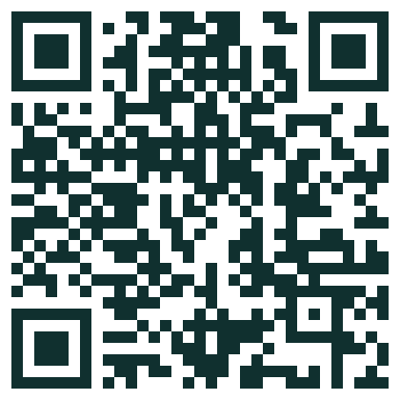



A6
Built for Indian practice and rules, honest about its limits, with a gated path from this prototype to a silent clinic pilot and a CDSCO filing
What runs today versus what a production version adds. Phases and gates are proposed: each phase starts only when the gate before it is met.
Indian impact
Roadmap
COMPLIANCE, MAPPED TO WHAT RUNS TODAY
SEE COMPLIANCE.MD
FIVE PHASES, EACH WITH A GATE
PROPOSED
Rule | What Pratibimb does today | Production adds
DPDP Act 2023 | consent per stream; opt out of AI; withdraw and delete; 18+ only | privacy notice, grievance officer, India hosting
Telemedicine Guidelines 2020 | never changes a dose; the doctor decides | clinician sign-off workflow
CDSCO software guidance, 2026 | model card, synthetic-data disclosure, audit log | likely Class B or C; QMS; clinical validation
ABDM | FHIR R4 and WellnessRecord export; ABHA masked | sandbox milestones M1 and M3; WASA audit
TRAI commercial messages | SMS, WhatsApp and voice templates (mocked) | DLT registration of headers and templates
ICMR AI ethics 2023 | patients can refuse AI; reasons always shown | bias benchmarking before deployment
Now
M3
M6
M12
M18
PROTOTYPE
done, Oct 2026
Gate met: 70% caught inside the budget (synthetic)
CONNECT
M0 to 3
ABDM sandbox; Android app on Health Connect. Gate: nightly sync from 3 watch brands
SILENT PILOT
M3 to 6
One hypertension clinic, consented patients, alerts hidden. Gate: budget holds on real data
LIVE PILOT
M6 to 12
Alerts to doctors; WHO SEAR chart; more languages; CGM for diabetics. Gate: safe, used
REGULATE
M12 on
CDSCO software filing (likely Class B or C); clinic network
BUILT FOR INDIA
HONEST LIMITS
TEAM AMAZE, IIM LUCKNOW
Budget watches
via Android Health Connect; Apple Watch via HealthKit
Synthetic labels: every result is on generated data; real numbers will be lower
NP
Nikita Pandey
Team leader, PGPSM, IIM Lucknow
Home BP cuff
the cheapest sensor that separates strain from a cold
Nightly, not minute by minute: budget watches sync hourly to daily
SA
Suraj Aryan
Team member, PGPSM, IIM Lucknow
LIVE DEMO
CODE
English and Hindi
with read-aloud on the patient view
No heart-attack detection: acute events go to SOS, family and 112
One tap to 112
and an ambulance booking link at every SOS step
Live demo pratibimb-pi.vercel.app
Code github.com/pndynkt/Team-AMAZE_IIM-Lucknow
Read first README, docs/ALGORITHM.md, docs/MODEL_CARD.md
Record adds ranking, not timing: its job is reading the watch correctly
ABDM ready
WellnessRecord export; ABHA masked everywhere
Framingham under-estimates South Asians: the WHO 2019 SEAR chart is next
Research prototype on synthetic data. Not a medical device. In an emergency, call 112.
NEXT
A silent pilot with one hypertension clinic on consented real data; the alarm budget and the twin's recovery of each person are the gates.
ANNEXURE A6 | phases, months and gates are the team's proposal; regulatory class is a judgement pending CDSCO review
SOURCE: docs/COMPLIANCE.md; DPDP Act 2023; CDSCO Medical Device Software guidance, 30 Jul 2026; NRCeS ABDM guide
8

Slide 9
HAPPIEST HEALTH
DIGITAL TWIN CHALLENGE 2026
THANK YOU
Read the body you have, not the average one.
ANNEXURES: THE PROOF BEHIND THE ONE-PAGER
A1
The problem and the people
four facts, Meera's 21 nights, personas, the event, barriers
A2
Data and architecture
the record, the nightly stream, the cohort, the stack
A3
How the twin decides
five steps on Meera, the bridge, borrowing strength, the decision
A4
Does it work
ablation, split ranges, colds vs the cuff, recovery, forecasts, limits
A5
The product
doctor console, twin page, what-if, alert budget, phone and SOS
A6
India, safety and the road ahead
compliance, gated phases, India fit, limits, team and links
Team AMAZE | Nikita Pandey (team leader), Suraj Aryan | IIM Lucknow pratibimb-pi.vercel.app

