Slide 1


Hackathon 2021
Challenge Sponsor: HPCC
Team: Big-O
Presented By: Neel Patel, Yagna Patel

Slide 2

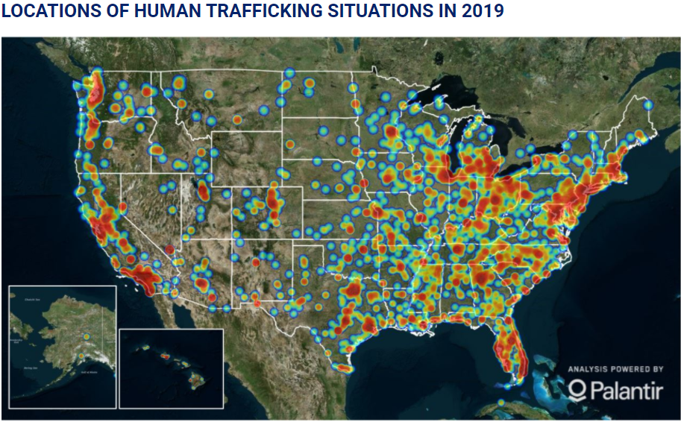
Background: ADAM Project
Missing Kids
Sexual Predators
Human Trafficking

Slide 3
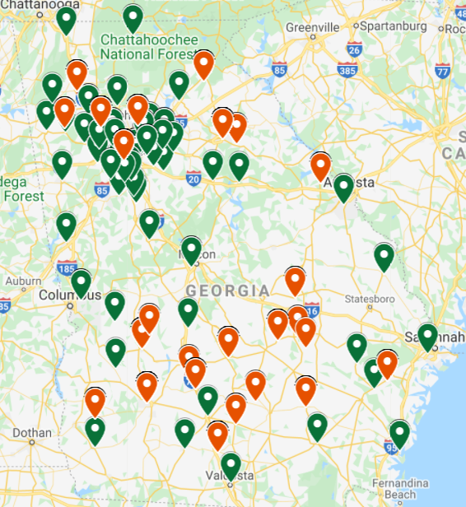
Hackathon Challenge
Using a weighted Scale to determine possible suspects for each missing kid
Datasets
Missing Kids in GA
US Geographical Data
Registered Sex offenders in United States
ECL

Slide 4
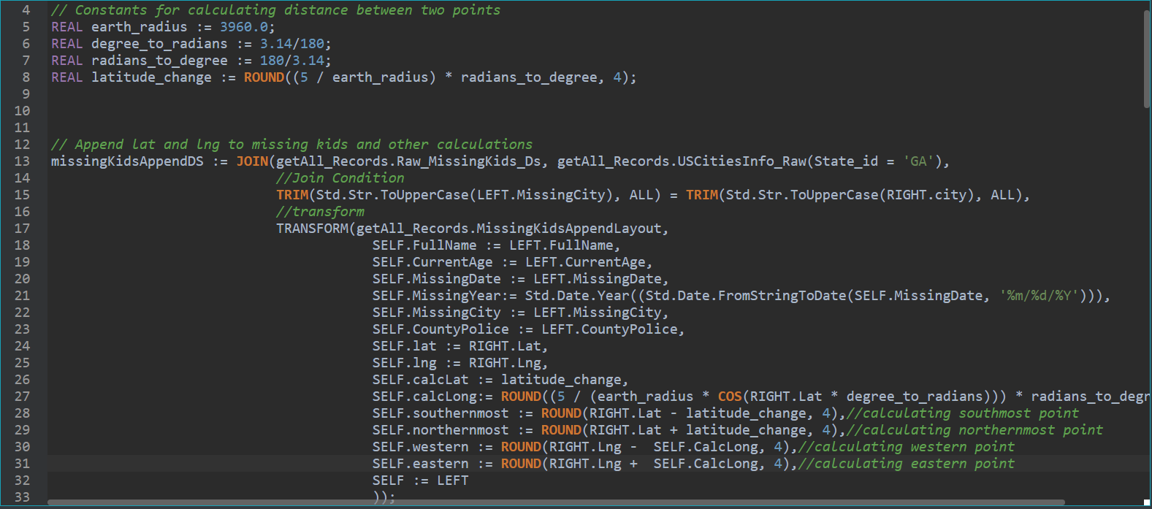
Solution
Create a Bounding Box for a missing kid
Identify the sex offenders in the given bounding box
Establish the list of sex offenders that are highly likely to abduct the kid

Slide 5
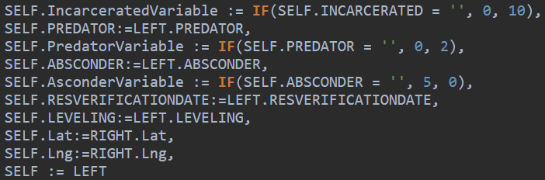
Weighted Scale
Assumptions
Dummy Variables
Predators, Absconder, or Incarcerated
Offender’s Age at the time kid went missing
How recently did the offender commit crime

Slide 6

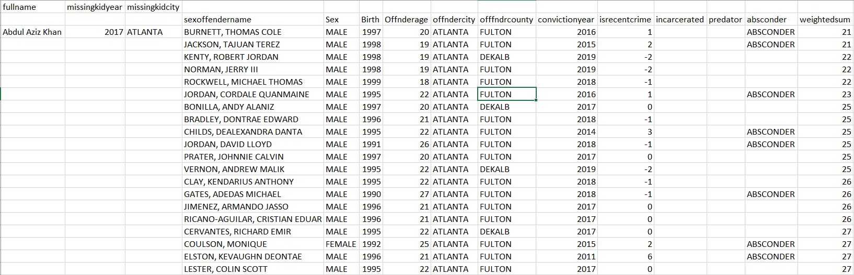
Results
Ranked sex offenders given a child goes missing based on the weighted scale

Slide 7

Future Directions
More Accurate Data
Optimizing the Weighted Scale
Reducing Assumptions and replacing them with facts from the dataset

Slide 8

Conclusion
In conclusion, given a dataset we were able to combine them to design a weighted scale that can rank sex offenders for a missing kid.

