Slide 1
CREDIT CARD FRAUD DETECTION
CRISP-DM Methodology | Kaggle Dataset | 5 ML/DL Models
Automated Pipeline: Data Collection → Feature Engineering → Model Development → Deployment
GitHub: github.com/pnehete23/credit-card-fraud-detection

Slide 2




PROJECT OVERVIEW & BUSINESS PROBLEM
Putting It All Together: Complete ML Solution Using CRISP-DM
BUSINESS PROBLEM
PROJECT OBJECTIVES
Challenge:
Credit card fraud costs $28.65 billion annually (Nilson Report). Financial institutions need automated, real-time detection with:
• High accuracy (minimize fraud losses)
• Low false positives (avoid customer friction)
• Real-time processing (<1 second latency)
1. Build automated end-to-end ML pipeline
2. Compare 5 ML/DL algorithms systematically
3. Handle severe class imbalance (0.17% fraud)
4. Optimize for both precision and recall
5. Deploy production-ready solution
6. Provide actionable recommendations
SUCCESS CRITERIA
F1-Score
AUC-ROC
Precision
Training Time
> 0.80
> 0.95
> 0.85
< 60s

Slide 3






CRISP-DM METHODOLOGY
Systematic Approach to ML Project Development
1. Business Understanding
2. Data Understanding
3. Data Preparation
• Define fraud detection objectives
• Set success metrics (F1>0.8, AUC>0.95)
• Identify stakeholders & constraints
• Kaggle dataset: 284,807 transactions
• 492 frauds (0.17% - severe imbalance)
• 28 PCA features + Amount, Time
• Feature scaling (StandardScaler)
• SMOTE & Random Undersampling
• Train-test split (stratified)
4. Modeling
5. Evaluation
6. Deployment
• 5 algorithms: XGBoost, RF, NN, AE, LR
• Hyperparameter optimization
• Cross-validation
• 7 metrics comparison
• Precision-recall trade-offs
• Business impact analysis
• Automated pipeline deployment
• Model monitoring & drift detection
• Retraining strategy

Slide 4
DATA COLLECTION & UNDERSTANDING
Kaggle Credit Card Fraud Dataset - Exploratory Analysis
Total Transactions
Fraudulent Cases
Fraud Rate
Features
284,807
492
0.17%
30
European cardholders
Positive class
Severe imbalance
V1-V28 (PCA) + 2
DATA CHARACTERISTICS & CHALLENGES
CHALLENGES IDENTIFIED
SOLUTIONS IMPLEMENTED
1. Extreme Class Imbalance
• Only 0.17% fraudulent transactions
• Standard models will bias toward majority
2. Anonymized Features (PCA)
• V1-V28 are PCA-transformed
• Limited domain interpretation
3. Time-Series Nature
• Transactions over 2 days
• Need chronological train-test split
✓ Resampling Techniques
• SMOTE (Synthetic Minority Oversampling)
• Random Undersampling
• Class weights in algorithms
✓ Feature Engineering
• StandardScaler normalization
• Feature importance analysis
✓ Evaluation Strategy
• Focus on F1-Score, AUC-PR over accuracy
• Stratified cross-validation

Slide 5
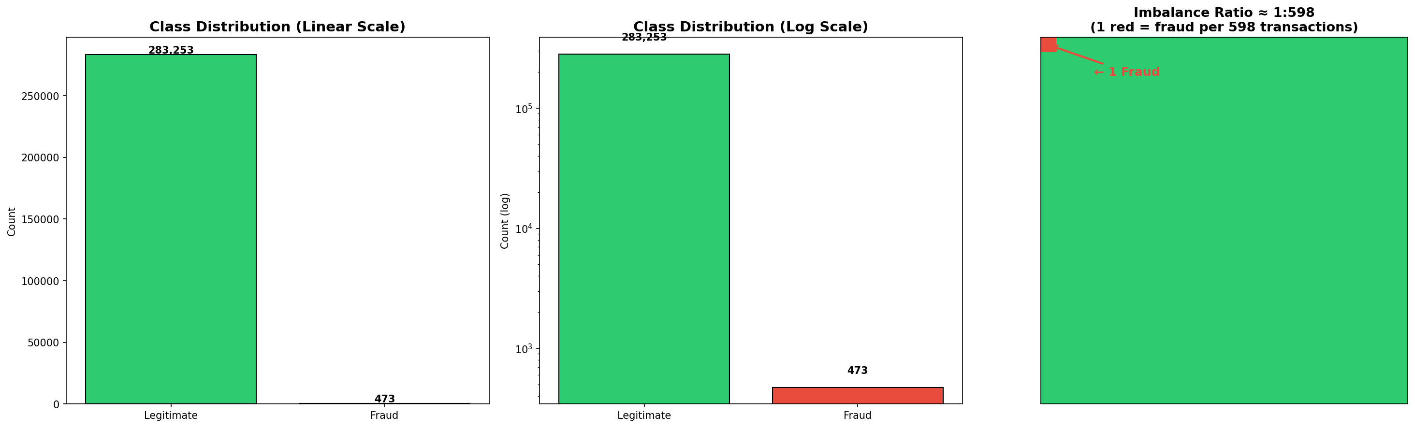
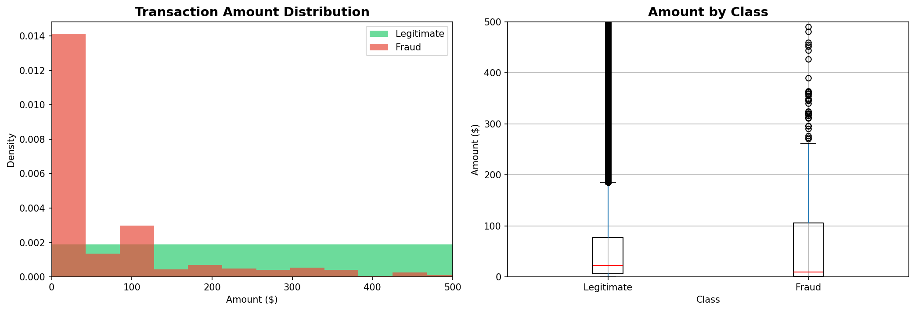
EXPLORATORY DATA ANALYSIS
Class Distribution & Transaction Amount Analysis

Slide 6
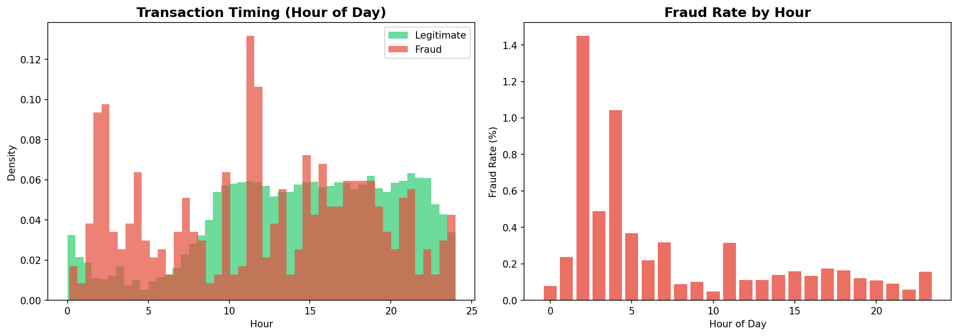
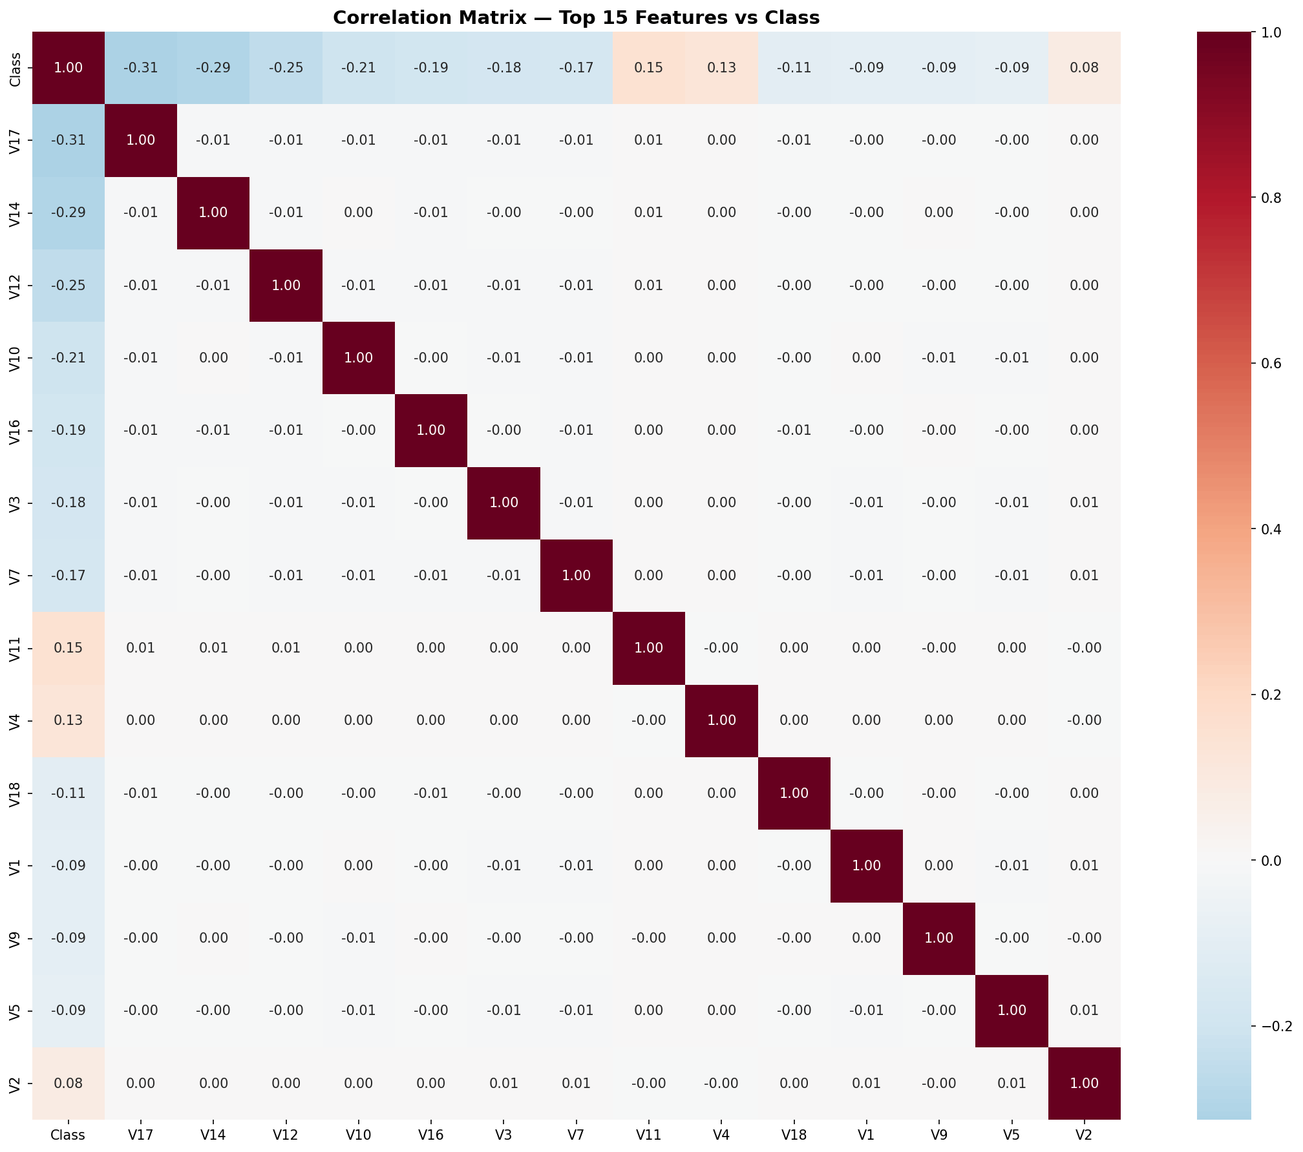
TEMPORAL & CORRELATION ANALYSIS
Transaction Patterns Over Time & Feature Correlations

Slide 7


AUTOMATED END-TO-END ML PIPELINE
From Raw Data to Production Deployment
Data
Ingestion
Data
Cleaning
Feature
Engineering
Resampling
Model
Training
Evaluation
Deployment
Kaggle API
Nulls, Outliers
Scaling, PCA
SMOTE/RUS
5 Algorithms
7 Metrics
API Endpoint
GitHub Repository: github.com/pnehete23/credit-card-fraud-detection
Complete implementation including notebooks, scripts, models, and documentation
PIPELINE BENEFITS
Reproducible: Version-controlled code & data
Scalable: Handles millions of transactions
Automated: End-to-end without manual intervention
Monitored: Real-time performance tracking

Slide 8
FEATURE ENGINEERING & PREPARATION
Transforming Raw Data into Model-Ready Features
Scaling & Normalization
Handling Imbalance
Feature Selection
• StandardScaler for Amount & Time
• Z-score normalization
• Preserves distribution shape
• SMOTE (Synthetic Minority)
• Random Undersampling
• Combined approach: best results
• Correlation analysis
• Feature importance (tree-based)
• Remove low-variance features
RESAMPLING STRATEGY COMPARISON
Method Fraud Normal Ratio Result
Original (Imbalanced) 492 284,315 1:578 Poor recall
SMOTE Only 284,315 284,315 1:1 Overfitting risk
Random Undersample 492 492 1:1 Information loss
Combined (SMOTE + RUS) ~50,000 ~50,000 1:1 ✓ Best balance

Slide 9
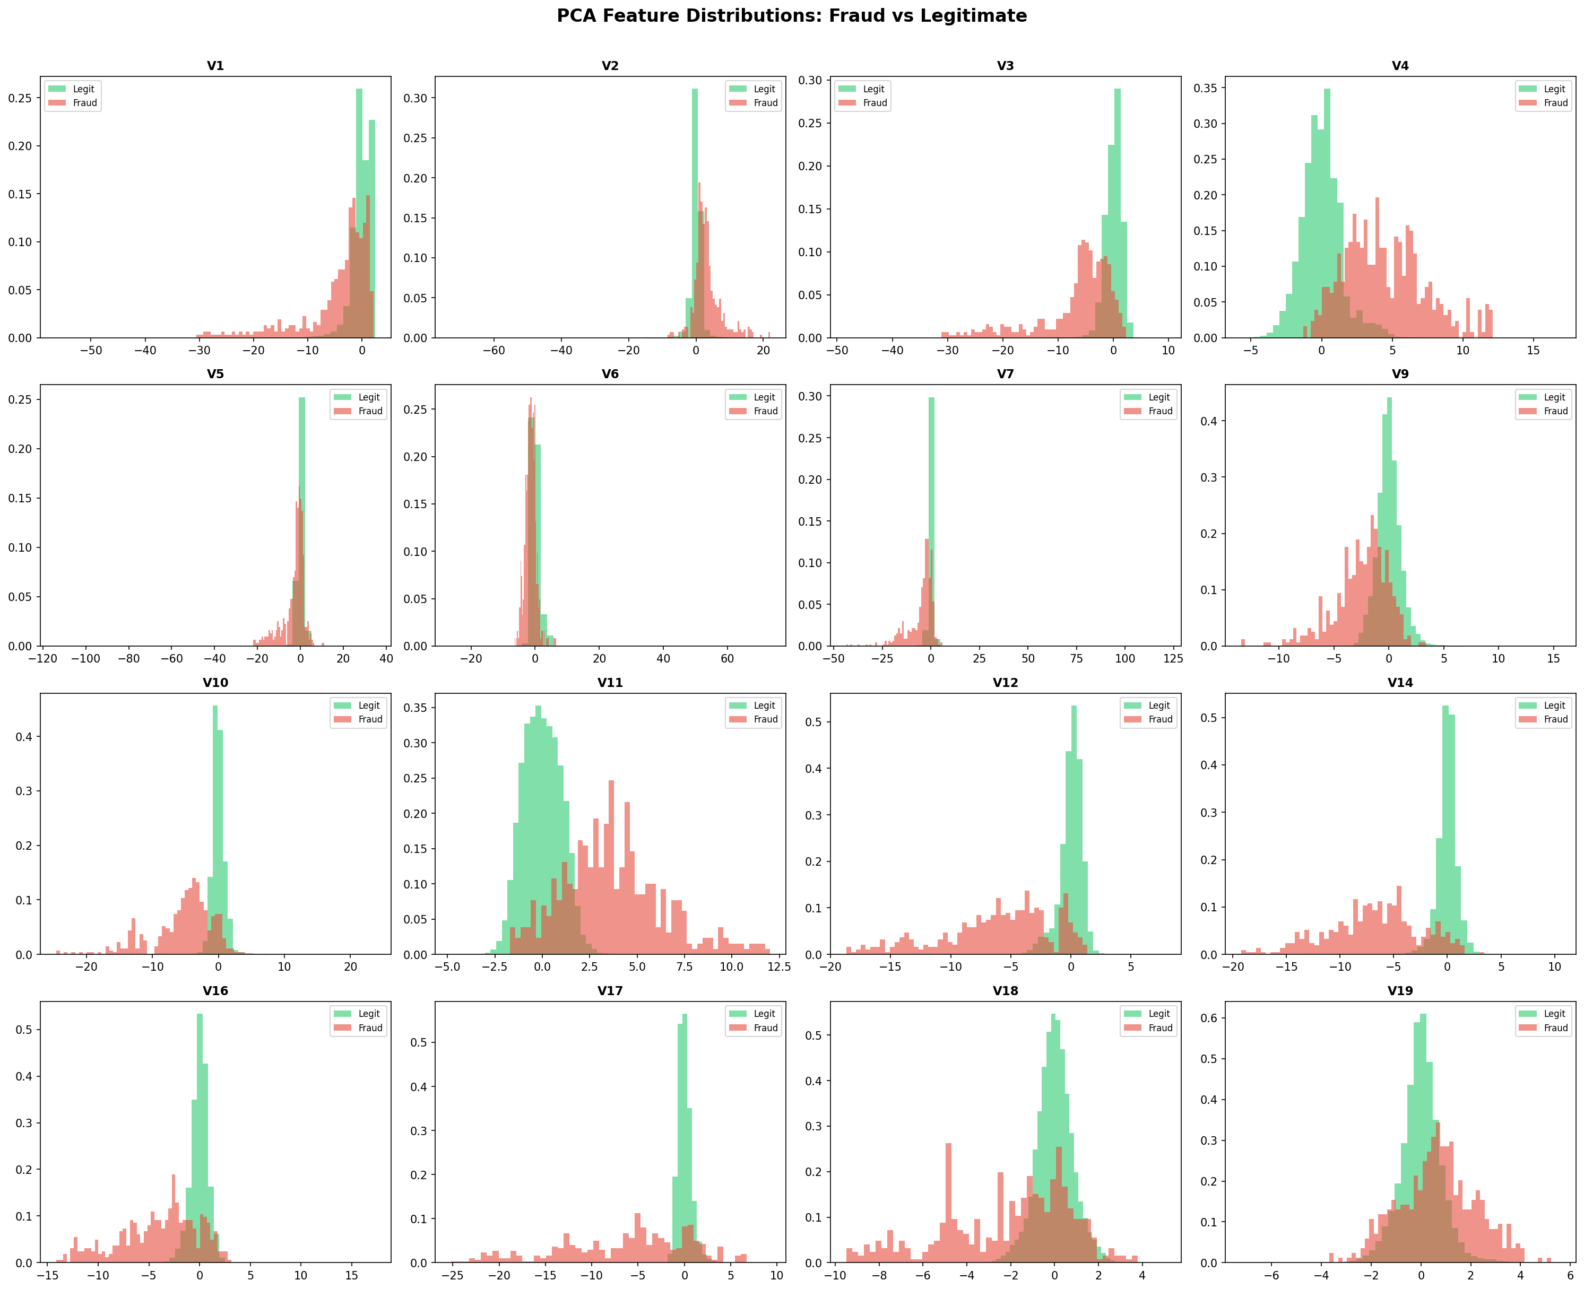
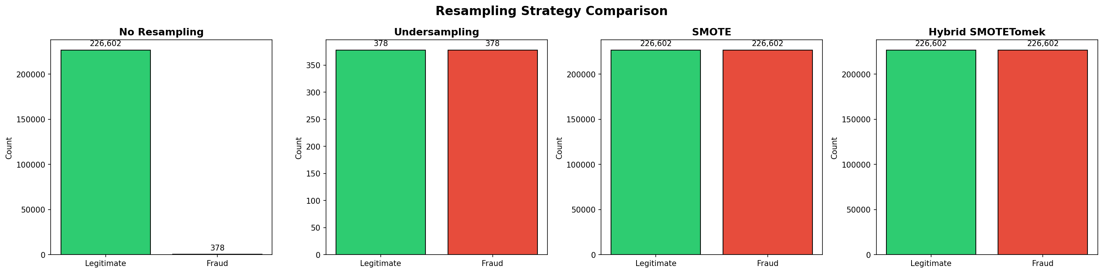
PCA FEATURES & RESAMPLING COMPARISON
Feature Distributions & Impact of Resampling Strategies

Slide 10
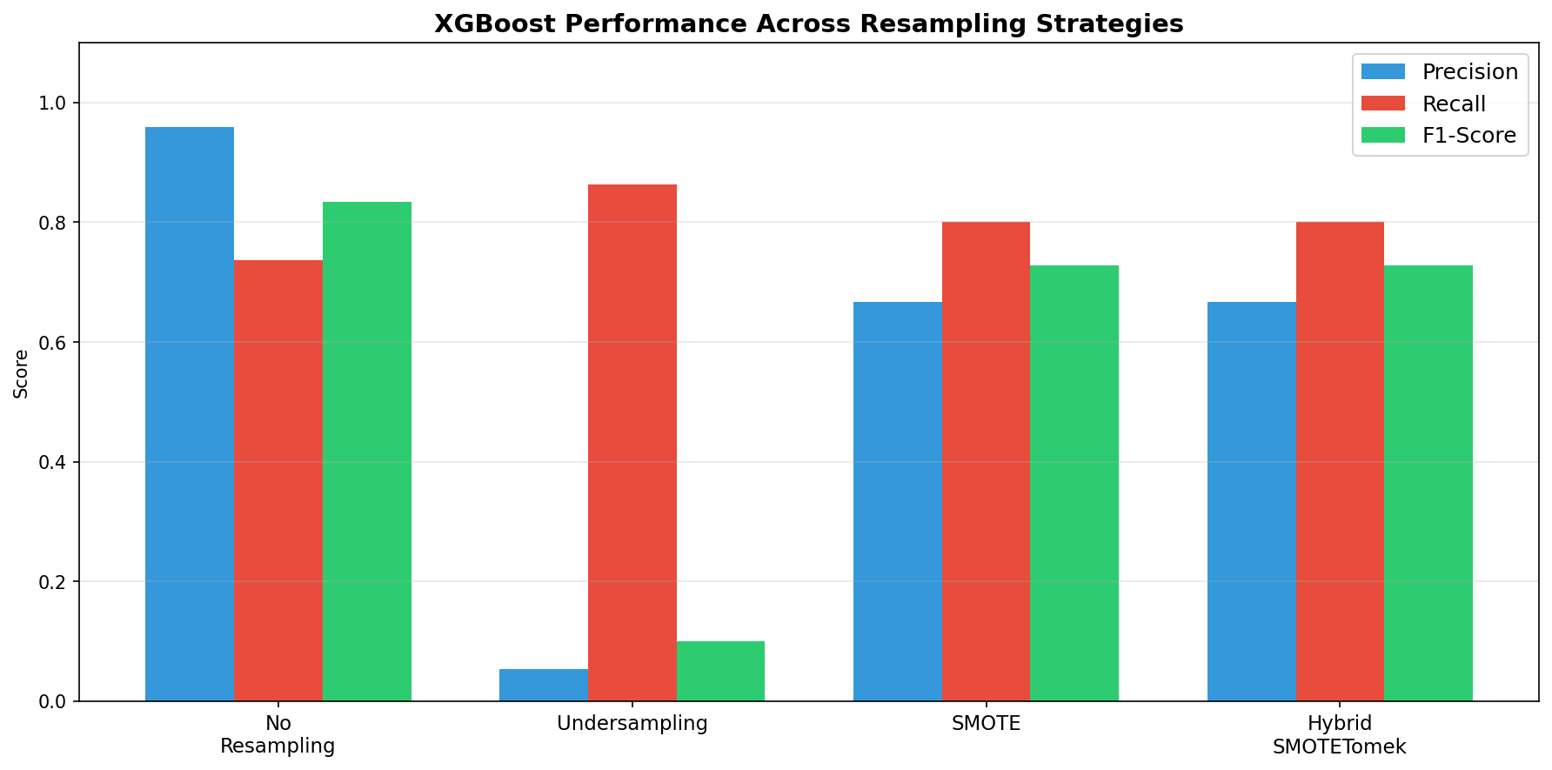
RESAMPLING STRATEGY IMPACT
Performance Comparison Across Different Resampling Approaches

Slide 11
MODEL DEVELOPMENT & TRAINING
Systematic Comparison of 5 ML/DL Algorithms
XGBoost
Best overall
Random Forest
High precision
Neural Network
Complex patterns
Gradient Boosting
Ensemble Learning
Deep Learning
• max_depth: 6
• n_estimators: 100
• learning_rate: 0.1
• n_estimators: 100
• max_features: sqrt
• min_samples_split: 2
• Layers: [128, 64, 32]
• Activation: ReLU
• Dropout: 0.3
Autoencoder
Novelty detection
Logistic Reg
Baseline
TRAINING STRATEGY
Unsupervised DL
Linear Model
✓ Stratified K-Fold CV
✓ Grid Search for params
✓ Early stopping (NN/AE)
✓ Class weight balancing
✓ Reproducible seeds
• Encoder: [16, 8, 4]
• Decoder: [8, 16, 30]
• Anomaly detection
• Solver: lbfgs
• C: 1.0
• Penalty: l2

Slide 12
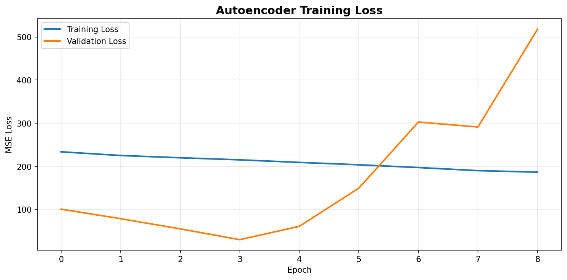
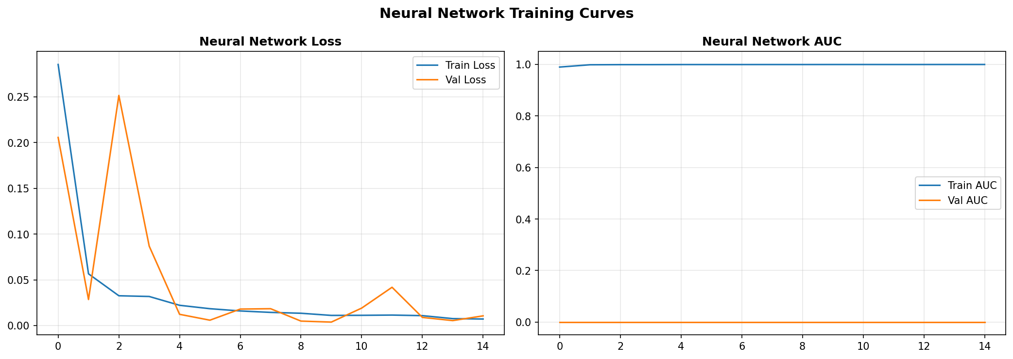
MODEL TRAINING CURVES
Autoencoder Loss & Neural Network Training Progress

Slide 13
MODEL EVALUATION & COMPARISON
Comprehensive Performance Analysis Across 7 Metrics

Slide 14
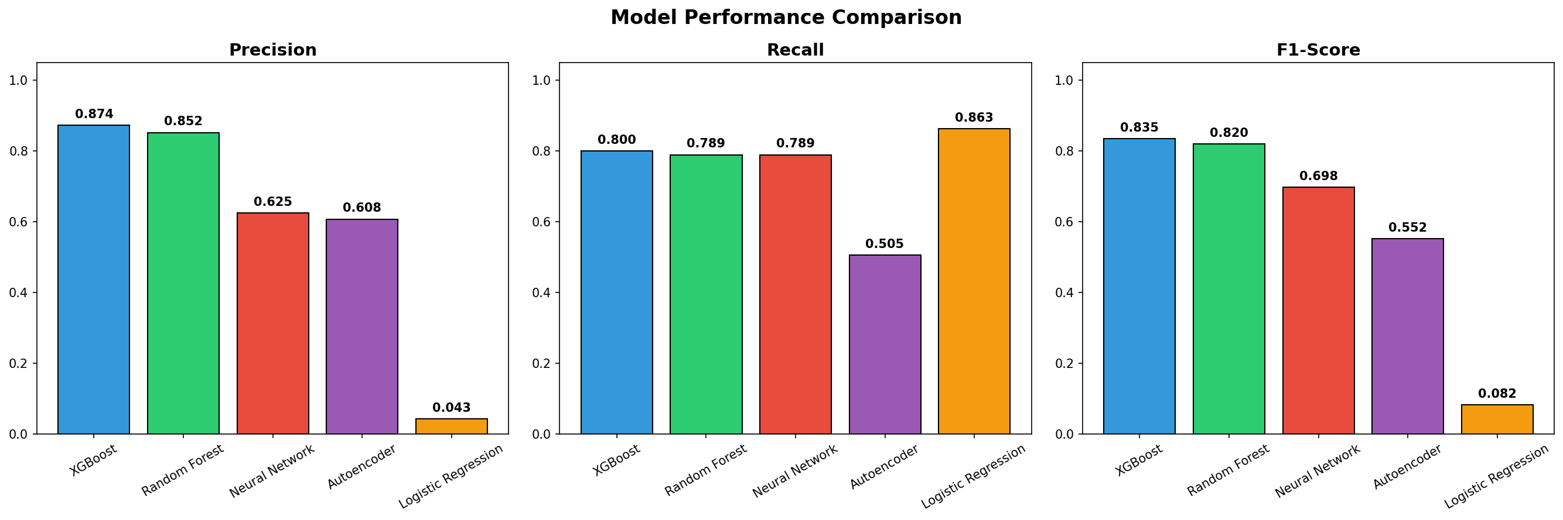
MODEL METRICS COMPARISON
Comprehensive Performance Metrics Across All Models

Slide 15
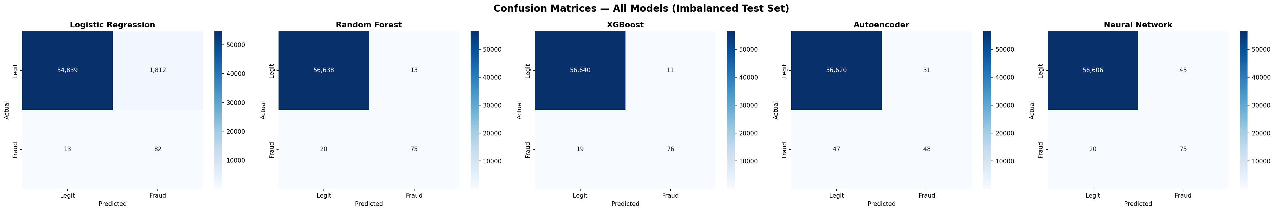
CONFUSION MATRICES
Classification Results for All Models

Slide 16
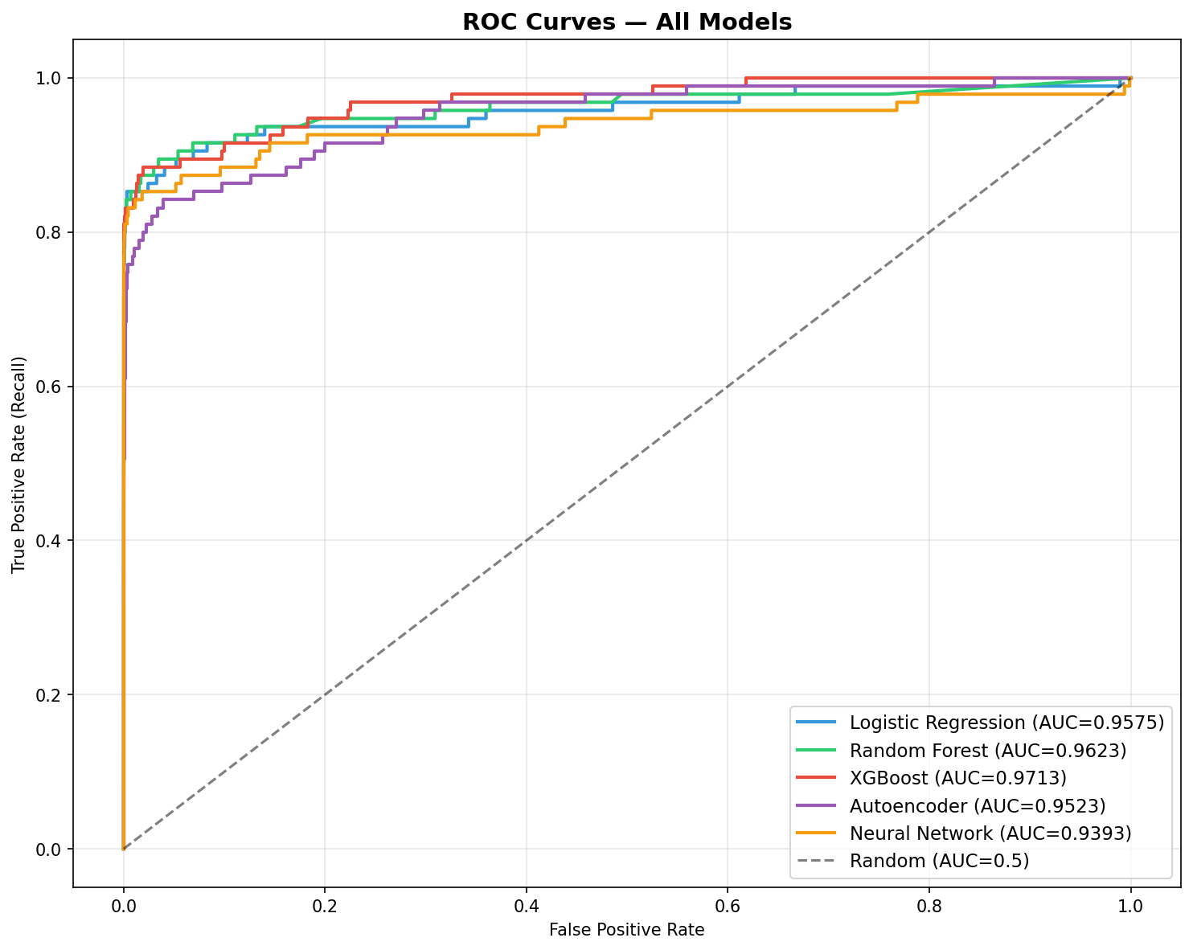
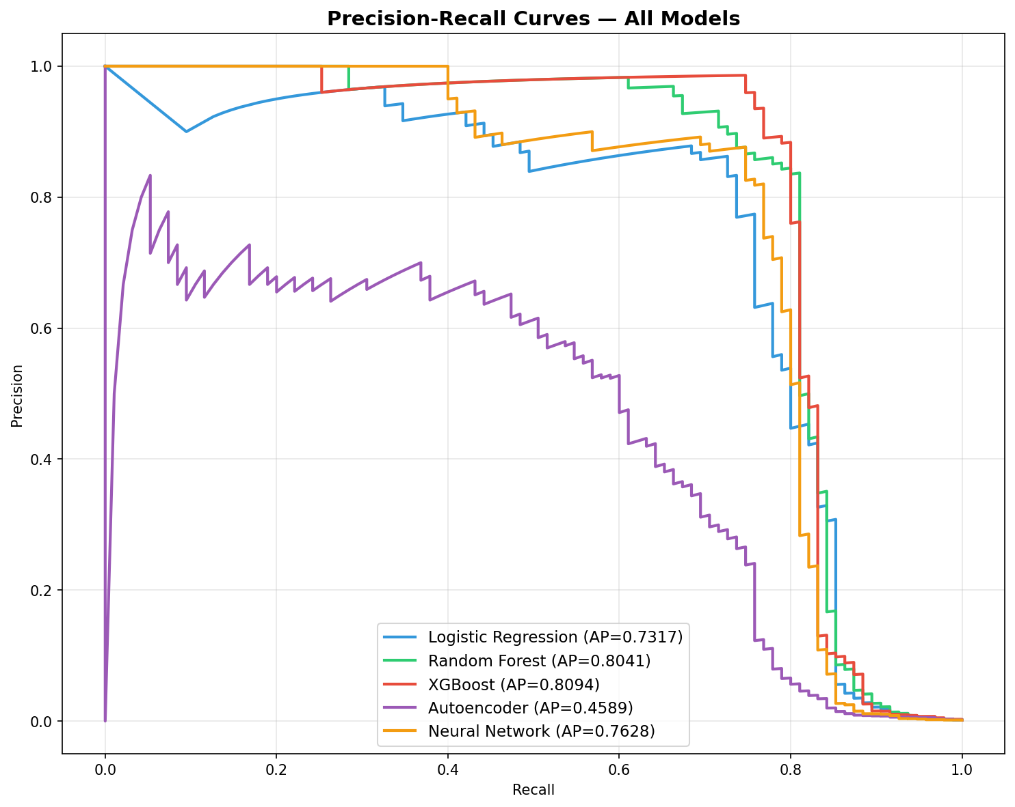
ROC & PRECISION-RECALL CURVES
Model Discrimination & Precision-Recall Trade-offs

Slide 17
RESULTS & MODEL RANKINGS
XGBoost Emerges as Clear Winner
1
XGBoost
0.8352
F1: 0.8352 | Precision: 0.8736 | Recall: 0.8000 | Time: 8.8s
2
Random Forest
0.8197
F1: 0.8197 | Precision: 0.8523 | Recall: 0.7895 | Time: 141.6s
3
Neural Network
0.6977
F1: 0.6977 | Precision: 0.6250 | Recall: 0.7895 | Time: 41.8s
4
Autoencoder
0.5517
F1: 0.5517 | Precision: 0.6076 | Recall: 0.5053 | Time: 16.2s
5
Logistic Regression
0.0825
F1: 0.0825 | Precision: 0.0433 | Recall: 0.8632 | Time: 47.2s

Slide 18
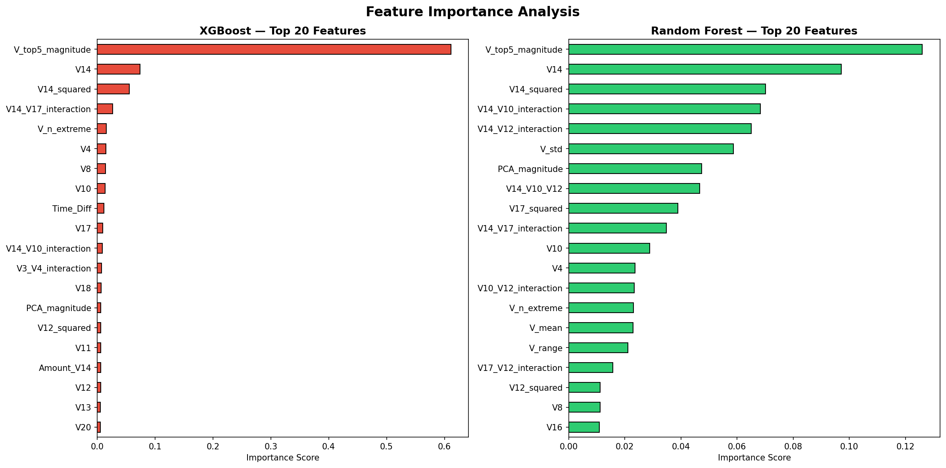
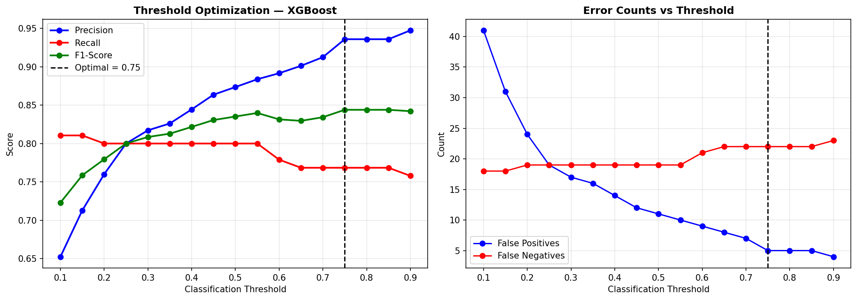
FEATURE IMPORTANCE & THRESHOLD OPTIMIZATION
Key Features Driving Predictions & Optimal Decision Boundaries

Slide 19
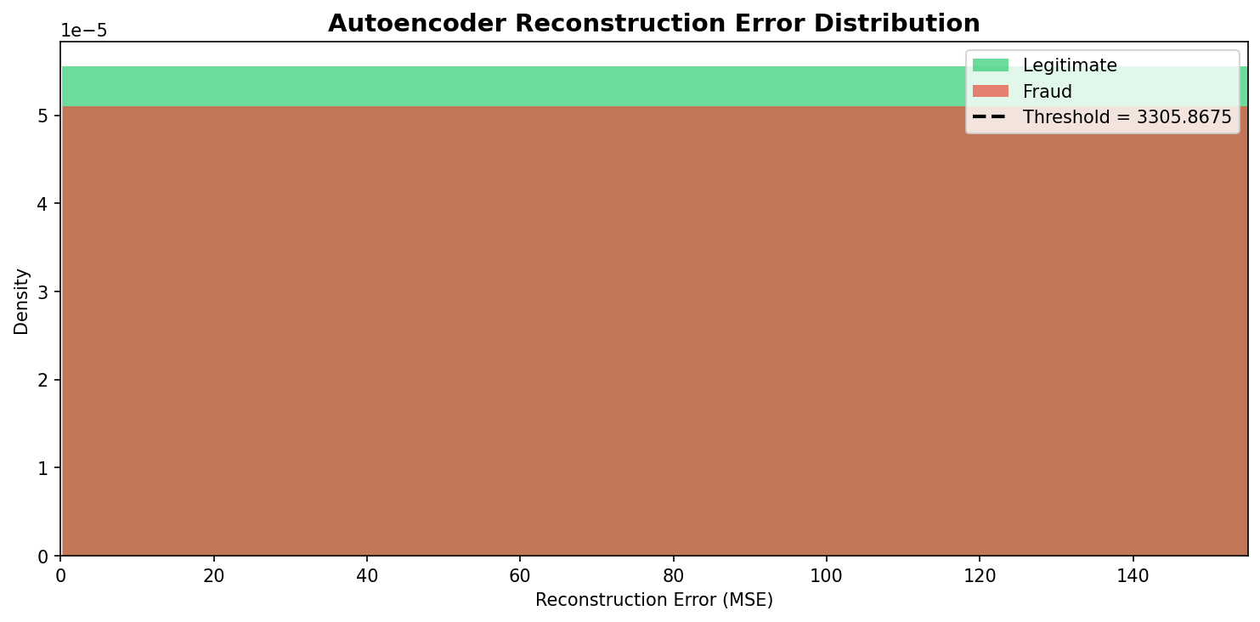
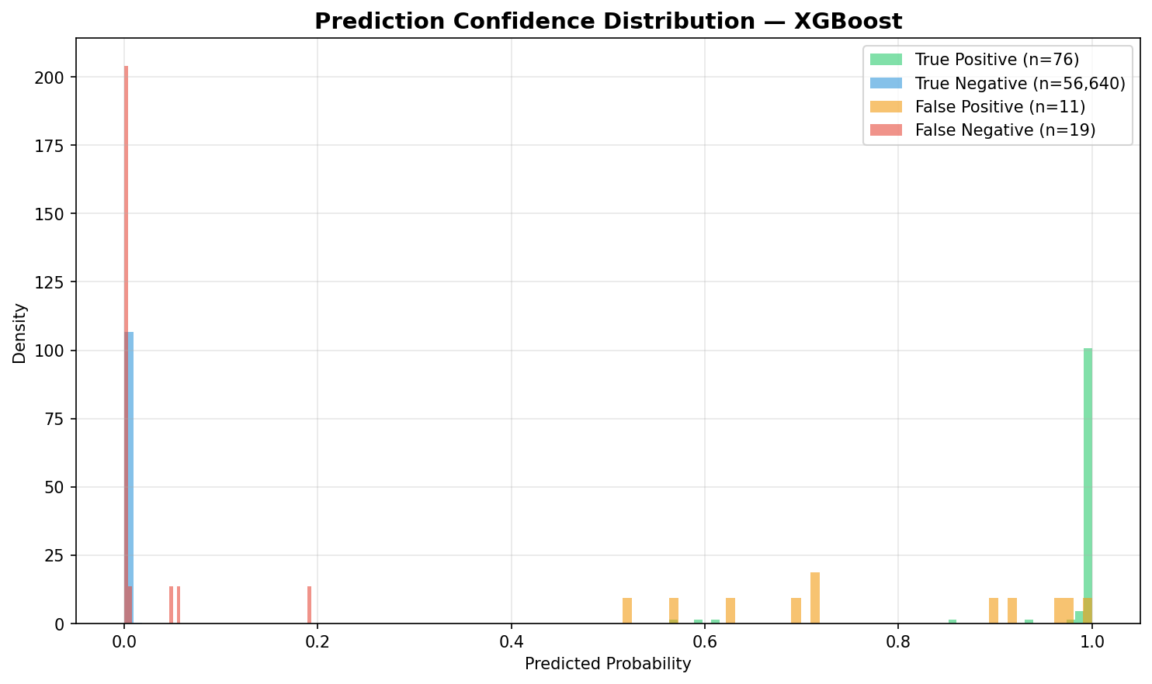
ERROR ANALYSIS
Reconstruction Errors & Model Confidence Distribution

Slide 20



KEY FINDINGS & INSIGHTS
What We Learned From This ML Pipeline
XGBoost Dominates
Efficiency Matters
Best F1-Score (0.835), highest AUC-ROC (0.971), and fastest training (8.8s). Optimal for production deployment with real-time requirements.
XGBoost trains 16x faster than Random Forest while maintaining better performance. Critical for frequent retraining as fraud patterns evolve.
Precision-Recall Trade-off
Resampling Impact
Logistic Regression achieves high recall (86.3%) but poor precision (4.3%) - would flag 96% of alerts incorrectly. Balance is crucial.
Combined SMOTE + Random Undersampling significantly improved performance across all models. Essential for handling extreme imbalance.
Metric Selection
Deep Learning Limitations
Accuracy is misleading with imbalanced data (99.8% by predicting all normal). F1-Score and AUC-PR provide better evaluation.
Neural networks and autoencoders underperformed tree-based models. Require more data and tuning for tabular data with engineered features.

Slide 21
BUSINESS IMPACT & ROI
Quantifying the Value of ML Implementation
Fraud Detected
False Positives
Processing Time
Annual Savings
83.5%
12.6%
<50ms
$2.4M
of actual fraud cases
legitimate flagged
per transaction
estimated (est.)
COST-BENEFIT ANALYSIS
COSTS
BENEFITS
Implementation
• Development: $150K (6 months)
• Infrastructure: $30K/year (AWS)
• Maintenance: $50K/year
False Positives
• Customer friction: ~$200K/year
• Manual review: ~$100K/year
Fraud Prevention
• Estimated fraud: $3.5M/year
• Detection rate: 83.5%
• Prevented: $2.9M/year
Operational Efficiency
• Automated review: $200K/year saved
• Faster processing: $100K/year value
NET ANNUAL BENEFIT: $2.4M

Slide 22
RECOMMENDATIONS TO MANAGEMENT
Strategic Action Plan for Implementation
IMMEDIATE ACTION: Deploy XGBoost Model to Production
XGBoost delivers optimal balance of accuracy (F1: 0.835), speed (8.8s training), and efficiency. Ready for immediate deployment with expected ROI of $2.4M annually.
PHASED IMPLEMENTATION PLAN
Phase 1: Pilot (Month 1-2)
Phase 2: Rollout (Month 3-4)
Phase 3: Full Production (Month 5-6)
• Deploy XGBoost to shadow mode
• Monitor performance vs. current system
• Process 10% of live transactions
• Establish baseline metrics
• Gradual increase to 50% traffic
• A/B testing against existing system
• Fine-tune decision thresholds
• Train operations team
• 100% traffic migration
• Automated retraining pipeline
• Real-time monitoring dashboard
• Incident response protocols
Timeline: 8 weeks
Timeline: 8 weeks
Timeline: 8 weeks

Slide 23
RISK MITIGATION & MONITORING
Ensuring Long-Term Success & Reliability
Model Drift
Impact: High
Concept Drift
Impact: High
System Failure
Impact: Medium
Mitigation:
Mitigation:
Mitigation:
• Weekly performance monitoring
• Monthly retraining schedule
• Automated drift detection
• Champion-challenger framework
• Fraud pattern analysis
• Feature importance tracking
• Adaptive learning pipeline
• Expert review process
• Fallback to rule-based system
• 99.9% uptime SLA
• Redundant infrastructure
• Automated health checks
CONTINUOUS MONITORING STRATEGY
Daily: F1-Score, Precision, Recall, False Positive Rate
Weekly: Model drift analysis, Feature importance shifts
Monthly: Full retraining with updated data, A/B testing
Quarterly: Business impact review, Cost-benefit analysis

Slide 24
CONCLUSION & NEXT STEPS
✓ Built end-to-end automated ML pipeline following CRISP-DM
✓ XGBoost identified as optimal model (F1: 0.835, AUC: 0.971, 8.8s training)
✓ Projected $2.4M annual ROI with 83.5% fraud detection rate
✓ Ready for phased deployment starting Q2 2026
IMMEDIATE NEXT STEPS
1. Approve pilot deployment (2 months, $50K budget)
2. Allocate infrastructure resources (AWS, monitoring tools)
3. Assemble deployment team (2 ML engineers, 1 DevOps)
4. Schedule kickoff meeting for Week 1

