Slide 1

Business management
Management accounting

Slide 2

Management accounting
YEAR 2004 | HEAD OFFICE |  |  |  |  |  | TOTAL COSTS
 | Management |  |  |  | Departments
Item & second-stage allocation | General | Administrative & Financial | Sales | Human Resources | Purchasing & Logistics | Research & Development
TOTAL | 562 050,9 | 2 915 398,9 | 10 172 300,7 | 851 999,9 | 745 075,7 | 1 493 243,2 | 16 740 069,3
Determination of costs of central services at the company’s head office
YEAR 2004 | Responsibility Centers |  |  |  |  |  |  | TOTAL COSTS
 | Principal |  |  |  |  | Auxiliary
Item & second-stage allocation | Purchasing | Foundry-Molding | Decoration | Quality Control & Packaging | Packing & Shipping | Engineering & Machinery | Factory Management
TOTAL | 473 716,7 | 5 233 512,1 | 3 899 363,7 | 753 439,5 | 1 060 000,0 | 0,0 |  | 11 420 032,0
Determination of indirect costs per responsibility center at the Quimper factory

Slide 3
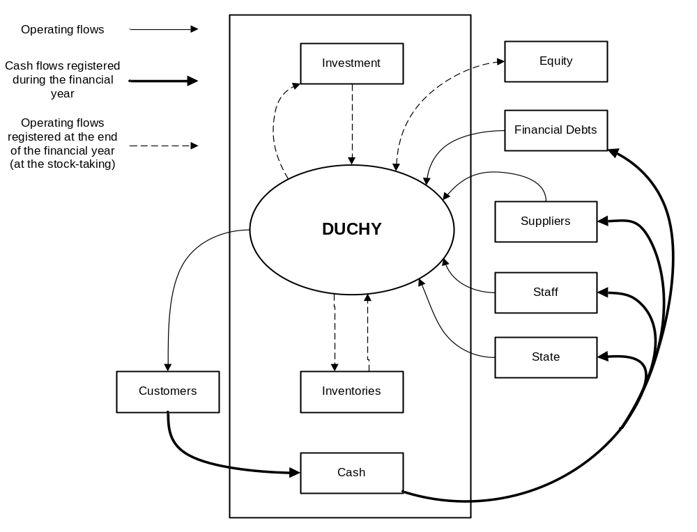
Management accounting
Duchy’s technical flows 2004
Notes:
Durant l’exercice :
Flux entrants sont traités comme des pertes ce sont des charges (emplois) (partie droite)
Flux sortants sont traités comme des bénéfices ils generent des produits (ressources)

Slide 4
Management accounting
Description | ACTIVITIES |  |  | TOTAL
 | Collector's classic edition soldiers | Basic soldier collection | Racing cyclists
TOTAL PRODUCTION | 4 990 292,4 | 18 454 708,7 | 1 008 506,3 | 24 453 507,3
DIRECT COSTS OF ITEMS SOLD | 2 369 899,4 | 8 233 207,4 | 101 086,4 | 10 704 193,2
DIRECT COST MARGIN | 2 620 393,0 | 10 221 501,2 | 907 419,9 | 13 749 314,1
INDIRECT FACTORY COST CHARGES | 2 167 781,0 | 9 006 179,3 | 246 071,6 | 11 420 032,0
PRODUCTION COSTS ON SALES | 4 537 680,4 | 17 239 386,8 | 347 158,0 | 22 124 225,2
PRODUCTION COSTS MARGIN | 452 611,9 | 1 215 321,9 | 661 348,3 | 2 329 282,1
INDIRECT ADMINISTRATIVE COSTS CHARGED | 558 003,1 | 558 003,1 | 558 003,1 | 1 674 009,3
PRODUCTION COSTS ON SALES | 5 095 683,5 | 17 797 389,9 | 905 161,1 | 23 798 234,5
FACTORY'S OPERATING INCOME | -105 391,2 | 657 318,8 | 103 345,2 | 655 272,8
Quimper factory’s income per activity in 2004
Notes:
When we add the total income per activity of the Quimper factory and the one of the Lorient factory to the other revenues of DUCHY, we obtain the operating result of DUCHY.
This operating result is a loss of about 8 millions. The income of DUCHY is a loss of 22 millions. This discrepancy is due to the financial result and the unusual result which decrease a lot the operating result.

Slide 5
Management accounting
QUIMPER | Collector's classic edition soldiers | Basic soldier collection | Racing cyclists | TOTAL
INDIRECT ADMINISTRATIVE COSTS CHARGED | 2 649 277,8 | 2 649 277,8 | 2 649 277,8 | 7 947 833,4
FACTORY'S OPERATING INCOME | -2 196 665,9 | -1 433 955,9 | -1 987 929,5 | -5 618 551,4
LORIENT | Indoor TOYS | Wheeled toys | Outdoor toys | TOTAL
INDIRECT ADMINISTRATIVE COSTS CHARGED | 2 930 745,3 | 2 930 745,3 | 2 930 745,3 | 8 792 235,9
FACTORY'S OPERATING INCOME | -175 757,5 | 70 129,4 | -3 160 810,0 | -3 266 438,1
52.5 % of the sales turnover of Duchy and the Quimper factory 47.5 %, the administrative costs will be allocate in the same proportions.
Notes:
90 % of the administrative costs are allocated to the Lorient factory and 10 % to the Quimper factory. One more logical allocation rule can be founded on the part of the sales turnover of Duchy created by each factory. The most lucrative activity would actually cost more in research and other administrative expenses then a less important one.
By this way, as the Lorient factory makes 52.5 % of the sales turnover of Duchy and the Quimper factory 47.5 %, the administrative costs will be allocate in the same proportions(see in the appendix for details).
Using this method but keeping an equal allocation inside the factory between the activities, we get

Slide 6
Management accounting
QUIMPER | Collector's classic edition soldiers | Basic soldier collection | Racing cyclists | TOTAL
Percent of the sales turnover by activity | 20,4 | 75,5 | 4,1 | 100,0
INDIRECT ADMINISTRATIVE COSTS CHARGED | 1 621 935,5 | 5 998 115,1 | 327 782,8 | 7 947 833,4
FACTORY'S OPERATING INCOME | -1 169 323,6 | -4 782 793,2 | 333 565,4 | -5 618 551,4
LORIENT | Indoor TOYS | Wheeled toys | Outdoor toys | TOTAL
Percent of the sales turnover by activity | 42,8 | 31,3 | 25,9 | 100,0
INDIRECT ADMINISTRATIVE COSTS CHARGED | 3 767 112,6 | 2 750 957,0 | 2 274 166,3 | 8 792 235,9
FACTORY'S OPERATING INCOME | -1 012 124,8 | 249 917,7 | -2 504 231,0 | -3 266 438,1
allocate administrative costs inside a factory between its activities according to the part of the sales turnover of the factory made by each activity
Notes:
Following the same idea, we could allocate administrative costs inside a factory between its activities according to the part of the sales turnover of the factory made by each activity. Then we get

Slide 7
Business management
Management analysis

Slide 8
Management analysis
 | QUIMPER | LORIENT | TOTAL FACTORIES | HEAD OFFICE | TOTAL
MARGIN ON VARIABLE COSTS | 8 527 260,2 | 10 669 437,8 | 19 196 698,0 | -10 621 271,0 | 8 575 427,0
 | QUIMPER | LORIENT | TOTAL (with Head Office)
Turnover | 24 453 128,0 | 27 051 104,0 | 51 504 232,0
Break-even point | 17 774 659,2 | 15 978 040,3 | 111 827 237,2
Actual break-even point
Notes:
The total income per activity of Lorient and Quimper factories is a loss of 8 millions. The margin on variable costs is of 8.5 millions. Then only half of the fixed costs can be covered by this margin on variable costs.

Slide 9
Management analysis
 | QUIMPER | LORIENT | TOTAL (with Head Office)
New Turnover | 26 898 440,8 | 32 461 324,8 | 59 359 765,6
Break-even point | 13 268 916,7 | 10 568 926,1 | 51 889 016,8
Break-even point with price increases and productivity gains
 | QUIMPER | LORIENT | TOTAL (with Head Office)
New Turnover | 22 661 862,1 | 37 083 047,0 | 59 744 909,1
Break-even point | 16 865 567,2 | 9 746 477,6 | 51 298 117,6
40% Quimper and 60% Lorient
 | QUIMPER | LORIENT | TOTAL (with Head Office)
New Turnover | 33 992 793,1 | 24 722 031,4 | 58 714 824,5
Break-even point | 10 717 426,0 | 13 411 627,8 | 52 927 852,5
60% Quimper and 40% Lorient
Notes:
As we can see the actual break-even point of Duchy is 111 827 237, 2 euros. To be profitable Duchy would have to manage to sell at least the double of its actual sales.
In the case of the expected increase of the unit selling prices and the increase of the productivity gains, the break-even point would decrease to 51 889 016,8 euros. Then its turnover would be high enough for Duchy to be profitable.
We can notice that it is more profitable for Duchy to maintain as high as possible the part of the sales turnover realized by the Lorient factory since the break-even point is then the lowest one.

Slide 10
Business finance
Financial analysis of the Duchy Corporation

Slide 11
Financial analysis of the Duchy Corporation
 | 2003 |  |  | 2003
Non-current assets | 26 685 704 |  | Equity | 9 496 547
Current assets | 30 649 202 |  | Short term liabilities | 44 502 386
Cash assets | 1 221 067 |  | Cash liabilities | 4 557 039
Balance sheet for DUCHY's 2003 fiscal years
Equity | 9 496 547 |  | Current assets | 30 649 202 |  | Working Capital | - 17 189 157
- Non-current assets | - 26 685 704 |  | - Liabilities | - 44 502 386 |  | - Working Capital Requirements | 13 853 184
WORKING CAPITAL | - 17 189 157 |  | WORKING CAPITAL REQUIREMENTS | - 13 853 184 |  | CASH POSITION | - 3 335 973
Notes:
Le fond de roulement est négatif : Dans ce cas, les ressources stables de l'entreprise sont inférieures à l'actif immobilisé constitué, c'est à dire que les ressources stables ne couvrent pas les besoins à long terme de l'entreprise. La règle prudentielle de l'équilibre financier n'est donc pas respecté. Elle doit donc financer une partie de ses emplois à long terme à l'aide de ressources à court terme ce qui lui fait courir un risque important d'insolvabilité. Une telle situation entraîne généralement une action rapide de la part de l'entreprise pour accroître ses ressources à long terme et retrouver un fond de roulement excédentaire.
le besoin en fond de roulement est négatif : Dans ce cas, les emplois d'exploitation de l'entreprise sont supérieurs aux ressources d'exploitation, L'entreprise n'a donc pas de besoin d'exploitation à financer puisque le passif circulant excède les besoins de financement de son actif d'exploitation.
L'entreprise n'a donc pas besoin d'utiliser ses excédents de ressources à long terme (Fond de roulement) pour financer d'éventuels besoins à court terme.
la Trésorerie nette de l'entreprise est négative : Dans ce cas, l'entreprise ne dispose pas de suffisamment de ressources financières pour combler ses besoins. elle doit donc recourir à des financements supplémentaires à courts termes (découverts bancaires...) pour faire face à ses besoins de financement d'exploitation. Il y a donc un risque financier à court terme si l'entreprise ne parvient pas à accroître rapidement ses ressources financières à long terme, ou à limiter ses besoins d'exploitation à court terme.

Slide 12
Financial analysis of the Duchy Corporation
 | 2004 |  |  | 2004
Non-current assets | 9 140 218 |  | Equity | 12 724 765
Current assets | 26 212 467 |  | Short term liabilities | 23 989 625
Cash assets | 1 367 496 |  | Cash liabilities | 5 788
Balance sheet for DUCHY's 2004 fiscal years
Fiscal year 2004
Equity | 12 724 765 |  | Current assets | 26 212 467 |  | Working Capital | 3 584 547
- Non-current assets | - 9 140 218 |  | - Liabilities | - 23 989 625 |  | - Working Capital Requirements | - 2 222 842
WORKING CAPITAL | 3 584 547 |  | WORKING CAPITAL REQUIREMENTS | 2 222 842 |  | CASH POSITION | 1 361 705
Notes:
The balance sheets of Duchy for fiscal years 2003 and 2004 reveal the missing of some long-term liabilities. We can notice it too in with its working capital and working capital requirements. In 2003 the working capital of Duchy was negative as its working capital requirements. It means that long term liabilities are not enough to cover the non current assets and that the short-term liabilities are then used to do it. In 2004 a real amelioration can be noticed since Duchy covers entirely its long-term assets with its working capital and covers its working capital requirements enough to be able to have a positive cash position. According this, it seems Duchy has improved its financial health.
Le Fond de roulement est positif :Dans ce cas, les ressources stables de l'entreprise sont supérieures à l'actif immobilisé constitué, c'est à dire que les ressources stables couvrent les besoins à long terme de l'entreprise. L'équilibre financier est donc respecté et l'entreprise dispose grâce au fond de roulement d'un excédent de ressources stables qui lui permettra de financer ses autres besoins de financement à court terme.
le besoin en fond de roulement est positif : Dans ce cas, les emplois d'exploitation de l'entreprise sont supérieures aux ressources d'exploitation. L'entreprise doit donc financer ces besoins à court terme soit à l'aide de son excédent de ressources à long terme (Fond de roulement), soit à l'aide de ressources financières complémentaires à court terme (concours bancaires...).
la Trésorerie nette de l'entreprise est positive : Dans ce cas, les ressources financières de l'entreprise sont suffisantes pour couvrir les besoins (soit Fond de roulement > besoin en Fonds de roulement), ce qui signifie que la situation financière de l'entreprise est saine est qu'elle est même en mesure de financer un surcroît de dépenses sans recourir à un emprunt.

Slide 13
Financial analysis of the Duchy Corporation
Duchy's self financing 2004 | - 8 102 360
Duchy's funds flow statement 2004 1st part
Movement of the global net Working Capital (net liability) | - 4 534 262
Duchy's funds flow statement 2004 2nd part
Movement of the global net Working Capital | 4 486 717
DUCHY's funds flow statement for fiscal year 2004

Slide 14
Financial analysis of the Duchy Corporation
 | 2004 | 2003
Financial year production | 52 764 569 | 51 331 040
Value added | 8 609 459 | 11 678 981
Earning before interest, taxes, depreciation and amortization | - 4 899 067 | - 2 275 587
Operating result | - 8 381 637 | - 4 505 816
Earnings before taxes | - 13 173 869 | - 6 831 287
Unusual result | - 9 431 649 | 869 361
Income | - 22 624 574 | - 5 961 926
DUCHY's Intermediate Management Balances for fiscal years 2004 and 2003
Notes:
The income of Duchy in 2004 is a loss of around 22 millions. Using its intermediate management balances, we can see that this loss begins since the “Earning before interest, taxes, depreciation and amortization”. Actually even if Duchy can reach an important “Financial year production”, its “Value added” is not high enough to assume the following salaries expenses which are necessary high due to the size of the company. Moreover very important interest expenses can be observed which are most important because of the choice of the company to have only short-term liabilities. If Duchy tries to obtain more long-term liabilities, it would be able to decrease expenses due to interests. Finally there is a very important loss due to the “unusual result”. This could be the first point to remedy since this result is not a meaning part of the operating of the company and then should not decrease in such a proportion the income of Duchy.

Slide 15
Financial analysis of the Duchy Corporation
Settlement terms (FAIRE COURBE)
 | YEAR 2003 | YEAR 2004
Settlement terms for customers | 43.04 days | 34.62 days
Settlement terms for suppliers | 131.68 days | 146.89 days
Notes:
The settlement terms for suppliers have increased of 15 days between 2003 and 2004 and stay higher than the usual French settlement terms for suppliers which can reach 90 days. Once again we can observe that Duchy has chosen to prefer short-term liabilities to long-term ones.
En obtenant des délais de paiement plus longs de la part de ses fournisseurs, l'entreprise accroît le montant de ses dettes fournisseurs ce qui entraîne une augmentation de son passif circulant. En conséquence, et à montant identique d'actif circulant, le Besoin en Fonds de Roulement de l'entreprise diminue d'un montant équivalent à celui de la hausse des dettes fournisseurs.
Cette stratégie permet à l'entreprise d'augmenter son passif circulant pour un même niveau d'actif circulant.
En négociant des délais de paiement plus courts auprès de ses clients, l'entreprise réduit le montant de ses créances clients ce qui entraîne une diminution de son actif circulant. En conséquence, et à montant identique de passif circulant, le Besoin en Fonds de Roulement de l'entreprise diminue d'un montant équivalent à celui de la baisse des créances clients.
Cette stratégie permet à l'entreprise d'augmenter son actif circulant pour un même niveau de passif circulant.

Slide 16
Business finance
Financial analysis of the Odylos Corporation

Slide 17
Financial analysis of the Odylos Corporation
Balance sheet for ODILOS' 2003 fiscal year
 | 2003 |  |  | 2003
Non-current assets | 1 978 513 |  | Equity | 6 149 189
Current assets | 8 703 635 |  | Short term liabilities | 4 710 070
Cash assets | 1 194 357 |  | Cash liabilities | 1 017 245
Working Capital, Working Capital Requirements and Cash Position for fiscal years 2003
Equity | 6 149 189 |  | Current assets | 8 703 635 |  | Working Capital | 4 170 676
- Non-current assets | - 1 978 513 |  | - Liabilities | - 4 710 070 |  | - Working Capital Requirements | - 3 993 565
WORKING CAPITAL | 4 170 676 |  | WORKING CAPITAL REQUIREMENTS | 3 993 565 |  | CASH POSITION | 177 111

Slide 18
Financial analysis of the Odylos Corporation
 |  | 2003 | 2002 | 2001
Commercial margin |  | 1 381 292 | 2 179 622 | 1 082 739
Financial year production |  | 8 339 411 | 8 791 734 | 8 972 395
Value added |  | 5 220 040 | 5 658 938 | 4 776 492
Earning before interest, taxes, depreciation and amortization |  | 1 618 299 | 1 933 877 | 1 286 177
Operating result |  | 1 071 554 | 1 048 892 | 437 445
Earnings before taxes |  | 1 051 127 | 885 819 | 248 016
Unusual result |  | -22 159 | -204 624 | 240 237
Income |  | 608 204 | 295 241 | 357 184
ODILOS' Intermediate Management Balances for fiscal years 2003, 2002 and 2001
Notes:
ODILOS seems in good financial health since it can cover all its working capital requirements with its working capital which is important enough to reach a positive cash position.
Since 2001 ODILOS has been able to have benefits. It has an important “value added” even if its “financial year production” is much less important than the one of a company like Duchy. This seems to be a reason why ODILOS can reach a positive income where Duchy can’t.

Slide 19
Business finance
Management and financial strategy

Slide 20
Management and financial strategy
Achat odilo
Notes:
The Price Earning Method can be used to estimate the value of a company according to its net income. To use this method to estimate ODILOS' value, its net income for the fiscal year 2003 must be increase by a factor of 7 or 8. ODILOS' net income for the fiscal year 2003 was of 608 204 €. So by using the Price Earning Method, we can consider that the value of ODILO is between 4 257 428 € and 4 865 632 €.
Following the idea exposed in question F part 1, we can say that Duchy’s financial health is not very fine. We saw in question F part 2 that Odilos’ value is between 4 257 428 € and 4 865 632 €. It could be acceptable to pay 5 millions euros for this company but regarding its 2003 income (608 204€) and supposing Odilos would be able to keep such an income, Mr Duplon will have to wait at least 8 years to get back his initial investment. Moreover this does not include the cost of his needed borrowing.
To conclude Mr Duplon should invest the sum of 4 000 000 € he has got in Duchy to improve its health and maybe to get a borrowing to begin a new funding strategy based on the long-term.

